Slide 1
Chest X-Ray Analysis
Mentor - Dr. Dinesh Singh
Aryan Ali - B20279
Vivek Jaiswal - B20172

Slide 2
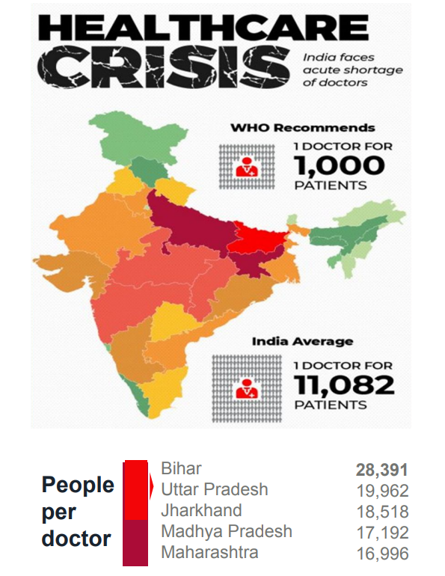
Problem Statement
Since there is shortage of radiologists in India, chest x-rays are not being diagnosed properly ontime.
Our objective is to develop an automated software to enhance chest X-Ray analysis using cutting edge technology such as lung segmentation which offers a critical advancement in medical diagnostics, enhancing accuracy and expediting disease identification. Potentially saving lives through timely diagnosis and accuracy.

Slide 3
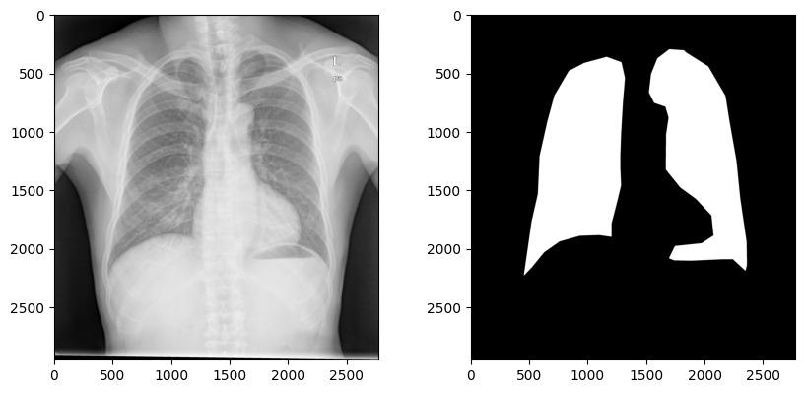
Data Format

Slide 4
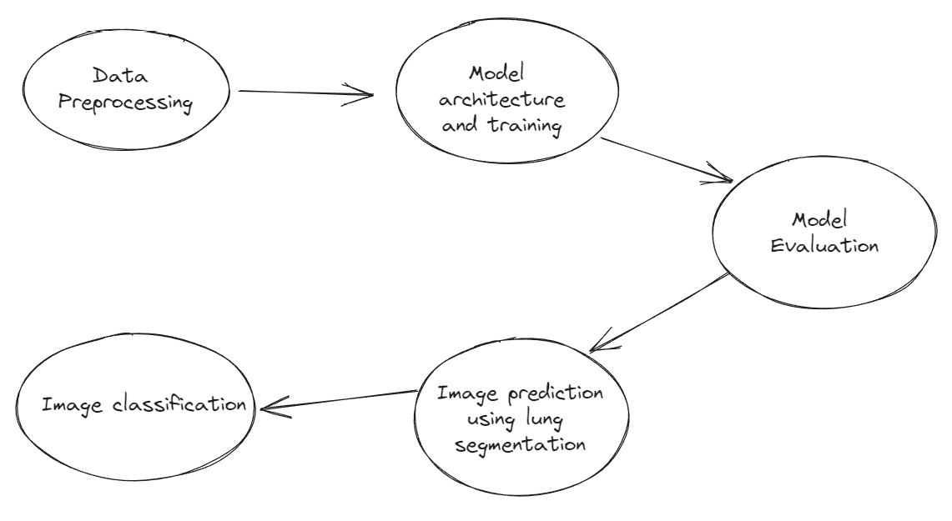
Model Formulation Approach

Slide 5
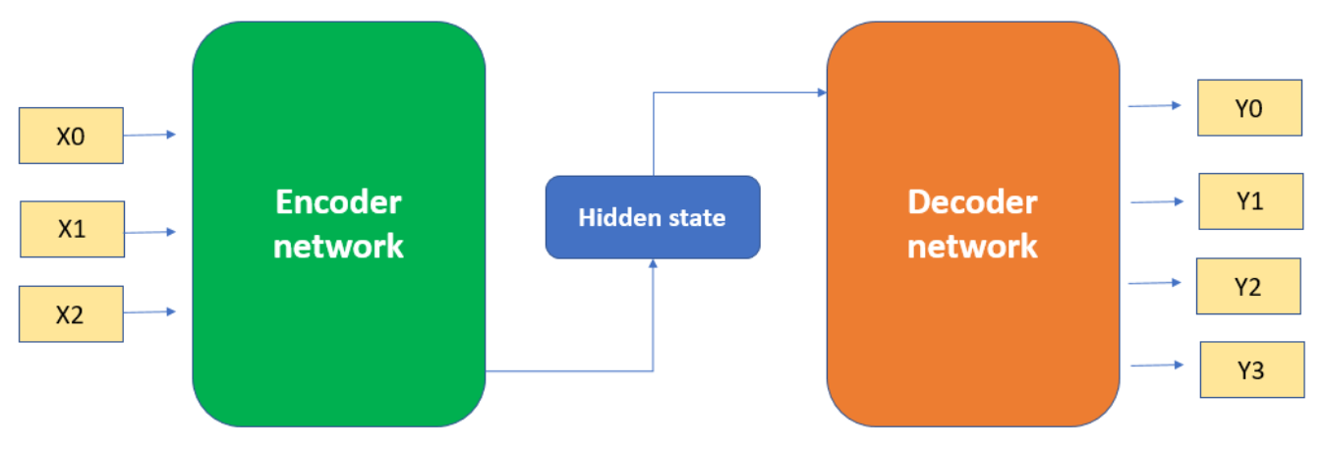
Encoder Decoder Model

Slide 6
UNet
UNet is a convolutional neural network (CNN) architecture designed for image segmentation tasks.
It consists of an encoder to capture features and a decoder to produce pixel-wise segmentation maps.
It is widely utilized in medical image analysis, particularly for tasks like organ and tumor segmentation due to its precise object boundary delineation.

Slide 7
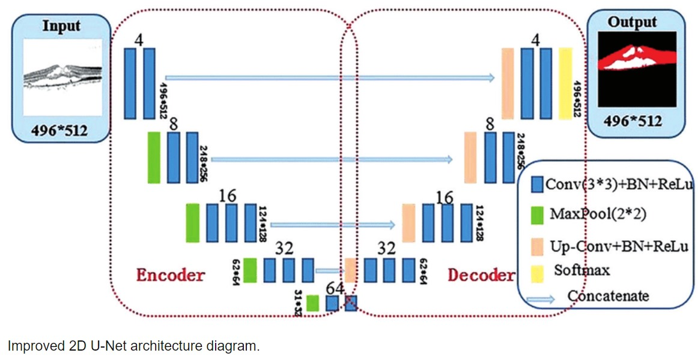
UNet - Architecture
References:https://scholar.google.com/scholar?hl=en&as_sdt=0%2C5&q=Automatic+lung+segmentation+in+chest+X-ray+images+using+improved+U-Net&btnG=

Slide 8
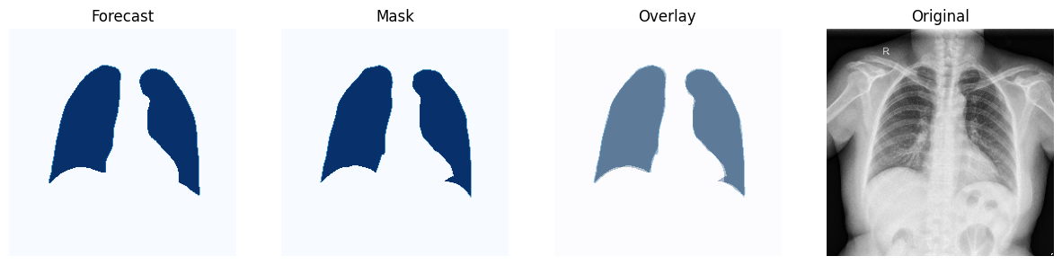
Output using UNet model

Slide 9
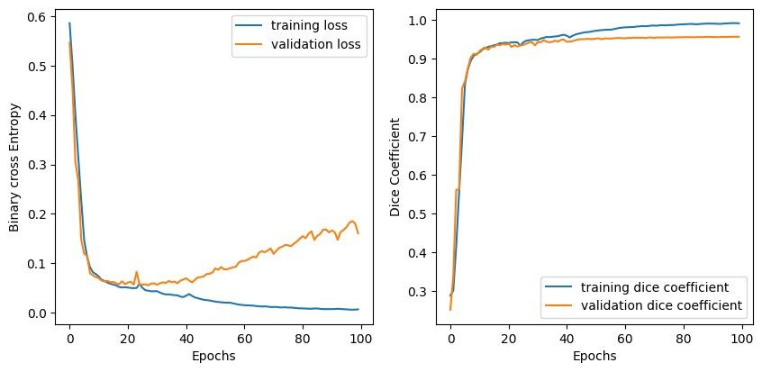
UNet Loss Function

Slide 10
DeepLabv3
DeepLabv3 is a deep learning architecture specialized in semantic image segmentation, which involves classifying each pixel in an image into a specific object or class.
It utilizes atrous (dilated) convolutions to capture object details at multiple scales without significantly increasing computational complexity.
DeepLabv3 is widely applied in tasks like autonomous driving, remote sensing (satellite image analysis), and medical image analysis to achieve precise and detailed object segmentation.

Slide 11
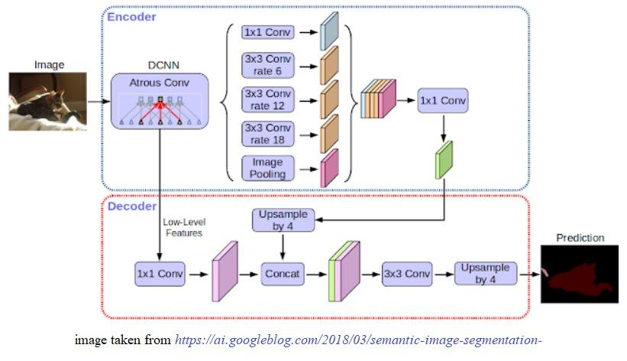
DeepLabv3 - Architecture
Reference:

Slide 12
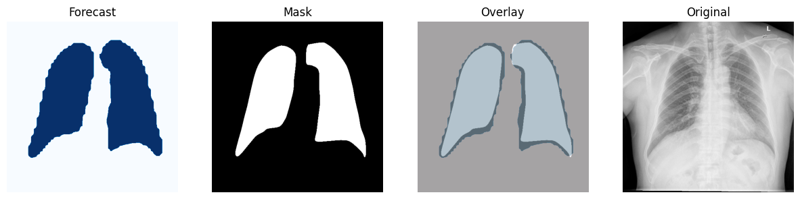
Output using Deeplabv3 model

Slide 13
Res UNet
Res-UNet combines the U-Net architecture for semantic segmentation with residual connections, integrating the strengths of both approaches.
The architecture excels at capturing fine object details, which is essential for tasks like medical image segmentation.
Residual connections enhance feature representation, making Res-UNet effective for tasks requiring precise object boundary delineation, such as organ and tumor segmentation in medical imaging.

Slide 14
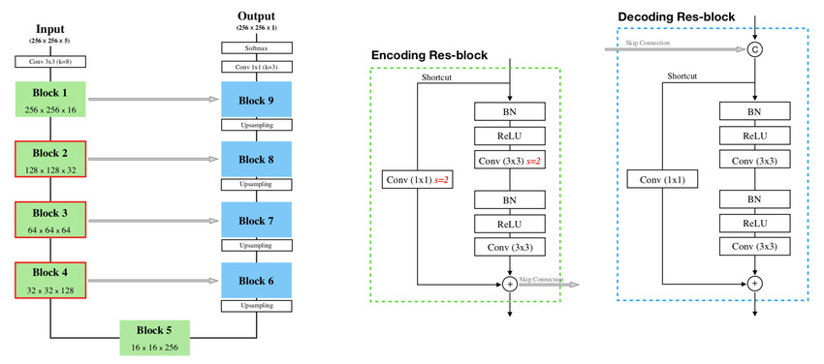
Res UNet Architecture
Reference:https://scholar.google.com/scholar?hl=en&as_sdt=0%2C5&q=Multi+Res+U-Net+Based+Image+Segmentation+of+Pulmonary+Tuberculosis+Using+CT+Images&btnG=

Slide 15
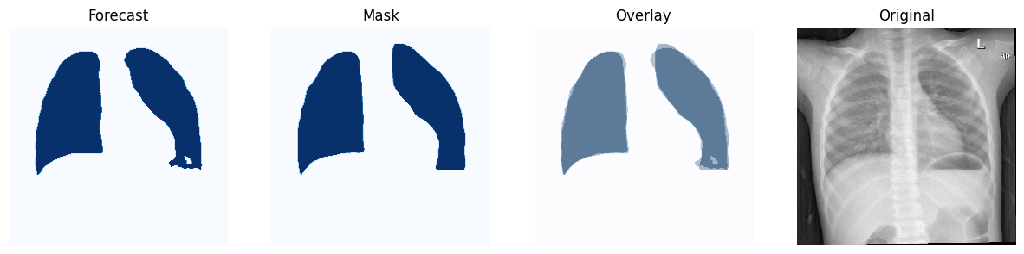
Output using Res UNet model

Slide 16
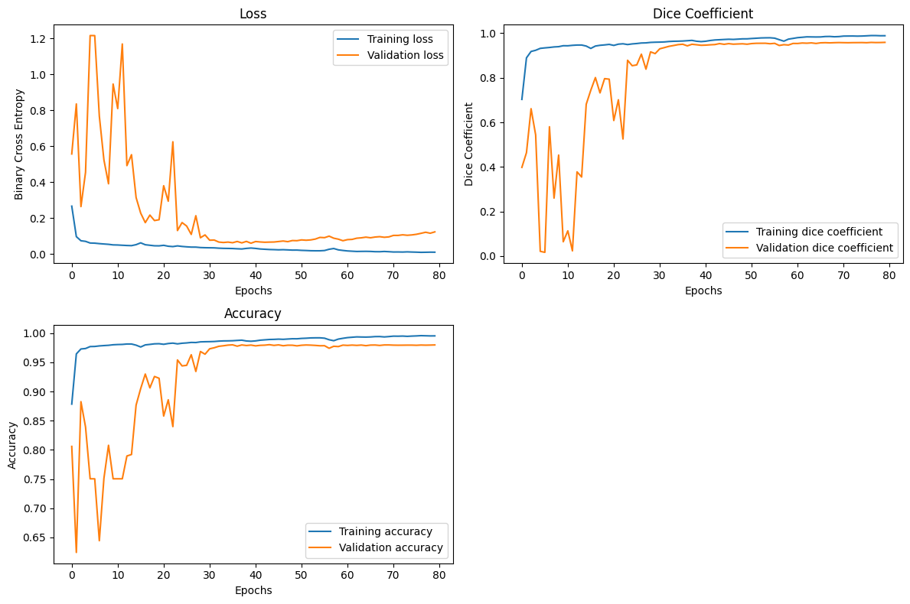
Res UNet Loss Function

Slide 17
Timeline and Milestone
August 2023
September 2023
October 2023
November 2023
Study research papers
Finalizing problem statement
Proposal of some novel framework for chest x-ray classification
Training Models for lung segmentation

Slide 18


Slide 19
THANK YOU

