Slide 1

Enhancing Patient Attendance in Medical Appointments
A Data-Driven Approach
Aryan Agarwal

Slide 2
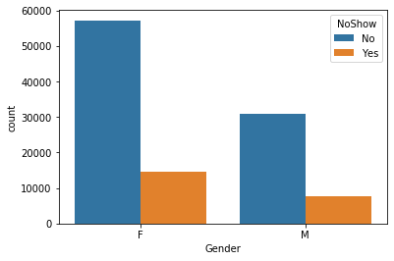
Gender Disparities
Female patients have a higher appointment rate than males
And both genders had almost a equal ratios of not showing up to the appointment.
81% of females didn’t show up to the appointment.
80% of males didn’t show up to their booked appointment.
A Data-Driven Approach

Slide 3
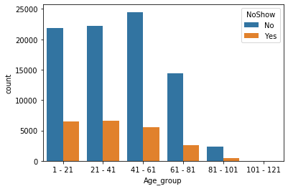
Age Group Dynamics
Show rates are consistent across age groups, except for ages 80 to 121.
Appointment rates are Comparatively lesser for the age group of 61-81

Slide 4
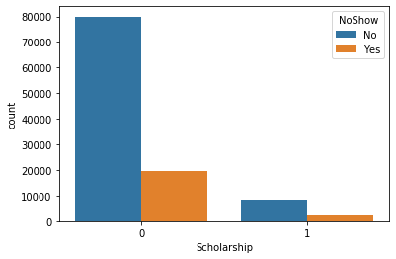

Scholarship Impact
Patients without scholarships show an 20%attendance rate
While scholarship holders have a 25% attendance rate.

Slide 5
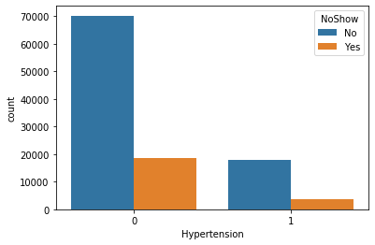

Hypertension Influence
Patients without hypertension attend at 22%, while those with hypertension attend at 15%.

Slide 6
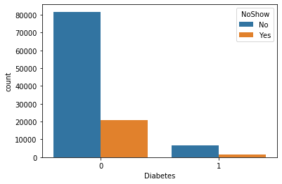

Diabetes Influence
Patients without diabetes attend at 20%, while those with diabetes attend at 17%.

Slide 7
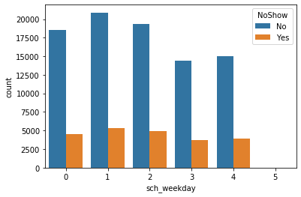
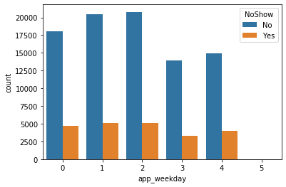

Weekday Appointment Patterns
No appointments on weekends as we can see no visualization on 5 .
From here we can conclude that the organization stays closed on weekends.

Slide 8
Recommendations
Leverage communication strategies for specific age groups, such as personalized reminders for patients aged 60 to 121.
Implement awareness campaigns or targeted interventions for patients with hypertension to improve attendance.
Launch educational initiatives for patients without diabetes to promote better understanding and encourage attendance.
Consider adjusting scheduling strategies to accommodate the lower appointment frequency on Saturdays by working half a day and the absence of appointments on Sundays.

