Slide 1

Medical Diagnosis
- Aryan Bharadwaj
Graph Neural Network Seminar

Slide 2
Objectives
Diagnosis
The Brain
About the project
Results

Slide 3
The Massive Global Burden
74%
>3B
Global Deaths
Neurological Cases
attributed to non-communicable
chronic diseases
of people currently living with a
neurological condition worldwide.
Notes:
https://www.who.int/news/item/14-03-2024-over-1-in-3-people-affected-by-neurological-conditions--the-leading-cause-of-illness-and-disability-worldwide

Slide 4
Brain Diagnosis
Definition: is the clinical process of identifying and evaluating pathological conditions affecting the central nervous system using automated computational tools, statistical models, and neuroimaging data.
Reduces Global Mortality: Brain disorders account for a massive, continuously growing percentage of global deaths, by early detection
Manages Complex Pathologies: Helps navigate complex, newly discovered variants of progressive neurological diseases.
Improves Clinical Accuracy: Precision analysis reduces diagnostic human errors across highly subtle brain changes.
Enhances Patient Betterment: Finding precise detection techniques directly elevates long-term healthcare outcomes and recovery.
Notes:
P. Khan et al., "Machine Learning and Deep Learning Approaches for Brain Disease Diagnosis: Principles and Recent Advances," in IEEE Access, vol. 9, pp. 37622-37655, 2021, doi: 10.1109/ACCESS.2021.3062484.

Slide 5
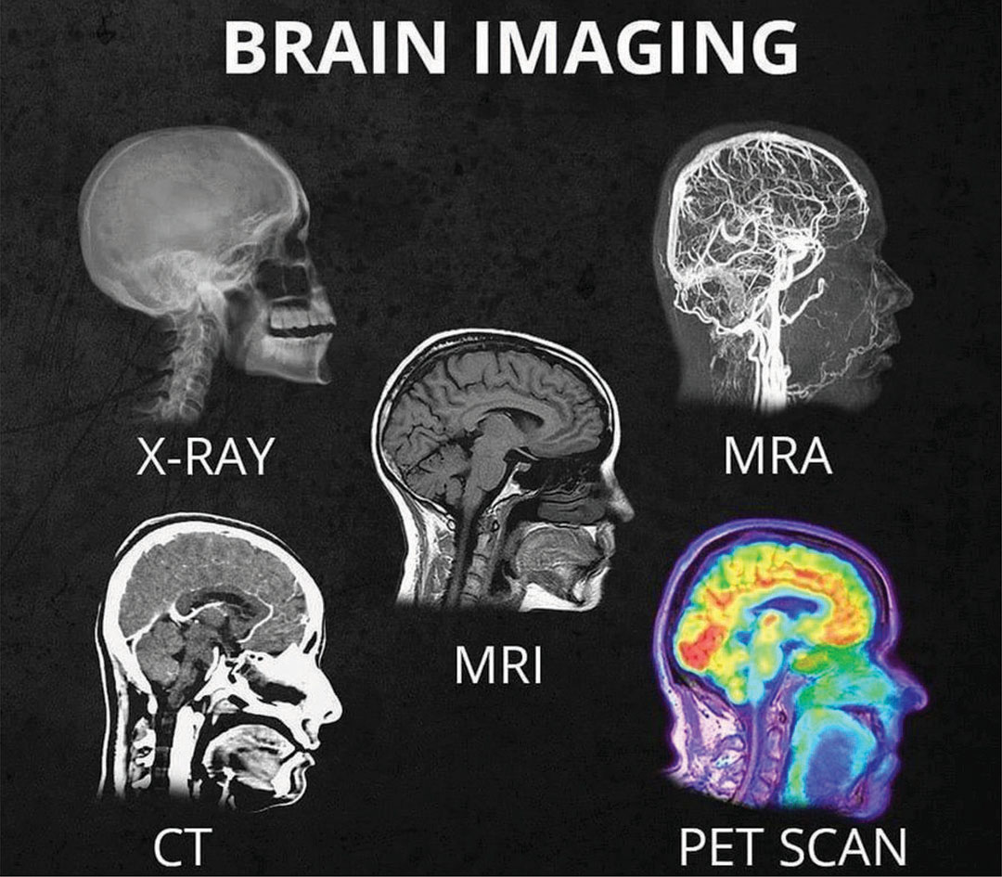
Types of Scans
Medical scans are diagnostic tools used to visualize the inside of the body. The four primary types:
X-ray
CT Scan
MRI
Ultrasound
PET
NIR
Notes:
https://sdbif.org/whats-the-difference-between-all-the-different-head-scans/

Slide 6
Why do we analyze?
Sociodemographic & Behavioral Data: General background variables including age, sex, socioeconomic markers, and critical health behaviors (e.g., sleep patterns, diet, and lifestyle habits).
Clinical Medical History: Comprehensive records tracking personal medical histories, physical health examinations, and specific disease-related symptoms.
Cognitive & Psychological Assessments: Standardized neurocognitive test scores alongside tracking scales for depression, behavioral changes, psychological updates, and caregiver burden.
Biomarkers & Lab Diagnostics: Laboratory results gathered from direct physical processing, including comprehensive blood panels and sensory assessment data (such as olfactory performance tests).
Notes:
https://sdbif.org/whats-the-difference-between-all-the-different-head-scans/

Slide 7
Why Machine Learning?
Processes Massive Dimensions: Computes millions of complex neuroimaging voxels simultaneously, surpassing human capability.
Detects Hidden Patterns: Identifies subtle, non-linear structural variations years before physical symptoms appear, allowing faster, life-saving therapeutic interventions.
Eliminates Human Subjectivity: Provides objective, automated diagnostic recommendations to eliminate fatigue and clinical bias.
Tracks Interconnected Dynamics: Maps complex, widespread network disruptions rather than isolated regional damage.
Notes:
P. Khan et al., "Machine Learning and Deep Learning Approaches for Brain Disease Diagnosis: Principles and Recent Advances," in IEEE Access, vol. 9, pp. 37622-37655, 2021, doi: 10.1109/ACCESS.2021.3062484.

Slide 8
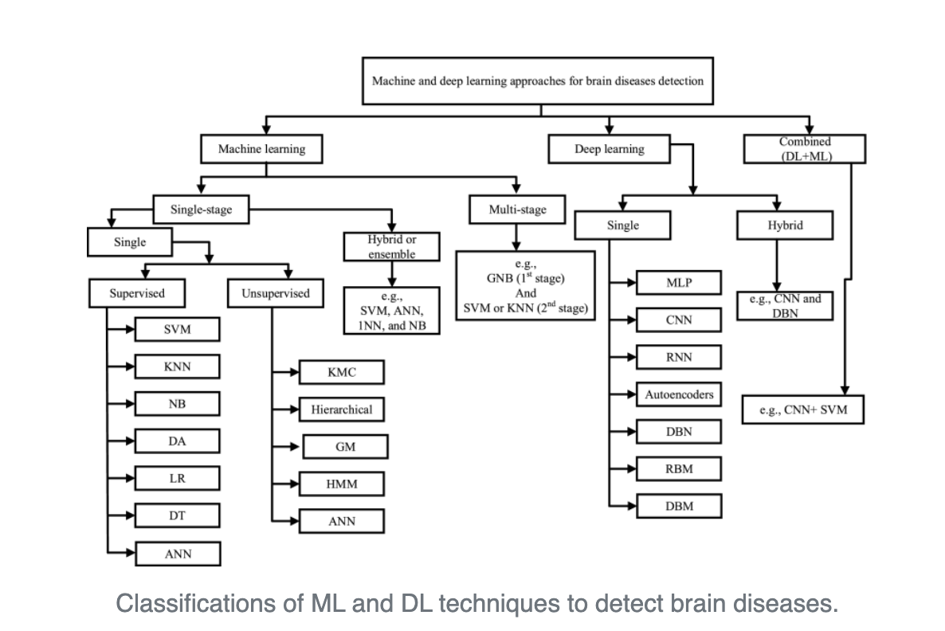
Brain Diagnosis
Notes:
P. Khan et al., "Machine Learning and Deep Learning Approaches for Brain Disease Diagnosis: Principles and Recent Advances," in IEEE Access, vol. 9, pp. 37622-37655, 2021, doi: 10.1109/ACCESS.2021.3062484.

Slide 9
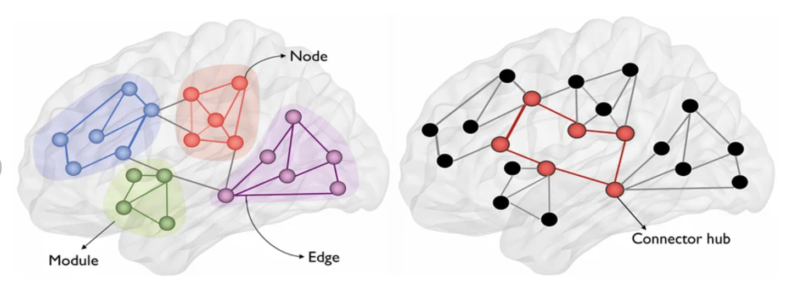
The Brain: A Global Communication Hub
The Networked Organ
The brain functions through thousands of interconnected nodes working in concert.
Edges: Structural and functional pathways.
Nodes: Anatomical regions .
Connectome: The complete map of neural links.
Module: A highly interconnected cluster of brain regions that group together to perform specialized neural functions.
Connector Hub: A high-traffic network node that links different modules together, coordinating global information flow across the brain.
Notes:
https://www.researchgate.net/figure/Illustration-of-graph-theoretic-measures-In-the-context-of-brain-networks-in-this-study_fig1_353482746

Slide 10






When the Brain Falters
Vascular (Stroke)
Tumors/Lesions
Neurodegeneration
Sudden Oxygen deprivation causing sudden immediate structural death in specific lobes
Physical mass effects displacing hralthy brain tissue and disrupting signaling
Slow, silent netowrk colapse. Typical of Alzheimer’s and Parkinson’s disease.
Notes:
https://medlineplus.gov/braindiseases.html

