Slide 1

SMART INDIA HACKATHON 2026
TITLE PAGE
Problem Statement ID: SIH26031
Problem Statement Title: Quality assessment and grading of onions are often subjective and vary across procurement centers, resulting in disputes and inconsistencies.
Theme: Smart Automation
PS Category: Software
Team ID: 141914
Team Name: IndieBuild

Slide 2
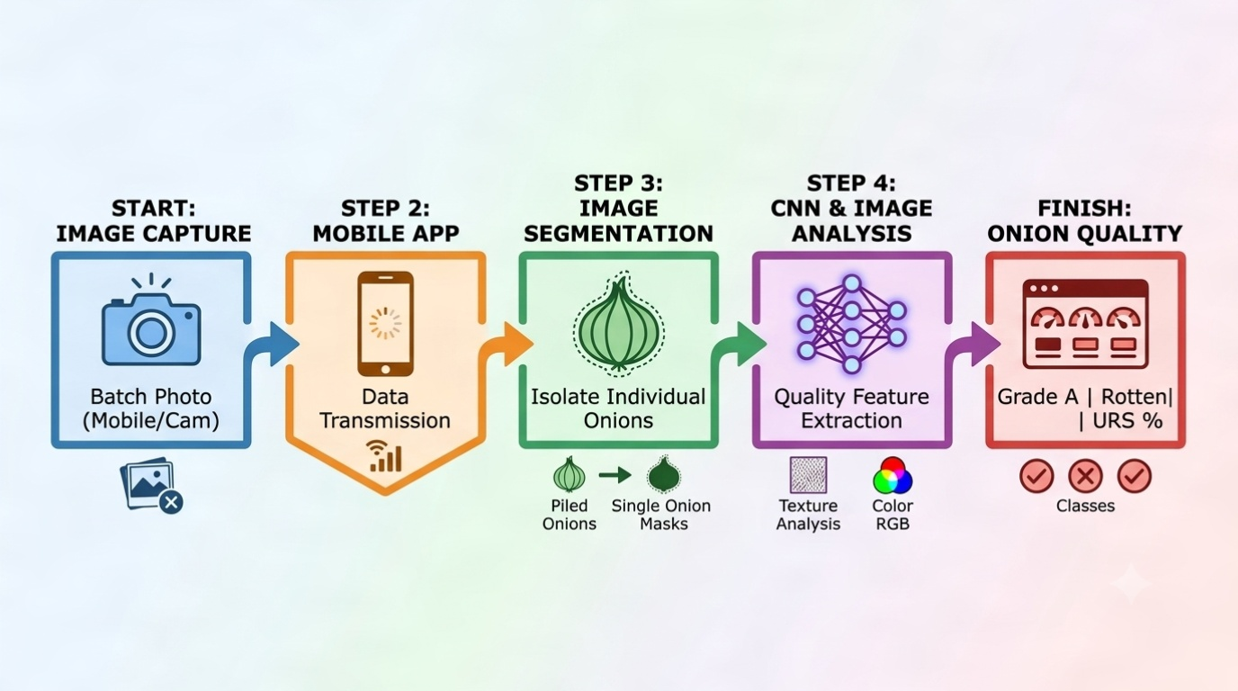

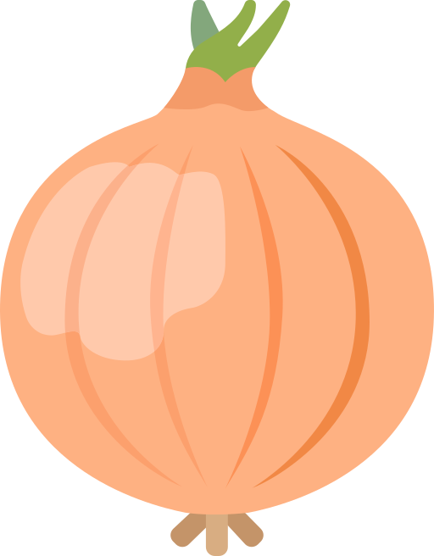
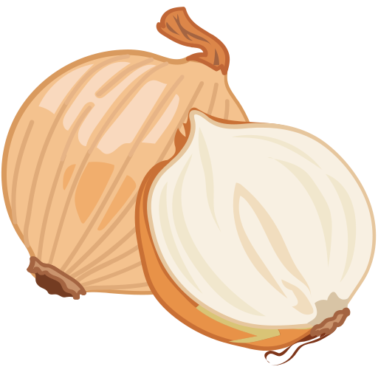
AgriVision
AI based onion quality estimator
IndieBuild
Problem:
Onion quality assessment at procurement centers is often performed manually by visual inspection.
This creates several problems:
Human error: Inspecting thousands of onion is time consuming
Slow inspection: Manual sorting takes significant time.
Limited transparency: There is often no digital evidence explaining how a batch was graded.
Our Solution:
AgriVision: Computer vision system for onion quality estimation
Capture onion batches via camera
Detect onions with bounding boxes
Identify rot, damage & sprouting
Fast batch processing
Instant digital quality report
Feedback learning in case of bad judgement of sample.
Key-Value Preposition:
Batch processing of multiple onions at once
Fast, low-latency analysis using a YOLO model + color-based pixel analysis for robust ensemble results.
Individual onion bounding & quality assessment
Instant Grade A/URS report
Offline availability of model

Slide 3
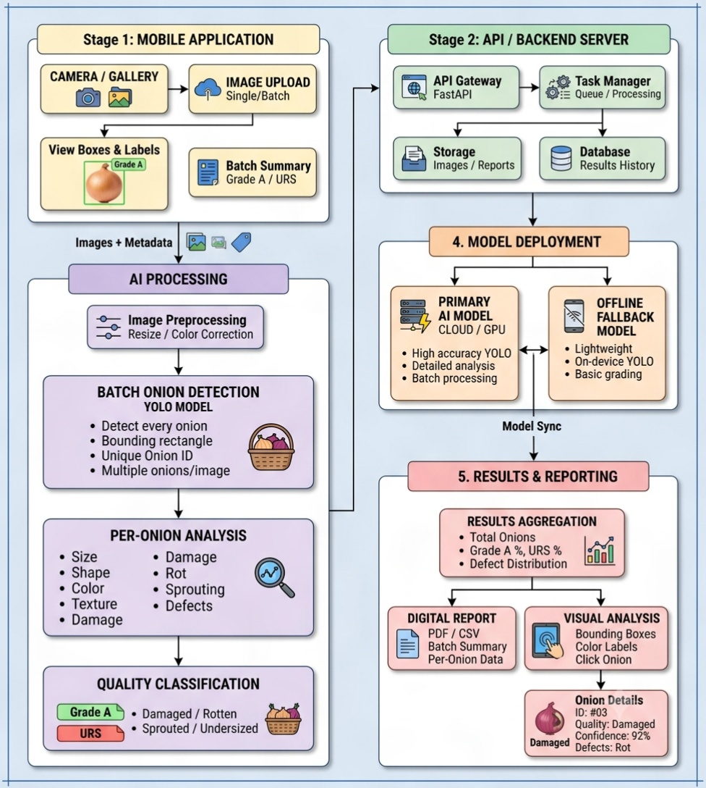
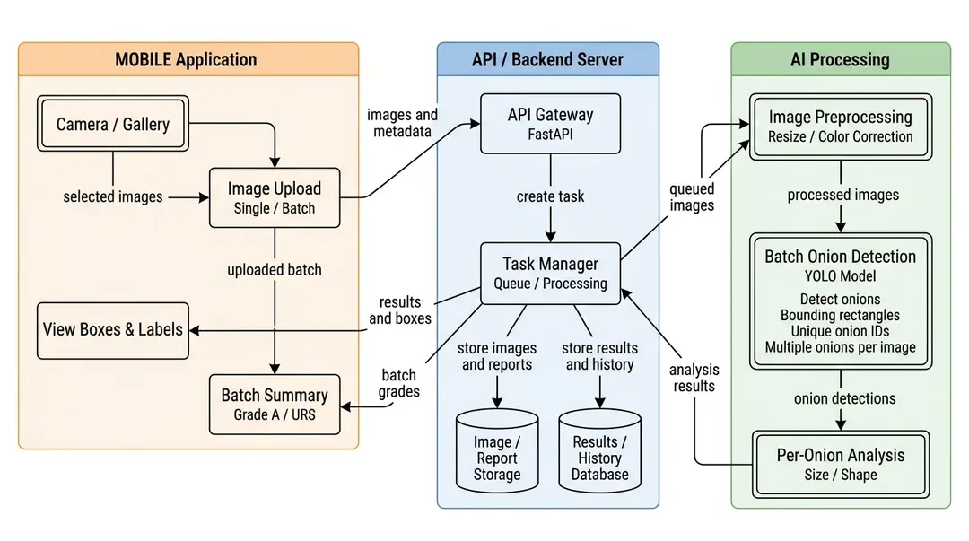
TECHNICAL APPROACH
IndieBuild
Tech Stack
Process Flowchart:
Frontend: Kotlin, Android SDK, Jetpack Compose, ONNX and Tensorflow lite runtime for local inference, ReactJS(for web interface design)
Backend: Nginx proxy, FastAPI, Tensorflow/Keras, YOLO12-seg, OpenCV, VGG16 CNN model
Database: PostgreSQL(user information storage), MongoDB(storing reports for batches).
System Architecture:

Slide 4
FEASIBILITY AND VIABILITY
IndieBuild
Technical Feasibility
Economic Viability
Resource Requirement
Economic Viability
Operational Viability
Technical Feasibility
Technical challenges
YOLO Segmentation for real-time onion detection.
OpenCV for image preprocessing, color-based detection, and size estimation.
TensorFlow Lite / ONNX Runtime for fast offline mobile inference.
FastAPI + PostgreSQL for backend services and data management.
India wastes around ~5 million tones of onion every year.
Our solution prevents wastage of onions beforehand.
Uses commodity smartphone hardware instead of specialized inspection equipment.
Open-source technologies reduce software and licensing costs.
Easy and free usage of app allows vendors to use the app without any extra cost.
Offline inference reduces continuous cloud/API costs.
Resource Requirement
Challenges | Solutions
Low quality of data for more complex model | Use human feedback to retrain the model to keep up with latest data
Inaccurate result for offline result | Use online server inference along with offline inference
Difficulty in processing the size of each onion | Use better normalization and Reference object/calibration for pixel-to-size conversion.
Smartphone camera for image capture.
GPU-enabled system for continuous online model training.
Annotated onion image dataset.
Cloud/server infrastructure for centralized storage and analytics.

Slide 5

IMPACT AND BENEFITS
IndieBuild
IMPACT
FUTURE ASPECTS
Impact on farmer: India has around 150 million farmers, use of AgriVision makers quality estimation more clear and leads to more objective price realization.
Accurate segregation of Grade A, URS and rejected onions can help farmers present consistent quality information during procurement and reduce quality-related disputes.
Economic Impact: Automated batch inspection reduces manual effort and inspection time.
Early identification and segregation of rotten, damaged and undersized onions can reduce avoidable wastage and improve the value recovered from each batch.
All-Crop AI: Expand from onions to fruits, vegetables, grains and other crops with crop-specific quality models.
Global AI Learning: We can collect scans and feedback across regions, climates and crop varieties to continuously improve accuracy.
Predictive Agriculture: We can Combine AI, weather, soil and historical data for crop health and yield prediction.
Market Intelligence: We can use quality, production and market data for crop price forecasting and smarter procurement planning in future.
Supply chain innovation: Historical quality data enables smarter procurement, better inventory planning, and data-driven supply-chain decisions, aligning with India’s ₹2,817 crore Digital Agriculture Mission.
Technological Impact: AgriVision brings AI-powered computer vision to agricultural procurement through real-time onion segmentation, defect detection, and size estimation. Its lightweight models enable low-latency/offline processing on smartphones, while digital records support scalable, data-driven quality management.
Environmental Impact: AgriVision can contribute to reducing agricultural food loss by enabling early identification and segregation of rotten and damaged onions, helping prevent avoidable wastage across the supply chain.

Slide 6
RESEARCH AND REFRENCES
IndieBuild
Technical Research: Improved YOLOv8n-seg for instance segmentation of mango fruits and peduncles in natural orchard environments: https://www.sciencedirect.com/science/article/pii/S2772375526006763 A Comprehensive Study on Onion Classification based on Machine Learning & Computer Vision https://thegrenze.com/ Novel Non-Destructive Quality Assessment Techniques of Onion Bulbs https://pmc.ncbi.nlm.nih.gov/articles/PMC6045999/ | Market Research: Department of Consumer Affairs (DoCA) Price Stabilization Fund (PSF) & Buffer Stock Procurement Guidelines https://agriwelfare.gov.in/sites/default/files/opr_gud_303_1.pdf ICAR-DOGR (Directorate of Onion and Garlic Research) Economic Analysis of Storage & Manual Grading Losses https://icar.org.in/en/node/4701
Datasets: Fruits by YOLO - Fruits Detection Dataset https://www.kaggle.com/datasets/kapturovalexander/fruits-by-yolo-fruits-detection YOLOv11 - Road Lane Segmentation Notebook https://www.kaggle.com/code/princekhunt19/yolov11-road-lane-segmentation Roboflow Onion Disease & Defect Dataset https://universe.roboflow.com/anas-kadiri-ffnxr/onion-disease

