Slide 1

Course: Information Retrieval
COVID Research
Search
Project 7 · TREC-COVID / CORD-19
Submitted to
Submitted by
Prof. [Professor Name]
[Team Member 1] — [Registration No.]
[Team Member 2] — [Registration No.]
[Team Member 3] — [Registration No.]
[Team Member 4] — [Registration No.]
01
Notes:
Manipal University Jaipur logo sourced unchanged from the university's official website: https://jaipur.manipal.edu/img/manipal-university-jaipur-logo-01.svg
Course: Information Retrieval. Replace professor, team-member and registration-number placeholders before presenting.

Slide 2
Problem and objectives
Find relevant research papers and make
the ranking evidence visible.
Retrieve
Search titles and abstracts using a research question.
Compare
Inspect TF-IDF, BM25, dense retrieval, and Hybrid RRF.
Evaluate
Measure results against graded relevance judgments.
02
Notes:
Project 7 goal: an emergency scientific search engine for COVID-19 pandemic research. Assignment source: Information Retrieval Project Assignments.pptx, slides 2, 9 and 24. The project retrieves documents rather than generating clinical advice.
Dataset reference: https://ir.nist.gov/trec-covid/data.html

Slide 3
Dataset and experiment scope
Experiment component | Value
Corpus available | 171,332 records
Local index | 20,000 records in source order
Judged queries evaluated | 50 of 50
Queries with relevant indexed papers | 47; the other 3 contribute zero
Original qrels are retained. Relevant papers outside the subset stay in the evaluation denominators.
03
Notes:
Measured project evidence: artifacts/experiment/evaluation.json; experiment ID 024ac8ffbc9b667bf50f. Index: 20,000 of 171,332 source-order records. All 50 queries and original qrels. Missing relevant papers remain in metric denominators.
TREC-COVID / CORD-19 data reference: https://ir.nist.gov/trec-covid/data.html
BEIR distribution: https://public.ukp.informatik.tu-darmstadt.de/thakur/BEIR/datasets/trec-covid-beir.zip

Slide 4
Preprocessing and indexing
Lexical path
Dense path
Lowercase and tokenize
Remove stop words
Apply simple suffix stemming
Build term-frequency postings
Keep raw titles and abstracts
Encode up to 256 tokens
Normalize 384-dimensional vectors
Index every selected paper
FastAPI computes rankings and evaluation.
React / Vite displays papers, scores, and rank evidence.
04
Notes:
Implementation evidence: backend/app/search_engine.py, tokenize(), stem(), _build_indices(), _build_sentence_index(). Raw titles and abstracts feed MiniLM; sparse preprocessing is not applied to transformer input.
Model reference: https://huggingface.co/sentence-transformers/all-MiniLM-L6-v2

Slide 5
Ranking models
Model | Ranking signal | Configuration
TF-IDF cosine | Term overlap weighted by rarity | Sublinear TF; smoothed IDF
BM25 | Term saturation and document-length normalization | k1 = 1.5; b = 0.75
Sentence Transformer | Semantic similarity across the indexed corpus | MiniLM; 384 dimensions
Dense search is independent of sparse candidates and scores all 20,000 indexed papers.
05
Notes:
TF-IDF implementation: sublinear TF, smoothed IDF and cosine normalization. Convention reference: https://scikit-learn.org/stable/modules/generated/sklearn.feature_extraction.text.TfidfTransformer.html
BM25: k1=1.5, b=0.75; positive Robertson-style IDF. Robertson and Zaragoza, The Probabilistic Relevance Framework: BM25 and Beyond, 2009.
Sentence Transformer: https://huggingface.co/sentence-transformers/all-MiniLM-L6-v2; pinned revision 1110a243fdf4706b3f48f1d95db1a4f5529b4d41. No fine-tuning on test qrels.

Slide 6
Hybrid Reciprocal Rank Fusion
RRF(d) = Σ 1 / (60 + rankₘ(d))
Combine rank positions across TF-IDF, BM25, and MiniLM.
A paper missing from a ranker contributes zero for that ranker.
Example paper | TF-IDF | BM25 | MiniLM
Position in each list | 7 | 2 | 1
1/67 + 1/62 + 1/61 = 0.04745
06
Notes:
RRF source: Cormack, Clarke and Buettcher, Reciprocal Rank Fusion outperforms Condorcet and individual Rank Learning Methods, SIGIR 2009.
Implementation: _rrf() in backend/app/search_engine.py, with k=60 and complete rankings.
Example evidence: artifacts/experiment/example-search.json. Query: coronavirus transmission in children. Paper: Laboratory-Confirmed Human Coronavirus Infections Among Children: Does Type Matter? Rank positions 7, 2, 1 produce 0.04745 after rounding.

Slide 7
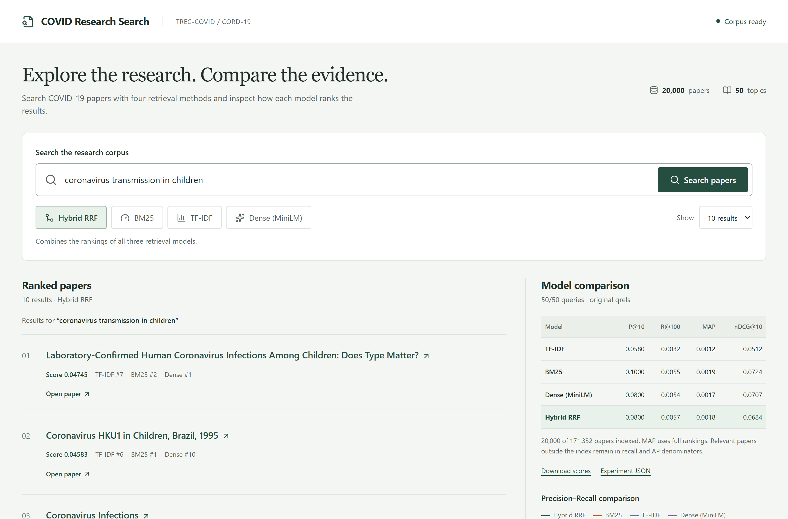
Working application
Search research papers
Switch among four
retrieval methods
Inspect model ranks
and open source papers
Download scores
and experiment JSON
07
Notes:
Actual screenshot captured from the running project in real Sentence Transformer mode: artifacts/report-work/project-search.png.
Example query and results: artifacts/experiment/example-search.json. Interface implementation: src/main.jsx. Live demo URL: http://127.0.0.1:5173.
The screenshot's aggregate table is measured over the judged query set; the displayed free-text query is an interaction example, not a separate qrels evaluation.

Slide 8
Measured retrieval performance
Model | P@10 | R@100 | MAP | nDCG@10
TF-IDF | 0.058000 | 0.003222 | 0.001220 | 0.051184
BM25 | 0.100000 | 0.005501 | 0.001890 | 0.072378
MiniLM (dense) | 0.080000 | 0.005382 | 0.001742 | 0.070707
Hybrid RRF | 0.080000 | 0.005742 | 0.001826 | 0.068359
BM25 leads on P@10, MAP, and nDCG@10.
Hybrid RRF leads on Recall@100.
Subset experiment · 20,000 papers · 50 queries · Original qrels
08
Notes:
Measured project evidence: artifacts/experiment/evaluation.json; experiment ID 024ac8ffbc9b667bf50f. Index: 20,000 of 171,332 source-order records. All 50 queries and original qrels. Missing relevant papers remain in metric denominators.
Precision@10 divides top-10 relevant hits by 10. Recall@100 uses original-qrels relevant counts. MAP averages full-returned-ranking AP over all 50 queries. nDCG@10 uses graded gains 2^relevance-1 and the original ideal ranking. No statistical significance test was performed.

Slide 9
Precision–Recall comparison
All four models
11 recall thresholds,
averaged over 50 queries.
Recall ≥ 0.1 is
unreachable in this
source-order subset.
Missing relevant papers stay in the denominators.
09
Notes:
Measured project evidence: artifacts/experiment/evaluation.json; experiment ID 024ac8ffbc9b667bf50f. Index: 20,000 of 171,332 source-order records. All 50 queries and original qrels. Missing relevant papers remain in metric denominators.
Chart data: artifacts/experiment/precision-recall.csv. Macro-averaged 11-point interpolated precision at recall levels 0.0 to 1.0. For each query, take maximum precision among retrieved prefixes meeting the threshold, or zero when unreachable. The zero-recall point is the best attained precision, not an empty result. All values at thresholds >=0.1 are zero because this subset cannot reach those recall levels.

Slide 10
Conclusion and next steps
Completed
Four retrieval methods, an interactive search tool,
and reproducible evaluation exports.
Finding
BM25 is strongest on three metrics;
RRF offers the highest Recall@100 in this run.
Next
Evaluate the full corpus, compare biomedical encoders,
and measure latency and memory.
Thank you
10
Notes:
Measured project evidence: artifacts/experiment/evaluation.json; experiment ID 024ac8ffbc9b667bf50f. Index: 20,000 of 171,332 source-order records. All 50 queries and original qrels. Missing relevant papers remain in metric denominators.
Deliverables: working search UI, TF-IDF, BM25, true Sentence Transformer retrieval, Hybrid RRF, native comparison table, PR graph, exports and completed report.
Limitations: source-order subset; general-purpose encoder; simple suffix stemming; 256-token truncation. Future work: full corpus, biomedical encoders, stronger preprocessing and measured latency/memory.
References: https://ir.nist.gov/trec-covid/data.html; https://huggingface.co/sentence-transformers/all-MiniLM-L6-v2; https://scikit-learn.org/stable/modules/generated/sklearn.feature_extraction.text.TfidfTransformer.html; Robertson and Zaragoza (2009); Reimers and Gurevych (2019); Cormack, Clarke and Buettcher (2009).

