Slide 1
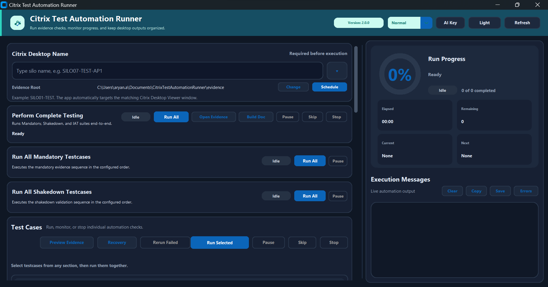
Citrix Test Automation Runner
Tool overview, button guide, how-to kit, and operational checklist
Version 2.0.0
Citrix Test Automation Runner v2.0.0 | 1

Slide 2
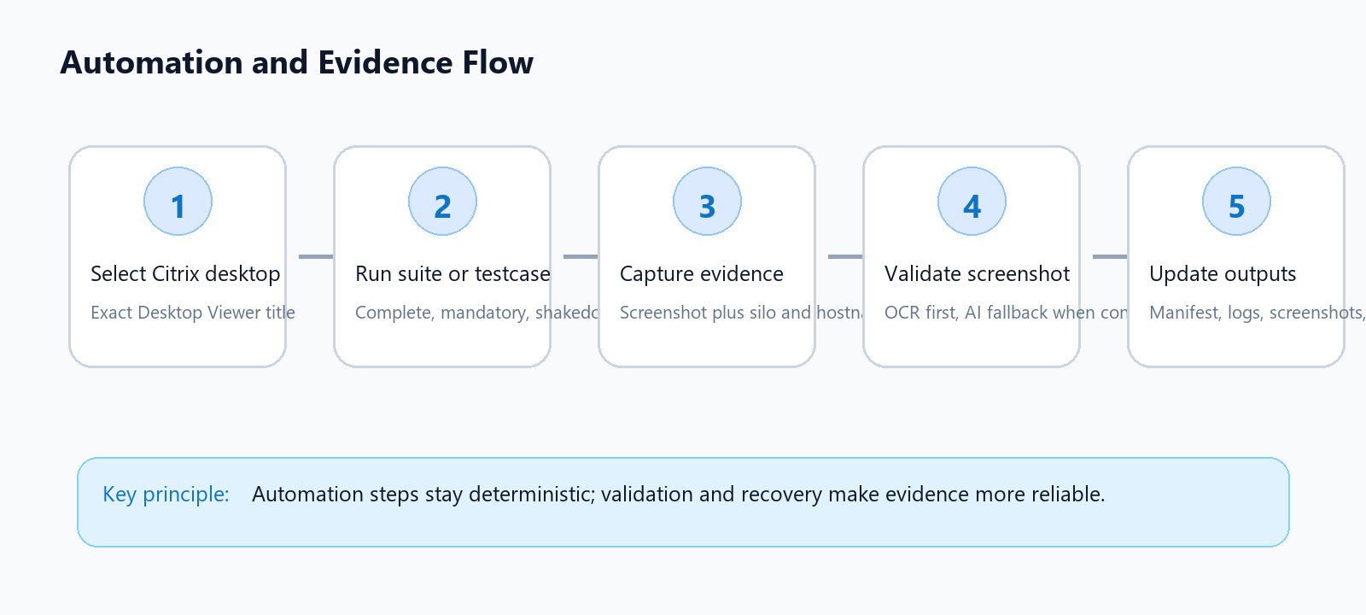
Why The Tool Exists
Reliable evidence collection for Citrix desktop validation.
Problem
Solution
Outcome
Manual evidence capture is slow, repetitive, and easy to mislabel across silos.
Automate test execution, screenshot capture, validation, logs, and report generation.
Faster runs, cleaner evidence, desktop-specific folders, and repeatable reporting.
Citrix Test Automation Runner v2.0.0 | 2

Slide 3
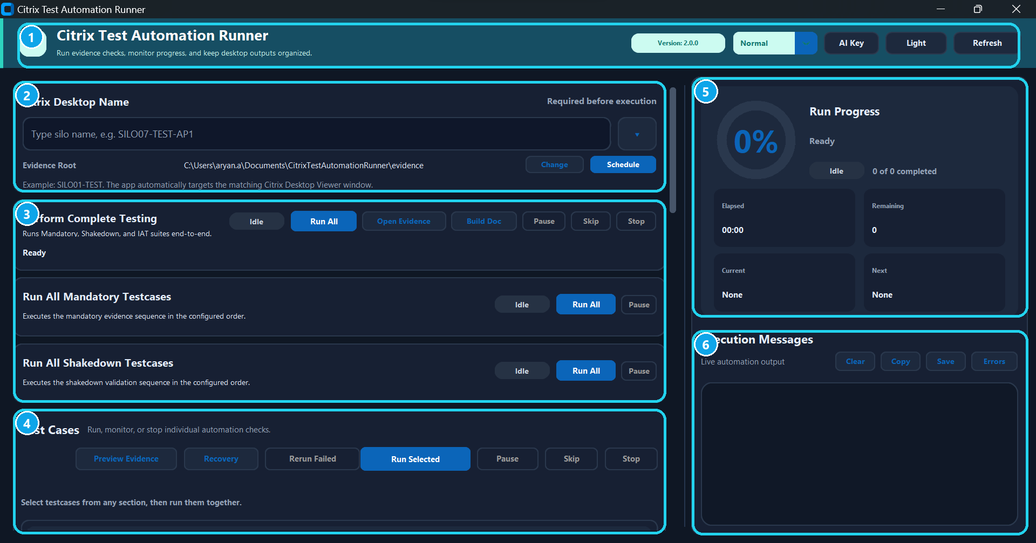
Main UI At A Glance
Six control areas make the runner easy to operate and monitor.
Citrix Test Automation Runner v2.0.0 | 3

Slide 4
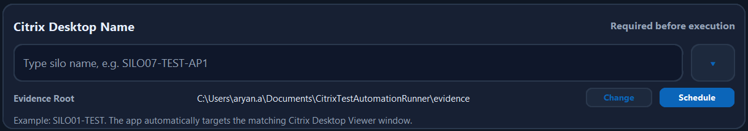
Desktop Setup And Evidence Root
The desktop name controls where automation runs; the evidence root controls where outputs go.
Use the exact Citrix Desktop Viewer title.
Dropdown stores recent desktop names for faster daily runs.
Change Evidence Root when outputs should go to Downloads or another approved folder.
Use Schedule only when all target Citrix sessions can remain logged in.
Best Practice
Evidence Root
Schedule Caveat
Copy the desktop title directly from the Citrix window. A mismatch can cause automation to run locally.
Default is under Documents. Every desktop gets its own folder.
Scheduled testing is only reliable when other sessions do not time out or require QR login.
Citrix Test Automation Runner v2.0.0 | 4

Slide 5
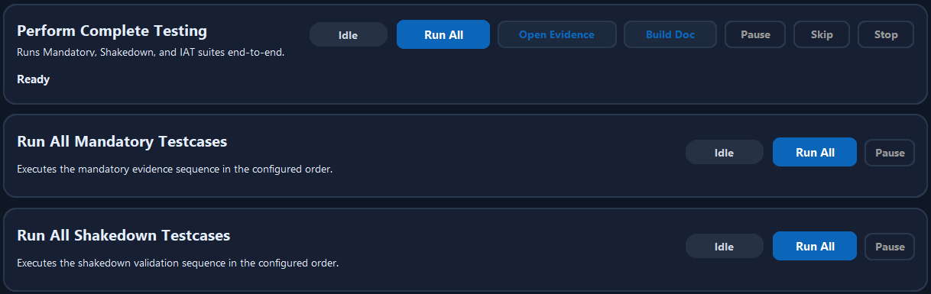
Run Controls
Choose the smallest run scope that solves the task.
Complete Testing
Runs mandatory, conditional Silo 43, shakedown, IAT, and post-complete checks.
Mandatory / Shakedown
Run focused suites when only one phase is needed.
Pause / Skip / Stop
Cooperative controls for long-running automation.
Primary
Secondary
Muted
Danger
Run All and Run Selected are primary.
Open Evidence and Build Doc are support actions.
Stop should be used only when you intentionally abort the run.
Citrix Test Automation Runner v2.0.0 | 5

Slide 6
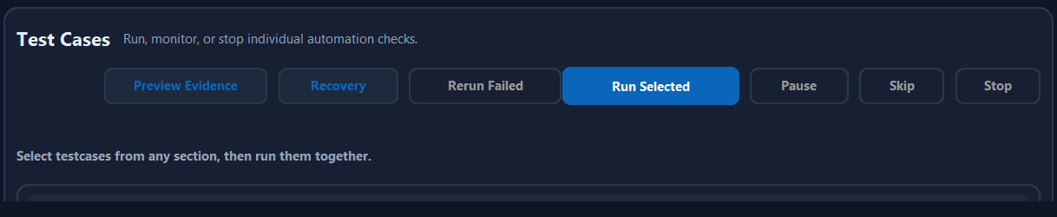
Individual Testcases And Recovery
Use selected runs and recovery instead of repeating a full suite unnecessarily.
Preview Evidence
Recovery
Run Selected
Review latest screenshots and manifest entries directly inside the app.
Focus on failed/manual items and rerun the exact testcase.
Run a custom mix from mandatory, shakedown, IAT, and Silo 43 sections.
Standalone testcase buttons keep their existing behavior.
Grouped Complete Testing optimizations do not change individual testcase runs.
After correcting a failed item, rebuild/download the Word report.
Citrix Test Automation Runner v2.0.0 | 6

Slide 7
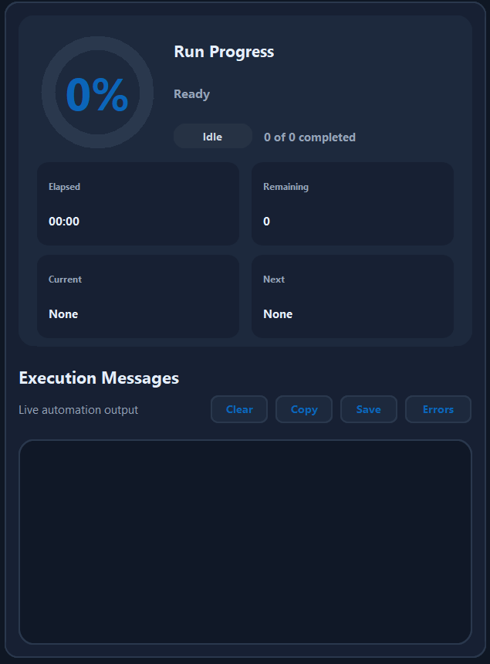
Run Monitor And Logs
Progress and logs stay visible while long-running automation executes.
Progress percent and completed count show run state.
Elapsed, remaining, current, and next help with monitoring.
Execution Messages show live steps, validation results, and failures.
Clear, Copy, Save, and Errors help with troubleshooting and sharing logs.
Citrix Test Automation Runner v2.0.0 | 7

Slide 8
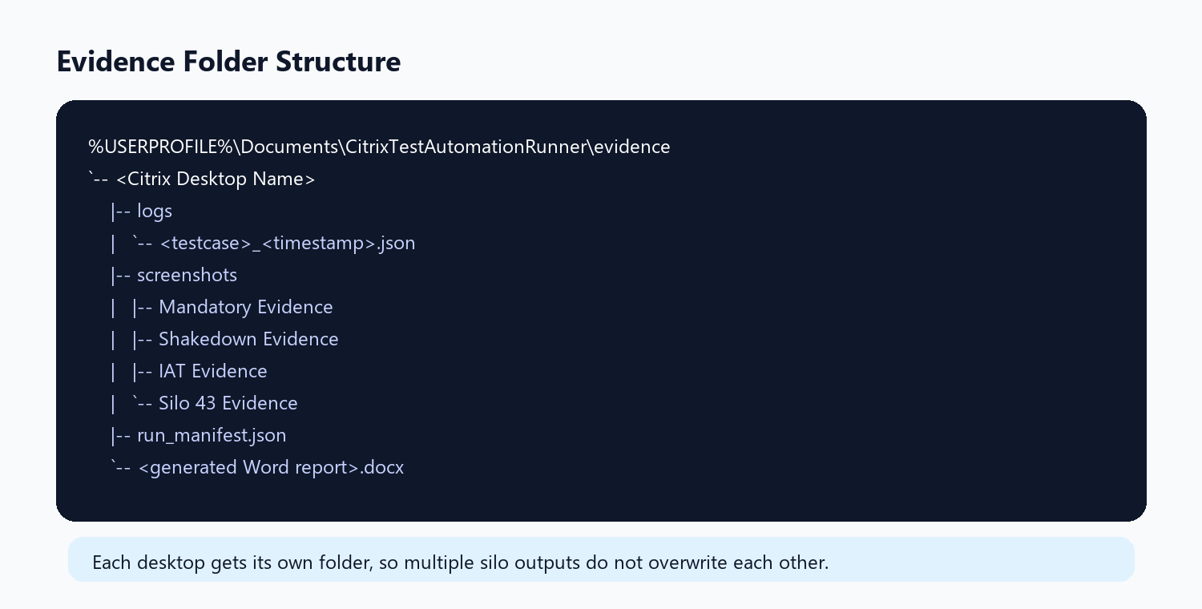
Evidence And Report Output
Every desktop is isolated to prevent screenshot and log overwrite.
Screenshots
Pass/fail PNG evidence with overlay.
JSON Logs
Step-by-step testcase and suite execution logs.
Manifest
Latest result index used by preview, recovery, and report generation.
Word Report
Client-friendly report generated from latest valid screenshots.
Citrix Test Automation Runner v2.0.0 | 8

Slide 9
Validation Model
OCR is local and fast; AI is used only as fallback when configured.
Capture
OCR
AI Fallback
Retry
Manifest
Screenshot with overlay
Validate expected text locally
Only if OCR is inconclusive
Where testcase supports it
Save final pass/fail state
AI key is not packaged in the release and is saved per Windows user.
AI Key dialog masks the value, tests connectivity, and can clear the saved key.
If corporate network blocks OpenAI, screenshots and logs remain available for manual review.
Citrix Test Automation Runner v2.0.0 | 9

Slide 10
Special Flows
Certain desktop types have conditional behavior.
Ring0
Silo 43
Zscaler
Applist validation is skipped where applicable while the rest of the run continues.
Oracle PATH, NICE variables, VLS warning, prod.dvfs.com ping, and BAD folder checks run only for Silo 43.
Mandatory and post-complete Zscaler evidence has dedicated validation and recovery paths.
Office
Browser
Command Session
PowerPoint launch evidence is used to reduce runtime and avoid Word/Excel instability.
Google/Yahoo and Edge policy/sync flows are optimized in suite execution while standalone runs remain intact.
Hostname/IP, Edge, WebView, and Applist can share command context in Complete Testing for speed.
Citrix Test Automation Runner v2.0.0 | 10

Slide 11
How-To Kit
The daily operator flow.
1. Open the target Citrix Desktop Viewer and keep it signed in.
2. Enter the exact desktop title in Citrix Desktop Name.
3. Confirm Evidence Root.
4. Click Run All for Complete Testing, or use a smaller suite/run selected.
5. Avoid interacting with Citrix while automation runs.
6. Review Run Monitor, Execution Messages, Evidence Preview, and Recovery.
7. Download or rebuild the Word report before sharing.
Golden Rule
If one item fails, rerun that specific testcase first. Do not repeat the full suite unless the desktop context is invalid.
Citrix Test Automation Runner v2.0.0 | 11

Slide 12
Things To Keep In Mind
Operational guardrails for reliable evidence.
Use exact desktop names. This is the most important targeting control.
Do not resize, click, or type inside Citrix during automation.
Keep inactive scheduled desktops from logging out before using batch schedule.
Use Build Doc after reruns so report status reflects the latest manifest.
Never share API keys in chat or email. Use AI Key setup per machine.
For support, share app version, desktop name, screenshot, JSON log, and UI execution log.
Citrix Test Automation Runner v2.0.0 | 12

