Slide 1
CS-555 Project
Flight Price Analysis

Slide 2
Research Scenario Description
This project aims to study a flight dataset, looking at how factors like the number of stops, how long the flight is, the airline you choose, when you leave and arrive, affect the price of the flight. This can assist travelers in making informed decisions when choosing flights.

Slide 3
Data Set
flightId: A unique identifier for each flight. A numeric code that distinguishes one flight from another.
airline: This column represents the airline that operates the flight
departure_time: The time when the flight departs.
stops: Indicates the number of stops the flight makes during its journey.
arrival_time: Similar to departure_time, this column contains the time when the flight arrives at its destination.
duration: The duration column represents the total time it takes for the flight to travel from the source city to the destination city.
days_left: This column indicates the number of days remaining until the departure of the flight. It could be a measure of how far in advance the flight is being considered.
price: The target variable for our price prediction model. This column contains the prices of the flights, which we aim to predict based on the other features.

Slide 4
Research Question-1
Exploring if the duration of the flight correlates with its price. Then, with a simple linear regression, predict flight prices based on duration. Through hypothesis testing, assess the significance of this prediction

Slide 5
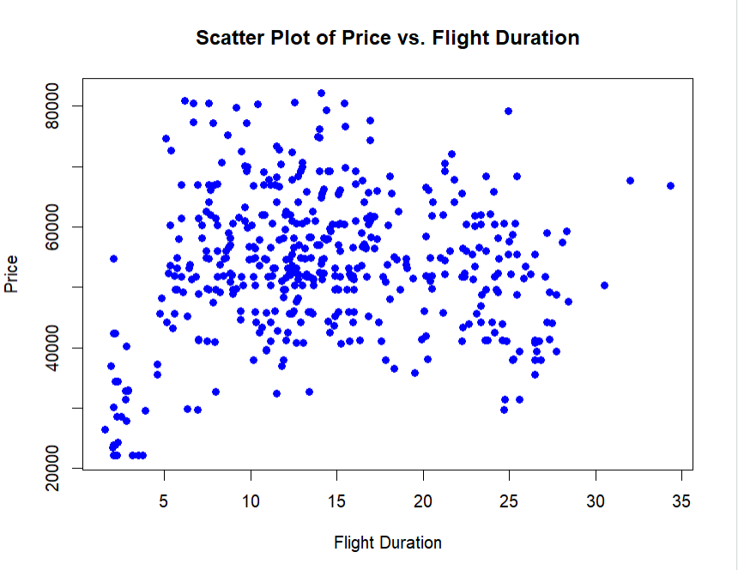
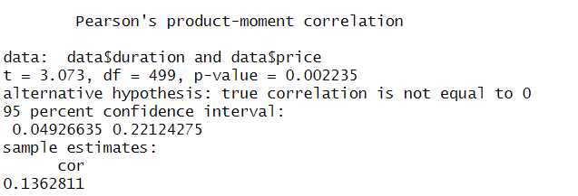
Correlation Test:

Slide 6
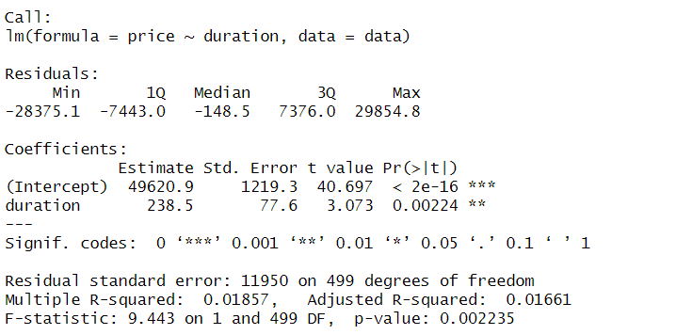
Linear Regression
Price = 49620.89 + 238.46 * Duration
CONCLUSION: The p-value for duration is less than 0.05 , we can reject null hypothesis and infer that duration of the flight has a significant linear relationship with the price. As the duration of the flight increases, the price tends to increase by an average of 238.46 units.

Slide 7
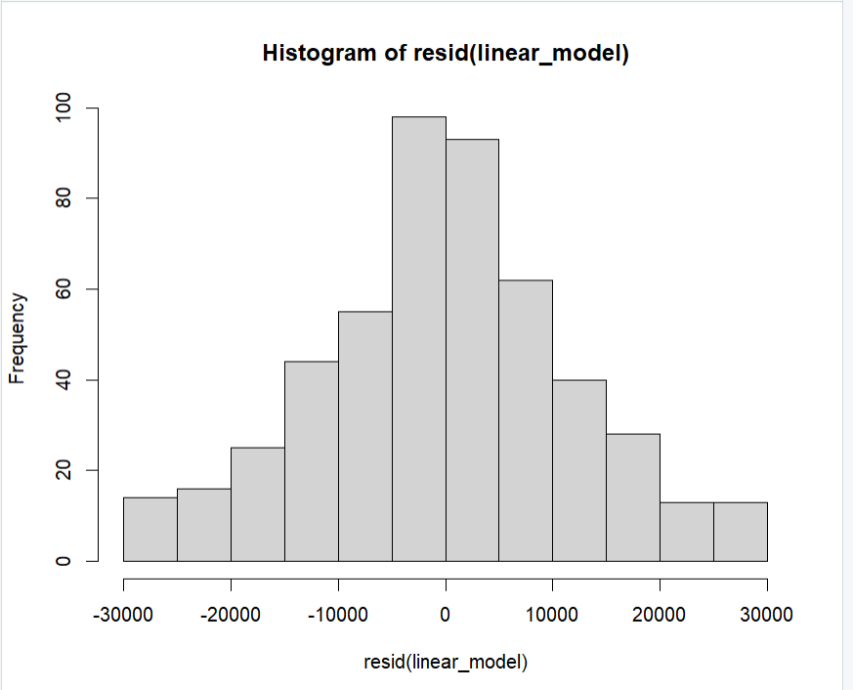
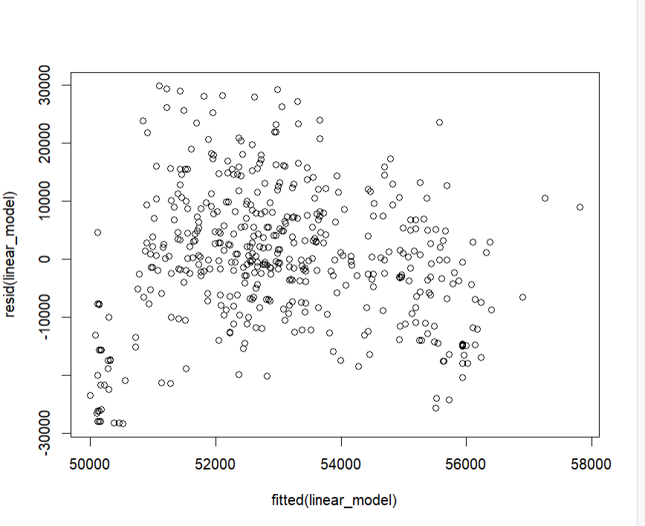
Checking For Assumptions
→Normally distributed residuals
→Linearity
→Constant Variance

Slide 8
Research Question-2
Investigating the impact of 'stops' on flight prices, stops are categorized into 'zero,' 'one,' and 'two_or_more' stops. Test whether there are significant mean price differences among these categories.

Slide 9
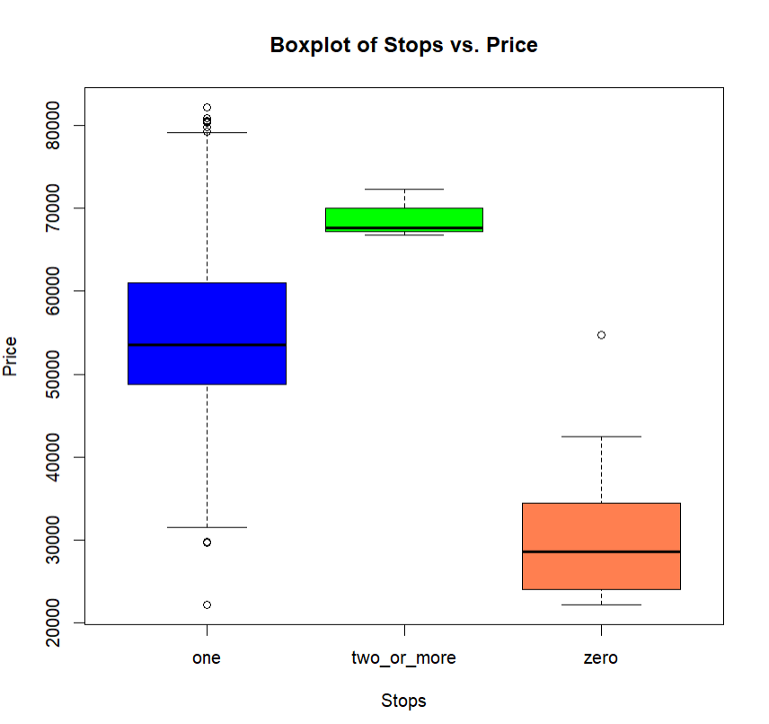

Slide 10
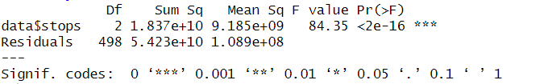
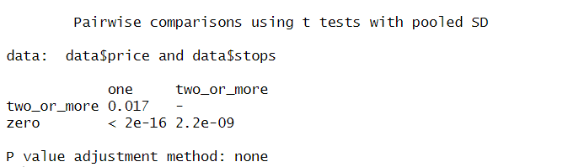
ANOVA Global F-test:
There is a difference in the mean price of flights between at least two of the number of stops.
Pairwise t-test:
→ There is difference in mean price of flights between all number of stops.
CONCLUSION: with a 95% confidence level, we can infer significant differences in mean prices among flights with varying numbers of stops. So, the number of stops does influence the price of the flight.

Slide 11
Research Question-3
Investigating the influence of 'airline' on flight prices, identify price differences. Extending the analysis, we incorporate 'days_left' as a covariate to explore whether airline effects on prices persist when accounting for time remaining until departure.

Slide 12
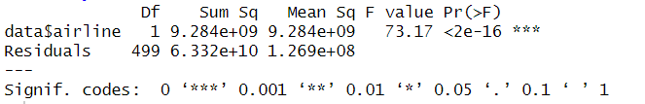
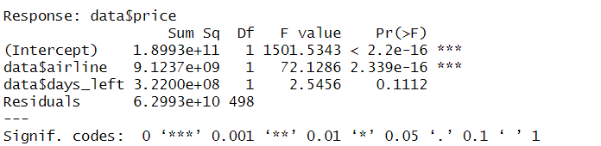
ANOVA
→There is a difference in mean prices for the airlines.
→Since there are only two airlines into consideration, no need for pairwise t-test.
ANCOVA
→The difference in the mean prices persist even after considering for the day left before departure
CONCLUSION: ‘Airline' has a significant impact on flight prices, and this effect persists even when considering the influence of 'days_left’. Both the choice of airline and the number of days left until departure contribute to the variability in flight prices

Slide 13
Research Question-4
Exploring the impact of 'departure_time' on flight prices. Extending the analysis to a two-way ANOVA, we introduce 'arrival_time' as a factor, aiming to uncover potential interactions and combined effects on flight prices.

Slide 14
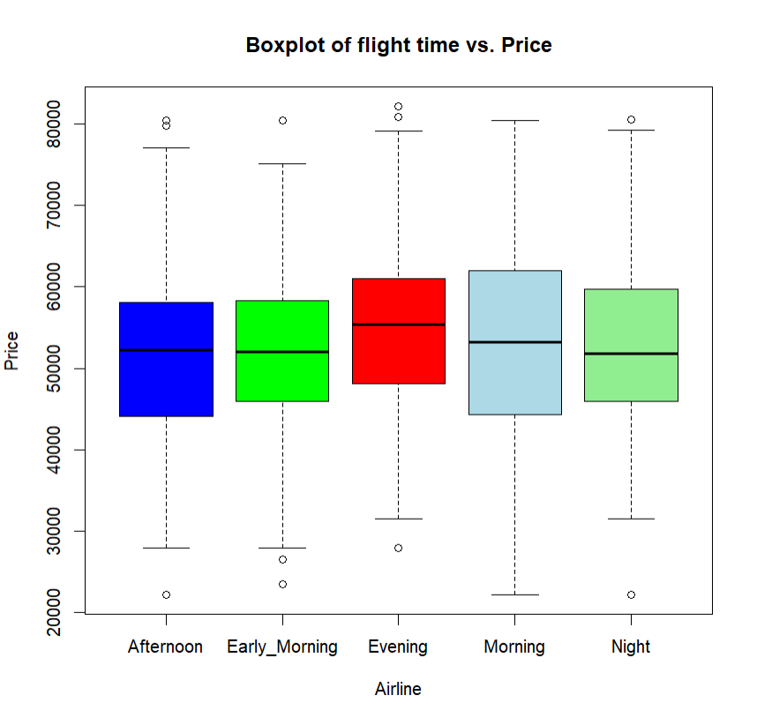

Slide 15
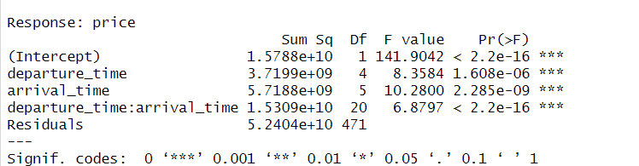
ANOVA
→The departure time has no effect on the price of the flights.
Two way ANOVA
→There is interaction between ‘departure_time' and 'arrival_time' and both combined have an impact on flight prices.

Slide 16
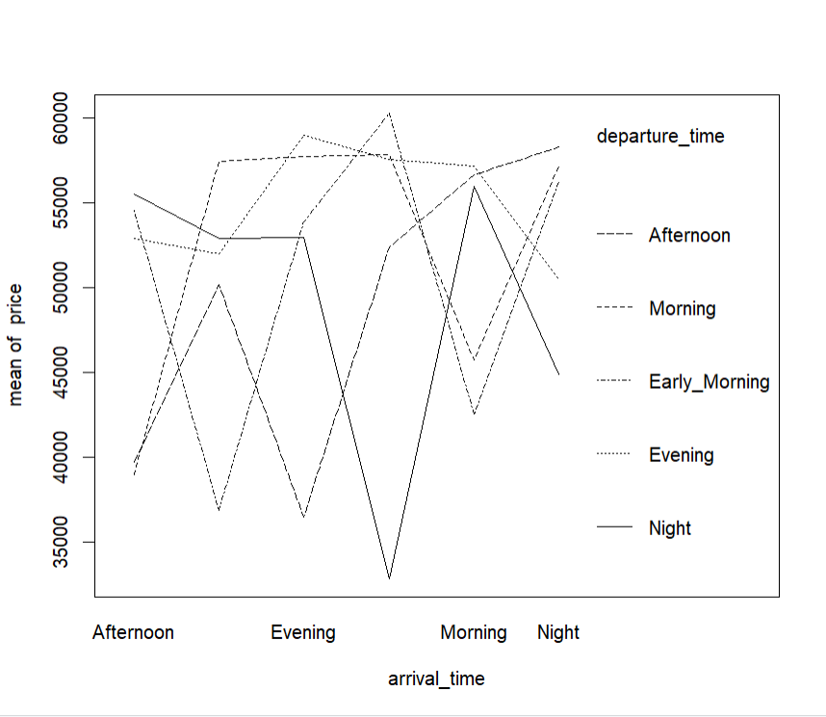
Interaction Plot

Slide 17
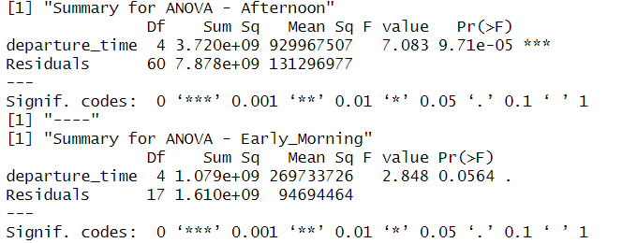
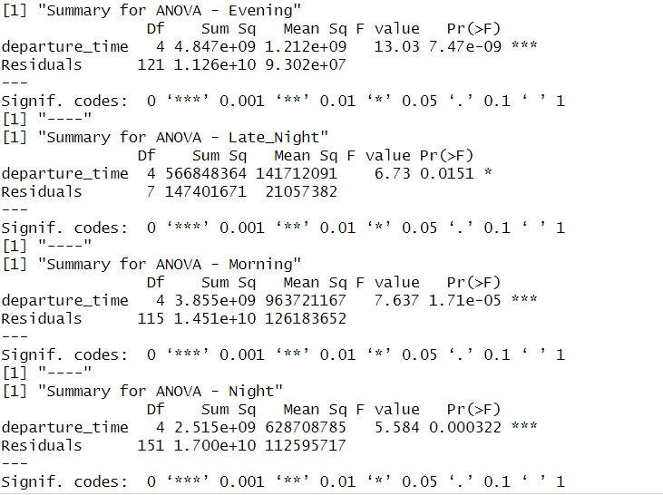
Stratifying the Departure time column and performing individual ANOVA
CONCLUSION: Departure time alone has no effect on the price of the flight.
If the departure time is “Early Morning” it does not matter what is the arrival time.
In all other cases, the departure and arrival time combined affect the price of the flight.

Slide 18
THANK YOU!

