Slide 1
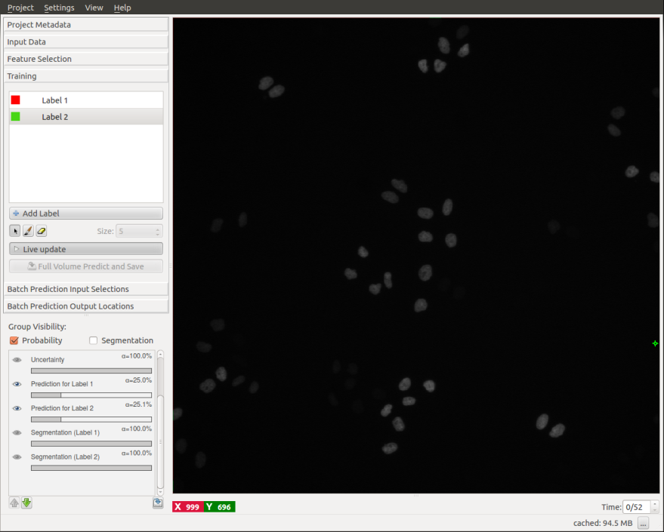
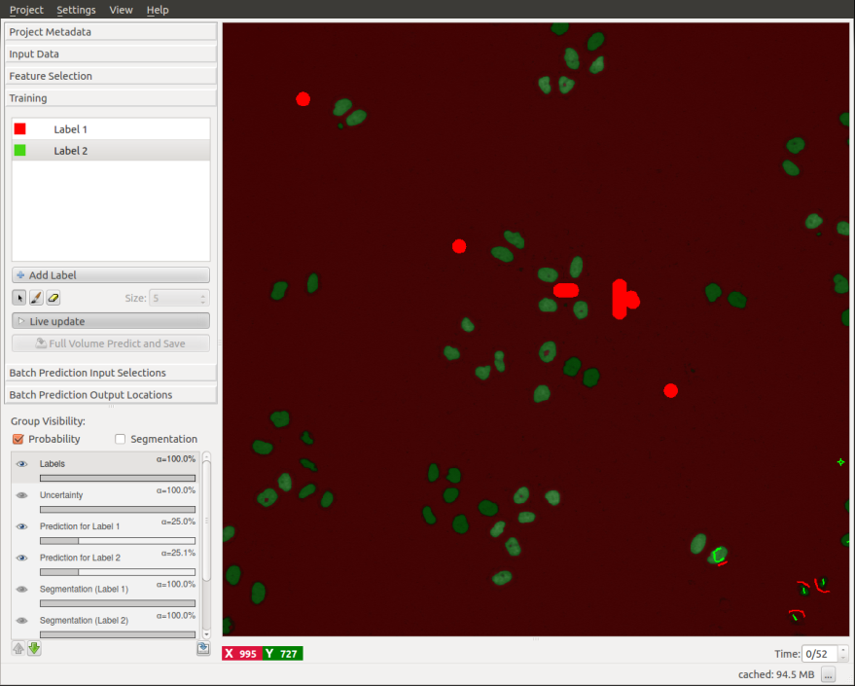
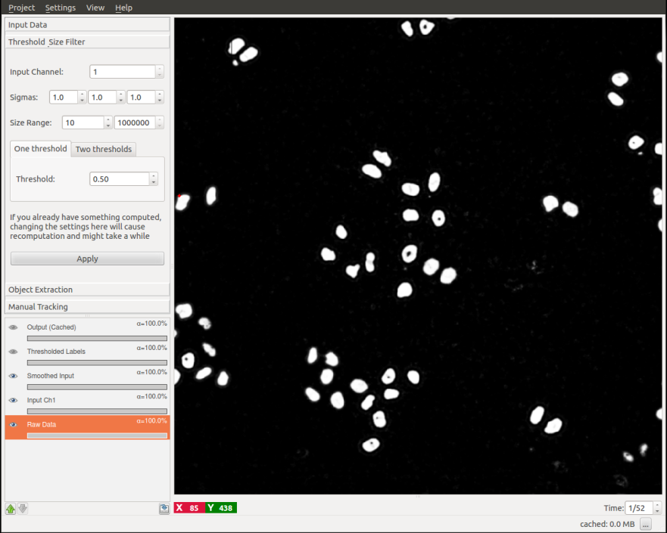
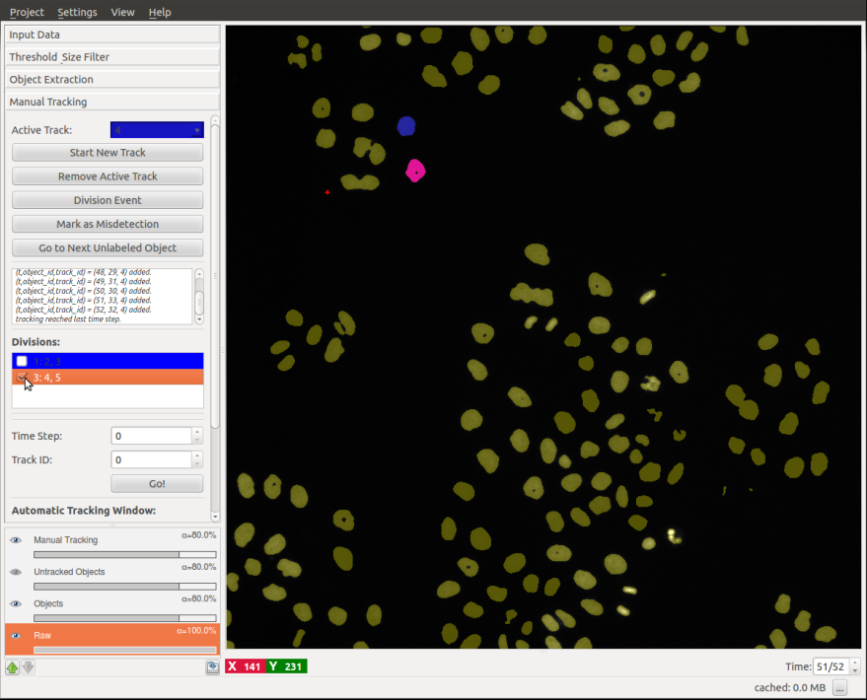
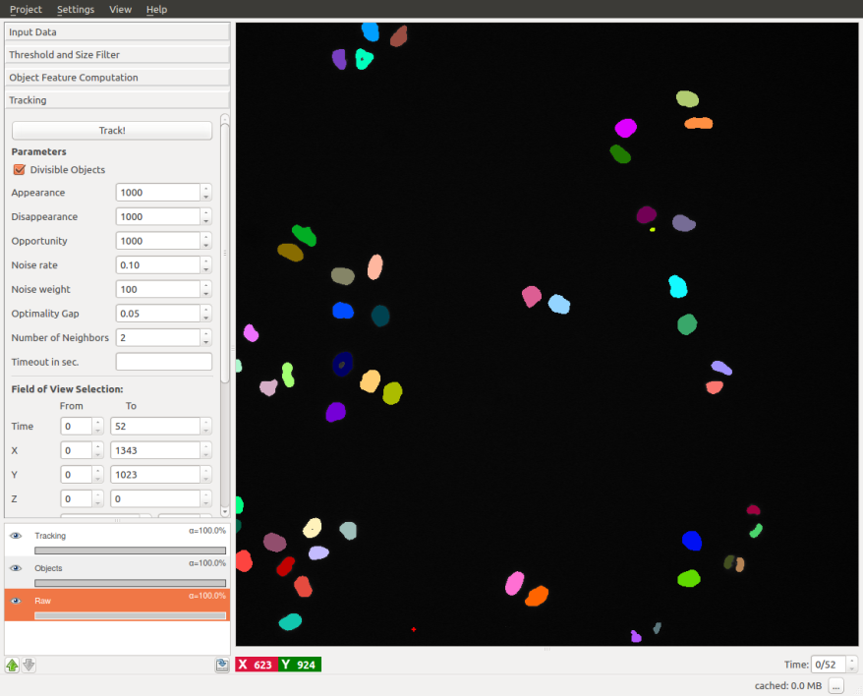
Pixel Classification
Raw Data
Segmentation
Object Extraction
Object Extraction
Manual Tracking
Automatic Tracking (Chaingraph)
Manual Tracking
Automatic Tracking

