Slide 1
1 · PROBLEM STATEMENT · ASSOCIATE PAIN POINTS
Four questions every account asks — and never answers
Different roles, same challenge: the knowledge that runs an account lives in people and threads, so a human is used as the retrieval mechanism.
1 Return from leave
2 New-joiner readiness
3 Knowledge on exit
4 Answers without waiting
“What changed while I was away?”
“How do I become productive quickly?”
“What happens when the person who knows leaves?”
“How do I get an answer without interrupting someone?”
Scroll back through 100+ unread mails, chats and ticket threads; decisions taken in threads you weren't on are simply missed.
KT calls that decay within a quarter, then months of asking someone else what the alert means.
The runbook they never wrote is the outage we take next quarter. Successors rediscover it through incidents.
A Teams ping, a call, a screen share: one question billed to two people's day plus context-switch loss.
3–5 h
60–90 days
Knowledge exits
1 question
per leave instance
to independent resolution
with the associate
= two people's time
ONE ROOT CAUSE
WHY EXISTING FIXES FAIL
Operational knowledge is tacit, scattered and individually held. Writing it down is unpaid, unrewarded work, so it never happens.
Wikis & runbooks decay: updating them is manual work outside the job.
Enterprise search only finds what was written down — never the tacit part.
Generic AI assistants answer confidently from the internet; a wrong answer reaches production.
COIH — Central Operational Intelligence Hub · UST D3 2026 · Fix It Forward with Claude

Slide 2
2 · ROI AND IMPACT
One knowledge layer, four returns — 120k–200k hours a year to start
Hours are derived from the stated 3–5 h leave-return estimate for a 5,000-person organisation. Ramp and interrupt targets are hypotheses to validate against an internal baseline.
3–5 h → < 1 min
≈ 80 %
60–90 → 30–45 days
100 %
leave-return catch-up in the prototype
(target in production: < 30 min)
of the 120k–200k h/year catch-up window recovered
new-joiner ramp to first independent resolution
of resolved incidents captured as knowledge (capture rate shown live)
Metric | Current | Target
Leave-return catch-up (primary metric) | 3–5 h per instance | < 30 min per instance
New-joiner ramp to independent resolution | 60–90 days | 30–45 days
Senior-engineer interrupt load | Recurring, unmeasured | Baseline, then −30–40 %
Repeat incidents with no captured resolution | Majority uncaptured | Every resolved incident captured
Knowledge coverage rate | — | Share of questions answerable with sources
Model cost per grounded answer (measured) | — | ≈ $0.003–0.011 · 2–8 s
WHO BENEFITS
Returning associates — minutes, not hours; no missed priority
New joiners — independent sooner, less dependence on asking
Senior engineers / SMEs — the same explanation is not given a fifth time
Delivery leadership — attrition and rotation carry less knowledge risk
Clients — faster, more consistent resolution
HOW WE MEASURE
Short survey of associates on our own account covering recent leave returns and onboarding (sample size stated) → before/after catch-up time, escalation contacts per ticket in the first 90 days, interrupt hours per week, capture rate.
Durable return: operational knowledge stops being a personal asset and becomes an account asset. Each incident handled makes the next one cheaper — the knowledge base is a by-product of work that was happening anyway, so it does not decay.
COIH — Central Operational Intelligence Hub · UST D3 2026 · Fix It Forward with Claude

Slide 3
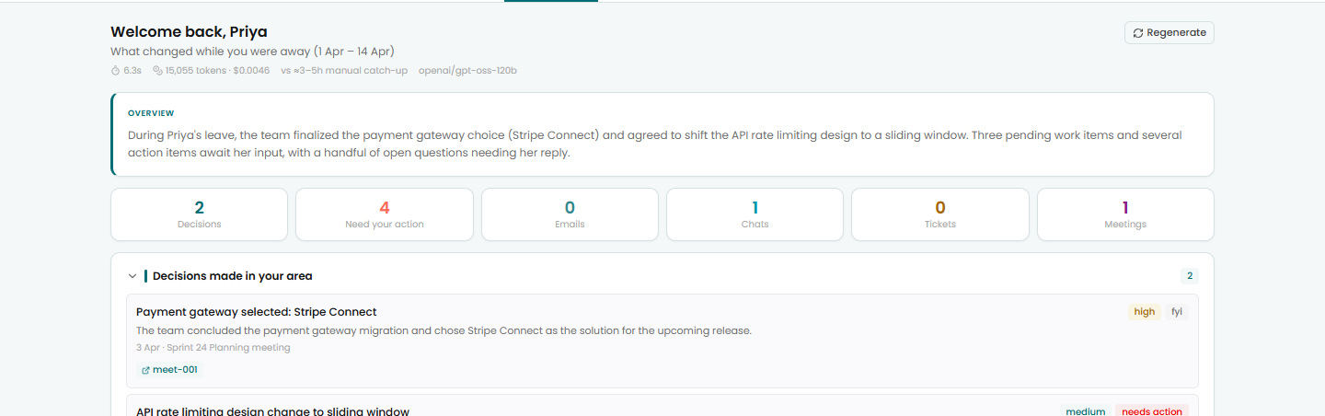
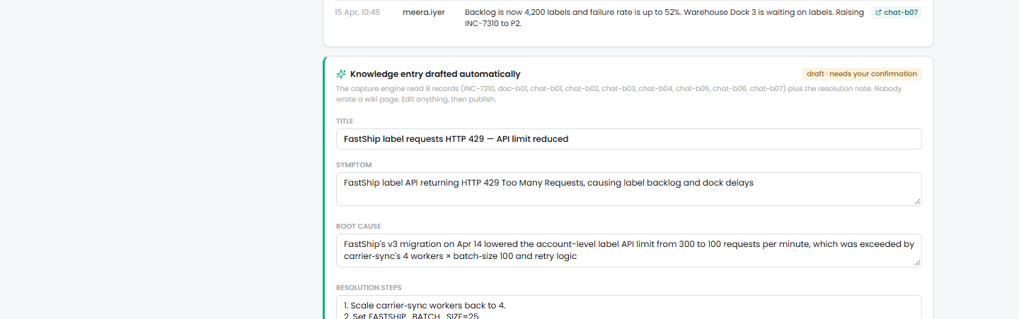
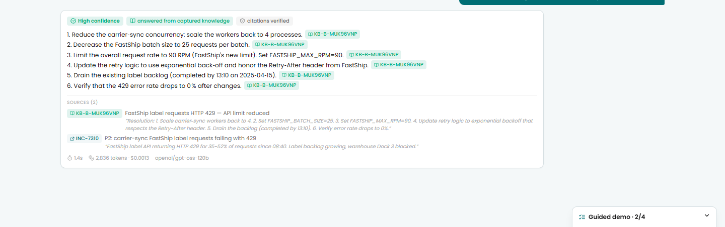
3 · SOLUTION · CLAUDE CODE USAGE · DEMO
COIH: the knowledge layer that builds itself
Answers grounded strictly in the account's own artifacts with a source on every claim — and captures new knowledge automatically from resolved incidents.
HOW IT WORKS
LIVE DEMO · 3 personas, 2 isolated accounts
CLAUDE CODE USAGE
1
Ingest
CLAUDE.md project memory: architecture, demo script, rules (grounded or silent, one feature per commit)
6 custom slash commands (/setup, /add-seed-data, /add-feature, /add-connector, /demo-test, /fix-theme)
Plan mode for the Express+Mongo → Vercel+JSON pivot; 8 design questions answered before code changed
Verified in the running app via browser preview and headless Chrome (CDP) with stubbed and live model calls
40 commits, 35 co-authored with Claude — git log reads as the build log
Read-only adapters normalise mail, chat, tickets, incidents, docs and transcripts into one record shape per account.
2
Retrieve
Agentic BM25 retrieval exposed as tools; the model searches, fetches full text and re-queries. Account-scoped index.
Priya · return-from-leave brief over Apr 1–14, every line linked to its source
3
Answer or refuse
Every sentence cites a record retrieved in that request; the server re-verifies every citation. No evidence → refusal that names the gap and the person to ask.
TECH & FEASIBILITY
React 18 + Vite · Vercel functions · MiniSearch BM25 · gpt-oss-120b via OpenRouter through a provider-neutral loop (Claude/Bedrock = one file) · synthetic data only · mocked connectors documented per source · second account = configuration, not a rebuild
4
Capture
Mark resolved → draft entry (symptom, root cause, steps, prevention, dead ends, contradicted docs) → one-click confirm → searchable immediately.
Meera · resolving INC-7310 auto-drafts a knowledge entry; confirm in one click
5
Compound
Demo: <add Vercel URL>
Code: github.com/AryanKulathinal/COIH_D3
The next person asking gets an answer instead of an escalation. Plain chat vs knowledge layer shown side by side.
Roadmap: guided incident triage · exit capture · OAuth adapters · hybrid retrieval · brief delivered in Teams
Meera · the question refused a minute earlier, now answered from the new entry
COIH — Central Operational Intelligence Hub · UST D3 2026 · Fix It Forward with Claude

