Slide 1
Session on React
An Introductory Session with Hands-On Demos
Presented by: Aryan Sajan Kulathinal

Slide 2
What We Will Learn Today
What is React?
Learning Materials and Resources
Tutorial 1: Build a To-Do List App using React JS

Slide 3
About React
Developed by Facebook (Meta)
A JavaScript library for building user interfaces
Component-based architecture
Enables creation of reusable UI components
Virtual DOM for efficient rendering

Slide 4
About React
JSX: JavaScript + XML syntax
Hooks: useState, useEffect, etc.
Ecosystem includes React Router, Redux, etc.

Slide 5
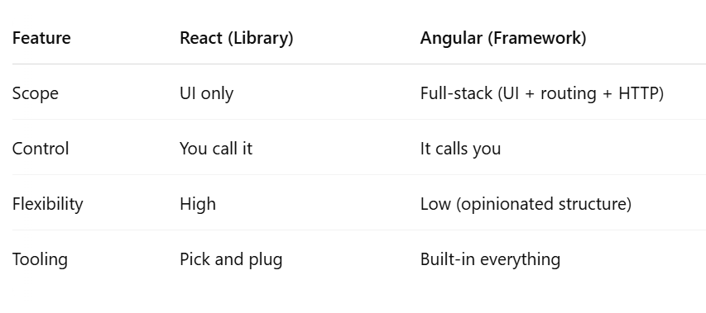
Library vs Framework

Slide 6
Learning Materials
Official Documentation: https://react.dev/learn
Tutorials: React Official Tutorial, freeCodeCamp, Codecademy
Videos: YouTube channels: Programming with Mosh, Academind,
Books: 'Learning React' by O'Reilly

Slide 7
Tutorial 1 - To-Do App (Overview)
We will build a simple To-Do app
Using create-react-app
Written in TypeScript
Features: Add, display, and delete tasks

Slide 8
Tutorial 1 - Step 1: Setup Project
npx create-react-app todo-ts-app --template typescript
cd todo-ts-app
npm start

Slide 9
Tutorial 1 – Folder Structure
src/
├── components/
│ ├── AddTodo.tsx
│ └── TodoItem.tsx
├── types/
│ └── todo.ts
├── App.tsx
├── index.tsx

Slide 10
notes
const [state, setState] = useState(initialValue);

Slide 11
Tutorial 2 - Overview
Tools Used: TypeScript, Tailwind CSS, Vite

Slide 12
TypeScript
Superset of JavaScript
Adds static typing
Better tooling and fewer runtime errors
Great for large-scale React apps

Slide 13
Tailwind CSS
- Utility-first CSS framework
- Rapidly build modern UIs
- Works well with React
- Easy to customize and responsive

Slide 14
Vite
- Next generation frontend tooling
- Extremely fast development server
- Lightning fast HMR (Hot Module Replacement)
- Supports React + TypeScript out of the box

Slide 15
Conclusion
- React is powerful and flexible
- Learn from official docs and tutorials
- Practice by building projects
- Explore modern tools like TypeScript, Tailwind, and Vite

Slide 16
Q&A
- Open floor for questions

Slide 17
Thank You
Happy Coding!

