Slide 1

CHATBOT
Presented By:
Aryan Kumar Rana(2100680130019)
Akshat Kumar Kakran(2100680130010)
Jatin Kumar(2100680130026)
Under the Guidance of:
Mr. Rakesh Sambyal (Assistant Professor)
Department of information Technology
Meerut Institute of Engineering & Technology, Meerut(U.P.)

Slide 2

ChatBot
INDEX
Introduction
Problem Statement
Objectives
Methodology
Flow chart
Hardware & Software
References

Slide 3
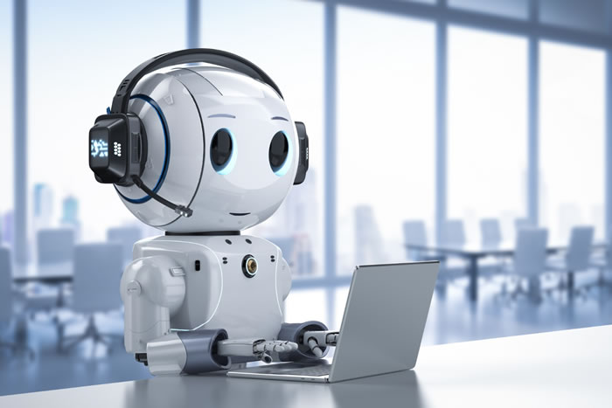
INTRODUCTION
Nowadays, different virtual assistants guide us on websites of banks, financial institutions, hotels, museums, universities, etc. We rely on them not only to get a job done or to find a place on Google Map, but also for searching new pieces of information on the web or for acquiring new knowledge and skills in a particular area.

Slide 4
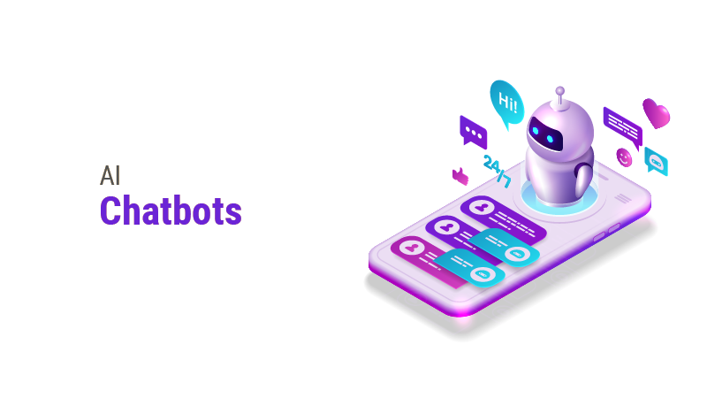
This is especially true for younger generations and economically active people, who are used to computer or phone assistants, like Cortana, Alexa, Siri, etc. for their everyday work and life. All these pose new challenges in front of adult educators, teachers, tutors and training professionals,
who should adapt to this new learning reality. They need to continuously develop their competences

Slide 5
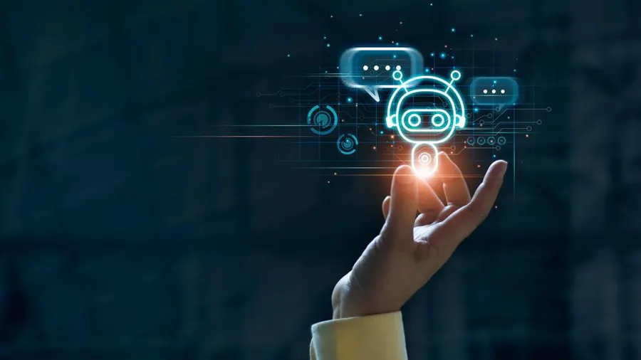
and to incorporate innovative educational practices and tools for creating unique tailor-made learning and for meeting the raised expectations of today’s learners. In 1966, an MIT professor named Joseph Weizenbaum created the first chatbot. He cast it in the role of a psychotherapist. A user would type a message on an electric typewriter connected to a mainframe. After a moment, the “psychotherapist” would reply.

Slide 6

P
R
O
B
L
E
M
Eliminates the added costs to meet global customer demands.
Automates repeat customer support enquiries.
Ends sales activity only taking place during working hours
Reduces abandoned carts.
Gives customers an accessible channel to find answers to their questions.
S
T
A
T
E
M
E
N
T

Slide 7
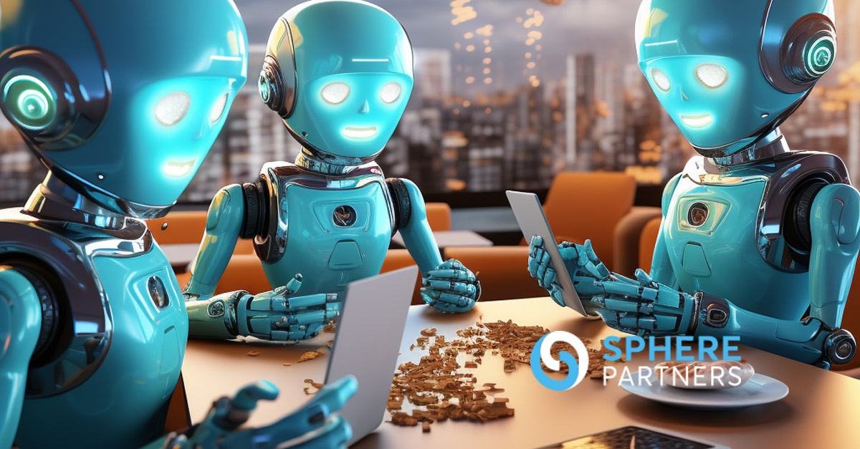
OBJECTIVES
1. Customer Support: Chatbots are frequently used in customer service to provide assistance and answer commonly asked questions.
2. Automation: They are designed to automate tasks and processes that would otherwise require human intervention.
3. Information Retrieval: They can search databases, provide real-time updates, and deliver relevant information based on user queries.
4. Entertainment: These chatbots may offer games, quizzes, or virtual companionship.
5. Data Collection and Analysis

Slide 8
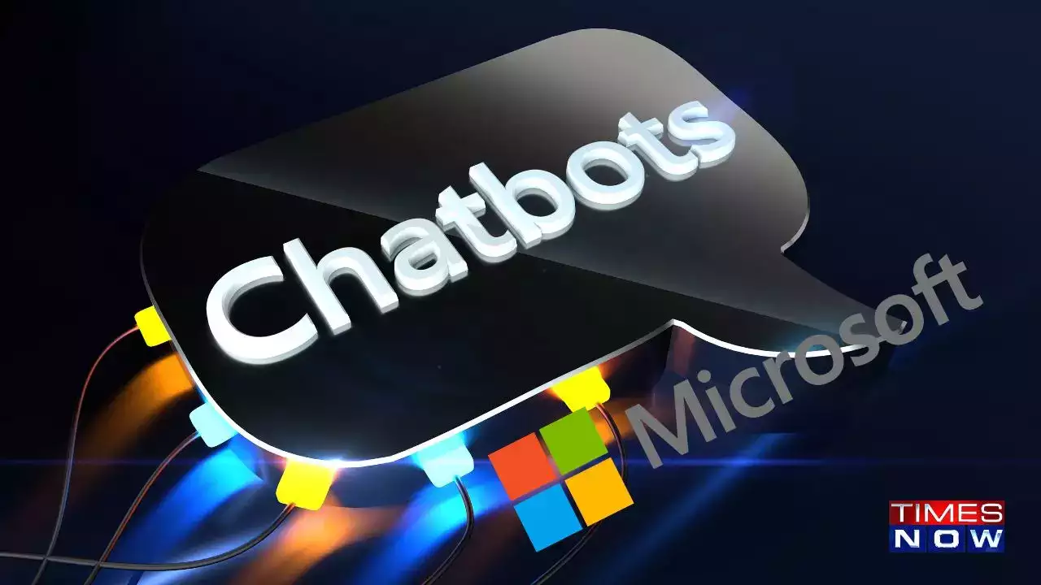
METHODOLOGY
The present Methodology provides an entry-level knowledge about the chatbot technologies and how they could be used in adult education, with a focus on online and blended learning environments. This way, we want to equip educators and training professionals with general theoretical knowledge about the specifics of applying such digital tools in the educational process and how to incorporate them into classrooms.

Slide 9
The Methodology consists of three parts. The first one is dedicated to the basic terms and definitions, purposes and fields of use of chatbot technologies. The second part is focused on chatbot-based learning and how to incorporate chatbot technologies into the educational process and for self-learning. The last part includes links to additional resources and references on the topic.

Slide 10
Although some authors distinguish ‘chatbots’ and ‘bots’, as the first ones are based on text-message interaction with users, while latter might include voice or even video-based communication and inclusion of artificial intelligence, for the purposes of the present Methodology, we will use these two terms as interchangeable.

Slide 11
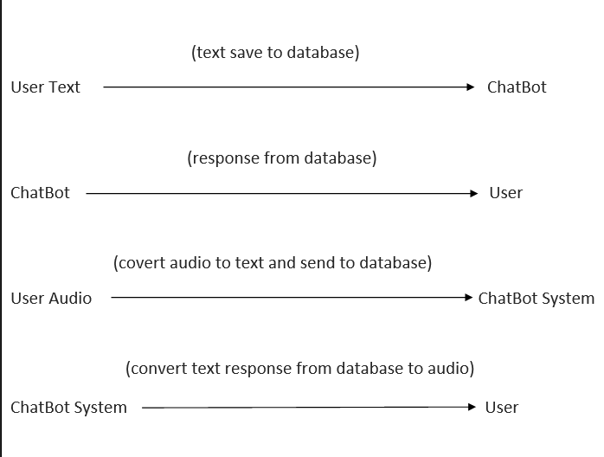
FLOW CHART

Slide 12
PLATFORM SPECIFICATION
HARDWARE SPECIFICATION
SOFTWARE SPECIFICATION
Processor Intel(R)
Core(TM)
RAM 16 GB
Minimum space required 190 MB
Display 15.6 bit color
Operating Environment Win 2000/XP
Platform . Net Framework & IIS Visual Studio 2022
Languages used: HTML/CSS, JavaScript, Php
Databases: MySql

Slide 13


REFERENCES
W3 Schools
GeeksForGeeks
Youtube

