Slide 1

OmniShield
Autonomous, on-prem cyber resilience for
Critical National Infrastructure
Predict. Correlate. Contain — before the breach.
Problem Statement 7 · 100% local LLM · Zero data egress
Notes:
Open confident. Team name + PS7 on screen.

Slide 2
THE PROBLEM
SOCs are reactive. Attackers are not.
1.59M
CERT-In incidents, 2023
2 weeks
AIIMS Delhi ransomware outage
>70%
govt entities on end-of-life IT
weeks
industry mean-time-to-detect
Static rules + signatures are blind to zero-days and low-and-slow APTs. The data is there — the intelligence to act on it isn't.
OmniShield · PS7: AI-Driven Cyber Resilience for Critical National Infrastructure
2

Slide 3
THE GAP
The data was always there. The intelligence layer wasn't.
We rebuilt the SOC to be predictive and agentic — not reactive and rule-bound.
Detect from behaviour → attribute with grounded AI → forecast the next move → contain in one click.
OmniShield · PS7: AI-Driven Cyber Resilience for Critical National Infrastructure
3

Slide 4
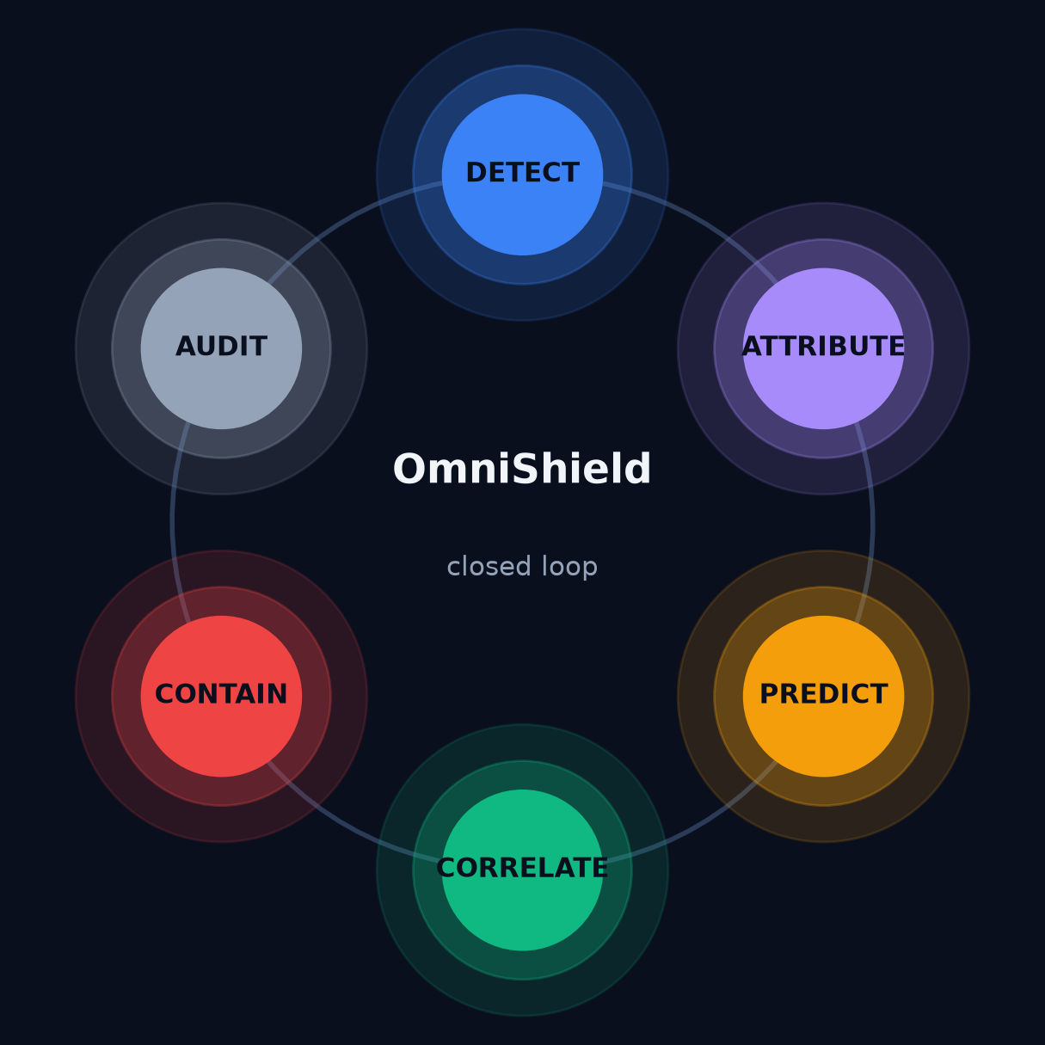
WHAT OMNISHIELD IS
One closed, autonomous loop
Six cooperating agents, one loop:
▸ DETECT — behavioural UEBA
▸ ATTRIBUTE — MITRE ATT&CK RAG
▸ PREDICT — next-move forecast
▸ CORRELATE — group by host
▸ CONTAIN — human-gated SOAR
▸ AUDIT — SQLite log
100% local. Air-gap capable. Nothing leaves the perimeter.
OmniShield · PS7: AI-Driven Cyber Resilience for Critical National Infrastructure
4

Slide 5
DIFFERENTIATOR · MODERN DATA
Not 1998 data. Real modern enterprise traffic.
▸ Live WebSocket stream of CIC-IDS-2017 — authentic 2017 enterprise flows.
▸ Modern threats: Heartbleed · Botnet · DDoS · PortScan · Slowloris · Infiltration.
▸ Dataset-pluggable: NSL-KDD · UNSW-NB15 · CIC-IDS-2017 — switched by one env var.
Most teams benchmark on 1998 KDD. We stream the traffic real SOCs actually face.
OmniShield · PS7: AI-Driven Cyber Resilience for Critical National Infrastructure
5
Notes:
ACCURACY: say 'authentic CIC-IDS-2017' only if the real CSV is loaded (scripts/prepare_cic.py). Otherwise say 'CIC-IDS-2017-format modern flows'.

Slide 6
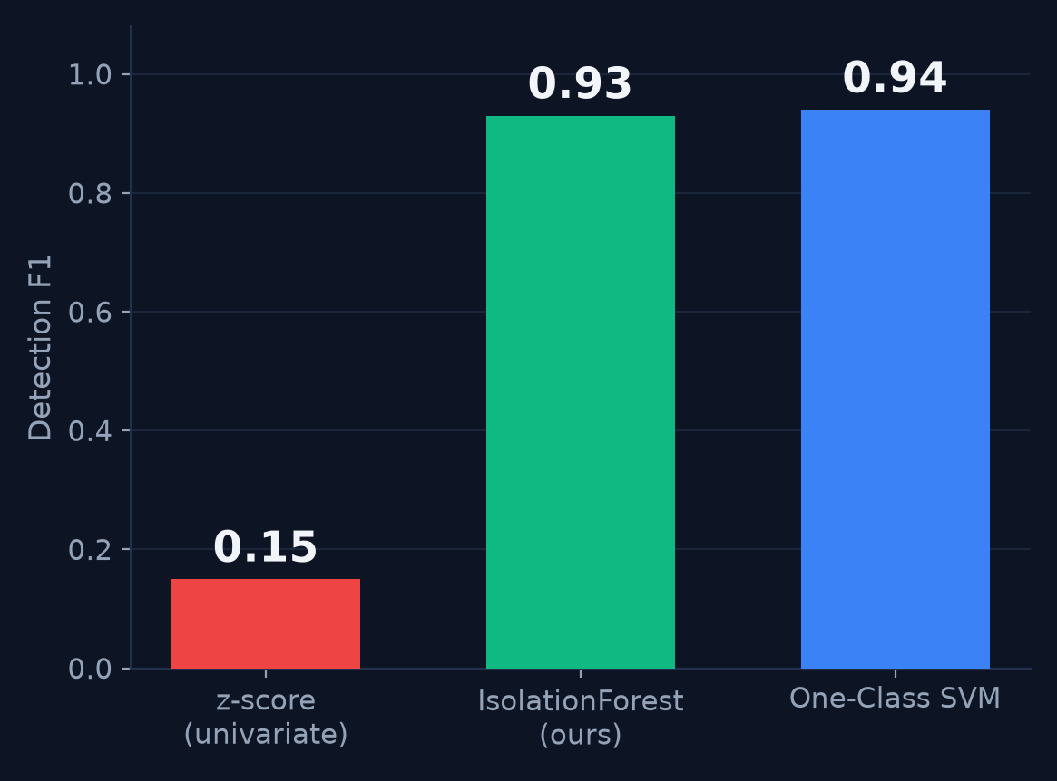
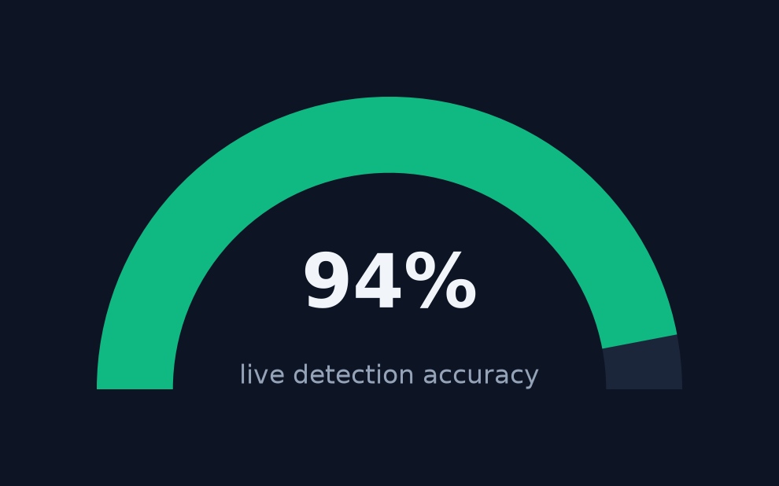
ML ENGINE · BEHAVIOURAL DETECTION (UEBA)
Multivariate IsolationForest — no signatures
▸ One-class IsolationForest trains on baseline normal flows.
▸ Per-entity UEBA: every host scored against ITS OWN normal — not a global threshold.
▸ Catches the low-and-slow scans the univariate baseline can't see.
OmniShield · PS7: AI-Driven Cyber Resilience for Critical National Infrastructure
6
Notes:
F1 0.93 = NSL-KDD one-class benchmark (python -m evaluation.eval_detection). Reproducible.

Slide 7
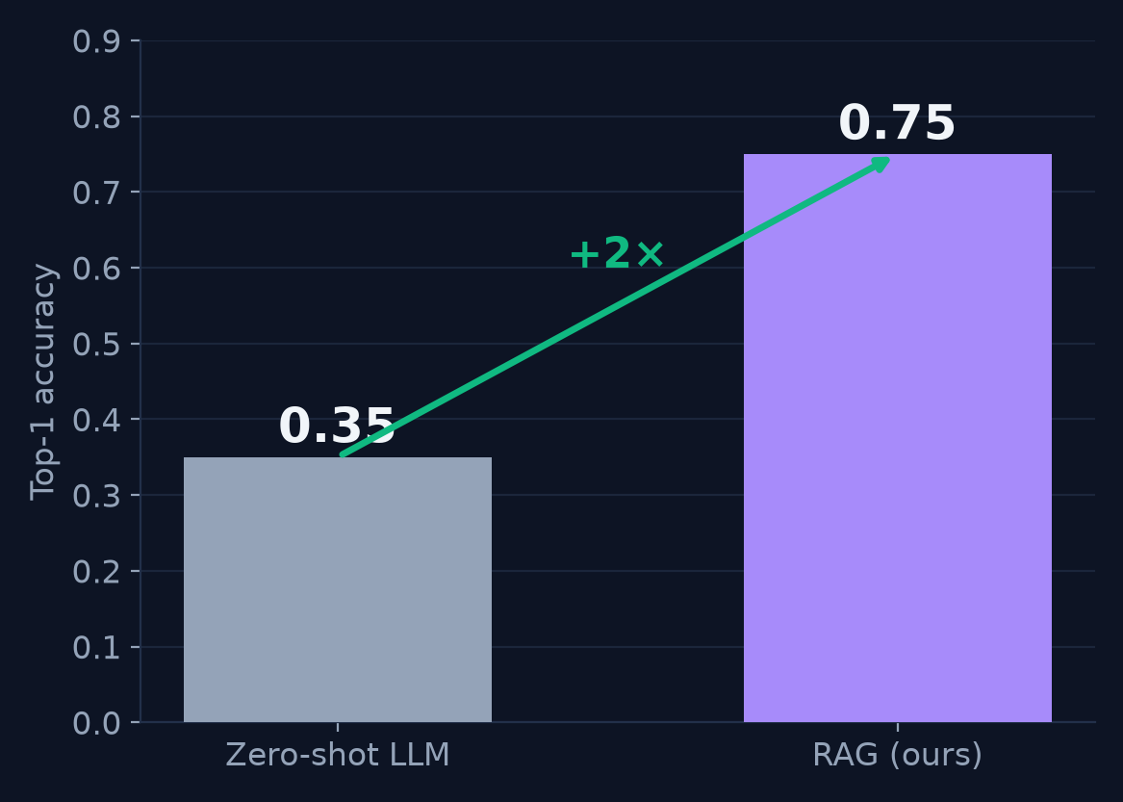
AI ATTRIBUTION · GROUNDED & SOVEREIGN
Local LLM, grounded in MITRE ATT&CK
▸ Local Llama 3.1 (8B) + RAG over 222 MITRE ATT&CK techniques.
▸ Retrieval grounding doubles accuracy — an honest ablation.
▸ ~7s, on-box. No cloud, no API keys — nothing leaves the perimeter.
OmniShield · PS7: AI-Driven Cyber Resilience for Critical National Infrastructure
7

Slide 8
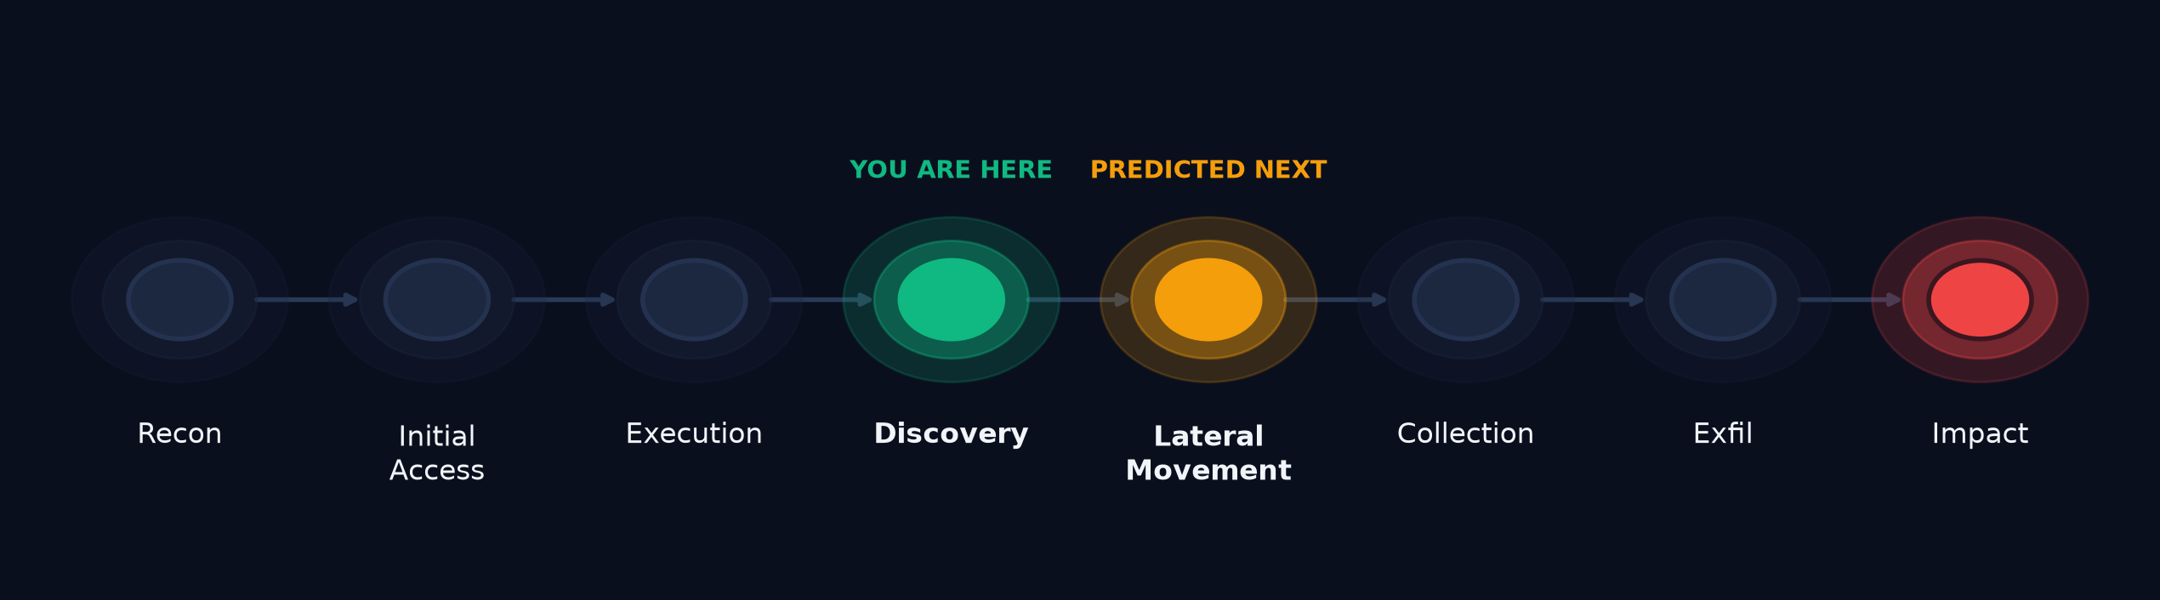
THE INNOVATION · NEXT-MOVE PREDICTOR
We forecast the attacker's next move
A deterministic graph over the ATT&CK kill chain maps behaviour to a tactic — then predicts the next stage, so you pre-stage containment before it happens.
PortScan → Discovery → forecast: Lateral Movement. DDoS → Impact → "terminal — isolate now."
OmniShield · PS7: AI-Driven Cyber Resilience for Critical National Infrastructure
8
Notes:
Your wow moment — slow down. 'We don't just say what's happening; we say what's next.'

Slide 9
ACTIVE INCIDENT CORRELATION
Weak signals → one story. No alert fatigue.
Scattered anomalies are grouped by source host into a single multi-stage incident — 40 red rows become one narrative.
host 192.168.1.66
Discovery → Credential Access → Lateral Movement → Exfiltration ⟶ forecast: IMPACT
OmniShield · PS7: AI-Driven Cyber Resilience for Critical National Infrastructure
9

Slide 10
SAFE AUTONOMY · HUMAN-GATED SOAR
One click. Threat neutralized. Fully audited.
▸ Analyst clicks once → firewall rule injected → source IP isolated → NEUTRALIZED.
▸ The AI never blocks alone: HTTP 428 until a human authorizes (blast-radius gate).
▸ Every action logged to SQLite — reversible and court-auditable.
The AI recommends. A human authorizes. The system acts and audits.
OmniShield · PS7: AI-Driven Cyber Resilience for Critical National Infrastructure
10

Slide 11
ARCHITECTURE & PROOF
Engineered, not hand-waved
▸ FastAPI + WebSocket · React dashboard · Chroma vector store · Ollama local LLM.
▸ Modular agents: Detection · Attribution · Forecast · Response · Audit.
▸ 47 automated tests (pytest). Reproducible benchmarks in evaluation/results/.
▸ Hardened: no hard-coded secrets, CORS allow-list, prompt-injection tested.
OmniShield · PS7: AI-Driven Cyber Resilience for Critical National Infrastructure
11

Slide 12
BUSINESS IMPACT
Weeks → seconds, on your own hardware
MTTD / MTTR
weeks → <60s
on confirmed anomalies
DATA SOVEREIGNTY
zero egress
on-prem, air-gap capable
ADDRESSABLE
govt CNI
EOL-IT estate, no cloud SIEM
IBM: avg breach ~$4.4M; fast containment saves ~$1M+. AIIMS lost 2 weeks. We isolate in under a minute.
OmniShield · PS7: AI-Driven Cyber Resilience for Critical National Infrastructure
12

Slide 13
OmniShield
Detect from behaviour. Predict the next move. Contain in one click. On-prem.
It doesn't just watch the breach — it gets ahead of it. And it runs live.
github.com/<your-repo> · Team <name> · Problem Statement 7
Notes:
End on 'and it runs live — let me show you' → cut to the demo.

