Slide 1

Network Traffic Analyzer
Packet Capture, Protocol Analysis & Threat Detection
Course: Computer Networks
Course Code: __________________
Faculty: Ms. Pragya Vats
Presented by: Aryan Minish Kanjiraparambil
Enrolment No.: 202407020024 | Roll No.: KU2407U024
DNS
CLIENT
WEB SERVER
NTA
ROUTER
SERVER
FIREWALL
Notes:
Introduce the project: a Python tool that captures packets, decodes every protocol layer, summarises traffic and flags suspicious activity. Course: Computer Networks, faculty Ms. Pragya Vats.

Slide 2

DISCUSSION & REVISION
What is packet capture, and why does it need administrator rights?
How does encapsulation let a decoder read one header at a time?
What do the TCP SYN, ACK, RST and FIN flags tell us about a connection?
How can ARP spoofing be used for a man-in-the-middle attack?
Which Computer Networks syllabus unit is most directly related to this project?
Notes:
Revision questions to open the discussion. Answers: capture reads raw frames via a raw socket, which the OS restricts; each header has a field naming the next protocol; SYN opens, ACK acknowledges, RST rejects, FIN closes; forged ARP replies redirect traffic through the attacker; all five units, especially Unit V (security).

Slide 3
Project Overview
What is this project about?
Purpose
Capture or read network packets and turn raw bytes into readable, layer-by-layer information.
Networking link
Decodes Ethernet, ARP, IPv4/IPv6, ICMP, TCP, UDP, DNS, HTTP, TLS, DHCP and NTP headers.
Expected output
Traffic statistics, a Wireshark-style packet list, charts and alerts for suspicious activity.
COMPUTER NETWORKS | MINI PROJECT | NETWORK TRAFFIC ANALYZER
Notes:
The analyzer works like a small, transparent Wireshark: it decodes packets and adds automatic summaries and security alerts.

Slide 4
Introduction to Network Traffic Analysis
Why do networks need monitoring?
Computer network
Devices exchange packets wrapped in Ethernet, IP, TCP/UDP and application headers (encapsulation).
Visibility challenge
Even a small LAN sends thousands of packets per minute; raw bytes are unreadable without a decoder.
Role of an analyzer
Decode the headers, summarise who talks to whom, and flag patterns such as scans, floods and spoofing.
COMPUTER NETWORKS | MINI PROJECT | NETWORK TRAFFIC ANALYZER
Notes:
Traffic analysis is used for troubleshooting, measuring usage and detecting attacks.

Slide 5
Problem Statement
The challenge we want to solve
Problem
Inspecting captures by hand is slow, and full tools such as Wireshark have a steep learning curve.
Need
A lightweight tool that decodes common protocols, summarises traffic and highlights attacks automatically.
Project scope
Reads pcap/pcapng files and captures live on Linux/Windows. It detects and reports; it does not block traffic.
COMPUTER NETWORKS | MINI PROJECT | NETWORK TRAFFIC ANALYZER

Slide 6
Aim and Objectives
Project goals
Aim
Build a Python network traffic analyzer that decodes, summarises and flags suspicious traffic.
Objective 1
Read pcap/pcapng files and capture live packets using raw sockets.
Objective 2
Decode 12 protocols across layers 2–7 and compute traffic statistics and conversations.
Objective 3
Detect 6 attack patterns and present results as reports, charts and a web dashboard.
COMPUTER NETWORKS | MINI PROJECT | NETWORK TRAFFIC ANALYZER

Slide 7
Existing System and Limitations
Current tools for monitoring traffic
Existing tools
Wireshark and tcpdump for manual packet inspection; Snort and Zeek as rule-based intrusion detection systems.
Limitations
Steep learning curve, heavy set-up, internals hidden from learners, and no quick summary of threats.
Balanced view
NTA does not replace these tools – it is a lightweight, transparent first-look tool for labs and learning.
COMPUTER NETWORKS | MINI PROJECT | NETWORK TRAFFIC ANALYZER

Slide 8
Proposed System
Network Traffic Analyzer workflow
Input
A live network interface (raw socket) or a .pcap / .pcapng file from Wireshark or tcpdump.
Decoding
Header-by-header decoding with Python’s struct module, following the RFC formats.
Analysis
Traffic statistics, 5-tuple conversations and six threshold-based detection rules.
Output
Console report, packet list, CSV/JSON, charts, HTML report and a Flask web dashboard.
COMPUTER NETWORKS | MINI PROJECT | NETWORK TRAFFIC ANALYZER

Slide 9
Computer Networks Concepts Used
Connection to the five syllabus units
Unit I
Application layer – DNS, HTTP, TLS (SNI), DHCP and NTP decoding.
Unit II
Transport layer – TCP flags, three-way handshake, ports, UDP datagrams.
Unit III
Network layer – IPv4/IPv6 headers, addressing, TTL and ICMP.
Unit IV
Link layer – Ethernet frames, MAC addresses, ARP and VLAN tags.
Unit V
Network security – port scans, SYN/ICMP floods, ARP spoofing, DNS tunnelling.
COMPUTER NETWORKS | MINI PROJECT | NETWORK TRAFFIC ANALYZER

Slide 10
System Architecture
High-level design
1. Capture
capture.py / pcap.py – raw-socket capture, pcap and pcapng reader/writer.
2. Decode
decoder.py – Ethernet → IP → TCP/UDP → DNS/HTTP/TLS into Packet records.
3. Analyse
stats.py / detector.py – statistics, conversations and six detection rules.
4. Present
report.py / web.py – console, CSV/JSON, charts, HTML report and dashboard.
COMPUTER NETWORKS | MINI PROJECT | NETWORK TRAFFIC ANALYZER

Slide 11
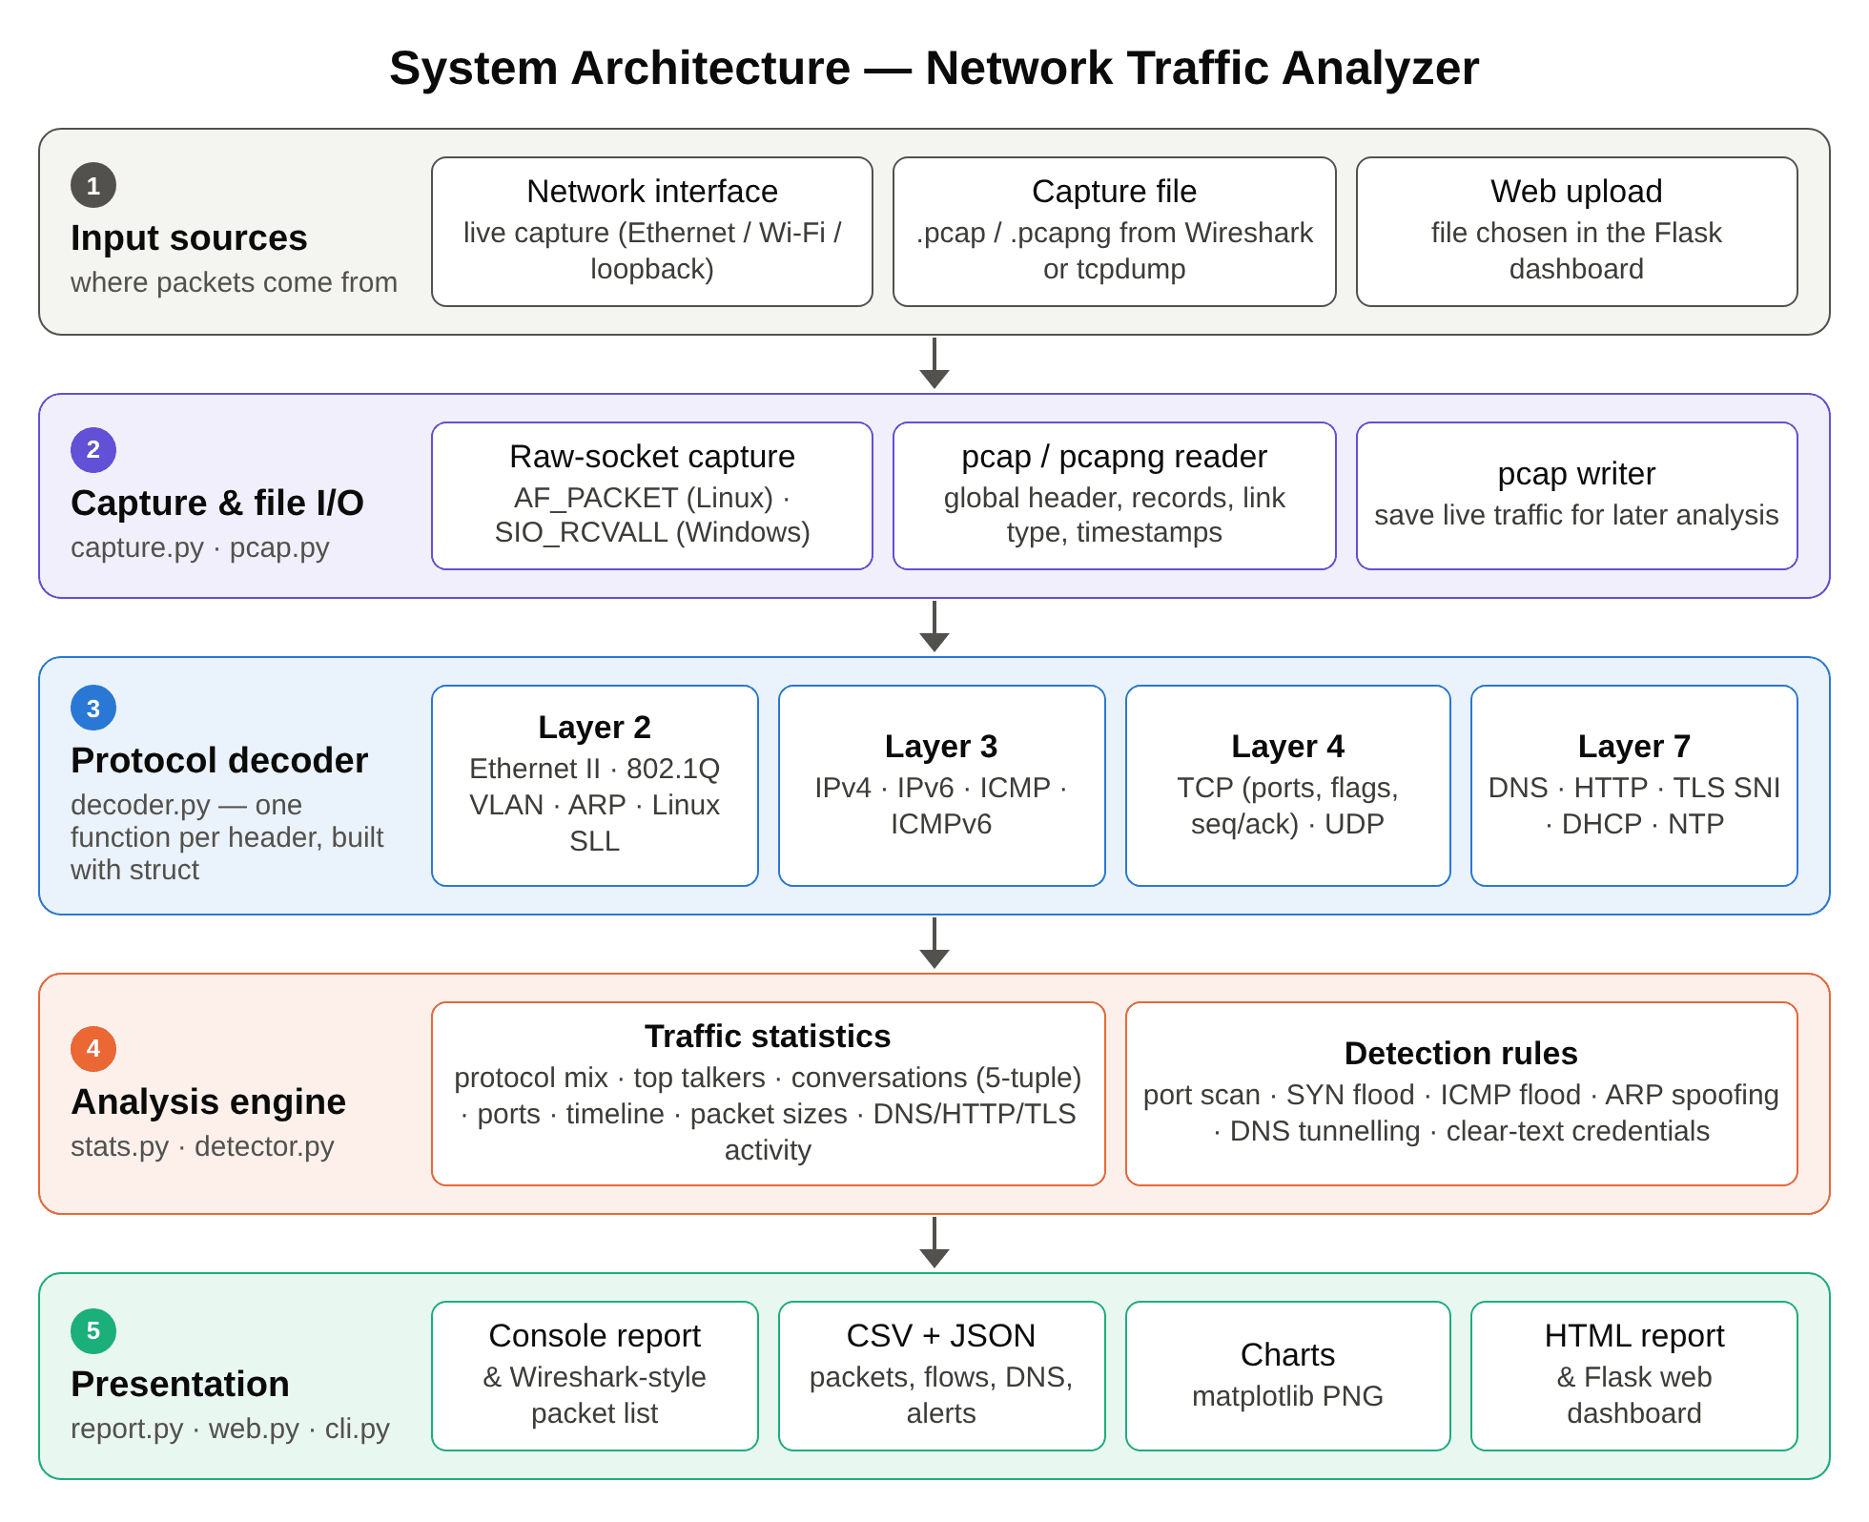
Architecture Diagram
Five-layer pipeline: input → capture → decode → analyse → present
COMPUTER NETWORKS | MINI PROJECT | NETWORK TRAFFIC ANALYZER
Notes:
Each stage is a separate module with one responsibility, which keeps the code easy to test and extend.

Slide 12
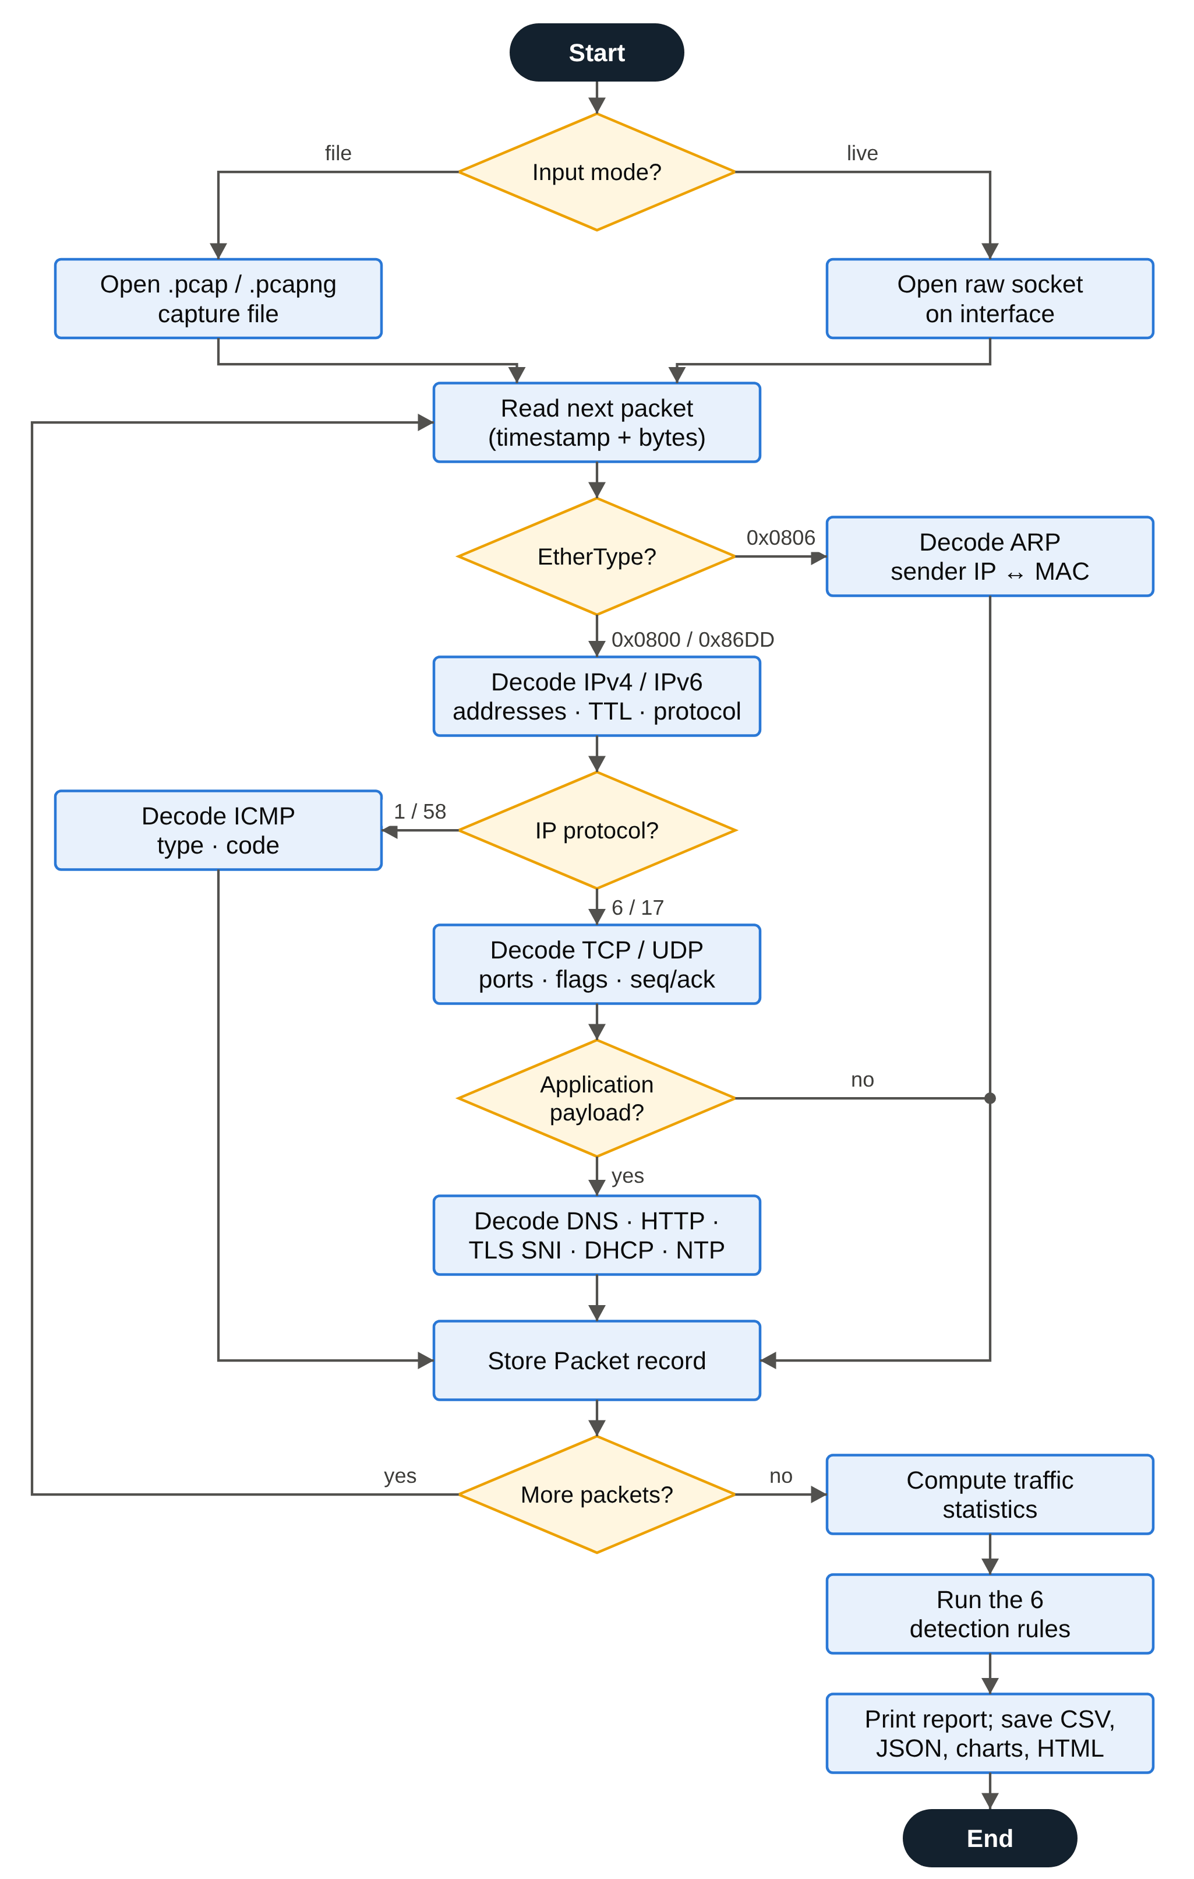
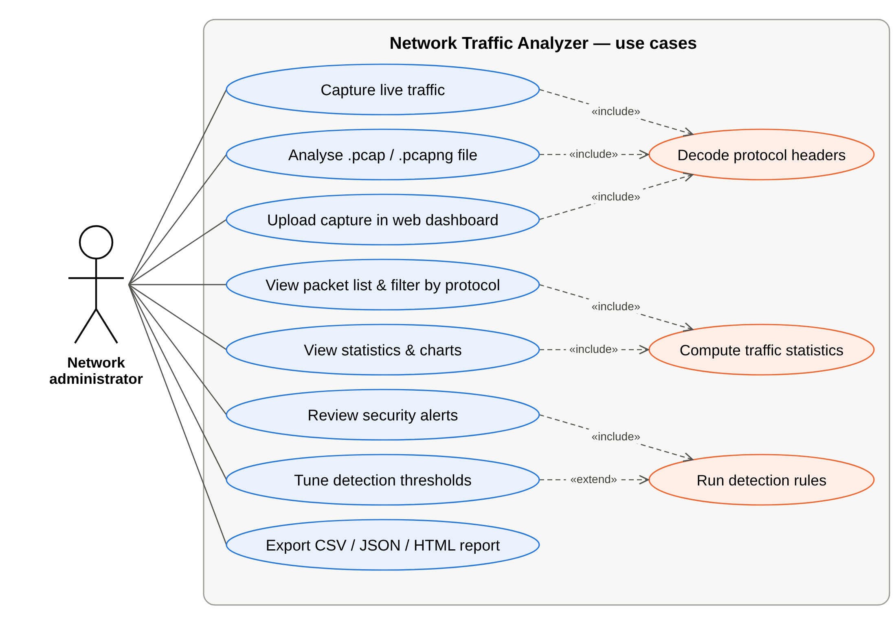
Flowchart and Use Case Diagram
How each packet is processed, and what the user can do
Use case diagram
COMPUTER NETWORKS | MINI PROJECT | NETWORK TRAFFIC ANALYZER
Notes:
Left: the decoder picks the next header from the current one (EtherType, IP protocol, port). Right: the actor's use cases; capture, analyse and upload all include protocol decoding.

Slide 13
Capture Data and Traffic Features
Reproducible, privacy-safe test data
Lab capture
Generated by make_sample_pcap.py: 4,676 packets over 116 s on a small LAN, plus a real live capture.
Fields decoded
MAC/IP addresses, ports, TCP flags, TTL, sizes, DNS names, HTTP hosts and TLS server names.
Ground truth
Six attacks injected at known times, so every alert can be checked exactly.
Privacy
Documentation IP ranges (RFC 5737) are used, and passwords are never stored.
COMPUTER NETWORKS | MINI PROJECT | NETWORK TRAFFIC ANALYZER

Slide 14
Detection Methodology
Explainable, threshold-based rules
Approach
Threshold rules over sliding time windows – the same idea used by Snort and Zeek.
Workflow
Capture → decode → aggregate → apply rules → rank alerts → report.
Example rule
Port scan: one source sends SYNs to ≥ 20 different ports of one host within 60 seconds.
Tuning
Thresholds set from the command line; a Shannon-entropy test spots random DNS names.
COMPUTER NETWORKS | MINI PROJECT | NETWORK TRAFFIC ANALYZER

Slide 15
Tools and Technologies
Suggested implementation stack
Language
Python 3 – the core uses only the standard library (struct, socket, ipaddress).
Libraries
matplotlib (charts), Flask (dashboard) and pytest (tests) – all optional.
Interface
Command line (python -m nta) and a Flask web dashboard in the browser.
Network analysis & code
Wireshark/tcpdump to create and cross-check captures. Code: github.com/AryanMinish/network-traffic-analyzer
COMPUTER NETWORKS | MINI PROJECT | NETWORK TRAFFIC ANALYZER

Slide 16
Implementation and Working
How the analyzer runs
Step 1
Read pcap/pcapng records, or receive frames from a raw socket.
Step 2
Decode Ethernet → IP → TCP/UDP → DNS/HTTP/TLS into a Packet record.
Step 3
Aggregate statistics: protocols, talkers, ports, conversations, timeline.
Step 4
Run the six detection rules and rank the alerts by severity.
Step 5
Print the report; save CSV, JSON, charts and HTML; serve the dashboard.
COMPUTER NETWORKS | MINI PROJECT | NETWORK TRAFFIC ANALYZER

Slide 17
Results and Performance Metrics
Measured on the lab capture
Packets analysed
4,676 packets · 3.3 MB · 115.6 s · 0 malformed packets
Protocols decoded
9 protocols identified · 732 conversations · 40 DNS names
Attacks detected
6 of 6 simulated attacks detected · 0 false alarms
Speed
≈ 0.11 s for the whole capture (≈ 39,000 packets per second)
Testing
30 of 30 automated unit tests passed
COMPUTER NETWORKS | MINI PROJECT | NETWORK TRAFFIC ANALYZER
Notes:
All numbers come from running python -m nta analyze samples/lab_traffic.pcap.

Slide 18
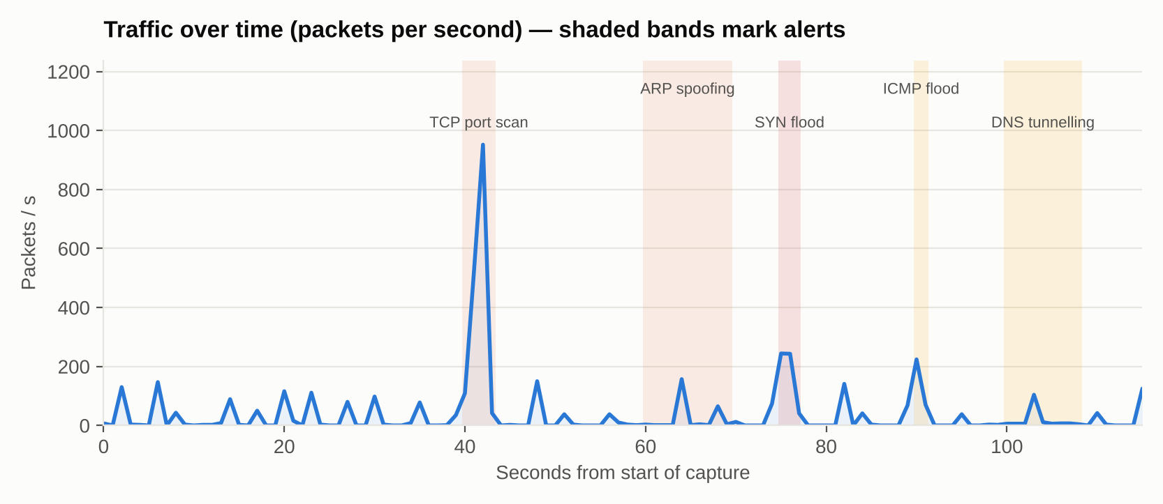
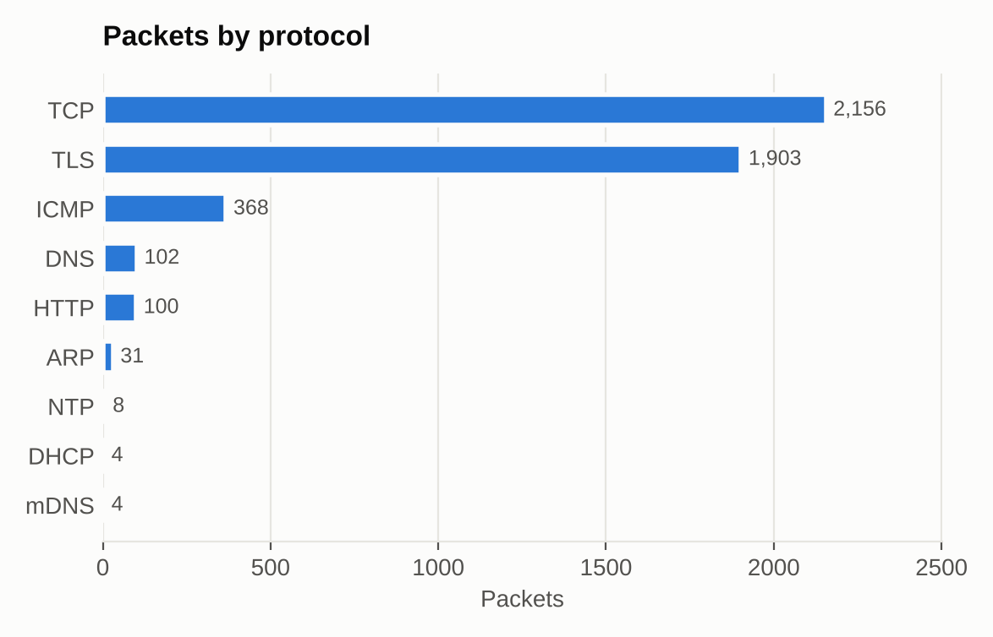
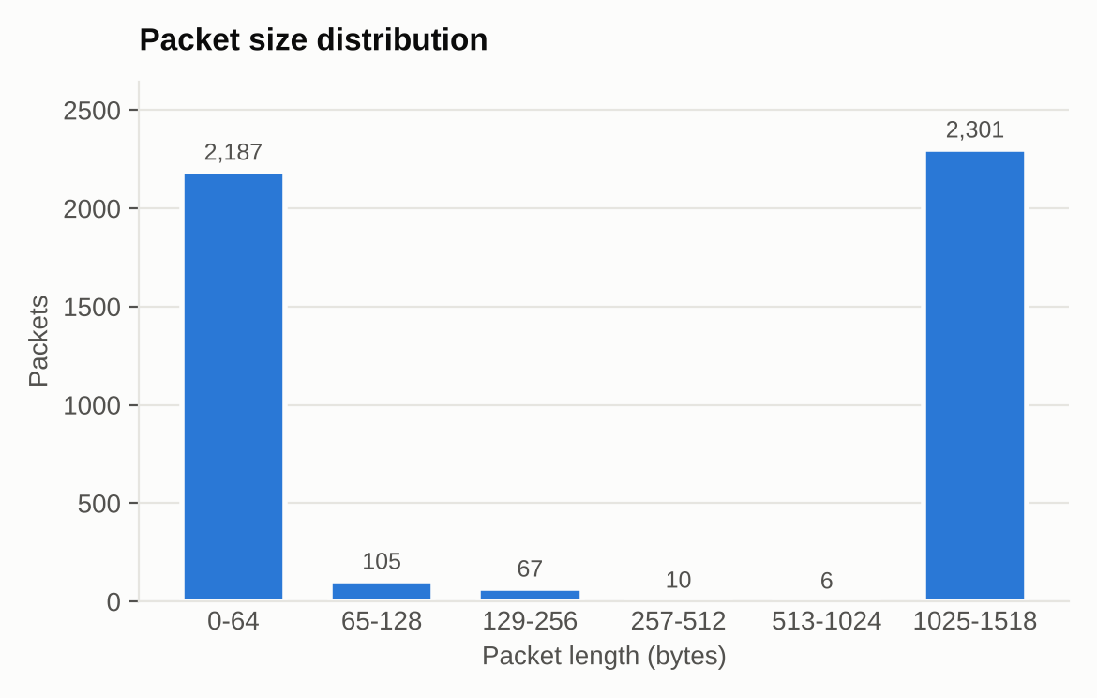
Results: Traffic Overview
Charts generated by the analyzer
4,676
packets in 115.6 s
952
packets/s peak (port scan)
2.7 MB
carried by TLS (HTTPS)
COMPUTER NETWORKS | MINI PROJECT | NETWORK TRAFFIC ANALYZER
Notes:
The timeline spikes match the injected attacks; the packet-size histogram is bimodal (small ACK/SYN packets and full-size data segments), typical of TCP bulk transfer.

Slide 19
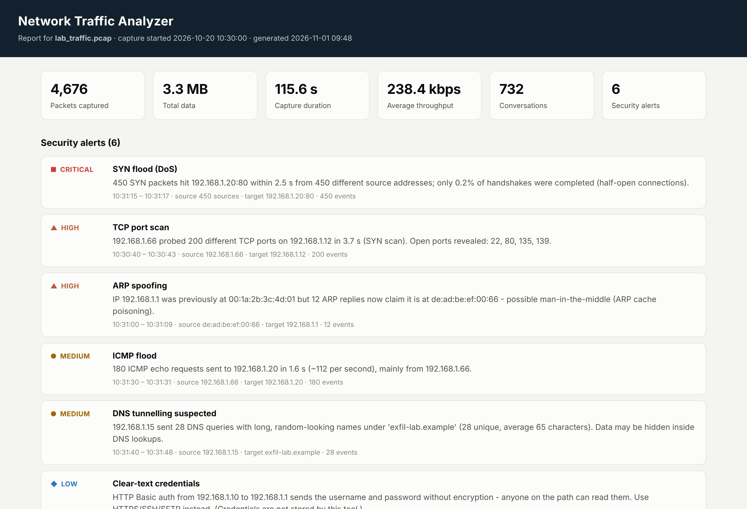
Results: Security Alerts
All six simulated attacks detected, ranked by severity
CRITICAL
SYN flood
450 SYNs in 2.5 s from 450 spoofed sources
HIGH
TCP port scan
200 ports in 3.7 s; open: 22, 80, 135, 139
HIGH
ARP spoofing
Gateway IP claimed by de:ad:be:ef:00:66
MEDIUM
ICMP flood
180 echo requests in 1.6 s (≈ 112/s)
MEDIUM
DNS tunnelling
28 long random names, avg 65 chars
LOW
Clear-text login
HTTP Basic auth to the router admin page
COMPUTER NETWORKS | MINI PROJECT | NETWORK TRAFFIC ANALYZER
Notes:
Each alert explains the evidence, e.g. which ports the scan found open and how few SYN-flood handshakes were completed. No false alarms were raised on the normal traffic.

Slide 20
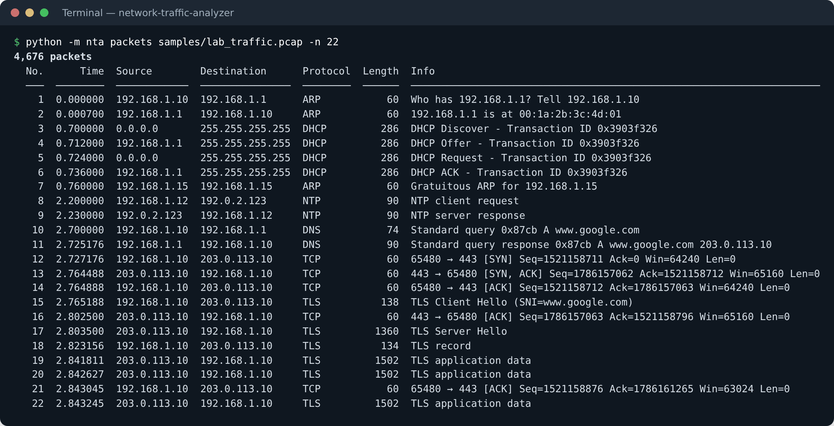
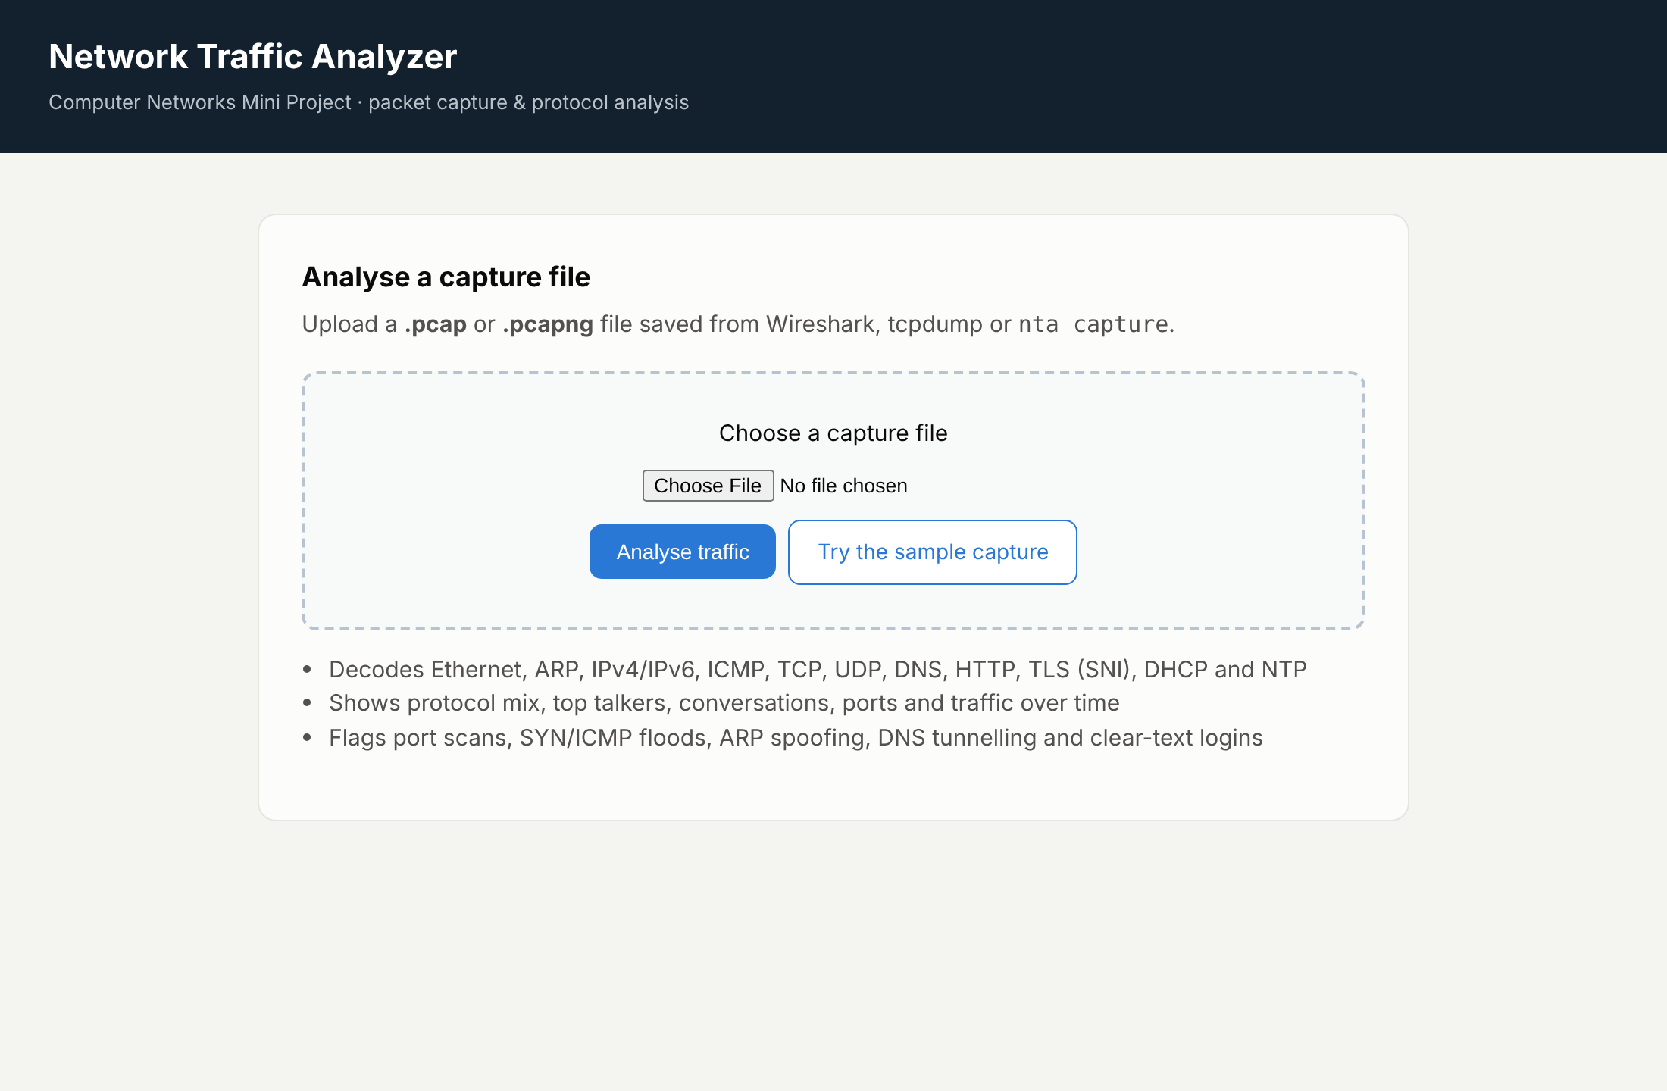
Output Screenshots
Packet list and web dashboard
Wireshark-style packet list: ARP, DHCP, DNS, TCP handshake, TLS SNI
Flask web dashboard – upload a capture and get the report
Live capture verified on a real interface: real HTTP requests and the TLS server name github.com were decoded correctly.
COMPUTER NETWORKS | MINI PROJECT | NETWORK TRAFFIC ANALYZER

Slide 21
Advantages, Limitations and Applications
What the project can and cannot do
Advantages
No-dependency core, transparent RFC-based decoding, fast analysis and explainable alerts.
Limitations
Cannot read encrypted payloads; rule thresholds need tuning; Python limits capture at very high speeds.
Applications
Networking labs, troubleshooting, teaching protocols and basic home/office security monitoring.
Ethics
Capture only on networks you own or are authorised to monitor; passwords are never stored.
COMPUTER NETWORKS | MINI PROJECT | NETWORK TRAFFIC ANALYZER

Slide 22
Conclusion and Future Scope
Summary and improvements
Conclusion
All objectives met: 12 protocols decoded, 6/6 attacks detected, live capture verified, 30 tests passing.
Future scope 1
TCP stream reassembly with round-trip time and retransmission analysis.
Future scope 2
Real-time web dashboard and machine-learning anomaly detection alongside the rules.
Future scope 3
libpcap/BPF for faster capture; alerts to e-mail or a SIEM; GeoIP for external hosts.
COMPUTER NETWORKS | MINI PROJECT | NETWORK TRAFFIC ANALYZER

Slide 23
References
Main sources used in the project
Textbook
J. F. Kurose and K. W. Ross, Computer Networking: A Top-Down Approach, 8th ed., Pearson.
Standards (IETF RFCs)
RFC 791 (IPv4), 9293 (TCP), 768 (UDP), 826 (ARP), 1035 (DNS), 2131 (DHCP), 8446 (TLS).
Tools
Wireshark User’s Guide; tcpdump/libpcap and pcapng format documentation; Snort and Zeek docs.
Python
Python documentation (struct, socket, ipaddress); matplotlib and Flask documentation.
COMPUTER NETWORKS | MINI PROJECT | NETWORK TRAFFIC ANALYZER

Slide 24
THANK YOU
Questions?
Aryan Minish Kanjiraparambil · 202407020024 · KU2407U024
Source code: github.com/AryanMinish/network-traffic-analyzer

