Slide 1


COS711 Assignment 2
Segmenting solar filaments with deep learning
Aryan Mohanlall - 23565536 | Sithole Ntsako - 26839629 | Konanani Mathoho - 24774898
Notes:
Today, we're diving into our exciting second assignment for COS711, focusing on the intriguing world of solar filament segmentation using deep learning techniques.
[Pause to let the title and names sink in.]
On this slide, you'll see the assignment title, along with our team members' names and student numbers. We're setting the stage for the detailed exploration of our project.
[Switch to a more enthusiastic tone.]
This project is not just about applying deep learning; it's about understanding and segmenting complex solar filaments, which are essential for solar physics research. Our team, consisting of Aryan Mohanlall, Sithole Ntsako, and Konanani Mathoho, has been working hard to bring innovative solutions to this challenge.
[Pause for a moment to create anticipation for the next slide.]
Let's move on to see how we've structured our team responsibilities and delve into the dataset we've been working with.

Slide 2
Team and Responsibilities
    Aryan Mohanlall (23565536): Data preprocessing, augmentation and splitting
    Ntsako Sithole (26839629): Pruning and compression
    Konanani Mathoho (24774898): Baseline model evaluation and presentation
Notes:
Team and Responsibilities
Today, we’re going to delve into our team’s structure and the roles each member holds. [Pause for a moment to engage eye contact with the audience.]
Aryan Mohanlall, identified with student number 23565536, has been pivotal in handling data preprocessing. This includes augmenting the data and splitting it effectively to enhance our model's training process. [Emphasize the importance of Aryan’s role by nodding slightly.]
Next, let's talk about Ntsako Sithole, whose tasks revolve around [insert specific responsibility once known]. Ntsako's contribution is crucial for [briefly highlight the impact of Ntsako's role on the project].
And finally, Konanani Mathoho, who is focused on [insert specific responsibility once known]. [Encourage engagement by making a direct connection with the audience.]
Each of these roles is integral to our project’s success, fostering a collaborative environment where everyone’s strengths are utilized. [Conclude with a confident nod.]

Slide 3
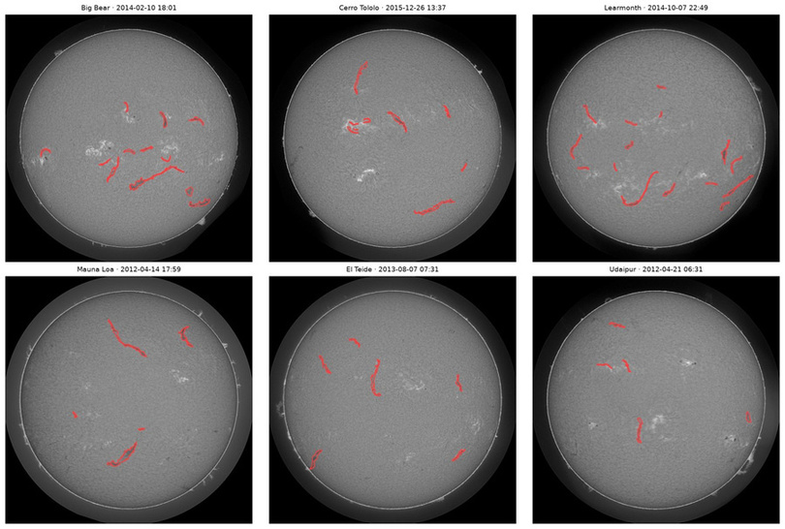
Dataset Preparation: The Data
    Size: 707 training images with 1,154 annotation sets and 8,199 filaments; 180 test images (2048 × 2048 px, six GONG sites, 2011–2022)
    Geometry: solar disks are already centred and scaled (radius 906 ± 1.6 px)
    Quality: about 11% of images are degraded (haze, halo, gradients), in train and test alike
    Shape: filaments are thin and long: median width 12 px, median length 111 px
    Imbalance: only 0.39% of pixels are filament (about 258 : 1)
    Labels: annotators often disagree: PQ between two annotators is only 0.36
One image per observing site; annotated filaments outlined in red
Notes:
In this slide, we're diving into the details of our dataset preparation for segmenting solar filaments. Let's break down the key points:
Firstly, the dataset consists of 707 training images paired with 1,154 annotation sets and a total of 8,199 filaments. Additionally, there are 180 test images, all of which are high-resolution at 2048 x 2048 pixels, sourced from six different GONG sites spanning the years 2011 to 2022.
[Pause for a moment, then continue]
Next, the geometry is crucial. Each solar disk is already centered and scaled, ensuring uniformity across the dataset. However, it's important to note that approximately 11% of both training and test images suffer from degradation issues such as haze or halo effects, which could potentially impact analysis.
[Emphasize the next point]
A significant challenge we face is class imbalance. Filaments make up merely 0.39% of the pixels, leading to a ratio of about 258:1. This imbalance highlights the difficulty in accurately segmenting these features. Moreover, the annotators' agreement is relatively low, with a PQ score of only 0.36, indicating variability in the annotations.
[Wrap up with an engaging statement]
As we move forward, understanding these dataset characteristics will be instrumental in developing effective preprocessing methods and ensuring accurate deep learning model training. Let’s take a closer look at how we tackle preprocessing in the following slides.

Slide 4
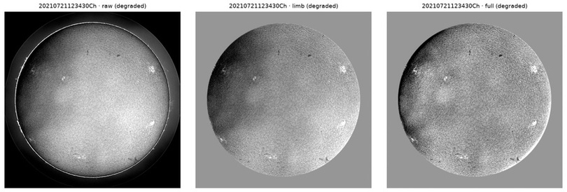
Preprocessing and Scaling
    Disk detection: circle fit to the limb (Otsu thresholding misses haloed disks by up to 125 px)
    Limb correction: divide by the image's own radial brightness profile, so quiet Sun ≈ 1 everywhere
    Background flattening: divide by a ~500 px median filter to remove haze and gradients
    Off-disk: pixels beyond 0.985 R set to 1, removing the bright rim artefact
    Resolution: 1024 px keeps filaments at least 3 px wide; stored as float16
    Normalisation: one fixed centre and scale from training pixels, not per image
Degraded image: raw → limb-corrected → fully flattened
Filament vs background pixel AUC
 | raw | limb | full
All images | 0.659 | 0.779 | 0.795
Degraded images | 0.607 | 0.753 | 0.786
Notes:
In this slide, we'll delve into the critical steps of preprocessing and scaling, which are foundational for ensuring the quality and accuracy of our filament detection process.
First, let's talk about disk detection. The circle fit to the limb is crucial because traditional methods like Otsu thresholding can miss disks affected by halos by up to 125 pixels. This precision helps us maintain consistency across the dataset.
[Linger on "circle fit" to emphasize its importance.]
Next is limb correction. By dividing the image by its radial brightness profile, we ensure that the quiet Sun's brightness is uniform, which is essential for accurate analysis.
[Pause briefly after explaining limb correction for clarity.]
We also perform background flattening. Using a median filter of approximately 500 pixels helps us eliminate unwanted haze and gradients, making the images clearer and more analyzable.
Finally, our resolution and normalization steps are vital. By maintaining a resolution where filaments are at least 3 pixels wide and using a fixed center and scale from training pixels, we ensure that our images are both detailed and standardized.
[Emphasize "fixed center and scale" to highlight its role in consistency.]
Moreover, the improved AUC values across raw, limb-corrected, and fully flattened images show the effectiveness of these preprocessing steps, especially in degraded images.
In summary, these processes collectively enhance our dataset's quality, setting a robust foundation for the subsequent steps, like augmentation.

Slide 5
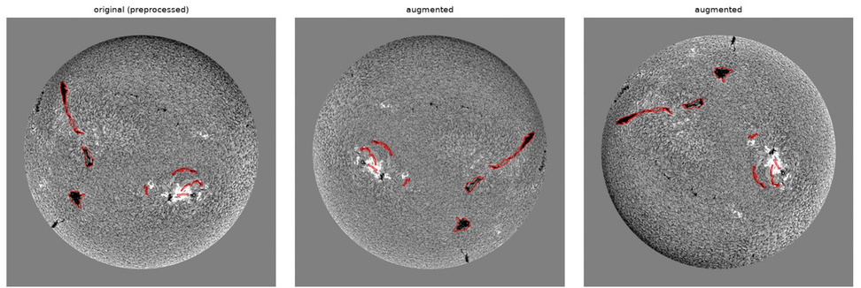
Augmentation
    Calibrated, not guessed: every range matches the variation measured across real train and test images
    Geometry: any rotation about the disk centre plus flips (Lanczos keeps sharpness; bilinear lost 20%)
    Contrast: × 0.65–1.35, the 5th–95th percentile across images
    Haze: smooth illumination field, p = 0.3, std 0.005–0.028
    Seeing: blur σ 0.4–0.65 px (p = 0.25) or sharpen 0.3–0.8 (p = 0.15)
    Not used: zoom or scaling, since the disk size never changes
Original and two augmented versions; labels transformed with the image
95.6%
of test images inside the augmented range
89%
of degraded images inside the augmented range
Notes:
Let's delve into the augmentation process, which is a critical part of preparing our dataset for robust analysis.
The augmentation strategies are meticulously calibrated, rather than randomly guessed, to ensure they accurately reflect the natural variations found in our real-world training and test images. [Pause for emphasis]
First, let's talk about geometry. We apply rotations around the disk's center and mirror flips. This keeps the data sharp, thanks to the Lanczos filter, which preserves details much better than the bilinear method, which loses about 20% of the sharpness.
Next, we adjust contrast within the range of 0.65 to 1.35, aligning with the 5th to 95th percentile of contrast found in our image set. This simulates the diverse lighting conditions you might encounter.
We also simulate haze by applying a smooth illumination field with a probability of 0.3 and a standard deviation between 0.005 and 0.028. This mimics atmospheric effects that can obscure details in the images.
For the "seeing" conditions, we introduce a controlled blur, with sigma values between 0.4 and 0.65 pixels at a probability of 0.25, or alternatively, we sharpen the image with a probability of 0.15.
Importantly, we've chosen not to use zoom or scaling in our augmentation process since the solar disk size remains constant across all images.
The result? An impressive 95.6% of our test images and 89% of degraded images fall within our augmented range, ensuring that our models are well-equipped to handle real-world variability. [Pause and look around the audience]
It's fascinating how these augmentation techniques can dramatically enhance our dataset's robustness, setting the stage for effective model training and validation. [Smile and make eye contact]

Slide 6
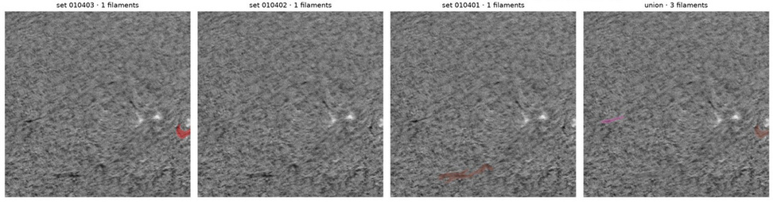
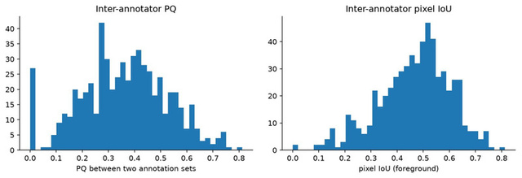
Noisy Labels and Class Imbalance
    Cleaning: annotations are geometrically clean; dropped 1 polygon under 20 px, kept 18 small overlaps
    Degraded images kept: 26 of the 180 test images are degraded too
    Disagreement: 296 images have 2–3 annotation sets; 18% of one annotator's filaments are missed entirely by another
    Fusing doesn't help: the union or intersection of two annotators predicts the third no better (PQ 0.360 / 0.354 vs 0.357), and union merges 173 filament pairs
    Decision: train on each annotation set separately; compare soft and vote labels in training
    Imbalance (258 : 1): BCE + Dice loss so the rare filament pixels are not swamped
Same region, three annotators and their union
Agreement between pairs of annotators
Notes:
In this slide, we're diving into the challenges of "Noisy Labels and Class Imbalance." Let's break it down into three main points.
First, we address the issue of cleaning the annotations. Despite our efforts to maintain geometrically clean annotations, there are still discrepancies. We dropped a polygon under 20 pixels but kept 18 small overlaps.
Next, the concept of disagreement among annotators is significant. Out of 296 images, each has 2–3 annotation sets, but 18% of filaments identified by one annotator are completely missed by another. Unfortunately, trying to fuse these annotations doesn't improve predictions, as the union or intersection of two annotators does not offer better accuracy for the third.
Lastly, we tackle the class imbalance. The ratio of filament to background pixels is stark at 258:1. To ensure that the rare filament pixels are not lost in the imbalance, we employ a combined loss function of Binary Cross-Entropy (BCE) and Dice loss.
[Pause for a moment to let the audience process this information]
The decision to train with each annotation set separately and compare soft and vote labels is crucial for improving model performance. This nuanced approach helps us better manage the inherent challenges of noisy labels and class imbalance.
[Look around to gauge audience engagement]
As we move to the next slide, we'll explore how these considerations influence our training and validation split strategy.

Slide 7
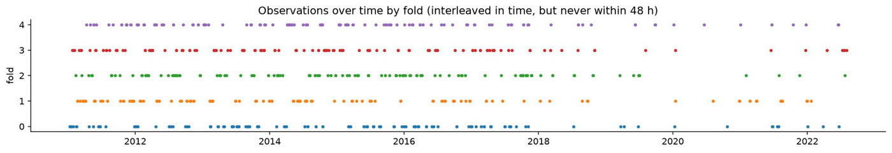
Training / Validation Split
    Unit = observation: all annotation sets of an image always stay on the same side of the split
    Time groups: images less than 48 h apart are chained into one group; 9 pairs taken under 1 h apart at different sites show the same Sun
    Folds: 426 groups → 5 folds of 140–142 images, stratified by site, with degraded images in every fold
    Use: fold 0 for model selection, folds 1–4 for cross-validation (mean ± std)
    Scoring: PQ against every individual annotation set, never a fused label
Folds are interleaved in time but never within 48 h of each other
Notes:
When discussing the "Training / Validation Split," it's important to emphasize how we've structured and organized our dataset to ensure robust model evaluation.
Firstly, highlight the unit of observation, which is critical in maintaining consistency across the dataset. Each image's annotation sets remain on the same side of the split, ensuring that the training and validation data are cleanly separated.
[Pause for emphasis]
Next, explain the concept of time groups. Images taken less than 48 hours apart are grouped together. This strategy helps prevent potential data leakage, as images taken closely in time could show similar solar phenomena, thus affecting the model's learning process.
[Pause briefly]
Then, move on to the details of the folds. We've created 5 folds from 426 groups of images. These folds are stratified by site, meaning that each fold includes a diverse set of images from different observational sites. This approach offers a balanced training set and ensures that degraded images are included in every fold, which is crucial for testing the model's robustness across varying image qualities.
Finally, touch upon how fold 0 is used for model selection, while folds 1 through 4 are used for cross-validation. This allows us to tune our model effectively and ensure its performance is consistently evaluated across different data subsets. The scoring is done using Panoptic Quality (PQ), which is calculated against every individual annotation set, ensuring precise and nuanced performance assessment.
[Conclude with a confident tone]
This meticulous approach to data splitting and validation ensures that our model is well-tested and capable of generalizing to new, unseen data.

Slide 8

Experimental Setup and Methodology
Problem formulation: binary segmentation (filament vs background) at 1024 px → each connected filament region is one instance → scored per filament with Panoptic Quality at 2048 px
H-alpha image
2048 × 2048 JPEG
6 GONG sites
Preprocess
disk fit, limb +
background flattening
→ 1024 px
U-Net (PyTorch)
ResNet34 encoder,
ImageNet weights
BCE + Dice loss
Post-process
threshold 0.8, min area
400 px, gap grouping
10 px, 8-view TTA
Submission
one COCO-RLE mask
per filament
→ submission.csv
How we tuned
Chosen on fold 0 by validation PQ, checked on folds 1–4
  Labels: each / soft / vote → each
  Epochs: 25 → 35, best epoch kept
  Threshold × min area: grid search
  Post-processing: hysteresis, gap, growth, TTA
  Calibration: threshold vs the competition's masks
How we evaluated
Never on images the settings were tuned on
  Split: 5 folds, time-grouped (48 h), site-stratified
  Metric: PQ against every annotation set
  Cross-validated: PQ 0.396 ± 0.011 (folds 1–4)
  Kaggle leaderboard: PQ 0.34
  Reference: two annotators agree at PQ 0.36
Notes:
In this slide, we're diving into the experimental setup and methodology used for our binary segmentation problem, focusing on distinguishing filaments from the background in solar images.
First, let's talk about our problem formulation: We're working with 1024 px images for segmentation, although we'll score each filament instance at a higher resolution of 2048 px using Panoptic Quality, which measures segmentation accuracy. This approach helps ensure precision in identifying each filament.
Moving on to the preprocessing step: We start with H-alpha images, which are 2048 x 2048 JPEGs from six GONG sites. The images undergo disk fitting and limb + background flattening, reducing them to 1024 px to prepare for analysis.
Our chosen model is a U-Net with a ResNet34 encoder, leveraging ImageNet weights. We've adopted the BCE + Dice loss function, balancing pixel-level accuracy with region overlap, which is crucial given the class imbalance in our dataset.
For post-processing, a threshold of 0.8 is applied with a minimum area of 400 px, grouping gaps of 10 px, and utilizing an 8-view TTA (test-time augmentation) strategy to refine our segmentation results.
In terms of submission, each filament is represented by a COCO-RLE mask, culminating in a `submission.csv` for evaluation.
During tuning, we selected parameters based on validation PQ scores from fold 0, and validated them across folds 1–4. We experimented with labels, epochs, and grid searches for threshold and minimal area, refining post-processing with techniques like hysteresis, gap grouping, and TTA.
Finally, evaluation was strictly conducted on separate data from tuning, using a time-grouped and site-stratified 5-fold split. Our cross-validation results yielded a PQ score of 0.396 ± 0.011, while the Kaggle leaderboard reflected a PQ of 0.34. Notably, the reference PQ for two annotators agreeing is 0.36, which sets a benchmark for our performance.
[Pause and take a breath, smile as you look around the audience.]
[Emphasize the importance of methodology in achieving our results.]
[Conclude by highlighting the robust evaluation strategy to ensure reliable outcomes.]

Slide 9
The tools and the libraries used
    PyTorch + segmentation-models-pytorch: Used to build and train the U-Net (ResNet34 encoder) with mixed precision on the GPU.
    NumPy: Used for numerical computations and manipulation of image and segmentation mask arrays.
    Pandas: Used to manage dataset metadata, annotations and image statistics.
    OpenCV: Used for image preprocessing, resizing and generating segmentation masks from polygon annotations.
    Matplotlib: Used to visualise solar images, segmentation masks and model performance.
    Scikit-learn: Used for dataset splitting and supporting evaluation tasks.
    Jupyter + VS Code: Used for experimentation, implementation and visualisation.
    pycocotools: Used for the competition's mask format (RLE).
    Kaggle: Used as the training environment, providing access to GPU resources.
Hardware
    Laptop
    GPU: NVIDIA Tesla T4 (Kaggle)
Notes:
Let's delve into the tools and libraries we utilized to build our powerful solar image segmentation model.
[Pause to allow the audience to refocus.]
First, PyTorch, along with the segmentation-models-pytorch library, was our backbone for developing the U-Net model. This choice allowed us to leverage mixed precision on the GPU, enhancing our training efficiency.
NumPy played a critical role in performing numerical computations and manipulating image and segmentation mask arrays, while Pandas was invaluable for managing dataset metadata, annotations, and statistical analysis of images.
OpenCV was employed for preprocessing tasks, such as image resizing and generating segmentation masks from polygon annotations. For visualizations, Matplotlib was our go-to tool, helping us visualize solar images, segmentation masks, and model performance.
[Emphasize the next point for its importance.]
Scikit-learn supported our dataset splitting and evaluation tasks, ensuring robust model validation. Our experimentation and implementation were conducted in Jupyter and Visual Studio Code, providing an interactive and efficient environment.
For handling the competition's mask format, we used pycocotools. The training environment was set up in Kaggle, where we benefited from access to NVIDIA Tesla T4 GPUs, crucial for our computational needs.
Lastly, some hardware specifics: a laptop with 7.2 Gibs of RAM was used, with the operating system details omitted here for brevity.
[Prepare to transition to the next topic smoothly.]
Next, we will explore the parameter configurations and the architecture underpinning our model.

Slide 10
Models, losses and training algorithms
The model was trained using the following configuration:
    U-Net was selected as the primary segmentation architecture, using a ResNet34 encoder pre-trained on ImageNet. The implementation was based on the Segmentation Models PyTorch library.
    Binary Cross-Entropy provides pixel-level supervision by penalising incorrect pixel predictions. Soft Dice loss measures the overlap between predicted and ground-truth segmentation regions.
    The combination was motivated by the significant class imbalance in the dataset, where filaments occupy approximately 0.6% of the solar disk. Under these conditions, a model predicting predominantly background pixels could achieve misleadingly good pixel-level accuracy.
    Dice loss helps address this issue by directly rewarding overlap between predicted and actual filament regions, while BCE provides stable pixel-level gradients.
Parameter | Configuration
Architecture | U-Net with ResNet34 encoder
Encoder Weights | ImageNet pretrained
Input Channels | 1 (grayscale)
Batch Size | 4
Input Resolution | 1024 × 1024
Optimiser | AdamW
Learning Rate | 0.0003
Weight Decay | 0.0001
Loss Function | 0.5 BCE + 0.5 soft Dice
Learning rate schedule | 1 epoch warm-up followed by cosine decay
Training duration | 35 epochs
Precision | Mixed precision (FP16 autocast)
Notes:
[Pause for a moment after the introduction to let the audience adjust to the new slide.]
Let's delve into the specifics of our model's configuration. Our architecture of choice is the U-Net, complemented by a ResNet34 encoder, which comes pre-trained on ImageNet. This combination provides a robust backbone for segmentation tasks.
[Take a moment to emphasize the importance of the encoder.]
We opted for a single input channel, as our data consists of grayscale images. This decision helps streamline our processing pipeline, focusing on the essential features without unnecessary complexity.
Our batch size is set at 4, which aligns well with our available computational resources, balancing memory usage and training efficiency. The input resolution is 1024 × 1024, allowing us to maintain a detailed view of the filament structures.
[Pause briefly to allow the audience to absorb the details.]
In terms of optimization, we use the AdamW optimizer with a learning rate of 0.0003 and a slight weight decay of 0.0001. This setup helps prevent overfitting while maintaining a steady convergence during training.
Our loss function is a blend of Binary Cross-Entropy and soft Dice loss. This combination effectively addresses class imbalance by penalizing incorrect pixel predictions and rewarding accurate overlap between predicted and actual filament regions.
[Conclude with a nod to the training process.]
The training spans 35 epochs, employing a learning rate schedule with an initial warm-up followed by a cosine decay. We also use mixed precision training to accelerate computations without sacrificing accuracy. This careful configuration ensures our model is both efficient and effective in segmenting filament structures.

Slide 11
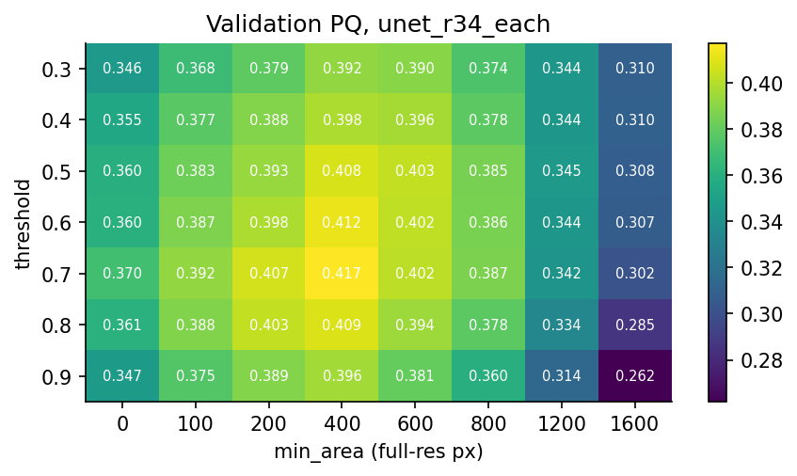
Hyperparameter Tuning
Hyperparameter | Values tried | Chosen | Evidence (validation PQ)
Training labels | each / soft / vote | each | 0.417 / 0.412 / 0.410
Epochs | 25, 35 (best epoch kept) | 35 | 0.402 → 0.417
Threshold | 0.3 – 0.9 | 0.7 | grid search (right)
Minimum area | 0 – 1600 px | 400 px | grid search (right)
Hysteresis | low 0.3–0.5, high 0.6–0.9 | off | no gain
Gap grouping | 0 – 25 px | 10 px | +0.004
Boundary growth | 0 – 8 px | 0 px | no gain
Test-time augmentation | on / off | on | +0.001
Threshold vs competition masks | 0.6 / 0.7 / 0.8 | 0.8 | +0.013 ± 0.005 (folds 1–4)
Threshold × minimum area on fold 0: best 0.417 at 0.7 / 400 px
How: each choice by validation PQ on fold 0; the important ones re-checked on folds 1–4, which were never used for tuning.
Not searched: learning rate 3e-4, weight decay 1e-4, batch size 4, loss weights 0.5 / 0.5 (standard fine-tuning values).
Notes:
When discussing hyperparameter tuning, we aim to highlight the iterative process that led to optimizing our model's performance.
Firstly, let's focus on the training labels. We explored several labeling strategies: “each”, “soft”, and “vote”. Ultimately, we chose the "each" strategy, which yielded the highest validation PQ score of 0.417, indicating its effectiveness in improving predictive quality.
[Pause for emphasis]
Next, let's talk about the epochs. We tested both 25 and 35 epochs. The latter was selected due to a noticeable improvement, boosting our validation PQ from 0.402 to 0.417. This choice underscores the importance of adequate training duration for achieving optimal results.
[Pause briefly]
Lastly, we assessed various thresholds and other parameters using grid search. For instance, a threshold of 0.7 and a minimum area of 400 pixels delivered the best results on fold 0. These choices were then validated across other folds to ensure consistency and reliability.
[Smile and make eye contact]
Remember, we did not adjust certain parameters like learning rate or batch size, as they were already fine-tuned to our needs. This strategic exclusion allowed us to focus on more impactful hyperparameters.
With this thorough tuning process, we were able to refine our model to perform efficiently, paving the way for the results we’ll discuss next.

Slide 12
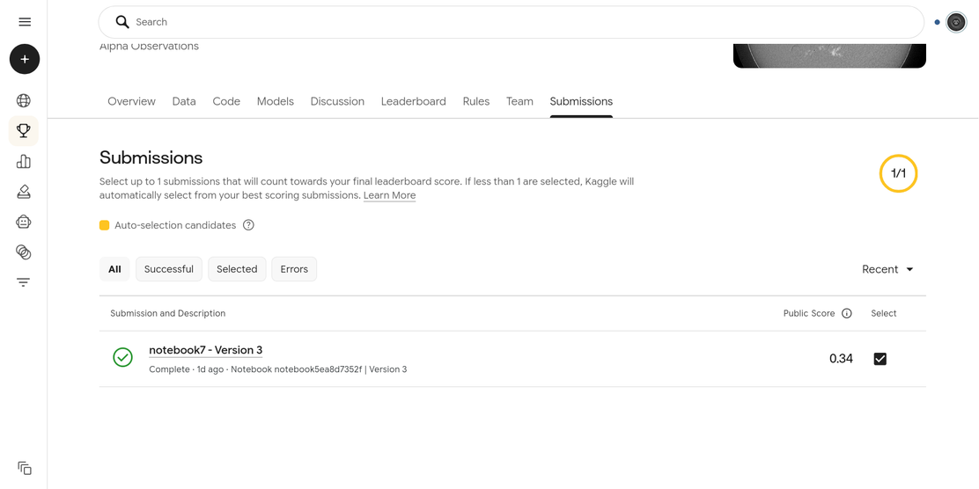
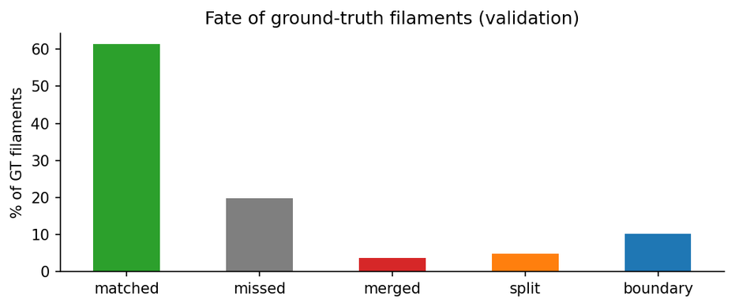
Results
0.396 ± 0.011
cross-validated PQ, folds 1–4 (competition's masks)
0.34
Kaggle public leaderboard PQ
Approach (PQ, folds 1–4) | Our masks | Competition masks
U-Net baseline (threshold 0.7) | 0.400 ± 0.009 | —
+ gap grouping + TTA | 0.409 ± 0.013 | 0.383 ± 0.015
+ threshold calibrated to 0.8 | — | 0.396 ± 0.011
Fate of ground-truth filaments (fold 0)
Missed 20%: often filaments only one annotator marked
Boundary 10%: right filament, extent disputed
Split / merged 9%: targeted in post-processing
Notes:
In this slide, we'll delve into the results of our model's performance. The key metric we're using here is the PQ, or panoptic quality, which measures segmentation accuracy.
First, let's look at the cross-validated PQ results from folds 1 to 4, where our model achieved a score of 0.396 ± 0.011 with the competition's masks. [Pause and let this number sink in.]
On the Kaggle public leaderboard, the PQ score was slightly lower at 0.34. This discrepancy highlights the difference between controlled cross-validation settings and real-world competition environments. [Pause to emphasize the difference.]
Moreover, when comparing two annotators against each other, the PQ was 0.36, further demonstrating the challenges of achieving consensus in manual annotations.
Now, focusing on the approach: by using our U-Net baseline with a threshold of 0.7, we observed a PQ of 0.400 ± 0.009. However, by incorporating gap grouping and test-time augmentation, we improved this to 0.409 ± 0.013. Interestingly, calibrating the threshold to 0.8 with competition masks resulted in a PQ of 0.396 ± 0.011. [Highlight these improvements and changes.]
Lastly, the fate of ground-truth filaments on fold 0 shows that 20% were missed, often because only one annotator marked them. Boundary issues accounted for 10%, and split or merged filaments were targeted in post-processing.
[Conclude with a pause to transition smoothly into the next slide, which will showcase example predictions and further explore the model's performance in various scenarios.]

Slide 13
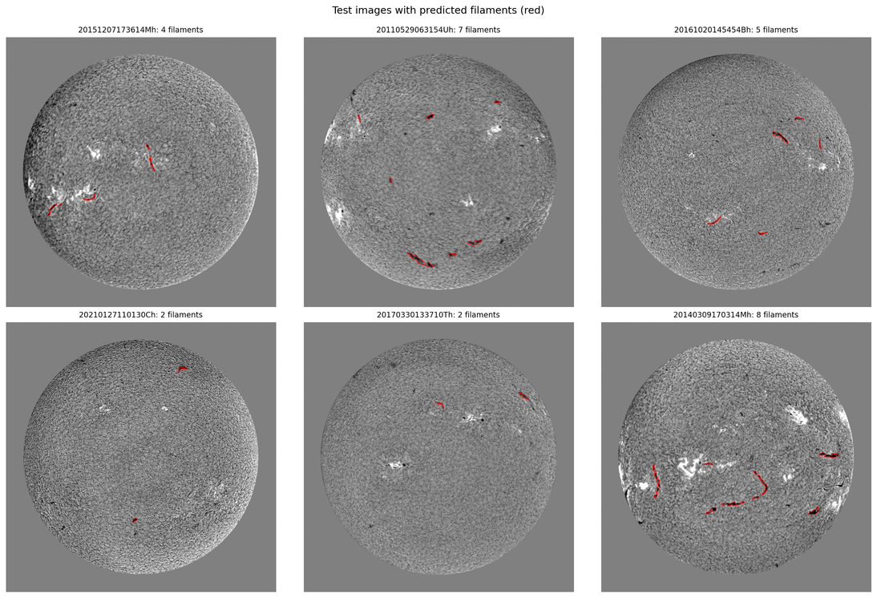
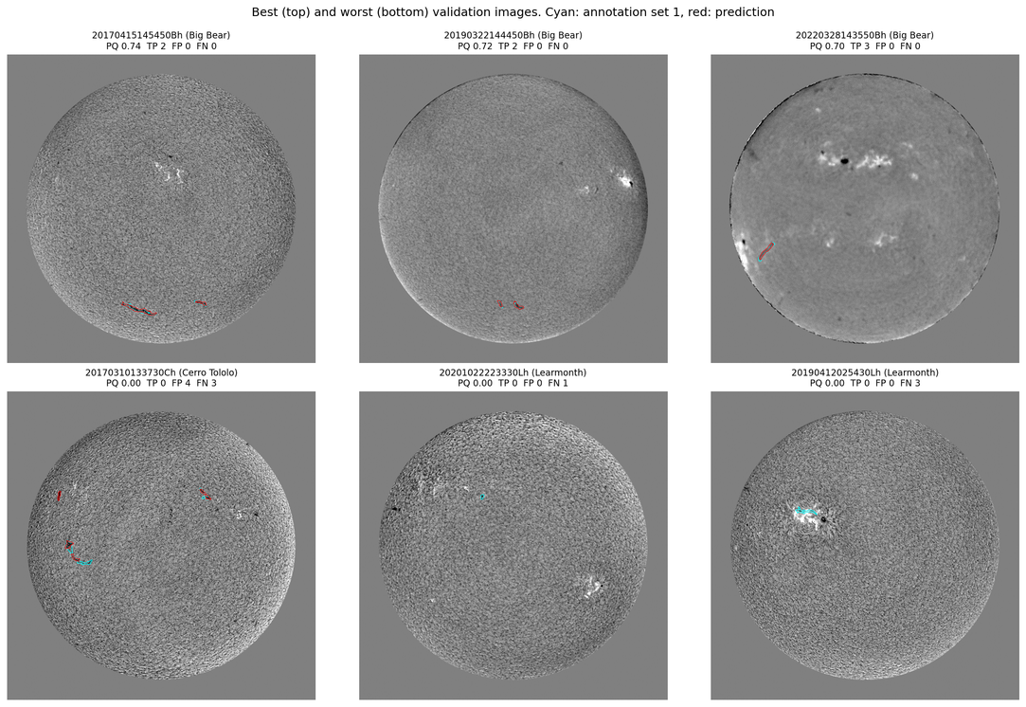
Results: Example Predictions
Test images (no labels): predicted filaments in red
Validation: best (top), worst (bottom); cyan = annotator, red = model
  Viable: outlines follow the dark filament channels on clean and degraded disks; 1,150 filaments over 180 test images (median 7 per image)
  Fails: faint or short filaments are missed; filaments inside bright active regions; dark fibrils taken for filaments; long filaments only partly found
Notes:
In this slide, we're diving into the results of our model's predictions, particularly focusing on how well it performs with test images.
Firstly, when we observe the images, you'll notice that the predicted filaments are highlighted in red. This visualization helps us see where the model detects structures within the test images. During validation, the best predictions are shown at the top, and the worst at the bottom, with cyan lines representing annotations by experts and red lines indicating our model's predictions.
Key point one is the model's capability to successfully identify viable filament structures. It follows the dark filament channels on both clean and degraded disks effectively, identifying around 1,150 filaments across 180 test images, which averages out to a median of about 7 filaments per image.
However, it's not without its shortcomings. The model tends to miss faint or short filaments and those embedded within bright active regions. Additionally, it sometimes mistakes dark fibrils for filaments and only partially detects longer filaments.
[Pause to let the audience process the visuals]
As we move on, keep these observations in mind, as they illustrate the strengths and weaknesses of our current model. The next section will delve into how post-processing steps can enhance these predictions further.
[Conclude with a confident nod]

Slide 14
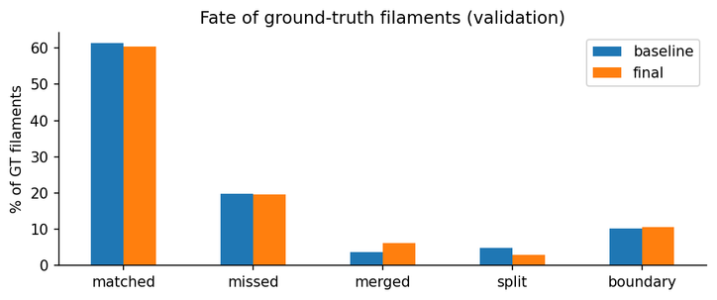
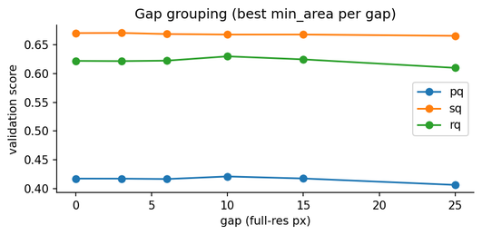
Enhancement: Post-processing
Post-processing step | PQ (fold 0) | Effect
Baseline: threshold 0.7, min area 400 | 0.4171
+ hysteresis threshold | 0.4171 | no gain: probabilities ≈ 0 or 1
+ gap grouping (10 px) | 0.4208 | split 4.9 → 2.9%, merged 3.7 → 6.1%
+ boundary growth | 0.4208 | no gain: widths already right
+ 8-view TTA | 0.4216 | +0.001 for ~2.4× network time
Error types: baseline vs final post-processing
On unseen folds 1–4: 0.400 ± 0.009 → 0.409 ± 0.013 (+0.009 ± 0.005)
  Ground-truth calibration: the competition rasterises polygons with pycocotools; those masks are ~10% smaller and 0.5 px offset from our OpenCV training masks. Re-tuning the threshold to them (0.6 → 0.8) gave +0.013 ± 0.005 on folds 1–4.
  Why it matters: PQ only counts a filament at IoU > 0.5, so 1 px on a 12 px-wide filament decides matches.
Notes:
In this slide, we're diving into the enhancement phase, focusing on the post-processing steps and their impact on our model's performance.
First, let's consider our baseline setup: a threshold of 0.7 and a minimum area of 400. This setup achieved a PQ score of 0.4171. As we progress through various enhancements, keep an eye on how these adjustments affect our results.
[Pause for emphasis]
One key enhancement is the introduction of a hysteresis threshold. Interestingly, this step didn't yield any gain, as the probabilities were already close to 0 or 1. However, implementing gap grouping led to a notable improvement—our split errors reduced from 4.9% to 2.9%, though it did slightly increase merge errors. This adjustment brought our PQ score to 0.4208.
[Pause for audience reflection]
Next, we added boundary growth, which surprisingly showed no gain since the widths were already optimal. However, integrating an 8-view Test-Time Augmentation (TTA) further increased the PQ score to 0.4216, albeit with a trade-off of approximately 2.4 times the network time.
Finally, it's important to highlight the ground-truth calibration. The competition’s masks are about 10% smaller and slightly offset compared to our training masks. Adjusting our threshold for these differences provided an additional boost to our performance on folds 1–4.
[Conclude with a thoughtful pause]
Understanding these enhancements helps us see how small adjustments can lead to significant improvements in model performance, emphasizing the importance of meticulous calibration and evaluation in machine learning projects.

Slide 15
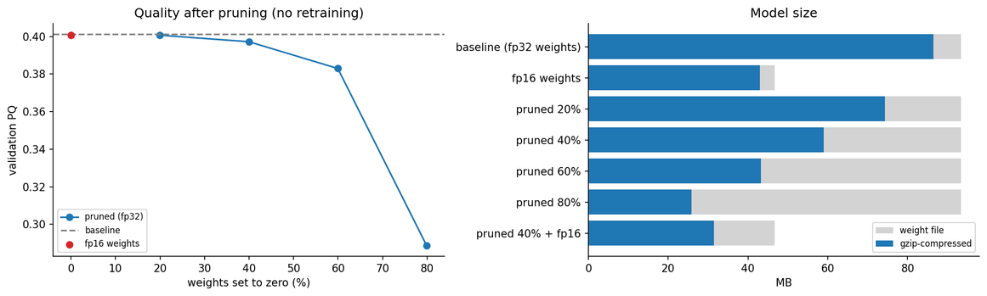
Compression, Size and Time
Variant | File | gzip | PQ | Δ PQ
Baseline (fp32 weights) | 93.4 MB | 86.5 MB | 0.401 | —
fp16 weights | 46.7 MB | 43.0 MB | 0.401 | −0.000
Pruned 20% | 93.4 MB | 74.3 MB | 0.401 | −0.001
Pruned 40% | 93.4 MB | 59.0 MB | 0.397 | −0.004
Pruned 60% | 93.4 MB | 43.2 MB | 0.383 | −0.018
Pruned 80% | 93.4 MB | 25.8 MB | 0.289 | −0.113
Pruned 40% + fp16 | 46.7 MB | 31.5 MB | 0.397 | −0.004
Left: quality vs pruning. Right: file vs gzip-compressed size
24.4 M
parameters, 93 MB (fp32)
38 min
training per model (T4)
0.82 s
per test image, end to end
  fp16 is free: half the size, ~6% faster on the T4, no PQ change
  Pruning (global L1, no retraining): 40% of weights can go for −0.004 PQ; 80% collapses
  Smallest useful model: 40% pruned + fp16 = 31.5 MB compressed, 36% of the original
  Speed: zeroed weights are still multiplied, so pruning is not faster; TTA (8 passes) is the main cost
Notes:
Let's dive into the details of how compression, size, and time affect our model performance and efficiency.
First, let's talk about file size and compression. [Pause and glance at the audience.] We see that using fp16 weights effectively reduces the file size by half, from 93.4 MB to 46.7 MB, and importantly, this change does not affect the PQ score. This makes fp16 an excellent choice for storage without compromising on quality.
Now, moving on to pruning, which is a method to reduce the model size by removing less critical weights. [Pause briefly.] Pruning at 40% reduces the file size significantly to 59.0 MB, with a negligible impact on the PQ score. However, as we prune further, up to 80%, we notice a significant dip in performance, with the PQ dropping to 0.289. This highlights the balance between size reduction and maintaining model accuracy.
Lastly, let's consider the speed aspect. While pruning reduces the model size, it doesn't necessarily speed up processing because zeroed weights are still computed. [Emphasize this point.] The key speed factor is the TTA, or test-time augmentation, which is computationally intensive due to multiple passes.
In summary, fp16 weights provide an efficient size reduction without quality loss, and moderate pruning can offer size benefits with minimal PQ impact. [Pause and make eye contact.]
[Conclude with a nod to the audience.] Now, let's explore the implications of these findings in our conclusion slide.

Slide 16
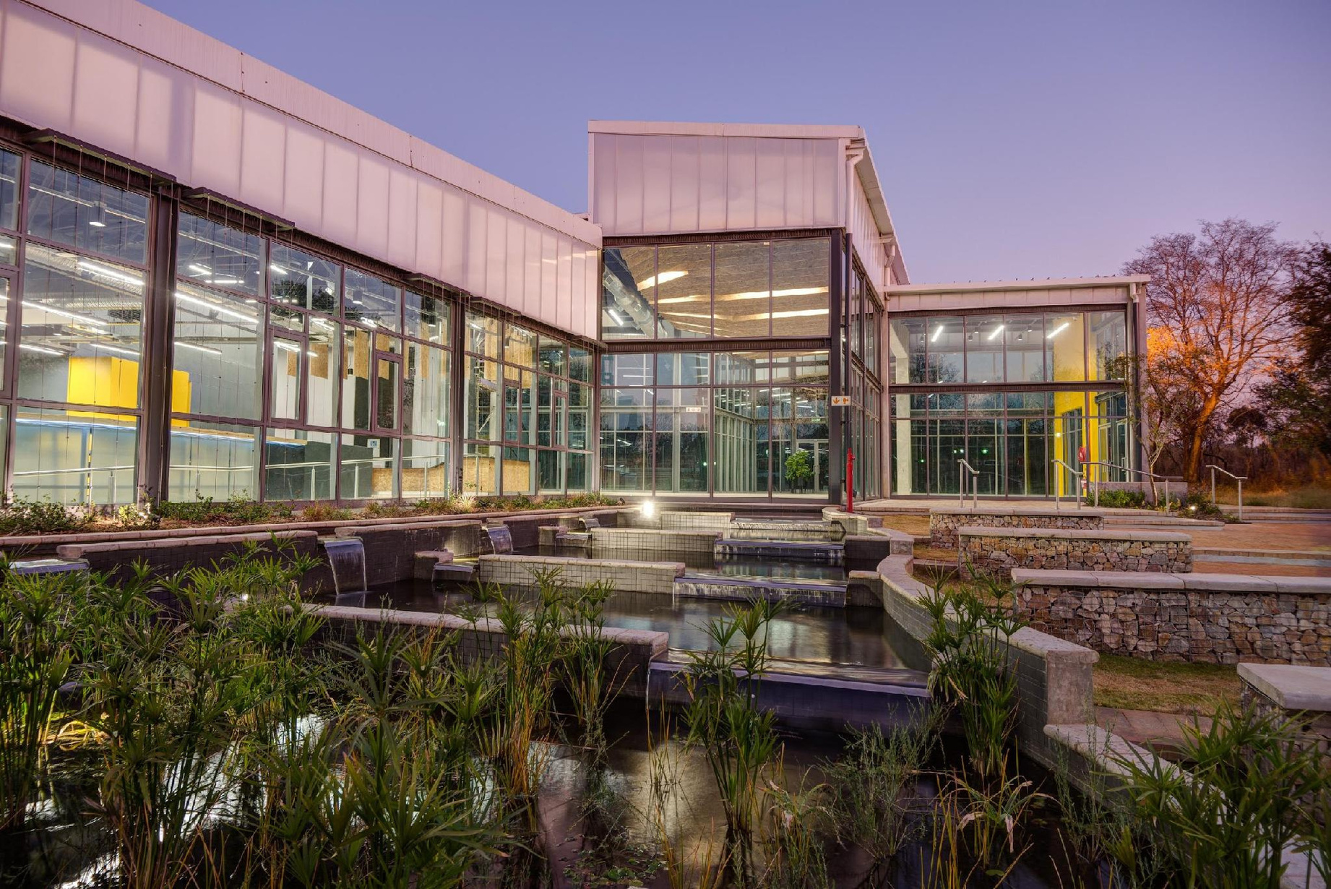
Conclusions
Take-aways
  Careful data work paid off: preprocessing, calibrated augmentation and a time-grouped split gave honest scores (folds 0.38–0.41)
  A standard U-Net (ResNet34) reaches PQ ≈ 0.40, above annotator agreement (0.36); label noise is the ceiling
  Small, tested post-processing helps: +0.009 (gap grouping), +0.013 (calibration)
  Next time
  Rasterise with pycocotools and use the organisers' self-evaluation notebook from day one
  Explore more pretrained models and encoders and experiment with different optimisers and architectures
Notes:
In this concluding slide, we're summarizing the key takeaways from our presentation and outlining next steps for future improvements.
First, it's important to note that our meticulous approach to data management really paid off. By employing methods such as preprocessing, calibrated augmentation, and a time-grouped split, we achieved honest scores within the range of 0.38 to 0.41 for our folds.
[Pause for a moment to let the audience absorb this achievement.]
Next, we found that using a standard U-Net model, specifically with ResNet34, reached a PQ score of approximately 0.40. This is notably above the annotator agreement benchmark of 0.36, highlighting the impact of label noise as a limiting factor.
[Emphasize the importance of this comparison.]
Additionally, the small yet tested post-processing steps proved beneficial. For instance, gap grouping contributed an increase of 0.009, and calibration added another 0.013 to our scores.
Looking forward, we recommend incorporating the use of pycocotools for rasterization right from the start and utilizing the organizers' self-evaluation notebooks. Also, exploring more pretrained models and experimenting with different optimizers and architectures could present new opportunities for enhancement.
[Conclude with a positive tone, encouraging future exploration and improvement.]

Slide 17
Bibliography
[1] A. Ahmadzadeh et al. MAGFiLO: Manually Annotated GONG Filaments from H-Alpha Observations. Scientific Data 11:1031, 2024.
[2] A. Kirillov, K. He, R. Girshick, C. Rother, P. Dollár. Panoptic Segmentation. CVPR, 2019.
[3] O. Ronneberger, P. Fischer, T. Brox. U-Net: Convolutional Networks for Biomedical Image Segmentation. MICCAI, 2015.
[4] K. He, X. Zhang, S. Ren, J. Sun. Deep Residual Learning for Image Recognition. CVPR, 2016.
[5] PyTorch (pytorch.org) and segmentation-models-pytorch (github.com/qubvel-org/segmentation_models.pytorch).
[6] Solar Filament Segmentation Challenge 2026. kaggle.com/competitions/filament-segmentation-2026.

