Slide 1
Advanced Libraries in Python
Mini Project: Image Filter App using Pillow & Matplotlib
Presented by: Aryan Ojha
Enrollment No:2401030730002 Assignment:3

Slide 2
What are Python Libraries?
- Python libraries are collections of pre-written code.
- They let us do more by writing less.
- Libraries simplify complex programming tasks.
- Help in areas like data, images, AI, etc.
- Example: Pillow helps with images.
- Matplotlib helps with charts.
- TensorFlow helps with AI.
- Libraries save time and reduce errors.
- We use two libraries in our mini project.

Slide 3
What is Pillow?
- Pillow is a Python library for image processing.
- It can open, resize, and apply effects to images.
- Easy to use and beginner-friendly.
- Can convert images to grayscale.
- Can apply filters like blur and edge detection.
- Supports many formats: JPG, PNG, etc.
- Works well with other libraries.
- We used it to modify an image.
- It's the core library in our project.

Slide 4
What is Matplotlib?
- Matplotlib is used for making graphs and plots.
- In our project, we used it to show images.
- It allows showing multiple images in one figure.
- You can control layout and titles.
- Useful in data science and machine learning.
- Makes results easier to understand.
- You can save plots as image files.
- Works well with other tools like NumPy.
- We used it to show original and filtered images.

Slide 5
Project Overview
- Name: Image Filter App using Pillow and Matplotlib
- Goal: Apply simple filters to a selected image
- Filters: Grayscale, Blur, Edge Detection
- Show all filters in one window using plots
- Beginner-friendly and easy to understand
- Uses two advanced libraries effectively
- Teaches image loading and manipulation
- Can be extended with more filters
- Helps learn visualization and image basics

Slide 6
Step 1: Load the Image
- First, import the Pillow library
- Use Image.open() to load the image file
- Save your image in the same folder as the script
- Handle error if image is missing
- Load only supported file types like .jpg/.png
- Image gets stored in a variable (e.g., img)
- Always make sure path is correct
- This is the first step before processing
- Required before applying filters

Slide 7
Step 2: Apply Filters
- Use Pillow’s functions to apply filters
- Convert to grayscale using .convert('L')
- Apply blur using ImageFilter.BLUR
- Detect edges using ImageFilter.FIND_EDGES
- Each filter returns a new image
- Keep original image unchanged
- Easy to chain or combine filters
- Great for learning image transformation
- These steps are simple and visual

Slide 8
Step 3: Show Results
- Import matplotlib.pyplot as plt
- Use plt.subplot() to organize layout
- Use plt.imshow() to show each image
- Turn off axes using plt.axis('off')
- Add titles using plt.title()
- Show all images with plt.show()
- Makes it easy to compare filters
- Final step to visualize output
- Clear and simple image display

Slide 9
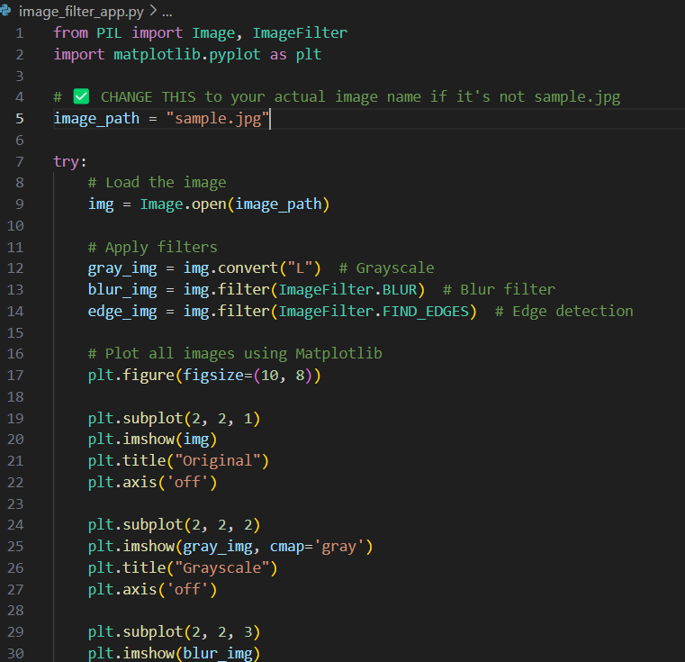
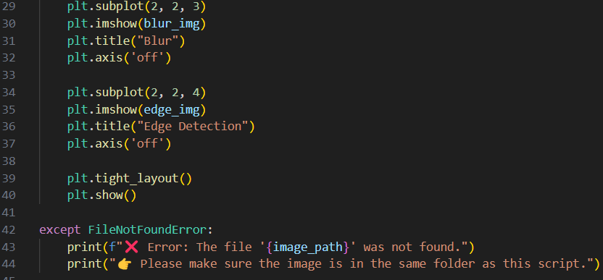
Python Code

Slide 10
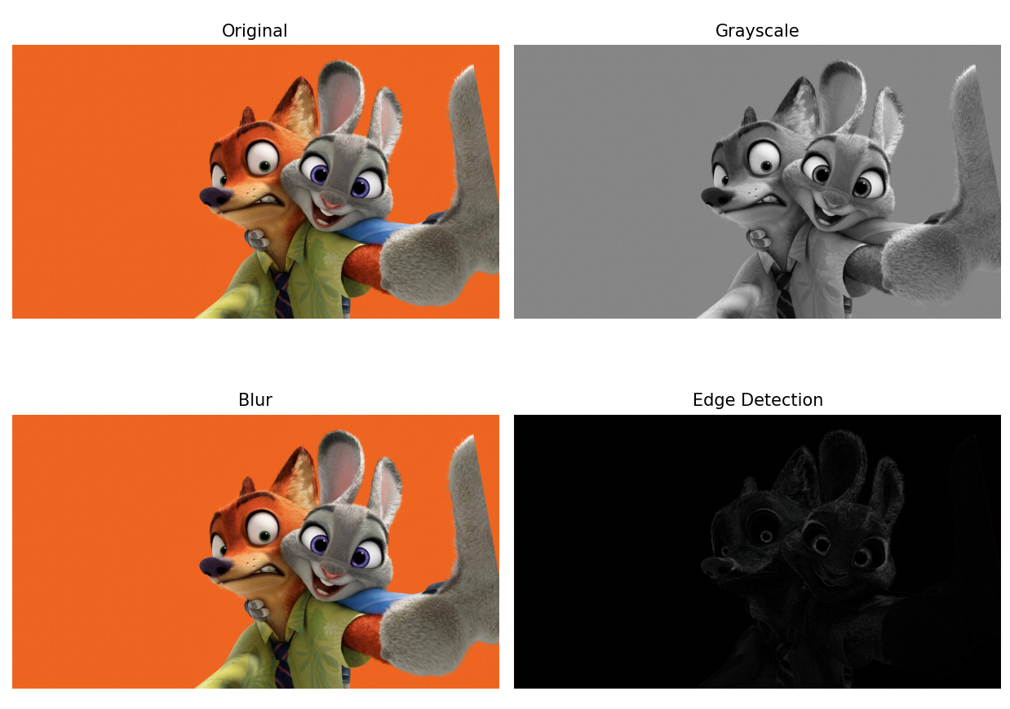
Output Screenshot

Slide 11
Libraries Used
- Pillow:
• Used for image loading and filtering
• Simple functions like convert(), filter()
- Matplotlib:
• Used to display images in a grid layout
• Useful for clear visual comparison
- These are powerful Python libraries
- Together, they help build fun projects
- Easy to learn and use
- Can be extended with NumPy, OpenCV
- Useful in real-world image apps

Slide 12
GitHub Repository
- https://github.com/AryanOjha09/image-filter-app.git

Slide 13
Thank You
Thanks for watching!
Presented by: Aryan Ojha

