Slide 1

3rd INTERNATIONAL CONFERENCE ON FUTURISTIC TECHNOLOGIES (3rd INCOFT 2025)
Visual Question Answering on the Indian Heritage in Digital Space Dataset Using the BLIP Model
Paper ID: 2495
ARYAN S PHADNIS
KLE Technological University, Hubballi, India

Slide 2
Outline
Introduction
Motivation
Issues and Challenges
Literature Survey
Problem Statement
Objectives and Scope
Proposed System (System architecture)
Methodology
Conclusions and Future scope
References

Slide 3
Introduction
Visual Question Answering (VQA) combines computer vision and natural language processing to answer questions about images. While promising for applications like education and tourism, existing systems struggle with culturally rich datasets like Indian heritage sites due to limited contextual understanding.
In this work, we fine-tune the BLIP model on the Indian Heritage in Digital Space (IHDS) dataset, achieving 86.42% accuracy on unseen data. Our approach bridges visual and textual modalities to interpret architectural, historical, and regional nuances, enabling precise answers to various different queries. This work advances AI-driven cultural preservation and sets a benchmark for heritage-specific VQA.

Slide 4
Motivation
Lack of Domain-Specific VQA Generic models often struggle to capture the cultural and historical nuances of Indian heritage sites, necessitating specialized solutions.
Educational and Tourism Potential An interactive VQA system can enrich visitor experiences, providing deeper insights into heritage landmarks and enabling immersive learning.
Challenges in Contextual Understanding Traditional image classification methods are limited to surface-level recognition, highlighting the need for multimodal approaches that integrate both visual and textual data.
Preservation of Cultural Heritage As many heritage sites face degradation or risk over time, a robust VQA system can digitally document and disseminate knowledge, ensuring that future generations continue to learn about and appreciate these sites.

Slide 5
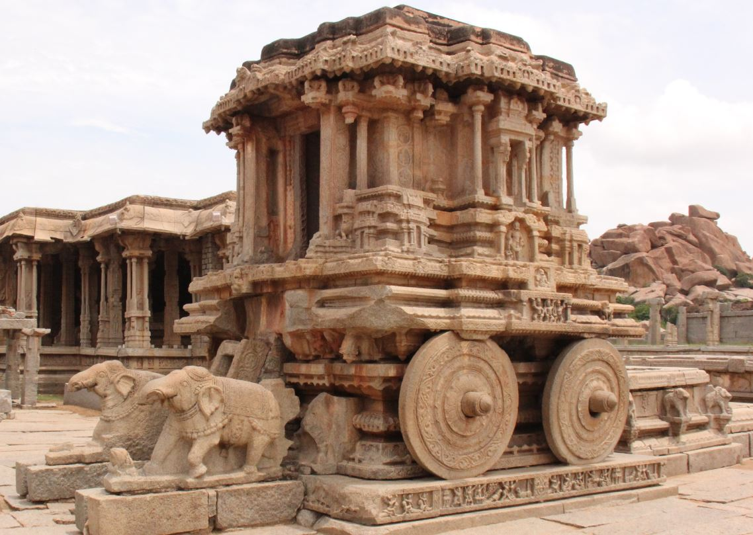

Issues and challenges
Cultural Context Gap Pre-trained VQA models lack domain-specific training for Indian heritage’s historical/architectural details.
Visual & Textual Challenges Inconsistent lighting/angles and ambiguous terms can cause confusion in feature alignment.
Data & Annotation Scarcity Limited heritage-specific QA pairs hinder nuanced cultural training.
Vision-Language Misalignment Struggles to synchronize visual cues (e.g., temple carvings) with ambiguous textual queries.
Ambiguity & Robustness Vague user questions and unpredictable real-world conditions challenge reliability.

Slide 6
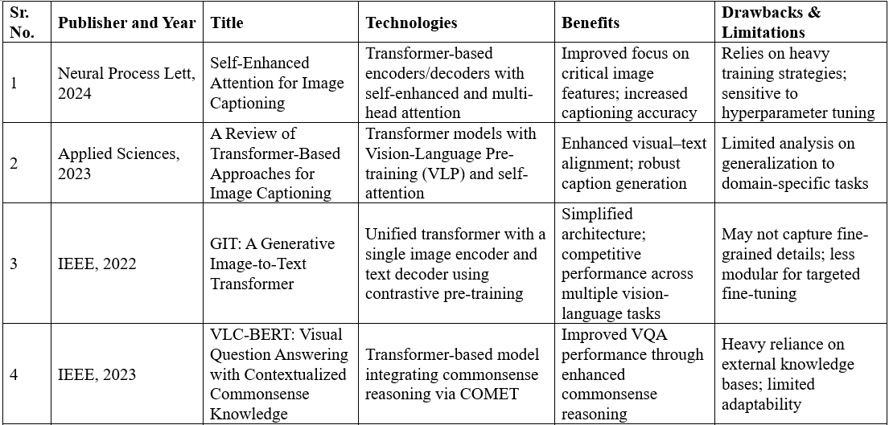
Literature Survey

Slide 7
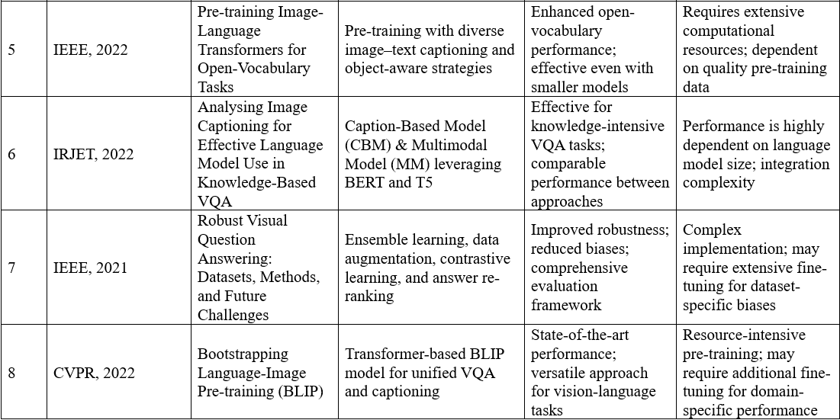

Slide 8
Problem Statement
To enable accurate Visual Question Answering (VQA) for Indian heritage sites by adapting the BLIP model to the Indian Heritage in Digital Space (IHDS) dataset. This addresses gaps in cultural context understanding and aligns vision-language modalities for domain-specific queries.

Slide 9
Objectives
Develop a domain-specific VQA system for Indian heritage using BLIP fine-tuning.
Capture cultural/historical nuances via curated annotations and multimodal fusion.
Ensure robustness for real-world educational/tourism applications.
Optimize training under hardware constraints using appropriate optimization techniques.
Establish benchmarks for heritage-specific VQA performance.

Slide 10
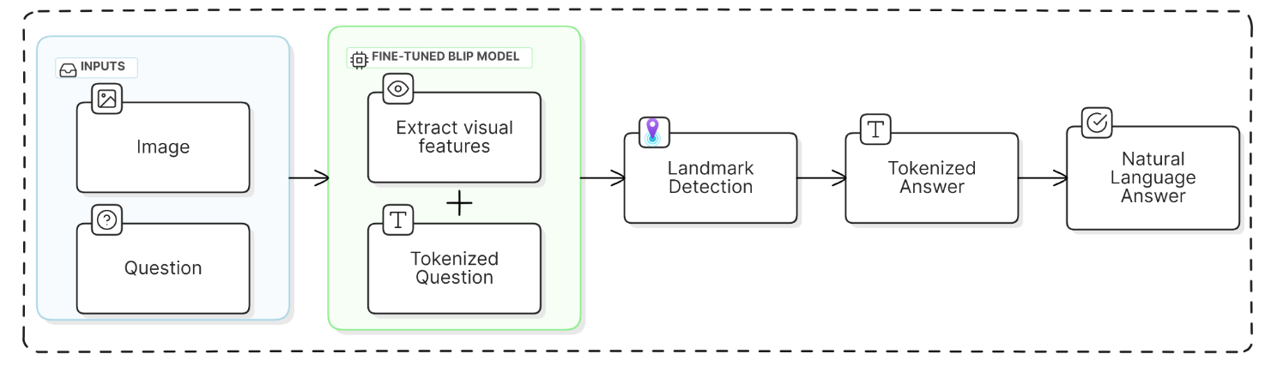
Proposed System
Input Stage – Users provide an image of a heritage site along with a textual question.
Feature Extraction – A fine-tuned BLIP model processes the image and question to extract relevant features.
Landmark Detection – The system identifies the specific heritage landmark (if applicable).
Answer Generation – The model produces a tokenized answer, which is then converted into natural language text.

Slide 11
Methodology
Dataset Preparation & Annotation – Used a curated subset of the Indian Heritage in Digital Space (IHDS) dataset with 3,000 annotated images, each paired with question–answer sets with data augmentation and tokenization using BlipProcessor.
Model Architecture – Adapted the BLIP model featuring a Vision Transformer (ViT) as the image encoder and a transformer-based decoder for text generation tailored to VQA on heritage sites.
Training & Optimization – Fine-tuned the BLIP model for 20 epochs with a batch size of 2 using the AdamW optimizer (learning rate = 2×10⁻⁵, weight decay = 0.01), along with gradient clipping (max norm = 1.0) and early stopping.
Evaluation Metrics – Measured Exact Match Accuracy and F1 Score; achieved 94.1% accuracy (F1 = 0.939) on the validation set and 86.42% accuracy (F1 = 0.89) on the test set.
Testing and Validation – Evaluated performance on 250 unseen samples using beam search (beam size 3 for questions <10 words; beam size 5 for longer questions) for answer generation.

Slide 12
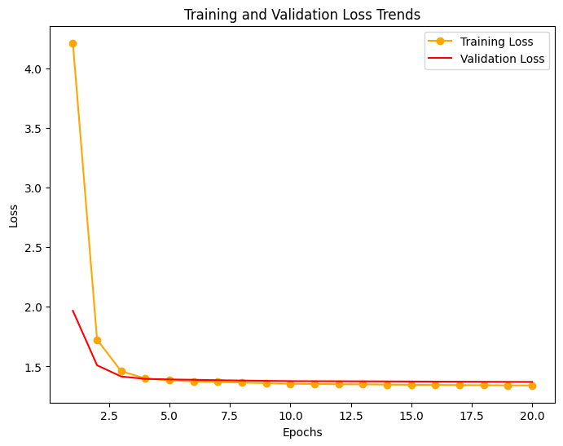
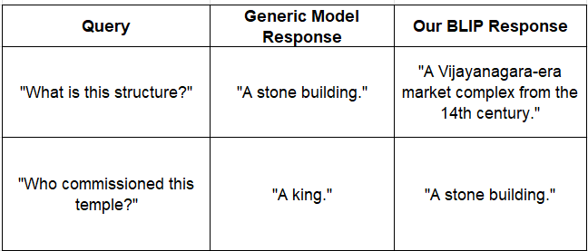
Results and Analysis
Achieved 94.1% accuracy and an F1 score of 0.939 on the validation set and achieved 86.42% accuracy and an F1 score of 0.89 on the test set.
While no prior work exists on IHDS, we tested pretrained VLC-BERT/GIT models without fine-tuning to highlight domain-specific gaps. This is not a fair comparison but demonstrates why generic models fail on heritage tasks.
Preliminary experiments indicated that the BLIP model was particularly effective for heritage-specific queries.
These results underscore the potential of our approach and pave the way for future comparative studies as more domain-specific benchmarks emerge.

Slide 13
Conclusion and Future Scope
By fine-tuning BLIP on the IHDS dataset, we achieve 86.42% accuracy and 0.89 F1-score, enabling precise VQA for Indian heritage sites. This work advances AI-driven cultural preservation and sets the stage for:
Multilingual Support: Regional languages (Hindi, Tamil) for broader accessibility.
Dataset Expansion: Include lesser-known sites (e.g., Hoysala temples).
Immersive Tools: AR/VR integration for interactive heritage tours.
Model Benchmarking: Fine-tune and benchmark alternative VQA models on the IHDS dataset to identify the most effective approach for heritage-specific tasks.

Slide 14
References
[1] Authors "Qingyu Sun, Juan Zhang, Zhijun Fang, Yongbin Gao" have implemented "Self-Enhanced Attention for Image Captioning" in "Neural Process Letters" vol:56, 2024.
[2] Authors "Oscar Ondeng, Heywood Ouma, Peter Akuon" have implemented "A Review of Transformer-Based Approaches for Image Captioning" in "Applied Sciences" vol:13, 2023.
[3] Authors "Jianfeng Wang, Zhengyuan Yang, Ce Liu" have implemented "GIT: A Generative Image-to-Text Transformer" in "IEEE Conference Proceedings", 2022.
[4] Authors "Sahithya Ravi, Aditya Chinchure, Leonid Sigal, Renjie Liao, Vered Shwartz" have implemented "VLC-BERT: Visual Question Answering with Contextualized Commonsense Knowledge" in "IEEE", 2023.

Slide 15
References
[5] Authors "AJ Piergiovanni, Weicheng Kuo, Anelia Angelova" have implemented "Pre-training Image-Language Transformers for Open-Vocabulary Tasks" in "IEEE", 2022.
[6] Authors "Ander Salaberria, Gorka Azkune, Oier Lopez de Lacalle, Aitor Soroa, Eneko Agirre" have implemented "Analyzing Image Captioning for Effective Language Model Use in Knowledge-Based VQA" in "IRJET", 2022.
[7] Authors " Jie Ma, Pinghui Wang, Dechen Kong, Zewei Wang, Jun Liu, Hongbin Pei, Junzhou Zhao" have implemented "Robust Visual Question Answering: Datasets, Methods, and Future Challenges" in "IEEE", 2021.
[8] Authors " Junnan Li, Dongxu Li, Caiming Xiong, Steven Hoi" have implemented "Bootstrapping Language-Image Pre-training (BLIP)" in "CVPR", 2022.

