Slide 1
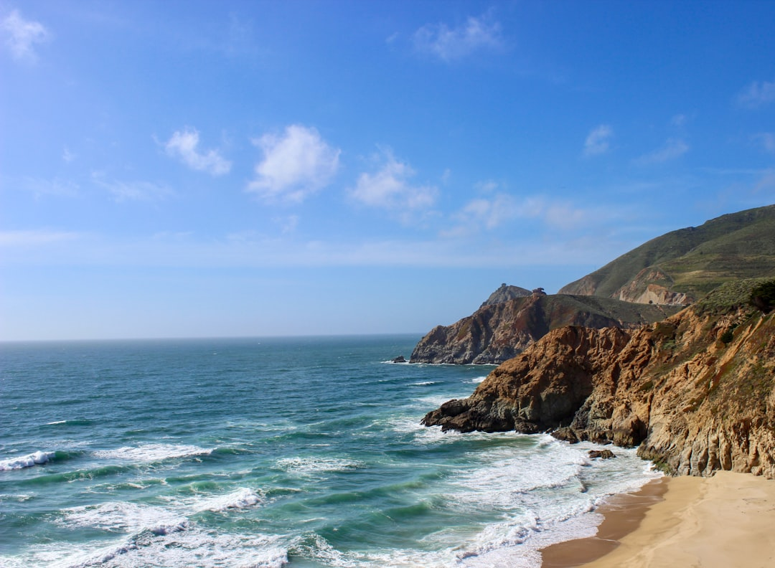
UNTITLED

Slide 2
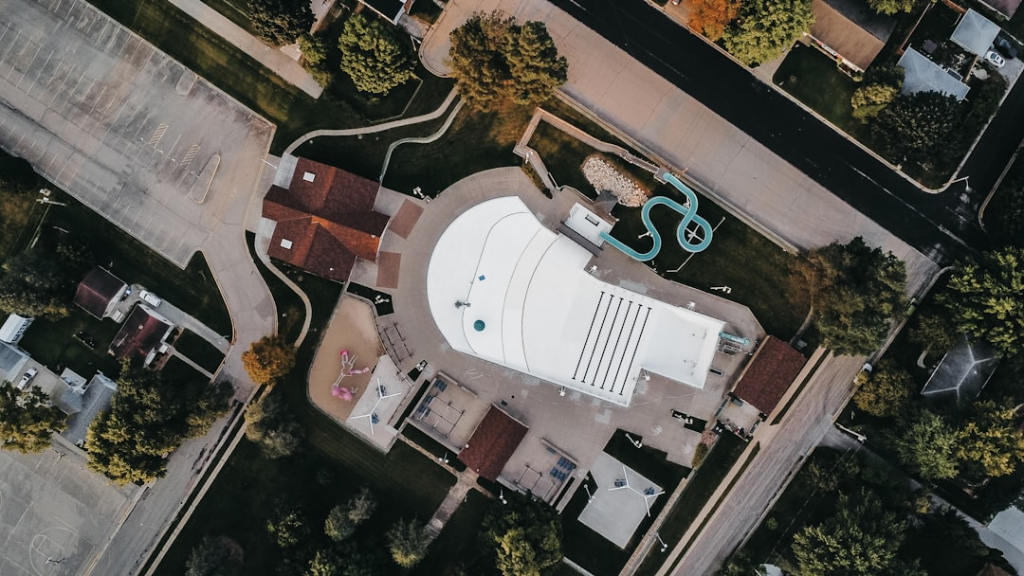
UNTITLED

Slide 3
UNTITLED

Slide 4
UNTITLED

Slide 5

UNTITLED

Slide 6
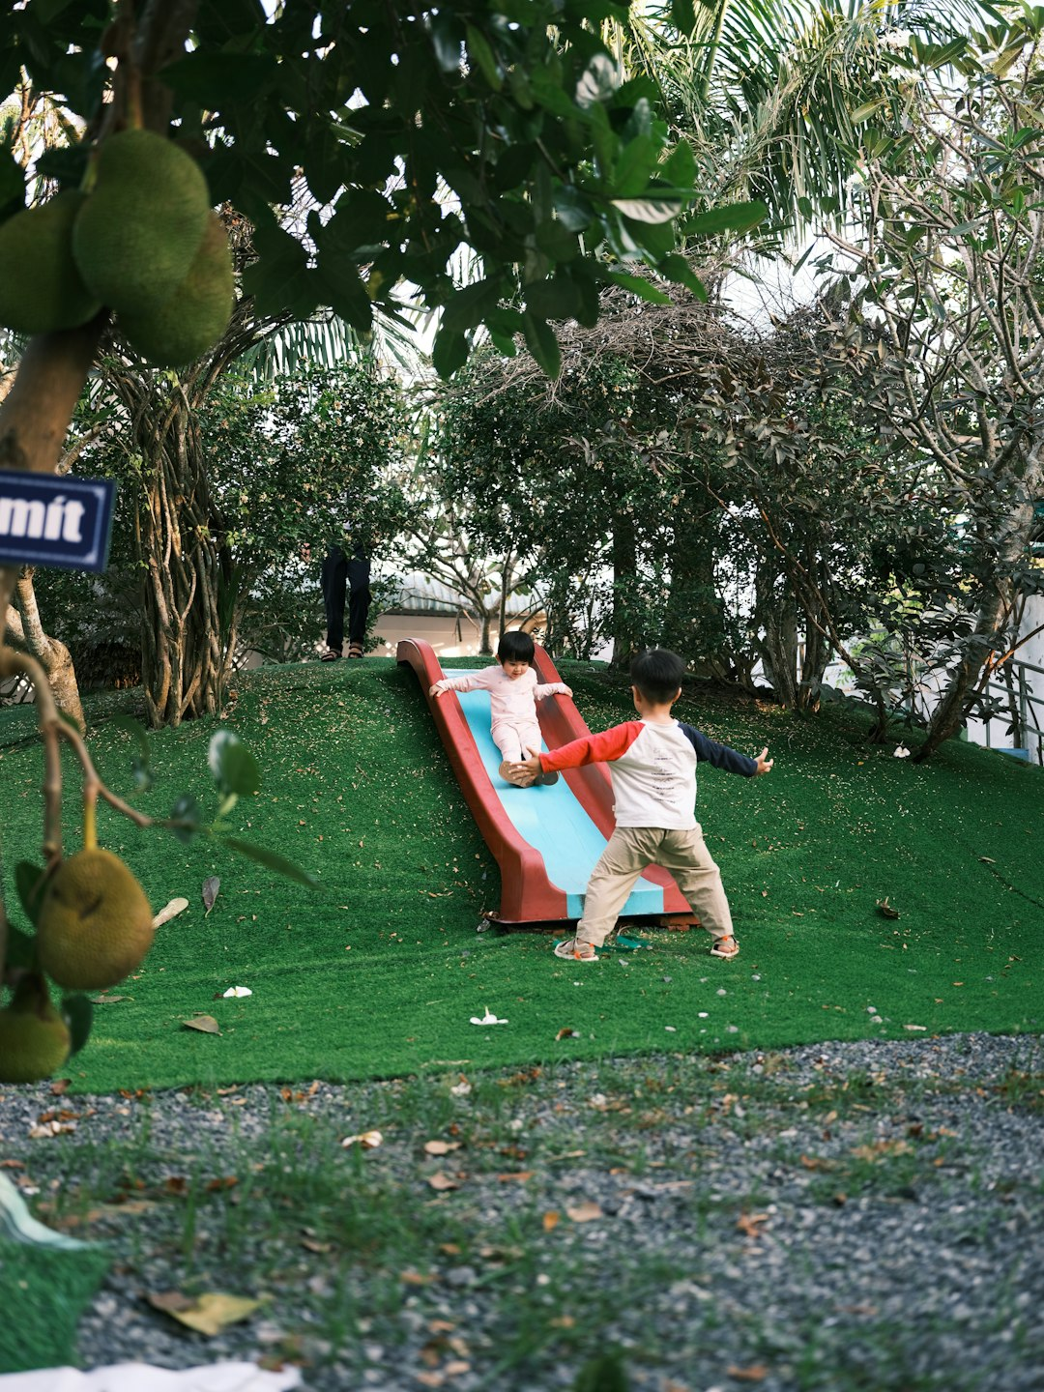
UNTITLED

Slide 7
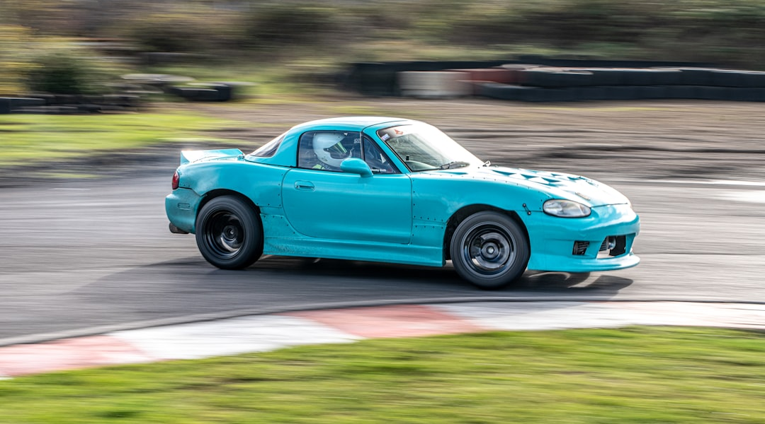
UNTITLED

Slide 8
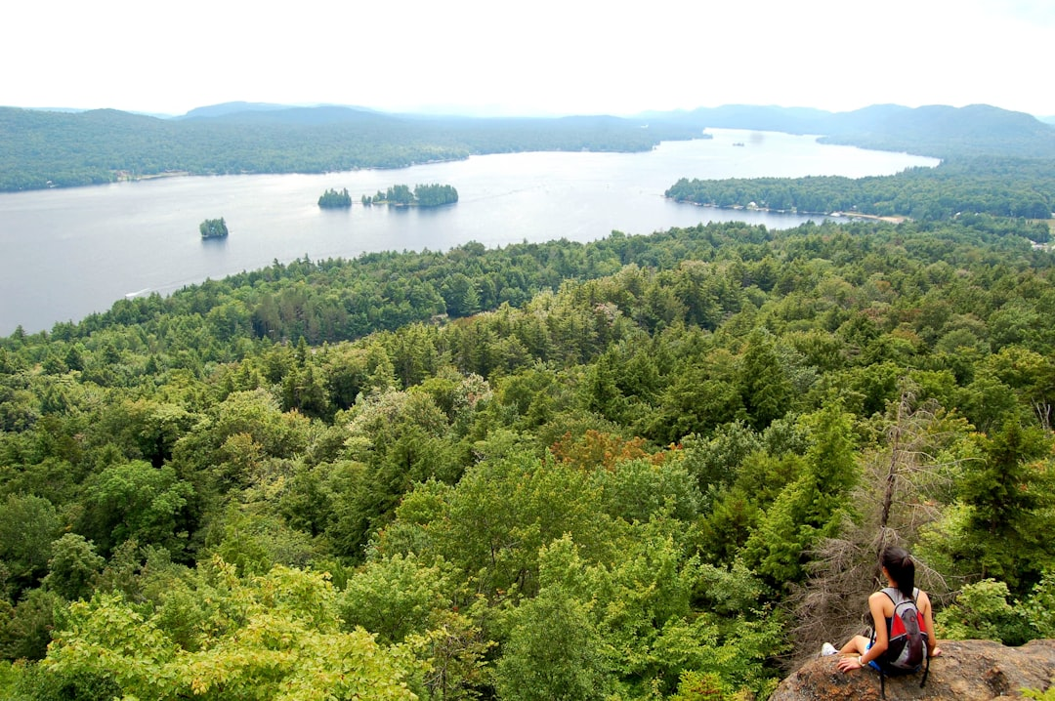
UNTITLED

Slide 9
UNTITLED

Slide 10
UNTITLED

