Slide 1












Commerce OS
PAYTM BUILD FOR INDIA · AI HACKATHON · TRACK 3
AI teammates that don't just respond but Act.
Built With Sarvam • Cognee • n8n
Team : Paytm Premi
Shiwansh Singh • Aryan Pandey

Slide 2




01 · PROBLEM STATEMENT
INDIA'S SHOPKEEPERS RUN ON INSTINCT.
PAYTM'S GROWTH RUNS ON PEOPLE.
~1.3 Cr
Acquisition is slow & leaky
Delivered ≠ active
kirana stores. Just over 90% of India's FMCG sales still flow through them
Lead scoring, KYC, bank, device and legal run one after another and depend on people. Merchants drop off halfway.
A Soundbox can sit unused. Nobody steps in when the merchant is stuck before the first payment.
₹30 L Cr
MSME credit gap, about 24% of demand (SIDBI)
Udhaar, stock-outs, cash gaps
Built for English & desks
24.5 bn
Informal credit goes unrecovered, festive stock runs out, and loans arrive after the moment has passed.
Merchants speak many languages, live on WhatsApp and have patchy connectivity. Customer PII must stay safe.
UPI transactions in Aug 2026. The data exists, but it isn't used for the merchant
Sources: Accenture/Nielsen via Cornell (2026); SIDBI MSME report (2025); NPCI data via Business Standard (Sep 2026).
CommerceOS · Paytm Build for India · Track 3
02
Notes:
Core problem: no single autonomous system takes a merchant from lead to a growing, credit-backed business. Everything today is manual, in English and after the fact. The irony is that UPI already generates the data needed to help them, and nobody acts on it for the merchant.
2

Slide 3












02 · PROPOSED SOLUTION
A TEAM OF AI AGENTS THAT RUNS THE
WHOLE MERCHANT LIFECYCLE
RevOps Commander plans every morning: moves field agents, devices and budget to balance GMV, CAC, time-to-first-txn and compliance
FIND
ONBOARD
ACTIVATE
GROW
FUND
SERVE
Hunter
Onboarder
Activator
Grower + Bazaar
Capital
Pulse
Scores leads without PII, picks the best outreach channel
5 KYC tracks in parallel. Fixes most exceptions itself
Ships the device, unsticks merchants, gets the first real payment
Collects udhaar, wins back customers, restocks for festivals
Offers credit before the merchant asks, repaid as % of daily sales
Answers the shop's customers on WhatsApp, recovers failed UPI
EVERY AGENT, EVERY TASK:
Working prototype: open source
Hear
Understand
Remember
Decide
Act
Learn
github.com/AryanPandey17/paytm-ai-hackathon
Humans step in only when a guardrail fires.
CommerceOS · Paytm Build for India · Track 3
03
Notes:
Walk the journey left to right. Stress three ideas: every agent follows the same six-step loop; they share one memory, so what Pulse learns about customers helps Grower, and Grower's cash-gap signal triggers Capital; and humans only step in when a guardrail fires. The GitHub link has the full running prototype.
3

Slide 4
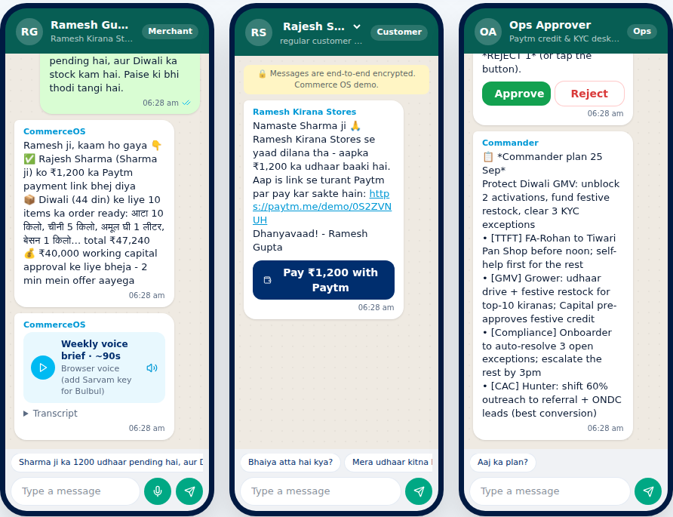
02 · PROPOSED SOLUTION: IN ACTION
ONE VOICE NOTE. SIX OUTCOMES.
A day with Ramesh's kirana in Dadar, built and working in our prototype.
1
Ramesh sends a Hindi voice note: "Sharma ji ka 1200 udhaar pending hai, aur Diwali ka stock kam hai"
Sarvam STT + LLM find 2 jobs
2
Sharma ji gets a polite Hindi reminder with a Paytm Collect link, and pays in one tap
Grower · Cognee · n8n
3
Bazaar forecasts Diwali demand, compares 3 suppliers and drafts purchase orders
Bazaar
4
Capital sees the cash gap and prepares ₹40k. Above the limit, so ops approves on WhatsApp
Capital · n8n send-and-wait
5
Ramesh taps Accept. Money lands instantly and the purchase orders go out
Capital → Bazaar
Live prototype: WhatsApp Studio (merchant · customer · ops approver)
6
A customer asks "atta hai kya?". Pulse answers. Ramesh hears his weekly Hindi voice brief
github.com/AryanPandey17/paytm-ai-hackathon
Pulse · Sarvam TTS
CommerceOS · Paytm Build for India · Track 3
04
Notes:
This is the live demo in one slide. One voice note triggers six real outcomes across four agents and all three partner technologies. The only human action is the ops approval, because the credit amount crossed our ₹25k guardrail. We can run this live for the judges.
4

Slide 5
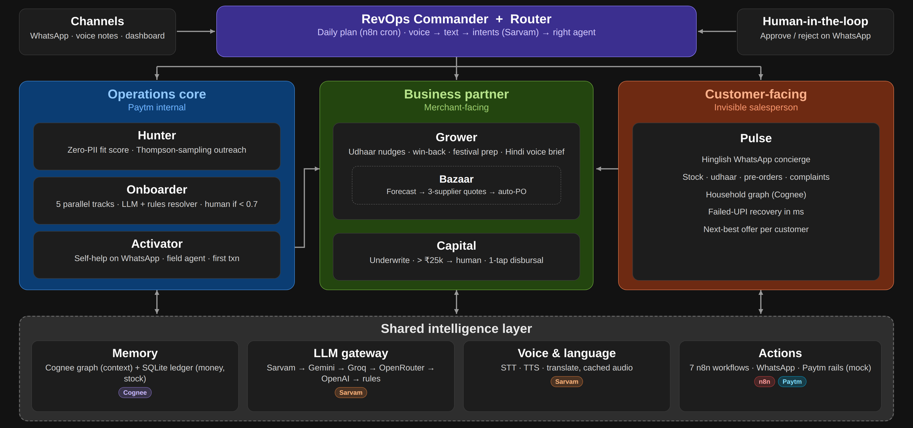
03 · TECHNOLOGY / TECH STACK
VOICE BY SARVAM. MEMORY BY COGNEE. HANDS BY N8N.
Python · FastAPI · uv · React · Vite · Tailwind · live SSE feed · every partner has an offline fallback
CommerceOS · Paytm Build for India · Track 3
05
Notes:
This is the architecture as implemented. Every WhatsApp message or voice note comes in through n8n. The router turns voice into text and intents with Sarvam, and the Commander plans the day. The three agent groups share one intelligence layer: Cognee for context memory plus an exact SQLite ledger for money and stock, an LLM gateway that falls back from Sarvam to Gemini, Groq, OpenRouter, OpenAI and finally offline rules, Sarvam voice, and n8n for every action. Humans come in only through WhatsApp approvals.
5

Slide 6

04 · USP
NOT A CHATBOT. A TEAMMATE.
Capability | Typical chatbot | CRM + field ops | CommerceOS
Takes real actions: payment links, credit, POs | No | Manual | ✓ Yes, via n8n
Covers the full lifecycle: find → fund | No | Siloed teams | ✓ 7 agents, 1 plan
Voice-first in Indian languages | Rarely | No | ✓ Sarvam STT/TTS
Remembers every merchant, customer & decision | Per chat | Partial CRM | ✓ Cognee graph
Humans only by exception, with guardrails | No | Humans do everything | ✓ Approvals on WhatsApp
Keeps working when an AI provider fails | No | n/a | ✓ 5-provider fallback + rules
Acts, not answers
Every decision ends in a real action on WhatsApp or the Paytm rails.
One shared brain
Pulse's customer insight fuels Grower. Grower's cash-gap signal triggers Capital.
Built for Bharat
Voice-first and vernacular, on WhatsApp, where merchants already are.
CommerceOS · Paytm Build for India · Track 3
06
Notes:
The table is the whole pitch: chatbots answer, CRMs record, field teams do the work by hand. CommerceOS does the work, across the full lifecycle, in the merchant's language, with one memory, and it degrades gracefully instead of breaking.
6

Slide 7



05 · IMPACT & BENEFITS
MORE MONEY FOR MERCHANTS.
LESS EFFORT FOR EVERYONE.
6 → 1
1 tap
11
92%
6 outcomes, 1 human step in our demo flow (prototype)
credit acceptance, repaid as % of daily sales (prototype)
voice languages via Sarvam: 10 Indian + English
KYC exceptions auto-resolved (pilot target)
For merchants
For their customers
For Paytm
  Udhaar recovered without awkward calls
  No stock-outs before festivals
  Credit at the moment of need, no forms
  A 90-second weekly brief in their language
  Instant answers on WhatsApp: stock, dues, pre-orders
  Failed payments recovered in the moment
  Offers that fit their household, not spam
  Lower CAC and faster time-to-first-txn
  Fewer human touches per merchant
  Higher GMV, device retention and loan book
  Every outcome feeds one learning memory
Prototype figures come from our working demo. The 92% is a design target to validate in a pilot.
CommerceOS · Paytm Build for India · Track 3
07
Notes:
Impact comes in three layers. Merchants get money back (udhaar), avoid lost sales (stock-outs) and get timely credit. Their customers get service. Paytm gets lower acquisition and operations cost and a bigger, healthier merchant base. The numbers are design targets we would validate in a 1,000-merchant pilot.
7

Slide 8
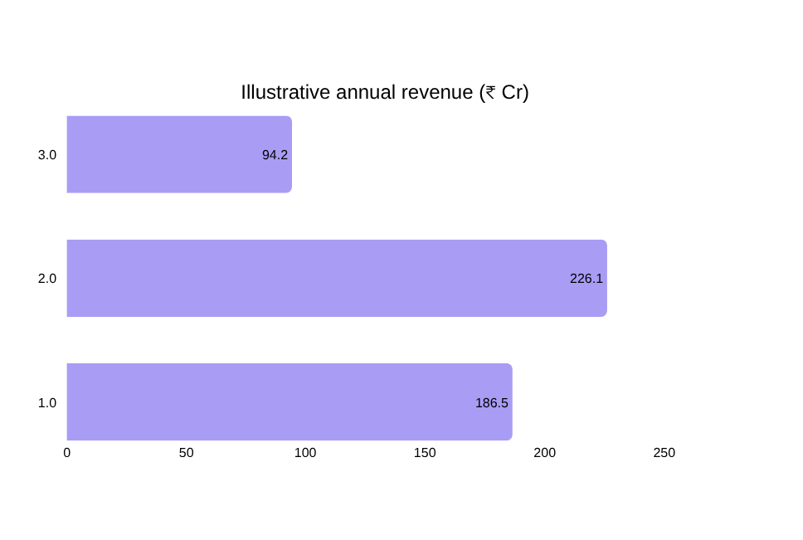



06 · BUSINESS MODEL
RIDES ON PAYTM'S 1.57 CR MERCHANTS
CommerceOS Pro
₹99/month add-on to the Soundbox subscription: Grower, Pulse and the voice brief
Credit distribution
Distribution fee on proactive working-capital loans from lending partners
Bazaar commerce
~1% take on supplier orders placed through Bazaar / ONDC
Cost savings
≈ ₹507 Cr/yr at modest adoption. Assumptions: 10% of 1.57 Cr merchants on Pro at ₹99/mo; 5% take one ₹40k loan/yr at a 3% fee; 3% buy ₹40k/mo via Bazaar at a 1% take.
Lower CAC and field-ops cost: agents do the busywork, people handle exceptions
Pilot
1,000 kiranas · Mumbai
City
Top 10 metros
Bharat
All Soundbox merchants
Base: Paytm Q1 FY27 earnings release (1.57 Cr subscription merchants, 5.0 Cr registered).
CommerceOS · Paytm Build for India · Track 3
08
Notes:
We don't need a new distribution channel. CommerceOS rides on Paytm's existing 1.57 crore subscription merchants. Three revenue streams plus a cost-saving story. The chart is an illustrative scenario at modest adoption, not a forecast, and even that is about ₹500 crore a year. Go-to-market: a 1,000-merchant pilot in Mumbai, then metros, then every Soundbox merchant.
8

Slide 9

EVERY KIRANA,
A GROWING,
CREDIT-BACKED
BUSINESS.
THANK
YOU
Run by AI teammates. On WhatsApp. In their language.
धन्यवाद
Ask us for
the live
demo →
github.com/AryanPandey17/paytm-ai-hackathon
Team Paytm Premi · Aryan Pandey · Shiwansh Singh
Notes:
Close on the vision, then offer the live demo: Run live demo in the dashboard, or a real voice note on WhatsApp.
9

