Slide 1
Stress, Strategy and Survival
The Realities of competitive entrance examinations in India

Slide 2
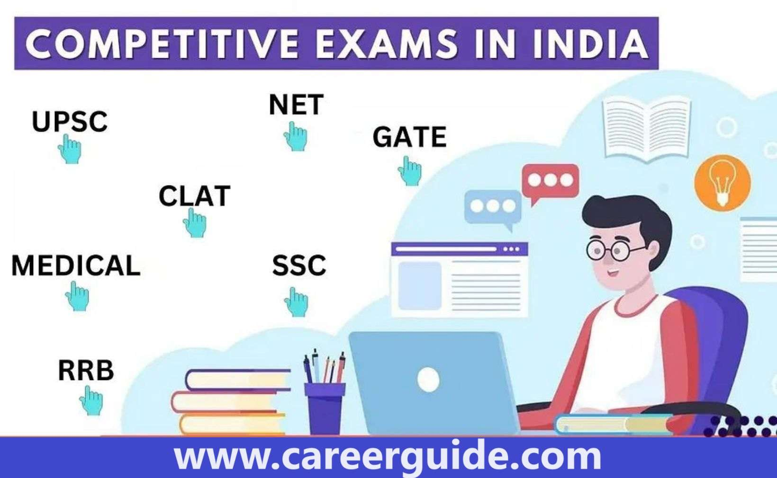
Introduction
Competitive entrance exams in India are very important for students' education and jobs. But they also cause a lot of stress. Students feel pressure from parents, teachers, and society. They study for years and take coaching classes, which can be very expensive. The fear of failure makes many students anxious and tired. Some students do not have enough money or support to prepare well. To reduce stress, schools should provide better help, and parents should support children without too much pressure. A fair exam system can make things easier for students.

Slide 3

Financial Barriers to Coaching
Coaching for competitive exams is very expensive, costing between INR 120,000 to 250,000 per year. Many students come from families that cannot afford these high fees, making it difficult for them to get proper guidance. This creates a gap between rich and poor students, as those who can afford coaching have a better chance of success. As a result, many talented students miss out on opportunities simply because they lack financial resources, making the system unfair for them.

Slide 4

Institutional Support and Its Limitations
Many students face high stress while preparing for competitive exams, but schools and institutions do not provide enough support. Limited counseling and mental health programs leave students struggling with anxiety and pressure. There is a strong need for better resources, such as counseling, stress-relief workshops, and mentorship programs, to help students cope effectively. Schools and policymakers must work together to create a healthier and more supportive learning environment.

Slide 5
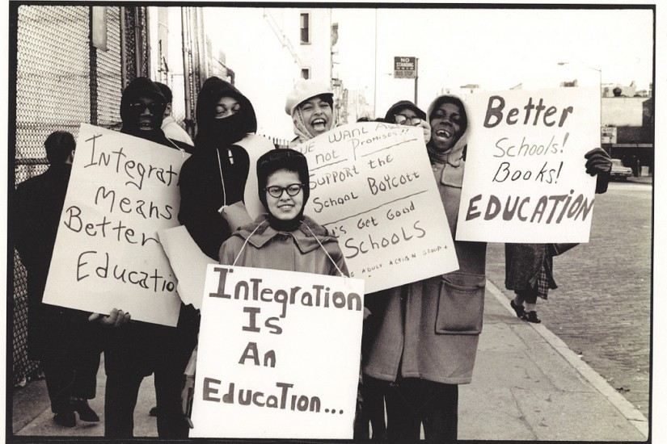
Conclusion
In conclusion, policymakers, educators, and families must work together to reform the high-stakes examination system. A balanced approach that values both academic success and mental well-being is crucial. By providing better support, reducing unnecessary pressure, and promoting healthier study habits, we can create a more positive and fair learning environment. Ensuring that students have the resources they need will help them achieve their goals without sacrificing their well-being.

Slide 6

Overview of Competitive Exams in India
The landscape of competitive examinations in India is vast and varied. These exams include:
Engineering Entrance Exams: JEE Main, JEE Advanced
Medical Entrance Exams: NEET
Management Entrance Exams: CAT, MAT

Slide 7
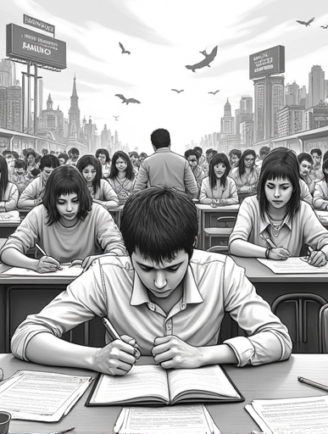
The Impact of Stress on Students
Several factors contribute to the stress experienced by students:
Competition: The high stakes of exams create a cutthroat environment.
Parental Pressure: Expectations from parents can lead to overwhelming stress.
Societal Expectations: The societal emphasis on academic success adds to the pressure.

Slide 8
Survey Findings
68%
81%
Students rated their stress levels between 8–10/10
Fear of Failure as a contributor to stress
79%
-
Parental Expectations as a contributor to stress
Other unspecified contributors to stress

Slide 9
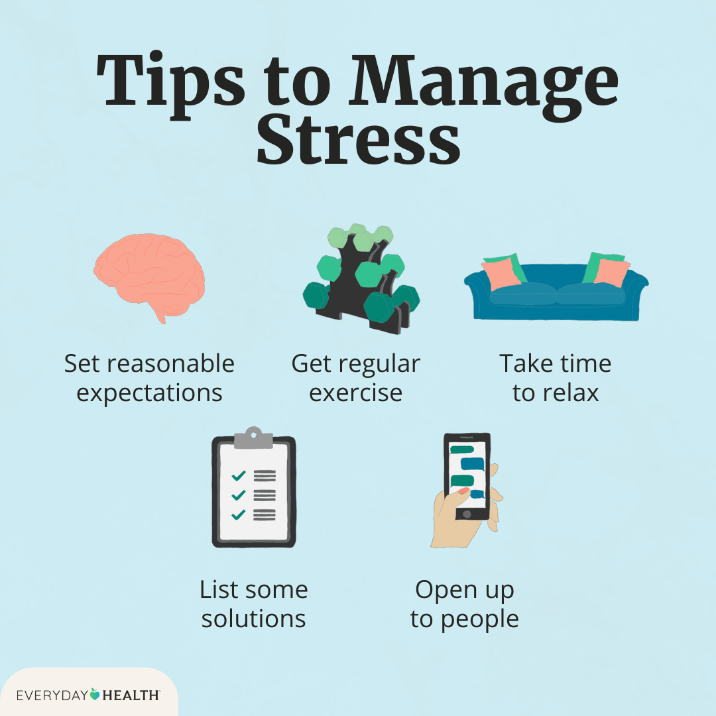
Coping Strategies Employed by Students
To manage stress, students are employing various coping strategies:
Structured Study Plans: Organizing study schedules to enhance productivity.
Mock Tests: Practicing under exam conditions to build confidence.
Online Learning Resources: Utilizing digital platforms for flexible learning.

Slide 10
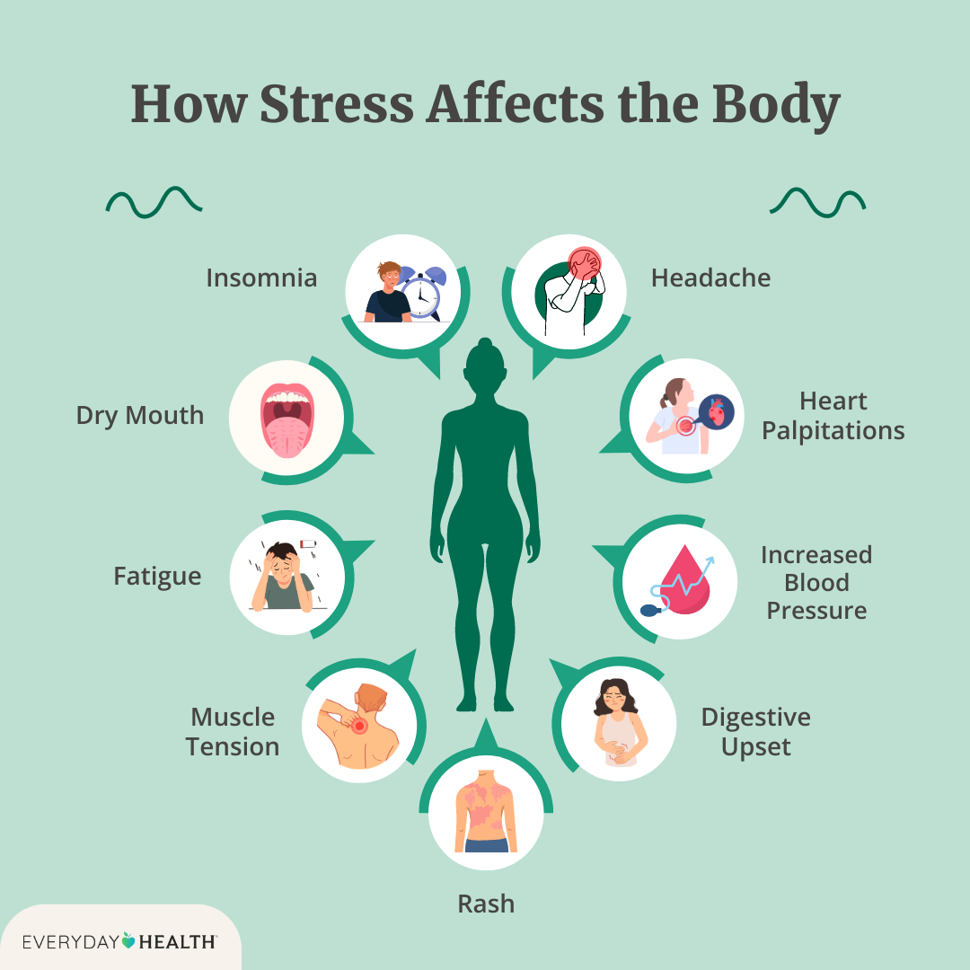
Consequences of Stress
The negative effects of stress on students are profound:
Sleep Deprivation: Lack of sleep affects concentration and health.
Anxiety: Increased anxiety levels can hinder performance.
Burnout: Prolonged stress leads to exhaustion and disengagement.

Slide 11

Recommendations for Improvement
To address the challenges faced by students, the following recommendations are proposed:
Institutional Counselling: Providing mental health support within educational institutions.
Parental Education Workshops: Educating parents on managing expectations and supporting their children.
Phased Examination Models: Distributing pressure more evenly by staggering exams.

