Slide 1
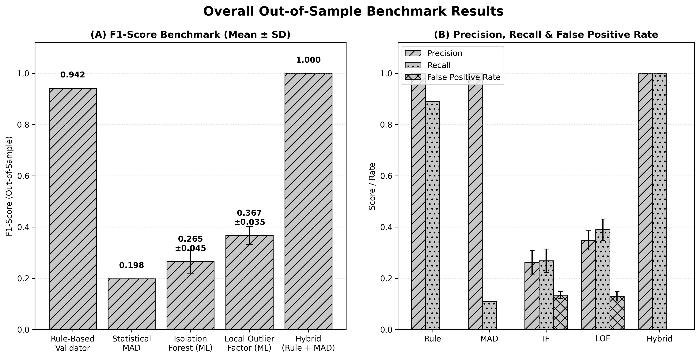
Figure 1. Overall out-of-sample benchmark performance across the five detection methods.

Slide 2
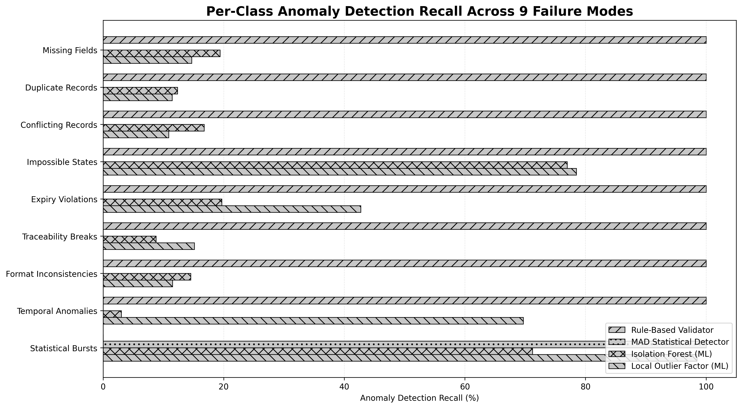
Figure 2. Per-class anomaly detection recall across the nine predefined failure modes.

