Slide 1
BANK MANAGEMENT SYSTEM
-BY GROUP MINTERS

Slide 2
GROUP MINTERS
Nitesh Kumar Shah (Leader) | All Rounder.
Aryan Rijal | Coder and contributor in Proposal.
Bishal Bista | Coder and contributor in Presentation.
Prasanna Pradhan | Coder and Designer of Presentation.

Slide 3
Objectives
Provide a simple banking solution using C++
Manage user accounts & balances
Record transaction history
Generate statements & reports
Secure system with admin and user roles

Slide 4
System Module
Admin module:
Create accounts, Display accounts,Download history.
User module:
Login, Deposit/Withdraw, Transfer money, View balance, Generate statements, Download history.

Slide 5
Data Storage
Accounts stored in:
accounts.csv (AccNo, Name, Balance, Password)
Transaction history per account:
history_.csv (Timestamp, Type, Amount, Balance, Note)

Slide 6
Key Features Implemented
Create account
Deposit / Withdraw
Transfer money
View account details
Generate monthly statement
Download full history
Separate Admin / User sessions

Slide 7
Example User Flow
User logs in with account number & password
Menu options:
View Balance Deposit Withdraw Transfer History
Statement Download history
Logout when finished

Slide 8
Strengths
Simple and lightweight (CSV based)
Clear separation of roles
Easy to extend
Transaction history with timestamps

Slide 9
Limitations
Future Enhancements
Passwords stored in plain text
No concurrency handling
No password reset
Limited input validation
Use hashed passwords
Add password reset/change feature
Switch to SQLite database
Add interest calculation & loans
Improve UI
Add search & reporting tools

Slide 10
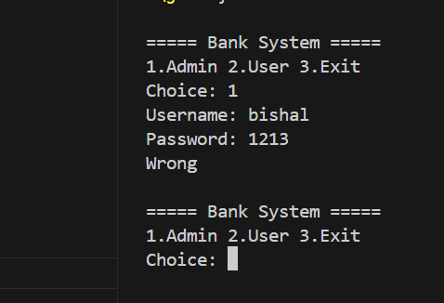
Output

Slide 11
CONCLUSION
The Bank Management System developed in C++ is a functional project that manages accounts, transactions, and reports efficiently. It supports both admin and user roles, allowing operations like deposits, withdrawals, transfers, and statement generation. By using file handling and structures, it ensures proper record keeping with transaction histories. Although the system has limitations such as plain-text passwords and basic input validation, it provides a strong base for future upgrades like secure authentication, database support, and an improved user interface.

Slide 12
Thanks!
Does anyone have any questions?
TEAM MINTERS

