Slide 1
Heavy Tails & Inference
in DBS, OCBC and UOB
DS607 Statistics for Data Science · Group project · Singapore banks, 2014–2024
Are daily returns Normal, and do CLT-based intervals agree with the bootstrap?
A
Aryan Singh
J
Jaanvi Bajaj
N
Nikhil Balaji
Question, Normal vs Student-t fit
Heavy tails, CLT vs bootstrap intervals
Data, dependence and stress tests
Slides 1–3
Slides 4–6
Slides 7–9
Notes:
PRESENTER: Aryan (about 1 min)
Say: Singapore's three domestic banks are central to its financial system, and risk models often assume daily returns are Normal. Our question: are DBS, OCBC and UOB daily returns from 2014 to 2024 well described by a Normal, and do CLT-based confidence intervals agree with bootstrap intervals?
Introduce the team (CONTRIBUTIONS.md): Aryan had the project idea and did the Normal vs Student-t fitting; Jaanvi did the exploratory analysis and the CLT/bootstrap intervals; Nikhil did data preparation, dependence and regime tests.
Roadmap: I start with what we found about the distribution, Jaanvi then shows the heavy tails and the intervals, Nikhil covers data, co-movement and stress, and we close together.
Note: you open with the answer to "is it Normal?" in the next slide, then Jaanvi shows the data behind it.

Slide 2
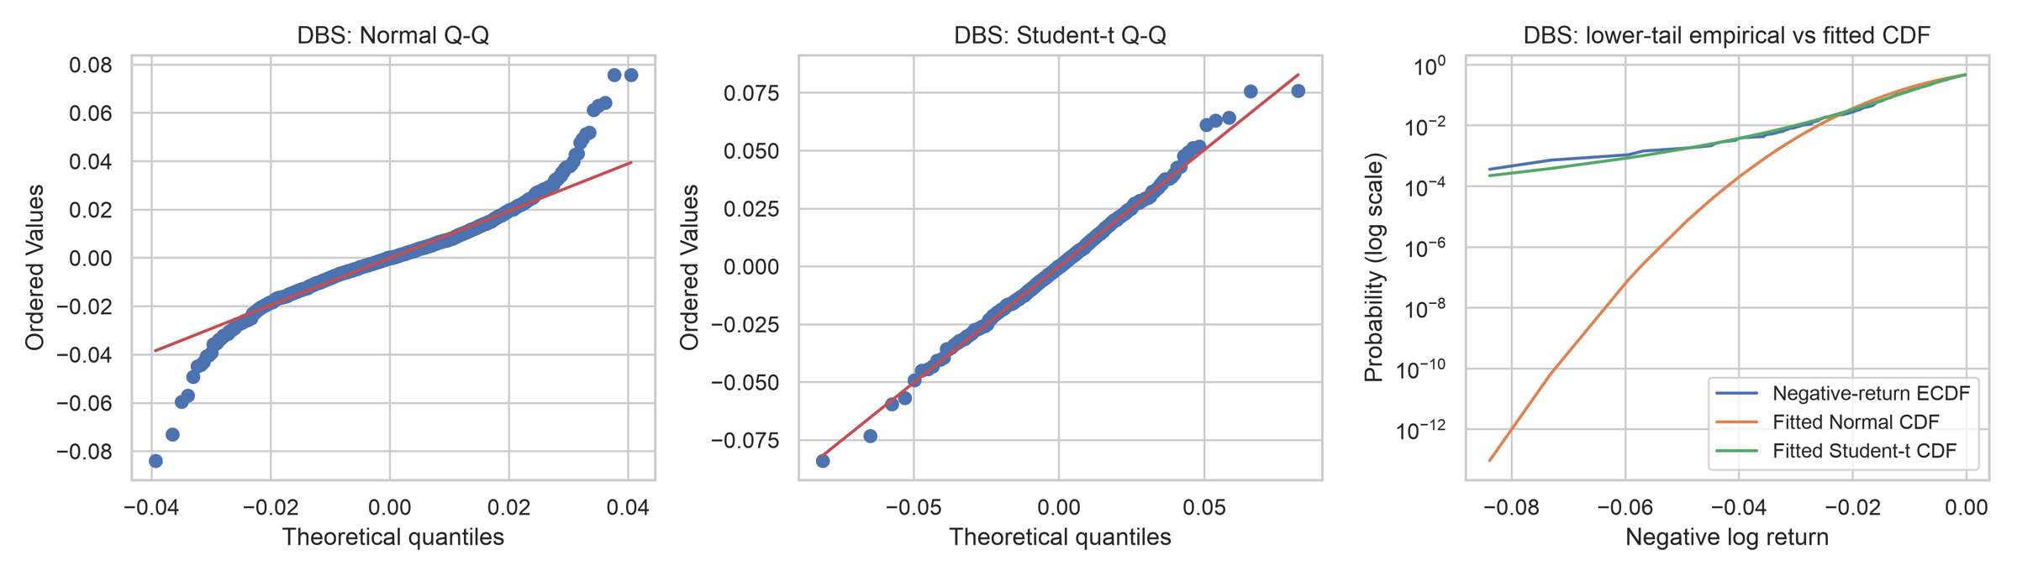
Normal fails in the tails; Student-t fits
DBS shown. OCBC and UOB figures are in outputs/figures.
Normal Q-Q
Points bend away from the line in both tails.
Student-t Q-Q
Points sit on the line, even at the extremes.
Lower-tail CDF
The Normal tail falls off far too fast.
Notes:
PRESENTER: Aryan (about 1.25 min). Basis: CONTRIBUTIONS.md - Student-t fitting, tail diagnostic figures.
Say: This is DBS. Left: the Normal Q-Q plot. If returns were Normal, the points would lie on the red line. In both tails they bend away. Middle: a Student-t fitted by maximum likelihood; the points sit on the line, even at the extremes. Right: the lower tail of the CDF on a log scale. The Normal's tail drops off many orders of magnitude too fast; the Student-t tracks the data. OCBC and UOB look the same, and the figures are in the repository.
Hand-off: "Next slide: the numbers behind this."

Slide 3
Degrees of freedom near 4; Normal rejected
Bank | LRT p | KS p (Normal) | KS p (Student-t)
DBS | < 0.001 | < 0.001 | 0.066
OCBC | < 0.001 | < 0.001 | < 0.001
UOB | < 0.001 | < 0.001 | < 0.001
All p-values from a parametric bootstrap (1,000 resamples); the smallest possible is about 0.001.
MM and MLE disagree
MM gives ν ≈ 5.1, MLE ≈ 4.1. MM uses the fourth moment, which is unstable near ν = 4, so it likely overstates ν.
Normal rejected; t imperfect
Student-t is not rejected for DBS (p = 0.066) but is for OCBC and UOB.
Notes:
PRESENTER: Aryan (about 1.25 min). Basis: CONTRIBUTIONS.md - MM and MLE fitting, fit tables.
Say: We fitted a Student-t by two methods. Maximum likelihood gives about 4.1, 4.2 and 3.8 degrees of freedom: very heavy tails. Method of moments gives about 5.1. MM relies on the fourth moment, which is noisy and barely exists when nu is near 4, so it likely overstates nu. The MM scale is s times sqrt((nu-2)/nu).
Tests: the likelihood ratio test of Normal vs Student-t and the KS goodness-of-fit tests use p-values from a parametric bootstrap, because standard cutoffs are not valid when parameters are estimated from the same data, and because the Normal sits on the boundary of the Student-t family. With 1,000 resamples, the smallest possible p-value is about 0.001. The Normal is rejected for every bank. The Student-t is not rejected for DBS (p = 0.066) but is for OCBC and UOB: better, not perfect.
If asked: why not just use the usual chi-square cutoff? Boundary case.

Slide 4
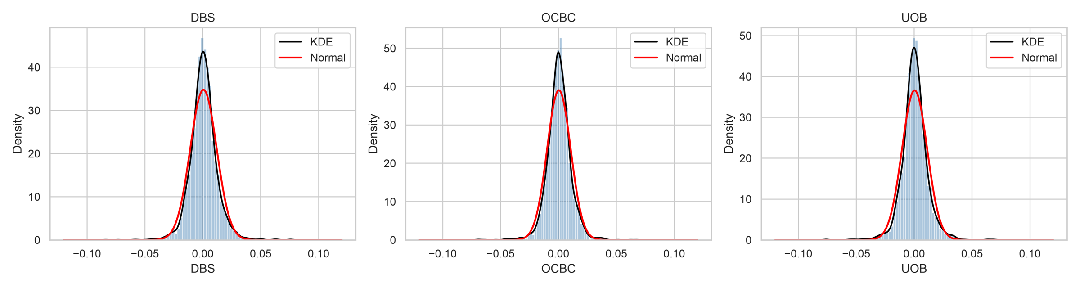
The data: far heavier tails than Normal
Histogram and KDE of daily returns vs the fitted Normal curve (red). 2,762 daily log returns per bank, 2014–2024.
Bank | Annualised volatility | Excess kurtosis | Worst day | Worst day in σ
DBS | 18.2% | 5.27 | −8.4% | −7.4σ
OCBC | 16.2% | 5.03 | −7.0% | −6.9σ
UOB | 17.3% | 5.25 | −7.6% | −7.0σ
Kurtosis ≈ 5, worst days ≈ −7σ
A Normal distribution makes a −7σ day practically impossible.
Notes:
PRESENTER: Jaanvi (about 1.25 min). Basis: CONTRIBUTIONS.md - summary statistics, histograms, KDE, ECDF and Q-Q figures.
Say: The data are Yahoo Finance adjusted close for the three banks, 2,762 daily log returns each. The histograms are more peaked than the Normal curve and have heavier tails. Excess kurtosis is about 5 for all three banks; a Normal gives 0. The worst day is about 7 standard deviations below the mean, which a Normal would essentially rule out.
Annualised volatility is 18.2% DBS, 16.2% OCBC, 17.3% UOB (daily standard deviation times square root of 252).
If asked: the 1% quantile alone is not strong evidence against Normal; the evidence is in the extreme tail and the Q-Q plots.
Hand-off: "With heavy tails in mind, do our usual confidence intervals still work?"

Slide 5
Mean returns: CLT and bootstrap agree
Bank | CLT 95% CI (daily mean) | Bootstrap 95% CI (daily mean) | Wald p (mean = 0)
DBS | 0.013 to 0.098% | 0.013 to 0.098% | 0.011
OCBC | −0.002 to 0.074% | −0.003 to 0.074% | 0.063
UOB | −0.004 to 0.078% | −0.005 to 0.078% | 0.074
p = 0.011
p = 0.063
p = 0.074
DBS: the mean daily return is significantly above zero
OCBC: interval includes zero
UOB: interval includes zero
The CLT is fine for means
With 2,762 observations the sample mean is close to Normal even with heavy tails, so both methods give the same interval.
Notes:
PRESENTER: Jaanvi (about 1 min). Basis: CONTRIBUTIONS.md - CLT, Wald and bootstrap interval analysis.
Say: For the daily mean, the CLT interval and the Efron bootstrap interval are almost identical for all three banks. Heavy tails do not matter much here: with 2,762 observations the central limit theorem works. Only DBS has a mean significantly different from zero (Wald p = 0.011). OCBC and UOB include zero.
Units: the intervals are daily mean returns in percent, so DBS is about 0.013% to 0.098% per day.
Hand-off: "Volatility is where the story changes."

Slide 6
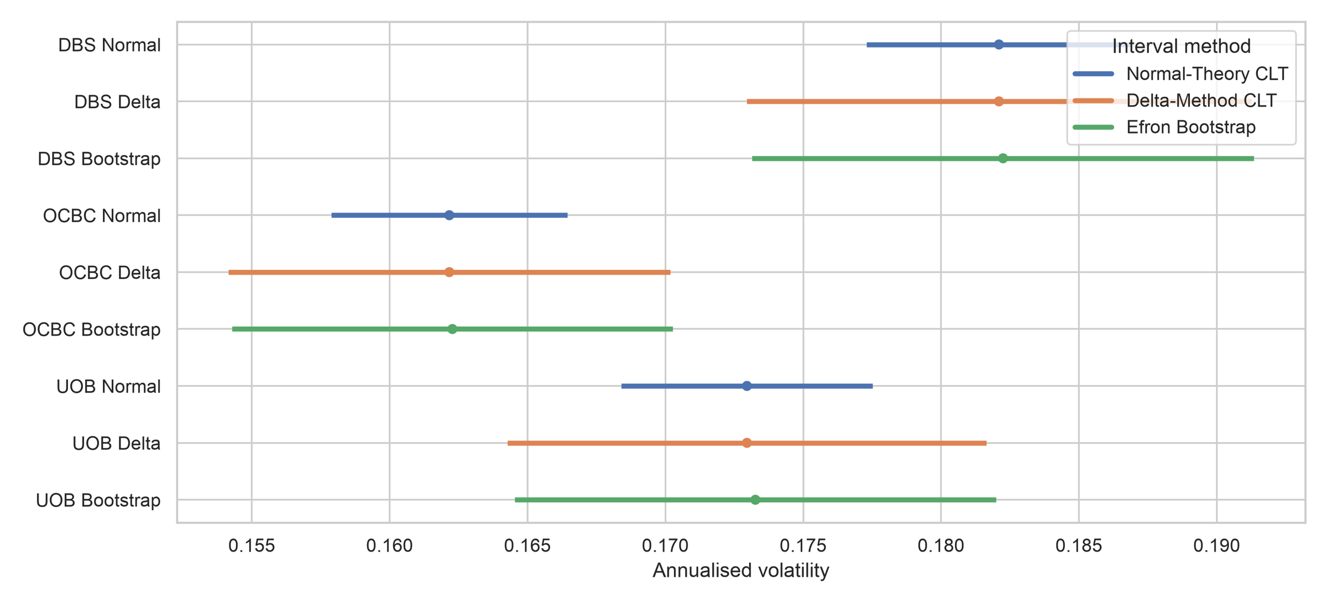
Volatility: textbook intervals too narrow
Annualised volatility, 95% intervals: Normal-theory, delta method, Efron bootstrap
Delta and bootstrap agree
DBS: Normal-theory 17.7–18.7% vs delta 17.3–19.1% vs bootstrap 17.3–19.1%. About 1.9× wider.
Why Normal-theory fails
It ignores kurtosis. The delta method uses the fourth moment; the bootstrap needs no formula.
Notes:
PRESENTER: Jaanvi (about 1.5 min). Basis: CONTRIBUTIONS.md - CLT, bootstrap and Monte Carlo interval analysis.
Say: For volatility the methods disagree. The textbook interval assumes Normal data and ignores kurtosis. The delta-method interval uses the fourth moment, and the Efron bootstrap needs no formula. Those two agree and are about 1.9 times wider than the textbook one.
Which is right? We simulated Student-t returns with nu = 5 and counted how often each 95% interval contained the true volatility. Normal-theory: 70.1%. Delta: 92.5%. Bootstrap: 92.6%. So the textbook interval is far too confident.
If asked: why not exactly 95%? With heavy tails the sample kurtosis is noisy, so even good intervals fall a little short. The bootstrap is the iid (Efron) one, so volatility clustering means intervals may still be slightly narrow.
Hand-off to Nikhil: "Now Nikhil covers the data events, co-movement and stress periods."

Slide 7
Clean data; extreme days kept and explained
3
2,762
2014–2024
Singapore banks: DBS, OCBC, UOB
daily log returns per bank
Yahoo Finance adjusted close
Date | Banks | Daily move | Market event
2020-03-09 | All three | −7.0% to −8.4% | COVID spread and oil-price crash
2020-03-23 | All three | −6.8% to −7.6% | COVID sell-off floor
2020-03-24/25 | All three | +6.2% to +7.6% | Global stimulus rebound rally
2024-08-05 | All three | −5.4% to −6.0% | Yen carry-trade unwind sell-off
2020-11-10 | DBS | +6.1% | Vaccine optimism rally
4 other dates | Mixed | ±5.2% to 7.6% | Not independently verified
Fixed before the analysis
α = 0.05, bootstrap B = 10,000, seed 42
Extreme day = a bank’s worst 10%
Calm 2017–19, COVID Feb–Jun 2020, rate-hike 2022–23
Raw data stored in the repo; pipeline runs offline
Extreme days were kept, not removed: they are what the project studies.
Notes:
PRESENTER: Nikhil (about 1.25 min). Basis: CONTRIBUTIONS.md - raw price handling, aligned returns, cleaning checks, cleaning log, extreme-date annotations.
Say: I prepared the data. Yahoo Finance adjusted close for the three banks, aligned on common trading dates: 2,762 daily log returns each. We kept the extreme days on purpose. The table shows the biggest moves and the events behind them: COVID in March 2020 and the yen carry-trade sell-off in August 2024. Four dates are marked not independently verified, and we say so in the cleaning log.
We fixed the settings before analysing: alpha 0.05, 10,000 bootstrap resamples, seed 42, extreme day = a bank's worst 10%, and the calm, COVID and rate-hike windows.
If asked: no LSEG cross-check was done. Why worst 10%? It keeps enough joint extreme days for a chi-square test (minimum expected count 27.8).

Slide 8
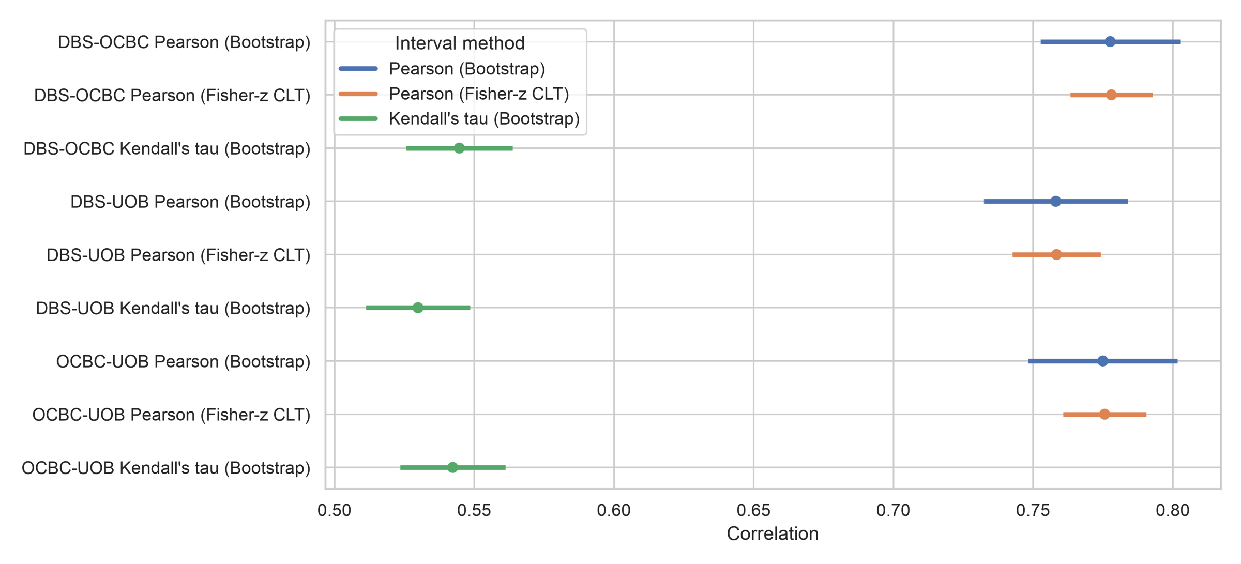
Strong co-movement, wider true uncertainty
0.76–0.78
Pearson correlation, all three bank pairs
0.53–0.54
Kendall’s τ (rank correlation)
Pair | Pearson r | Fisher-z CI width | Bootstrap CI width | Kendall τ
DBS–OCBC | 0.778 | 0.029 | 0.050 | 0.545
DBS–UOB | 0.759 | 0.032 | 0.052 | 0.530
OCBC–UOB | 0.776 | 0.030 | 0.053 | 0.543
Notes:
PRESENTER: Nikhil (about 1.25 min). Basis: CONTRIBUTIONS.md - Pearson and Kendall dependence analysis.
Say: The three banks move closely together: Pearson correlation is 0.76 to 0.78 and Kendall's tau, which uses only ranks, is 0.53 to 0.54. Both rank the pairs the same way (DBS-OCBC highest, DBS-UOB lowest), but the intervals overlap, so we do not claim the pairs differ.
Back to our research question: does the CLT agree with the bootstrap for co-movement? The Fisher-z interval is the CLT-based interval for a correlation and assumes bivariate Normal data. It is about 0.03 wide; the bootstrap interval is about 0.05 wide, roughly 1.7 times wider. Same message as volatility: Normal-based intervals understate uncertainty.
Pearson and Kendall are on different scales, so compare interval widths and ordering, not raw values.

Slide 9
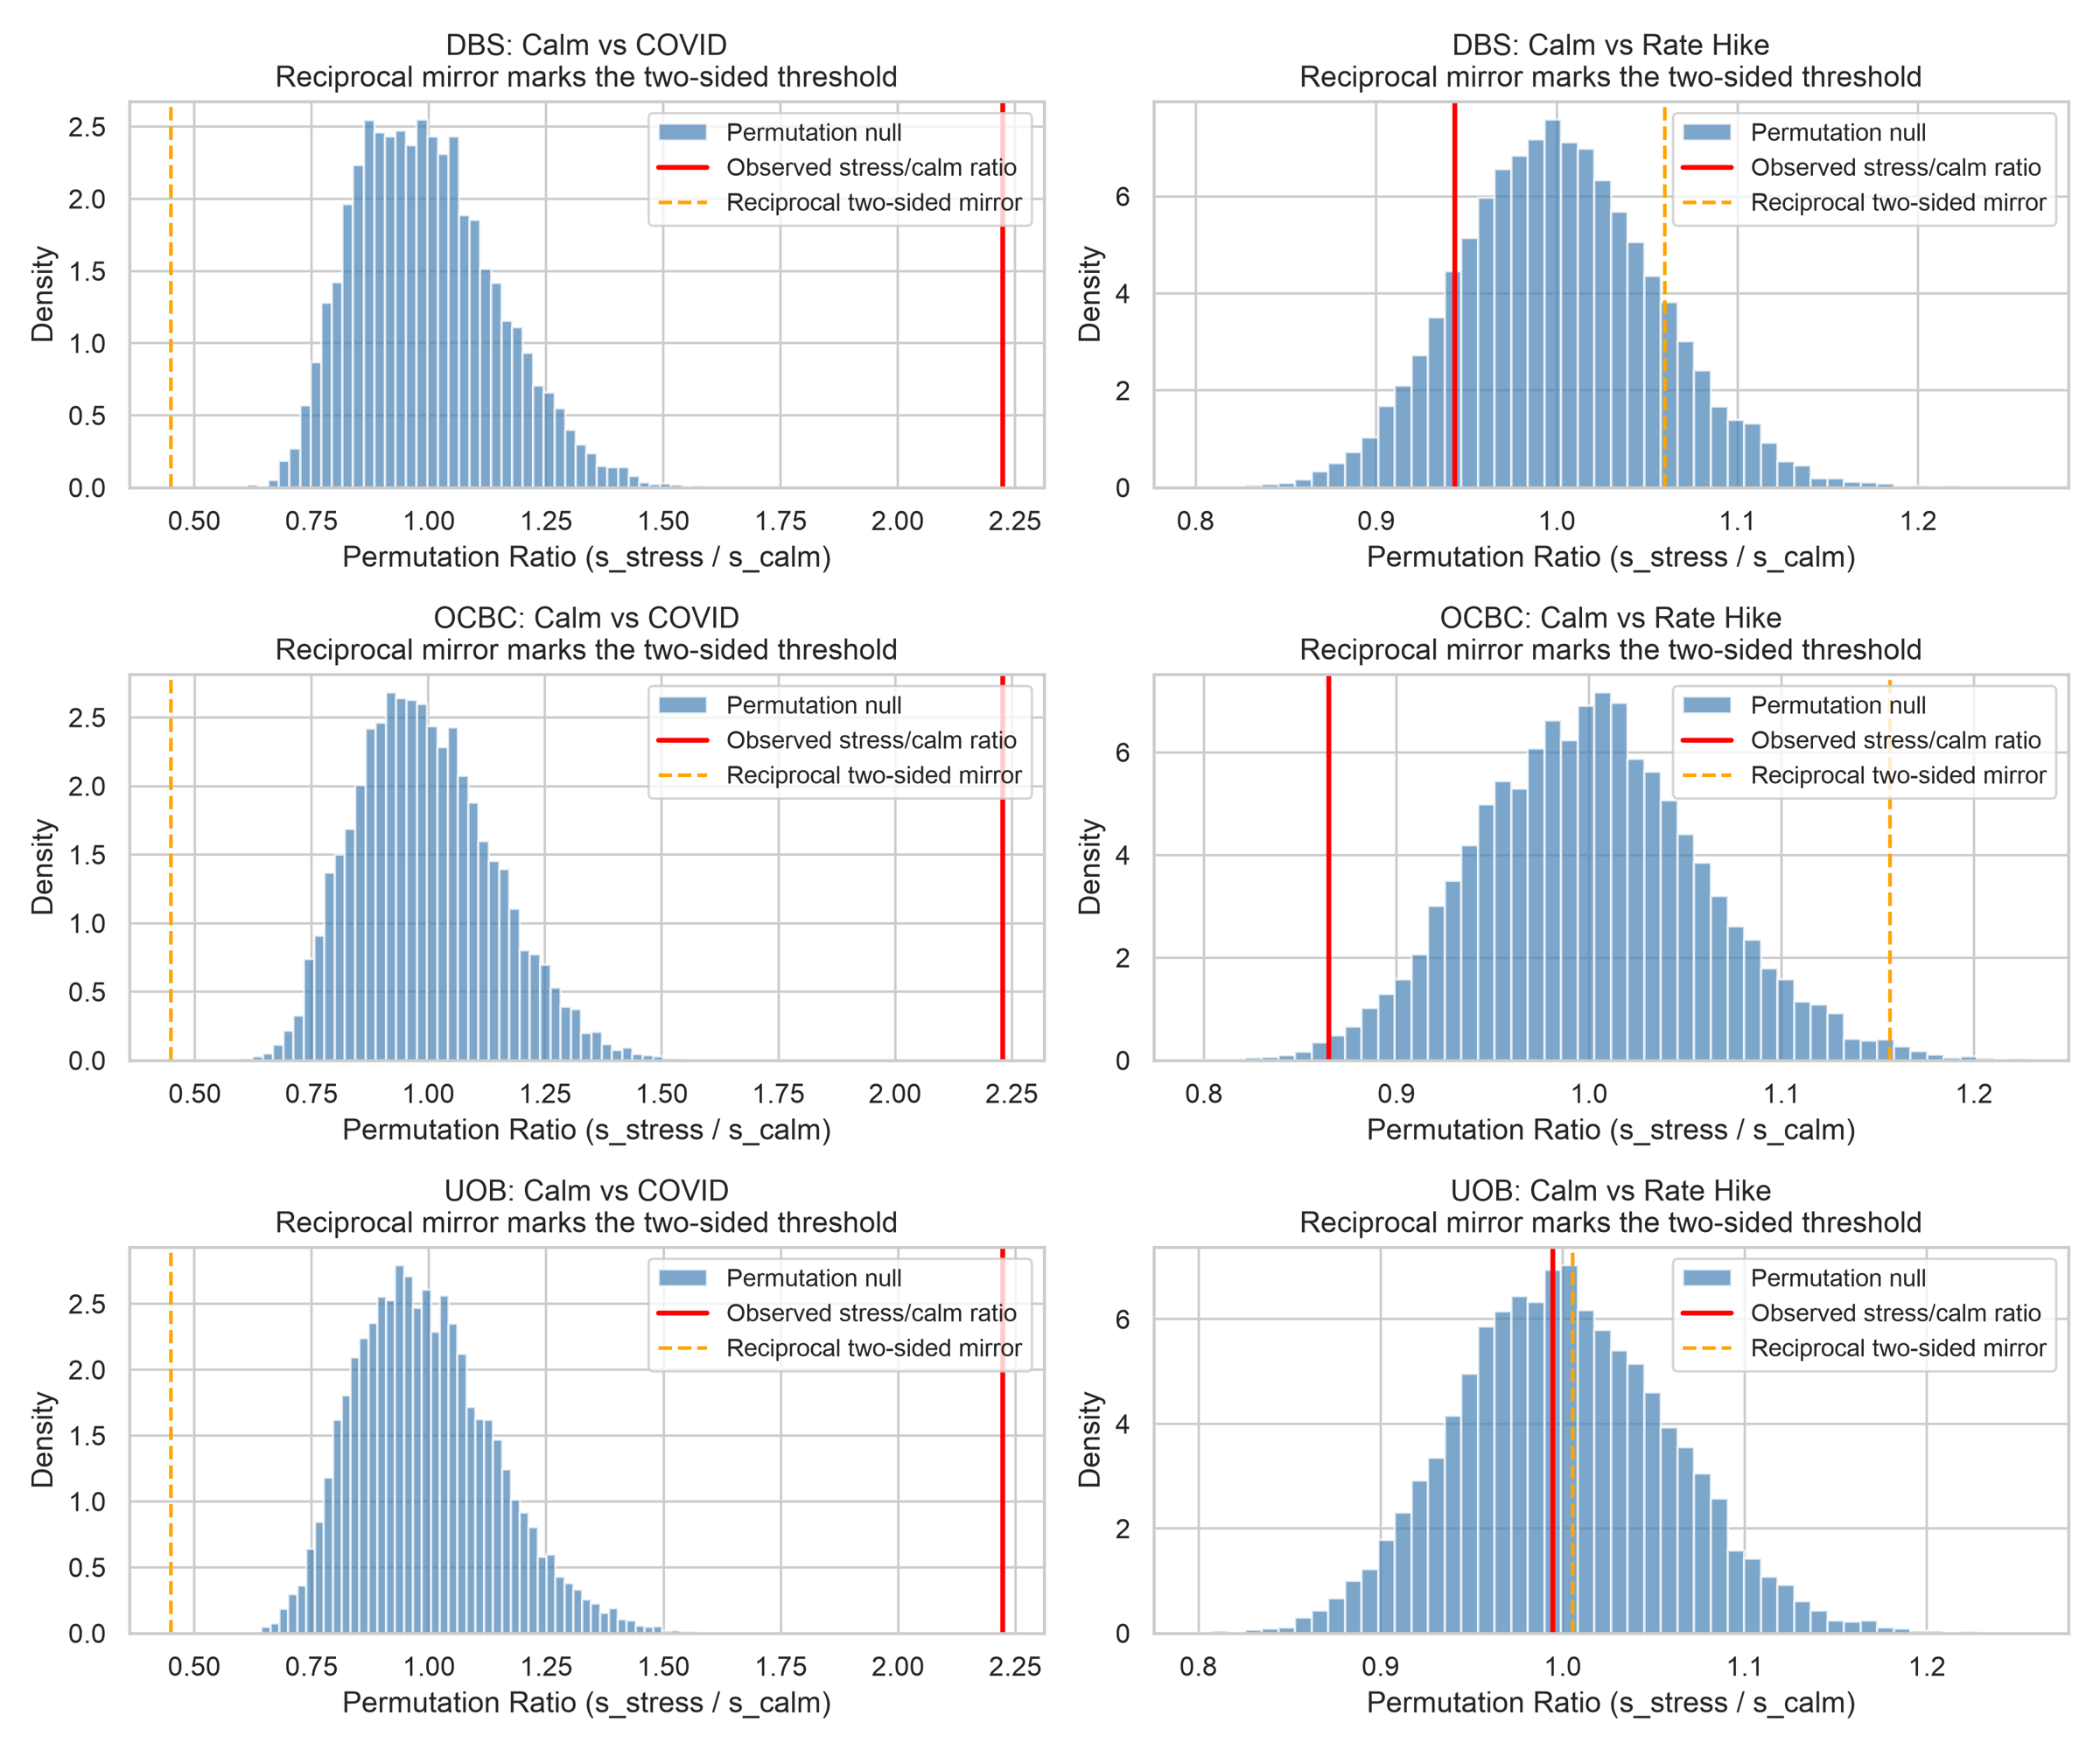
Stress doubles volatility; extremes cluster
2.2×
COVID volatility vs calm, all three banks (permutation p < 0.0001)
0.86
OCBC rate-hike vs calm: lower volatility, p = 0.014, not significant after Bonferroni (6 tests)
53–60%
Chance the second bank is also in its worst 10% when the first is. It would be 10% if independent (χ² rejects independence)
Permutation null distributions of the volatility ratio (stress ÷ calm), observed ratio in red
Notes:
PRESENTER: Nikhil (about 1.25 min). Basis: CONTRIBUTIONS.md - permutation, contingency and regime analysis.
Say: We fixed the calm window (2017-2019), the COVID window (Feb-Jun 2020) and the rate-hike window (2022-2023) in advance. A permutation test shuffles the period labels to build the null distribution of the volatility ratio. COVID volatility is about 2.2 times the calm level for all three banks; the red line is far outside the null (p < 0.0001, the smallest possible with 10,000 permutations).
The rate-hike period is not a crash. Only OCBC changes, and it is lower (ratio 0.86, p = 0.0143), which does not survive a Bonferroni correction across six tests (0.05/6 = 0.0083).
Extreme days: when one bank is in its worst 10% of days, the other is too 53% (DBS-OCBC), 56% (DBS-UOB) and 60% (OCBC-UOB) of the time, versus 10% if independent. The chi-square test rejects independence for all pairs.
If asked: days are not independent (volatility clustering), so p-values are likely too small; the effect sizes are the message.
Hand-off: "We will now close together with our takeaways."

Slide 10
Takeaways and limitations
What we found
Limitations
Normal-based risk numbers understate tail risk. Student-t (ν ≈ 4) fits far better, but not perfectly.
A
Volatility clustering: days are not independent, so intervals and p-values are probably too narrow.
One market, 11 years, three closely related banks.
Many tests without multiplicity adjustment; 4 cleaning-log events not independently verified.
CLT intervals are fine for means, but Normal-theory volatility intervals cover only 70%. Use delta or bootstrap.
J
The banks fall together 53–60% of the time, and stress doubles volatility.
N
Notes:
PRESENTERS: All three (about 1.25 min). Each person gives the takeaway beside their own initial, then Nikhil reads the limitations.
Aryan: Answer to our question: no, returns are not well described by a Normal. Excess kurtosis is near 5 and worst days near -7 sigma. A Student-t with about 4 degrees of freedom is much better, though not perfect.
Jaanvi: CLT and bootstrap agree for the mean but not for volatility: Normal-theory intervals cover only 70%, delta and bootstrap about 92.5%.
Nikhil: The banks' extreme days cluster, and COVID doubled volatility. Limitations: volatility clustering (so iid bootstrap, permutation and chi-square results are probably too confident), one market and window, multiple tests without adjustment, four unverified cleaning-log events.
LIKELY QUESTIONS
- Why bootstrap p-values for KS and the LRT? Parameters are estimated from the same data and Normal is a boundary case, so the textbook null distributions do not apply. (Aryan)
- Why is the Normal-theory volatility interval only 70%? It ignores kurtosis; delta and bootstrap include it. (Jaanvi)
- Why do MM and MLE differ (5.1 vs 4.1)? MM relies on the fourth moment, which is unstable near nu = 4. (Aryan)
- Why is Fisher-z narrower than the bootstrap? It assumes bivariate Normal data. (Nikhil)
- Why a 10% extreme-day threshold? Enough joint extremes for a valid chi-square. (Nikhil)

