Slide 1




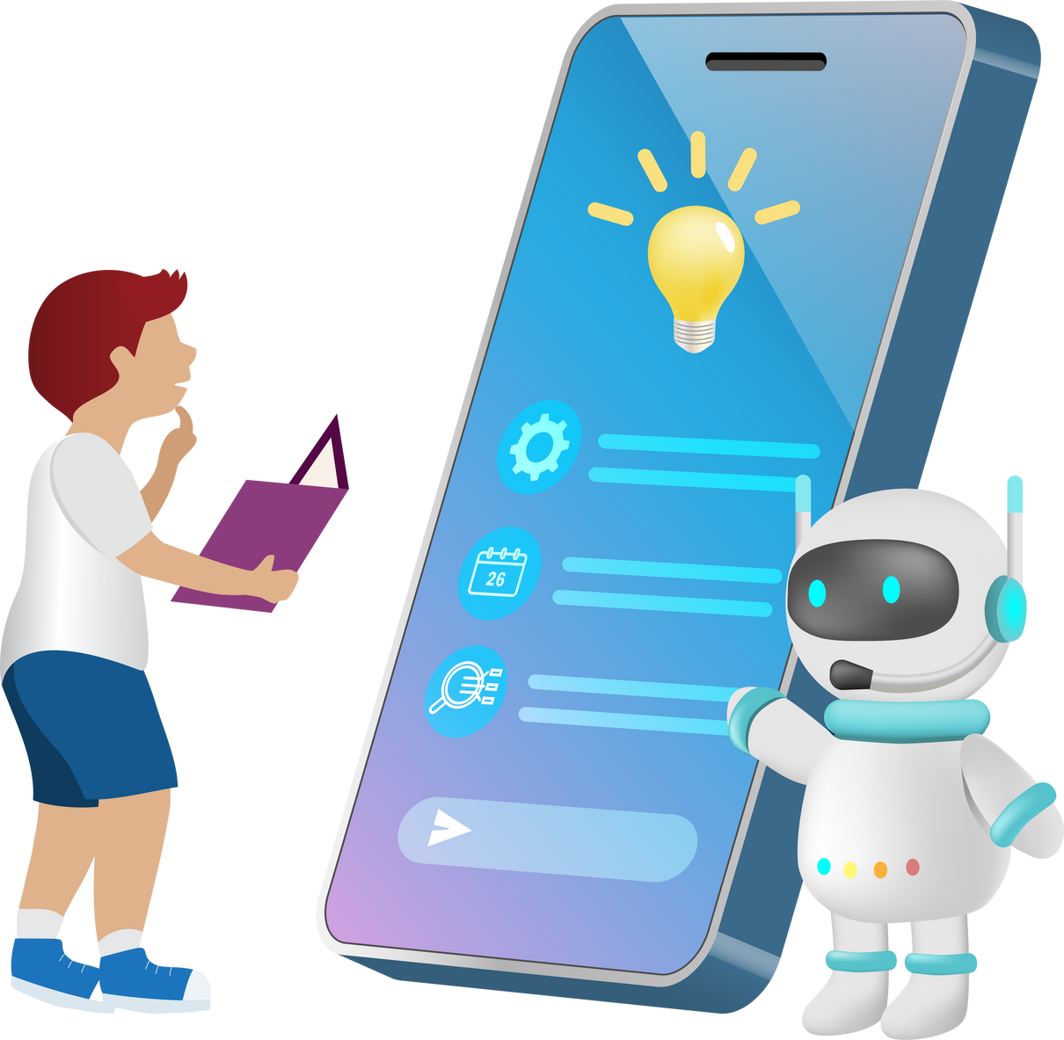
CODEKRAKEN
ORION
Presented by: Aryan Saini
IDEAFORGE

Slide 2


About Us
A virtual digital companion here to simplify your life and boost productivity. A versatile, 24/7 assistant at your fingertips, ready to assist with tasks and provide information whenever you need it.
Our virtual assistant harnesses the power of cutting-edge AI technology to understand natural language and engage in meaningful conversations. It learns from your interactions, becoming more adept at catering to your specific needs over time.

Slide 3





Tech Stack and Tools
Python
Speech Recognition
Natural Language Processing
OPEN AI API

Slide 4



Goals
Objective 01
Objective 02
Efficient as it remembers conversation until it's closed so that it can take references from past conversation to answer and once the program is closed, it erases all the conversation except the one which is important(the one which is instructed to remember)
Help play, pause, mute, unmute, set volume to a specified level and also increase/decrease volume by a specified factor viz.10., crolls up/down, close window
Objective 03
With the convenience of voice commands or text-based chat, a virtual assistant seamlessly integrates into your daily routine, helping you stay organized, informed, and efficient. No need to juggle multiple apps or tasks; your virtual assistant is your all-in-one solution for managing various aspects of your life.

Slide 5




Features
Searches the given item said on Google, Flipkart, Amazon, Ajio, Myntra, Nykaa, Youtube when asked
Plays videos on Youtube, Plays next / previous track on Spotify and switches between text to input and voice to input modes dynamically
Uses natural language processing to recognize the meaning of the sentence / input (no need to learn predefined commands)

Slide 6
CODE KRAKEN
THANK YOU
For watching this presentation
Team : IdeaForge

