Slide 1
Data-driven Hallucination of Different Times of Day from a Single Outdoor Photo
Team Name: Patanjali
Team Members:
Prajwal Krishna(20171086 , CSE)
Faizan Farooq Khan(20171209 , CSE)
Aryan Sakaria (20171123 , CSE)
Mentor TA: Pranay Gupta
Github repo link: ​ https://github.com/PK1210/Image-Hallucination

Slide 2
Problem statement
Given a single image as input, we want to automatically create a plausible-looking photo that appears as though it was taken at a different time of the day. This should be done using a fixed database of time lapse videos, of which the input image may not be a part of. Also we want to make the image look realistic, while preserving the colour schema.

Slide 3
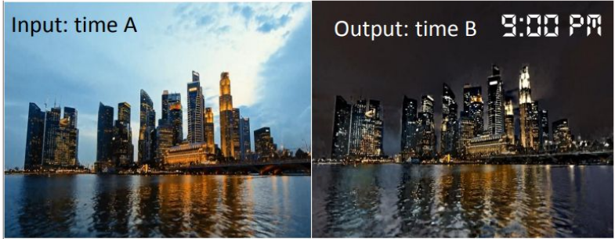

Slide 4
Goals of our project
Given a single image as input, our main goal is to time hallucinate the photo, as if it was taken at some other time of the day.
Output image should look realistic, without dramatically altering the color appearance of the picture.

Slide 5
Database
Our database contains around 450 time-lapse videos, which covers a wide range of videos with different backgrounds and foregrounds, such as different landscapes and cityscapes, including city skyline, lake, and mountain view.
This database was obtained from the
Link for the dataset: https://drive.google.com/open?id=169AH1CZ9jSlBNGaIyiKwh9ZuIOxCf0MT

Slide 6
Procedure
Our project can be divided into the following parts:
Global Matching
Selection of frames
Local Matching
Locally Affine Color Transfer

Slide 7
Global Matching
Given the scene in the input image, we would like to identify the time lapse video from our dataset, which shows a scene similar to the given input. For this we would use a standard scene matching algorithm(Xiao et al. [2010]), using Histogram of Oriented Gradients (HOG).

Slide 8
Selection of frames
Now that we have a video corresponding to an input image, we want to pick the frame, best corresponding to the input image. Once we find this, we pick the output frame by using the time, at which we want to show the hallucinated image.
We use the color histogram and L2 norm to pick the matched frame.

Slide 9
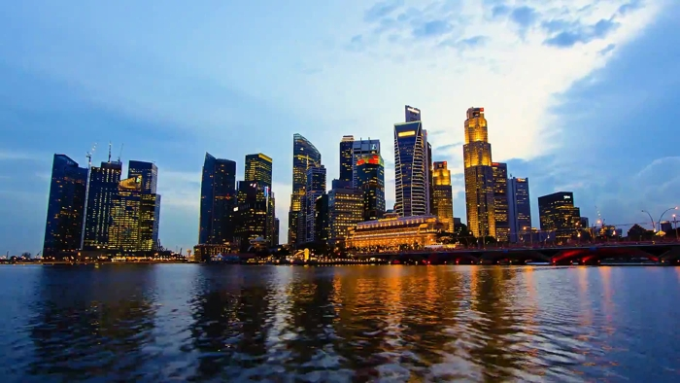
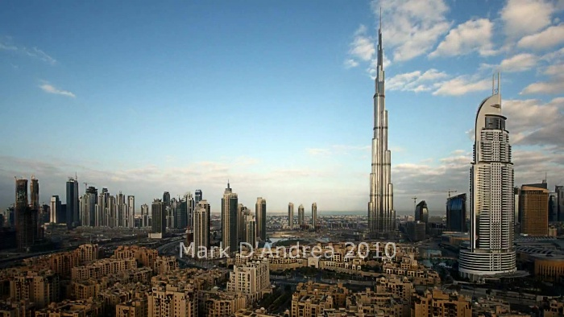
Original image
Best matching frame

Slide 10
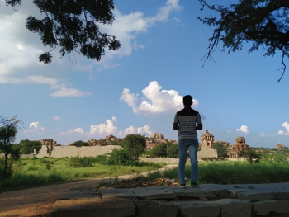
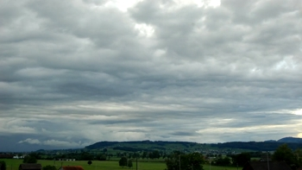
Original image
Best matching frame

Slide 11
Local Matching
Since now we have an input image and a frame from dataset at the same time of the day, we now want to find the local matching function from the input image to the frame. We propose to do this by using the Markov random field to compute dense correspondences between the images and then finally warp the videos to match the input at the pixel level. Now we apply the same function on the frame corresponding to the output time, to get a potential output image. For this, we formulate the problem as a Markov random field (MRF) using a data term and pairwise term. Moreover, we try to exploit additional knowledge from the
timelapse video.

Slide 12
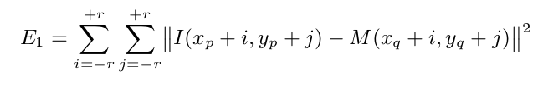
Energy function(Data term)
For each patch in I(Input images), we seek a patch in M(best matched frame) that looks similar to it. We use the L₂ norm over square patches of side length 2r + 1. For pixel p ∈ I and the corresponding pixel q ∈ M , we calculate pixel wise difference in intensities for the patch centered around the pixel.

Slide 13

Energy function(Pairwise term)
A pairwise MRF term was introduced to gain additional knowledge from the video, that the matches should remain consistent throughout the video. For two adjacent pixels pi and pj in I, we name Ω the set of the overlapping pixels between the two patches centered at pi and pj. For each pixel o∈Ω, we define the offsets δi=o−pi and δj=o−pj. For the energy we use L₂ norm within each frame t, and we want to minimize this for the worst case over the length of video to handle. This gives the pairwise term as -

Slide 14


MRF Formulation (cont.)
Final equation for energy:
Denoting λ parameter controlling the importance of the pairwise term compared to the data term, Ni the neighboring pixels of i,we find q to minimize the energy function, we plan to use Belief Propagation to do so.
Considering all possible pairings between a pixel in I with a pixel in M would be impractical because of the number of possible assignments. We pick the top n samples by randomly sampling the candidates for each patch according to the probability:
where Z is a normalization factor and σ controls how diverse the sampled patches are.

Slide 15
Locally Affine color transfer
At this step, the current output image will look unrealistic, and to fix this, we would need to perform color transfer in each patch, while preserving the overall structure of the image. So we define some affine models, which locally describe the color variations between the matched frame and the target frame. Now we can create an output image, locally affine to the input image, explained by the same affine models.

Slide 16
Denoising image
One of the side effects of using the affine mapping is that it may magnify the noise in the input image (if any). To avoid the noise magnification, we use the bilateral filtering to decompose the input image into a base layer and a detail layer. The base layer is mostly obtained noise-free, so we apply our locally affine transfer to the base layer instead of the input image. Then finally, we obtain the final output image by adding the detail layer to the transferred base layer.

Slide 17
Locally Affine color transfer (cont.)
A naive solution would be to compute each affine model A k as a regression between the k th patch of M̃ and its counterpart in T̃ , and then independently apply A k to the k th patch of I for each k.
However, the boundary between any two patches of O would not be locally affine with respect to I, and would make O have a different structure from I, e.g., allows for spurious discontinuities to appear at patch boundaries. Instead of this naive approach, we formulate this problem as a least-squares optimization that seeks local affinity everywhere between O and I

Slide 18

L 2 -optimal locally affine model
We use v k (·) to denote the k th patch of an image given in argument. For a patch containing N pixels, v k (·) is a 3 × N matrix, each column representing the color of a pixel as (r, g, b) T . We use v̄ k (·) to denote the patch augmented by ones, i.e., 4 × N matrix where each column is (r, g, b, 1) T . The local affine functions are represented by 3 × 4 matrices, A k . With this notation, the first term in our energy models the need for the A k matrices to transform M̃ into T̃ . With a least-squares formulation using the Frobenius norm k · k F , i.e., the square root of the sum of the squared coefficients of a matrix, this gives:

Slide 19

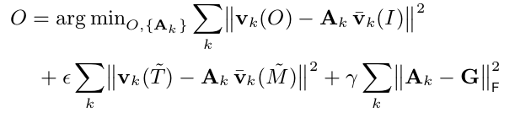
We also want the output patches to be well explained by the input patches transformed by the A k matrices:
Finally, we add a regularization term on the A k matrices for the case when Equation is under-constrained e.g., v k ( M̃ ) is constant. For this we regularize A k using a global affine model G, the regression by the entire picture of M̃ and T̃ , with the Frobenius norm. Formally, we solve

Slide 20
Work done
Understanding following sections of the paper :
Global Matching
Frame Selection
Local Matching( MRF Formulation)
Locally affine color transfer(*)
Coded
Global Matching
Frame Selection
Selection of patches for MRF

Slide 21
References
1.http://people.csail.mit.edu/yichangshih/time_lapse/time_lapse.pdf
2. XIAO , J., HAYS , J., EHINGER , K., OLIVA , A., AND TORRALBA , A. 2010. Sun database: Large-scale scene recognition from abbey to zoo. In Computer vision and pattern recognition (CVPR), 2010 IEEE conference on, IEEE, 3485–3492
3. https://papers.nips.cc/paper/1832-generalized-belief-propagation.pdf

Slide 22
THANK YOU

