Slide 1
Data-driven Hallucination of Different Times of Day from a Single Outdoor Photo
Team Name: Patanjali
Team Members:
Prajwal Krishna(20171086 , CSE)
Faizan Farooq Khan(20171209 , CSE)
Aryan Sakaria (20171123 , CSE)
Mentor TA: Pranay Gupta
Github repo link: ​ https://github.com/PK1210/Image-Hallucination

Slide 2
Problem statement
Given a single image as input, we want to automatically create a plausible-looking photo that appears as though it was taken at a different time of the day. This should be done using a fixed database of time lapse videos, of which the input image may not be a part of. Also we want to make the image look realistic, while preserving the colour schema.
We want to work from a single input photograph and allow the user to request a different time of day

Slide 3
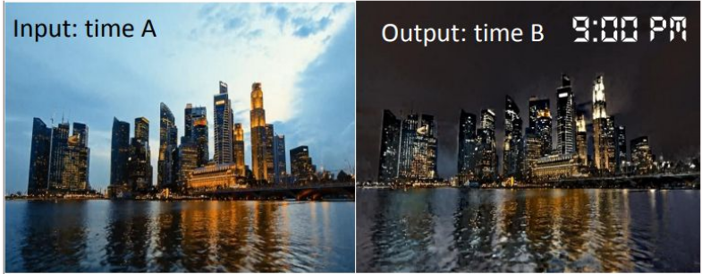

Slide 4
Goals of our project
Given a single image as input, our main goal is to time hallucinate the photo, as if it was taken at some other time of the day.
Output image should look realistic, without dramatically altering the color appearance of the picture.
Deal with the large variability of appearance changes.
Preserve structures in the input images in output images, (such as edges).

Slide 5
Database
Our database contains around 450 time-lapse videos, which covers a wide range of videos with different backgrounds and foregrounds, such as different landscapes and cityscapes, including city skyline, lake, and mountain view. This database is given a priori and independent of the user input, in particular, it does not need to contain a video of the same location as the input image.
Link for the dataset: https://drive.google.com/open?id=169AH1CZ9jSlBNGaIyiKwh9ZuIOxCf0MT

Slide 6
Procedure
Our project can be divided into the following parts:
Global Matching
Selection of frames
Local Matching
Locally Affine Color Transfer
Handling Noisy Inputs

Slide 7
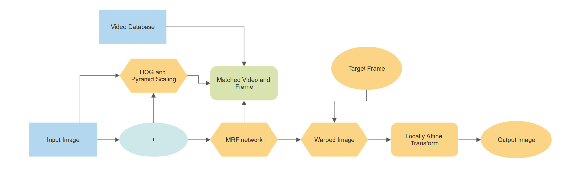
Procedure

Slide 8
Global Matching
Given the scene in the input image, we would like to identify the time lapse video from our dataset, which shows a scene similar to the given input.
We sample 10 regularly spaced frames from each video, and then compare the input to all these sampled frames. To assign a score to each time-lapse video,we use the highest similarity score in feature space of its sampled frames. For this we would use a standard scene matching algorithm, using Histogram of Oriented Gradients (HOG) and Spatial Pyramid Matching.

Slide 9
Global Matching - First step
First, we calculate dense HOG descriptor, which was given by Dalal and Triggs(2005). Here, we take 16 * 16 windows with stride of 8 on image and calculate gradient magnitude and direction over each points in four 8*8 subwindows, take these 64 gradients and put them in 9 bins (undirected edges) depending on the angle, (we allow sharing of magnitude between bins) to get a histogram of gradients which we normalize. To handle color images we select strongest gradient in RGB.Then we put the results of each subwindow one after another, which results in a 36 * 1 descriptor per window.

Slide 10
Global Matching - Second Step
Now since we are doing dense correspondence with overlapping window, we can compress our descriptor without losing much information, PCA would work but will make it computationally inefficient. So we instead approximate this 36 values using 4 normalizing factors and 9 orientation factors thus a total of 13 values representing the 4*9 original vectors. Also, we can add directed edges which will take 18 orientations. Keeping both takes 31 dimensional features. This is described in details here. Also we combine these for 2*2 neighbourhood to get a 124 dimensional feature.

Slide 11
Global Matching - Third Step
We use concept of bag-of-words and use this to quantize these descriptors into 300 visual words found using K-Means on the initial frames from timelapse dataset. This gives a small descriptor(1024 for 256*256) for images. We repeat above for 3 levels of spatial histograms and use histogram intersection, at each level which combined, where weight of each level is 1/(2^L); this give us a similarity between images.

Slide 12
Selection of frame
Now that we have a video corresponding to an input image, we want to pick the frame, best corresponding to the input image. Once we find this, we pick the output frame by using the time, at which we want to show the hallucinated image.
We use the color histogram and L2 norm to pick the matched frame.

Slide 13
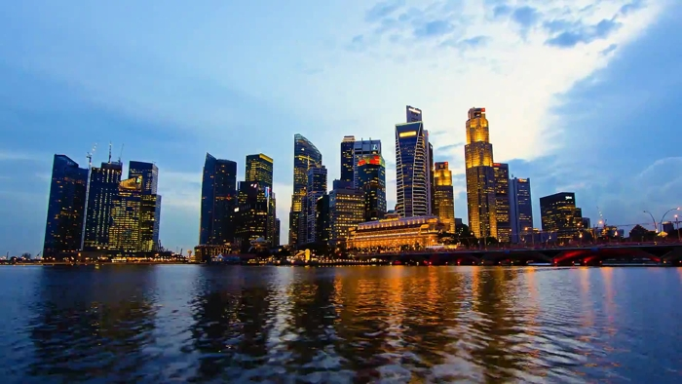
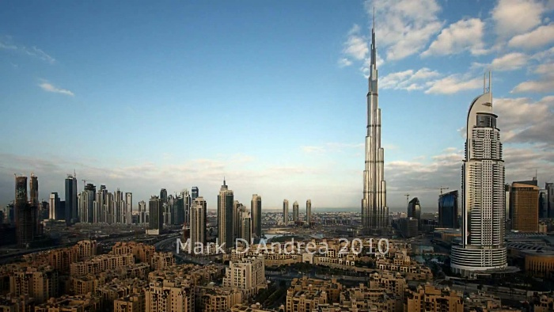
Original image
Best matching frame

Slide 14
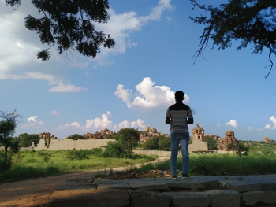
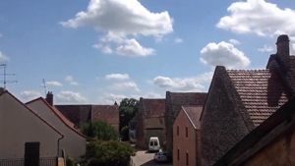
Original image
Best matching frame

Slide 15
Local Matching
We seek to pair each pixel in the input image I with a pixel in the match frame M
Methods like SIFT are not used because they are designed to match with a single image and are not designed for videos.
For this, we formulate the problem as a Markov random field (MRF) using a data term and pairwise term.

Slide 16
Local Matching
MRF formulation allows us to exploit structure found in time-lapse video
Scene geometry remains constant over the frames as the camera does not move in time-lapse videos

Slide 17
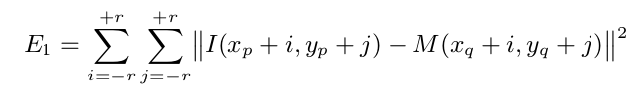
Energy function(Data term)
For each patch in I(Input images), we seek a patch in M(best matched frame) that looks similar to it. We use the L₂ norm over square patches of side length 2r + 1. For pixel p ∈ I and the corresponding pixel q ∈ M , we calculate pixel wise difference in intensities for the patch centered around the pixel.

Slide 18
Energy function(Pairwise term)
A pairwise MRF term was introduced to gain additional knowledge from the video, that the matches should remain consistent throughout the video.
For two adjacent pixels pi and pj in I, we name Ω the set of the overlapping pixels between the two patches centered at pi and pj.

Slide 19
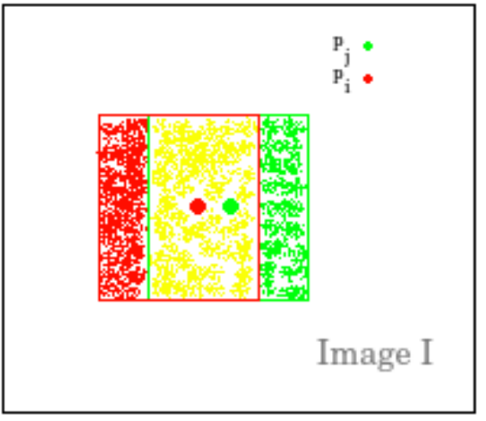
Energy function(Pairwise term)
For two adjacent pixels pi and pj in I, we name Ω the set of the overlapping pixels between the two patches centered at pi and pj.
Yellow region represents Ω, the set of overlapping pixels

Slide 20

Energy function(Pairwise term)
For each pixel o∈Ω, we define the offsets δi=o−pi and δj=o−pj.
For the energy we use L₂ norm within each frame
Then we take the L∞ across the frames of the video

Slide 21
MRF Graph (cont.)
The MRF graph made is of dimensions of the input image, with the preliminary terms calculated using only input image and matched frame, whereas the edge weights are calculated using all the frames of the matched video

Slide 22
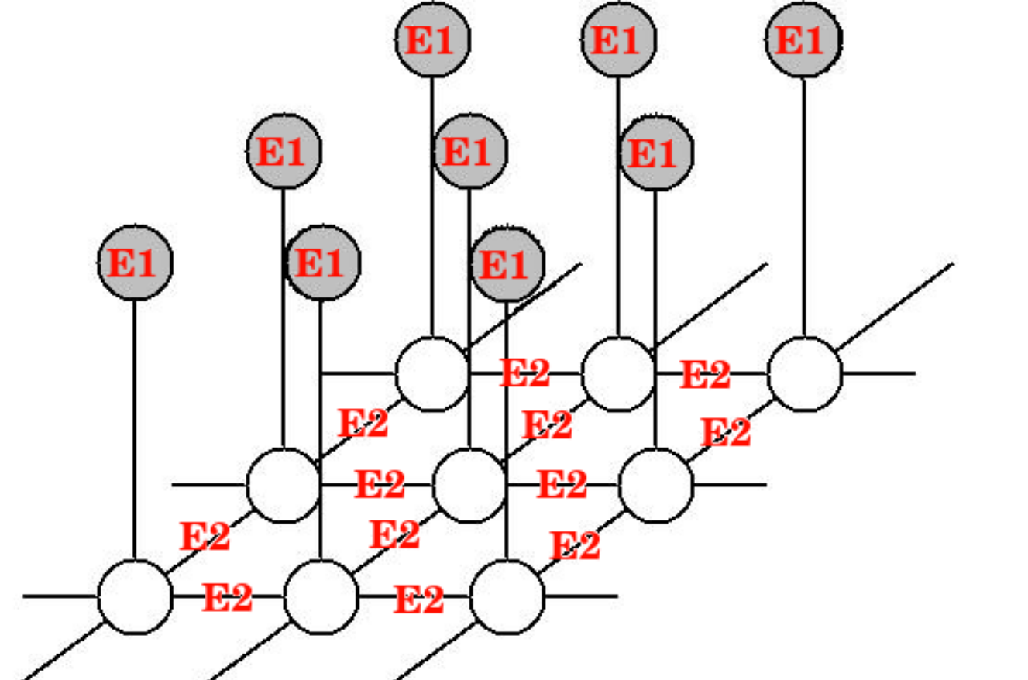
MRF Graph (cont.)
MRF graph for one image:

Slide 23


MRF Formulation (cont.)
Final equation for energy:
Denoting λ parameter controlling the importance of the pairwise term compared to the data term, Ni the neighboring pixels of i,we find q to minimize the energy function, we plan to use Belief Propagation to do so.
Considering all possible pairings between a pixel in I with a pixel in M would be impractical because of the number of possible assignments. We pick the top n(=30) samples by randomly sampling the candidates for each patch according to the probability:
where Z is a normalization factor and σ controls how diverse the sampled patches are.

Slide 24

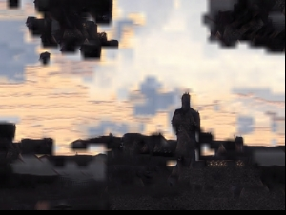
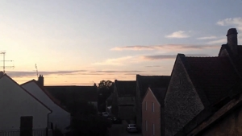
Local Matching(warping image)

Slide 25
Locally Affine color transfer
Given a densely-aligned pair of time-lapse frames obtained from our first strategy, we still need to address remaining discrepancies with our input, both because the distribution of object colors is never exactly the same.So we address to transfer the variation of color rather than the output color itself. The intuition being, if a red building turns dark red over time, transferring this time of day to a blue building should result in a dark blue.
For this we have four variables input image(I), output image(O), matched frame(M) and target frame(T) for construct {Ak}.

Slide 26
Locally Affine color transfer
We design the transfer to meet two goals -
We want it to explain the color variations observed in the time-lapse video. We seek a series of affine models {Ak} that locally describe the color variations between T and M.
We want a result that has the same structure as the input and that exhibits the same color change as seen in the time lapse video. We seek an output O that is locally affine to I, and explained by the same affine models {Ak}.

Slide 27
Locally Affine color transfer (cont.)
A naive solution would be to compute each affine model A k as a regression between the k th patch of M̃ and its counterpart in T̃ , and then independently apply A k to the k th patch of I for each k.
However, the boundary between any two patches of O would not be locally affine with respect to I, and would make O have a different structure from I, e.g., allows for spurious discontinuities to appear at patch boundaries. Instead of this naive approach, we formulate this problem as a least-squares optimization that seeks local affinity everywhere between O and I

Slide 28

L 2 -optimal locally affine model
We use vk to denote the kth patch of an image given in argument. For a patch containing N pixels, vk is a 3 × N matrix, each column representing the color of a pixel as (r, g, b) . We use v̄k to denote the patch augmented by ones, i.e., 4 × N matrix where each column is (r, g, b, 1) T . The local affine functions are represented by 3 × 4 matrices, Ak . With this notation, the first term in our energy models the need for the Ak matrices to transform M into T . With a least-squares formulation using the Frobenius norm this gives:

Slide 29

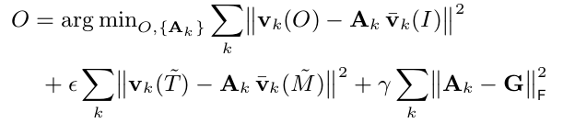
We also want the output patches to be well explained by the input patches transformed by the A k matrices:
Finally, we add a regularization term on the Ak matrices to make sure that they are not wildly different. For this we regularize Ak using a global affine model G, the regression by the entire picture of M and T̃ , with the Frobenius norm. Formally, we solve

Slide 30
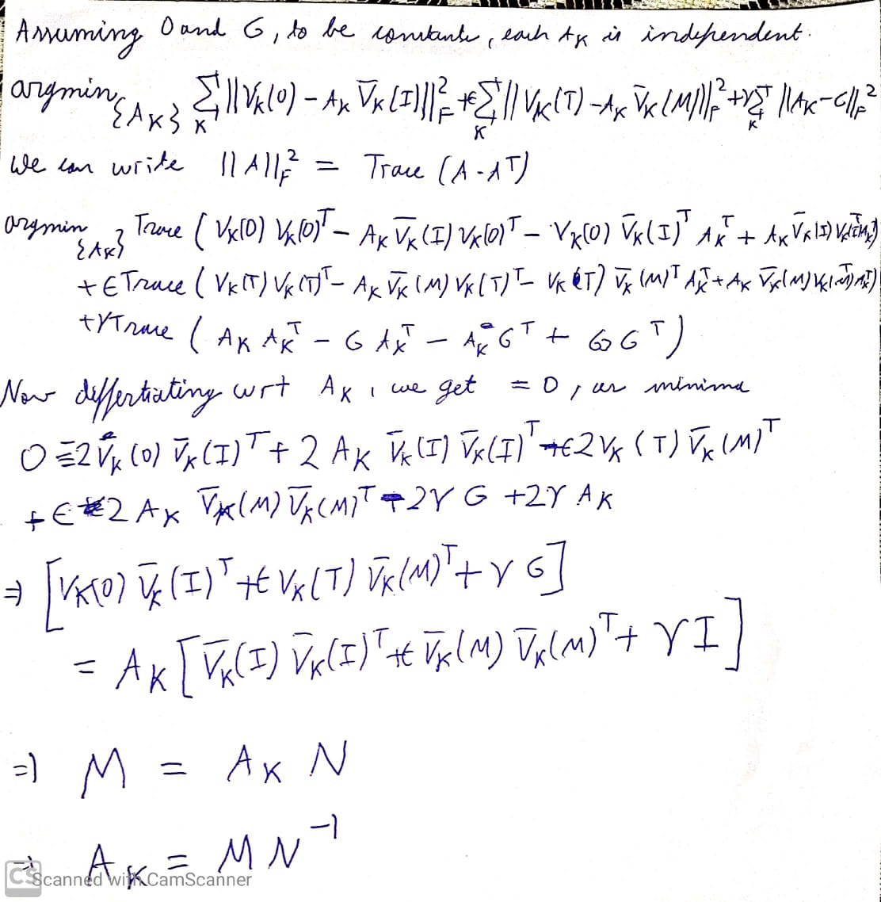
Derivation of closed form solution for finding locally affine color transfer matrix.

Slide 31
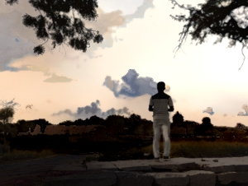
Final Output

Slide 32
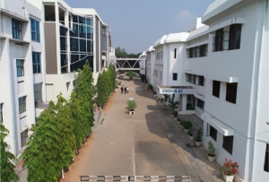
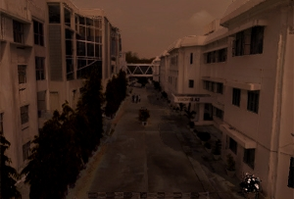
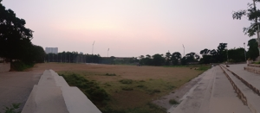
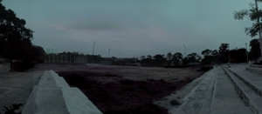

Slide 33
Denoising image
One of the side effects of using the affine mapping is that it may magnify the noise in the input image (if any). To avoid the noise magnification, we use the bilateral filtering to decompose the input image into a base layer and a detail layer. The base layer is mostly obtained noise-free, so we apply our locally affine transfer to the base layer instead of the input image. Then finally, we obtain the final output image by adding the detail layer to the transferred base layer.

Slide 34
References
1.http://people.csail.mit.edu/yichangshih/time_lapse/time_lapse.pdf
2. XIAO , J., HAYS , J., EHINGER , K., OLIVA , A., AND TORRALBA , A. 2010. Sun database: Large-scale scene recognition from abbey to zoo. In Computer vision and pattern recognition (CVPR), 2010 IEEE conference on, IEEE, 3485–3492
3. https://papers.nips.cc/paper/1832-generalized-belief-propagation.pdf
4. https://inc.ucsd.edu/~marni/Igert/Lazebnik_06.pdf
5. http://cs.brown.edu/people/pfelzens/papers/lsvm-pami.pdf

Slide 35
THANK YOU

