Slide 1
Lex Orion
Lex Orion: Task 5 Reflection and Report
Group 32
Name
PRN
Sreehari Nair
23070122144
Parth Damle
23070122161
Pratik Lakra
23070122166
Aryan Sheladia
23070122202

Slide 2
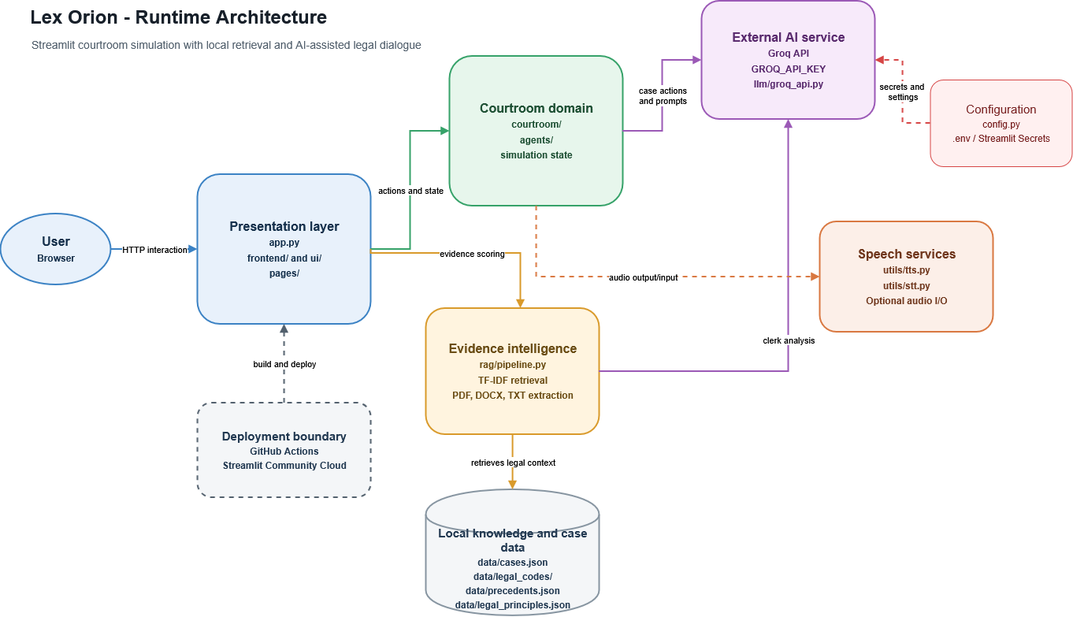
Lex Orion architecture
01
Task 5 Reflection and Report
Indian Court
Simulator
Streamlit presents the courtroom and evidence tools.
Local retrieval supplies case and legal context.
Groq generates dialogue and clerk analysis.
Notes:
Lex Orion is a Streamlit courtroom simulation application. The browser interacts with app.py and the UI modules. Courtroom and agent modules maintain simulation state and prepare prompts. The RAG pipeline extracts uploaded PDF, DOCX and TXT evidence and retrieves relevant local context with TF-IDF. Local case files, legal codes, precedents and principles provide the knowledge base. Groq supports agent dialogue and clerk analysis. Configuration supplies runtime settings and the API key. Speech input and output are optional. This slide preserves the architecture image supplied in Task 1. Its deployment boundary shows the intended GitHub Actions and Streamlit Community Cloud route. Slide 2 distinguishes that route from the current workflow implementation.
Sources
https://github.com/Sreenair-1/devops/blob/main/docs/Task1/lex-orion-architecture.drawio.png
https://github.com/Sreenair-1/devops/blob/main/README.md
https://github.com/Sreenair-1/devops/blob/main/config.py

Slide 3
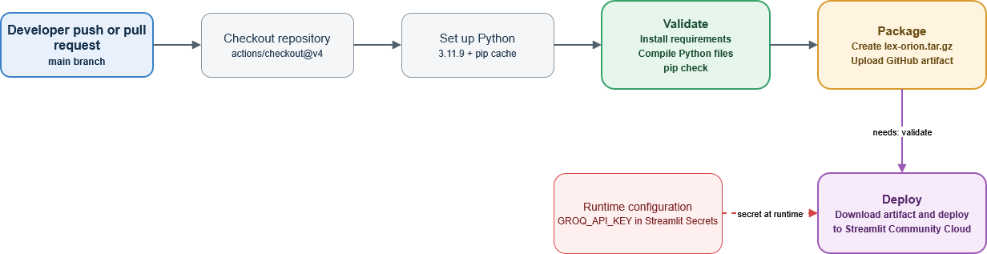
GitHub Actions pipeline
02
Repository validation and application packaging
Implemented in ci.yml
Packaging and deployment
Pushes and pull requests on main trigger Python 3.11.9 setup, dependency installation, compileall and pip check.
The package job uploads lex-orion.tar.gz after validation. Cloud deployment remains a separate step.
Notes:
The active workflow and Task 1 workflow both define validate and package jobs. Pushes and pull requests targeting main trigger the workflow. Validation checks out the repository, sets up Python 3.11.9 with a pip cache, installs requirements, checks Python syntax with python -m compileall -q ., and checks dependency metadata with python -m pip check. The package job depends on validate. It copies the source while excluding Git metadata, build output and Python cache directories, creates dist/lex-orion.tar.gz, and uploads a GitHub Actions artifact named with the commit SHA. The supplied pipeline diagram also contains a deployment box, but the workflow currently contains no deployment job. Streamlit Community Cloud deployment and runtime secret configuration therefore remain separate steps. The syntax and dependency checks are validation gates, not functional application tests.
Sources
https://github.com/Sreenair-1/devops/blob/main/.github/workflows/ci.yml
https://github.com/Sreenair-1/devops/blob/main/docs/Task1/ci.yml
https://github.com/Sreenair-1/devops/blob/main/docs/Task1/lex-orion-github-actions.drawio.png

Slide 4
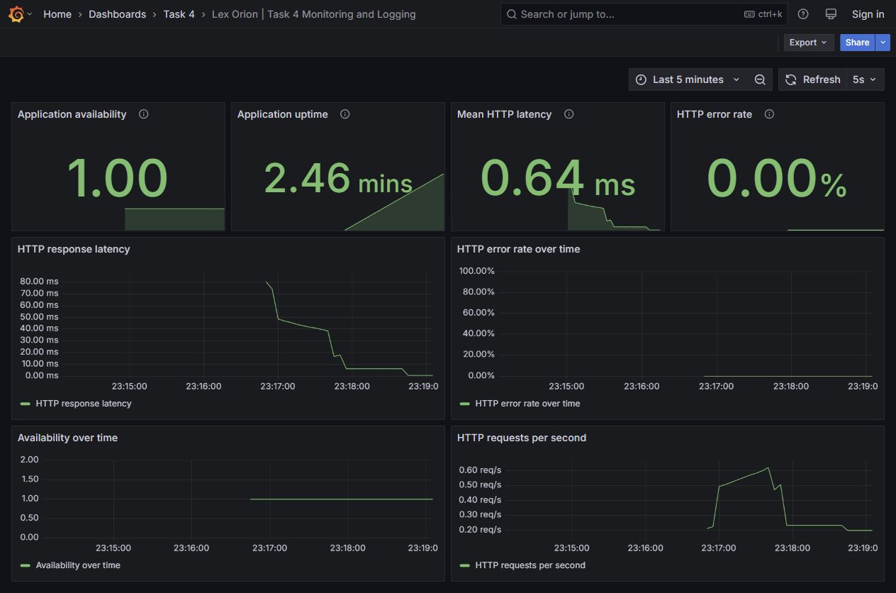
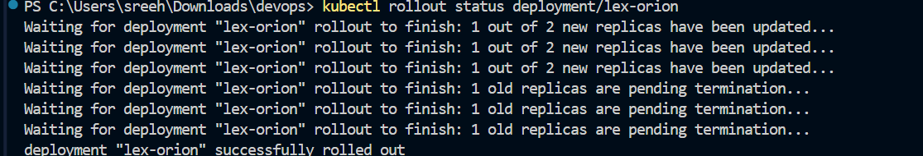
Kubernetes deployment, rollback and monitoring
03
Deployment configuration, rollout and recovery evidence
Deployment & rollout
Rolling update completed. Two replicas use readiness/liveness probes; maxUnavailable 0 and maxSurge 1.
Rollback verified
Undo restored lex-orion:task3-v1. Rollout status succeeded; both pods are Running (1/1).
Prometheus and Grafana
Availability, uptime, HTTP latency and errors are tracked in Grafana. JSON logs capture each request.
HTTP latency measures server responses, not LLM generation time.
Notes:
Task 3 deploys two lex-orion replicas behind a ClusterIP Service. Readiness and liveness probes use /_stcore/health. RollingUpdate sets maxUnavailable to 0 and maxSurge to 1; the supplied terminal capture shows the rollout completing successfully.
Rollback evidence: the supplied rollout history screenshot lists revisions 1 and 2. The rollback screenshot shows kubectl rollout undo deployment/lex-orion returning “rolled back”, rollout status completing successfully, the image returning to lex-orion:task3-v1, and both pods Running with 1/1 readiness and zero restarts.
Prometheus and Grafana track process uptime, application availability, mean HTTP latency and HTTP error rate. JSON request logs record timestamp, method, path, status and latency. HTTP latency measures server responses, not LLM generation time.
Sources
https://github.com/Sreenair-1/devops/blob/main/docs/Task3/Files/Docker/Dockerfile
https://github.com/Sreenair-1/devops/blob/main/docs/Task3/Files/k8s/deployment.yaml
https://github.com/Sreenair-1/devops/blob/main/docs/Task3/Files/k8s/service.yaml
https://github.com/Sreenair-1/devops/blob/main/docs/Task3/image-11.png
User-provided screenshots: kubectl rollout history; kubectl rollout undo/status, restored image and pod health.

Slide 5
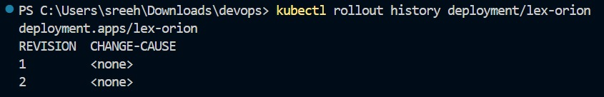
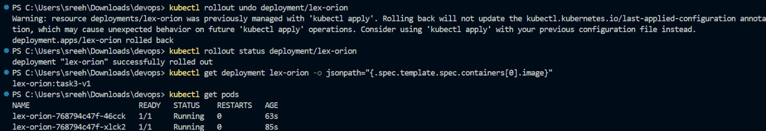
Task 3: Kubernetes Rollback Verification
04
Saved revisions, successful undo, restored image and healthy pods
Revision history
Rollback and health verification
Notes:
The first screenshot shows kubectl rollout history deployment/lex-orion with revisions 1 and 2. The second shows kubectl rollout undo deployment/lex-orion; kubectl rollout status reports successfully rolled out; the image query returns lex-orion:task3-v1; and both lex-orion pods are Running, 1/1 Ready, with zero restarts.
The output also includes Kubernetes' warning that the Deployment was previously managed with kubectl apply. The rollback command completed, and this warning concerns the last-applied annotation for future apply operations.
Evidence supplied by the user. Task 3 asks for deployment, rolling update and rollback demonstration with YAMLs and screenshots.

Slide 6
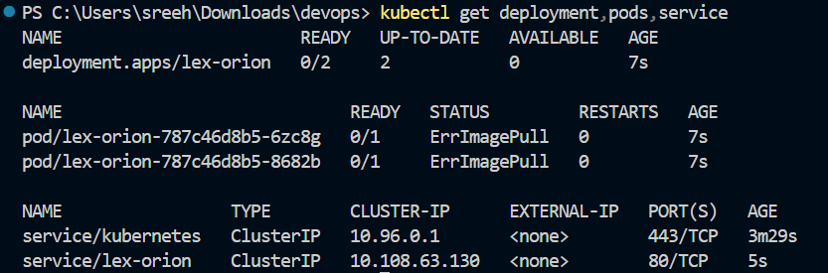
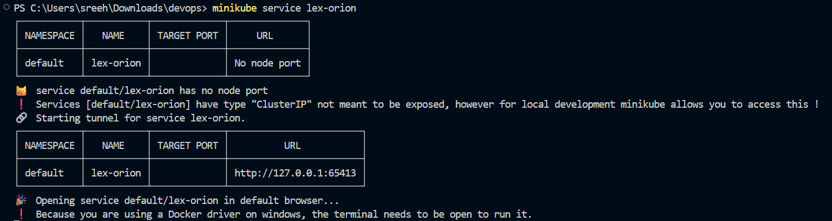
Challenges and responses
05
Issues observed during deployment and monitoring
Image availability
Initial pods showed ErrImagePull. Local image tags and pull policy must match the Minikube runtime.
Local service access
The Service uses ClusterIP. minikube service created a local tunnel, and its terminal must stay open.
Monitoring compatibility
The HTTP instrumentation uses Streamlit 1.44.1. Pinning compatible versions makes the setup repeatable.
Notes:
The first observed deployment issue is ErrImagePull: Task 3 image 6 shows two unready pods and zero available replicas. Another screenshot shows the lex-orion:task3-v1 image inside the Minikube Docker environment, and the supplied deployment manifest uses imagePullPolicy Never. Later rollout and pod screenshots demonstrate a healthy deployment. The evidence supports checking the local image tag, image availability and pull policy, but does not document every corrective command.
The second issue is local access to a ClusterIP Service. Task 3 image 8 shows minikube service creating a tunnel and providing a localhost URL, with an instruction to keep the terminal open under the Docker driver on Windows. This establishes local access without changing the Service type.
The monitoring launcher instruments Tornado HTTP request handlers. A compatible Streamlit 1.44.1 and prometheus-client 0.21.1 are pinned in requirements-monitoring.txt. The local environment had no running Docker daemon during Task 4, so Prometheus and Grafana used native Windows binaries. Grafana also needed its data directories before starting. The final start and stop scripts were exercised and both Prometheus targets, the app health endpoint and Grafana were verified after restart. These issues motivate repeatable startup scripts and explicit dependency versions.
Sources
https://github.com/Sreenair-1/devops/blob/main/docs/Task3/image-6.png
https://github.com/Sreenair-1/devops/blob/main/docs/Task3/image-4.png
https://github.com/Sreenair-1/devops/blob/main/docs/Task3/image-8.png
https://github.com/Sreenair-1/devops/blob/main/docs/Task3/Files/k8s/deployment.yaml
E:/Case Study Devops/Task4/requirements-monitoring.txt
E:/Case Study Devops/Task4/start.ps1

Slide 7
Lessons learned
06
Reflection on the completed implementation
01
Early validation
Syntax and dependency checks create a repeatable gate before packaging.
02
Reproducible deployment
Image tags, pull policy and cluster configuration must agree.
03
Useful operational signals
Readiness checks establish health. HTTP metrics and logs help explain failures.
04
Evidence of recovery
Rollback restored task3-v1; rollout status succeeded and both pods were Running.
Notes:
The project demonstrates how small, repeatable checks support application delivery. The CI workflow catches syntax and dependency inconsistencies before producing a source bundle, while functional tests would improve coverage beyond these existing checks. Local container deployment depends on matching image versions and pull policy to the actual cluster runtime. Health probes and rollout status provide operational checks that supplement configuration files.
Monitoring benefits from clear metric definitions. Application process uptime and health availability answer different questions. HTTP response latency is distinct from LLM response time. Zero observed HTTP errors during normal traffic is meaningful when the request count is nonzero, and a controlled HTTP 403 test verifies that errors contribute to the metric. Request logs provide the method, path, status and latency needed to inspect individual failures.
Recovery is now demonstrated directly: Kubernetes history lists revisions 1 and 2, rollout undo succeeds, rollout status confirms completion, the Deployment returns to lex-orion:task3-v1, and both pods are Running at 1/1 readiness.
Together, the architecture, pipeline flow, observed challenges, rollback evidence and these lessons form the Task 5 report.
Sources
https://github.com/Sreenair-1/devops/blob/main/.github/workflows/ci.yml
https://github.com/Sreenair-1/devops/tree/main/docs/Task3
https://github.com/Sreenair-1/devops/blob/main/docs/Task3/image-9.png
https://github.com/Sreenair-1/devops/blob/main/docs/Task3/image-12.png
User-provided screenshots: kubectl rollout history; kubectl rollout undo/status, restored image and pod health.
E:/Case Study Devops/Task4/README.txt

