Slide 1
Advanced Data Mining Final Project
Breast Cancer Wisconsin (Diagnostic) — Deliverables 1–4
Aryan Shrestha
MSCS-634
Notes:
Hello everyone, my name is Aryan, and this presentation summarizes my final project for the Advanced Big Data and Data Mining course.
The project uses the Breast Cancer Wisconsin Diagnostic dataset and covers all four deliverables—from data exploration and modeling to final insights, ethical considerations, and recommendations.
I’ll briefly walk you through the dataset, the main methods I used, the key results, and how these findings can be applied responsibly in a healthcare setting.

Slide 2
Dataset & Project Goals
What we’re solving and why this dataset is a good fit
Dataset: Breast Cancer Wisconsin (Diagnostic) — 569 samples, 30 numeric features, binary diagnosis.
Goal: derive data-driven insights and build predictive + interpretable models.
Workflow: preprocessing & EDA → feature engineering → regression → classification → clustering → pattern mining.
Deliverables Summary
D1: Clean data + EDA (class separation, multicollinearity)
D2: Regression (predict mean area; best: polynomial ridge)
D3: Classification (tuned SVM), clustering (k-means), association rules (interpretable patterns)
Notes:
This project uses the Breast Cancer Wisconsin Diagnostic dataset, which includes 569 samples and 30 numeric features based on cell nucleus measurements from biopsy images.
Each case is labeled as malignant or benign.
The goal was not only to build accurate prediction models, but also to understand and explain patterns in the data using different data mining techniques.
To achieve this, I followed a complete workflow that included data cleaning and exploration, feature engineering, regression, classification, clustering, and association rule mining.
The project was completed in four deliverables.
Deliverable 1 focused on data cleaning and EDA, where I found clear class separation and strong feature relationships.
Deliverable 2 involved regression modeling to predict mean area, with polynomial ridge regression performing the best.
Deliverable 3 included classification using a tuned SVM, clustering with K-Means, and association rule mining to extract interpretable patterns.

Slide 3
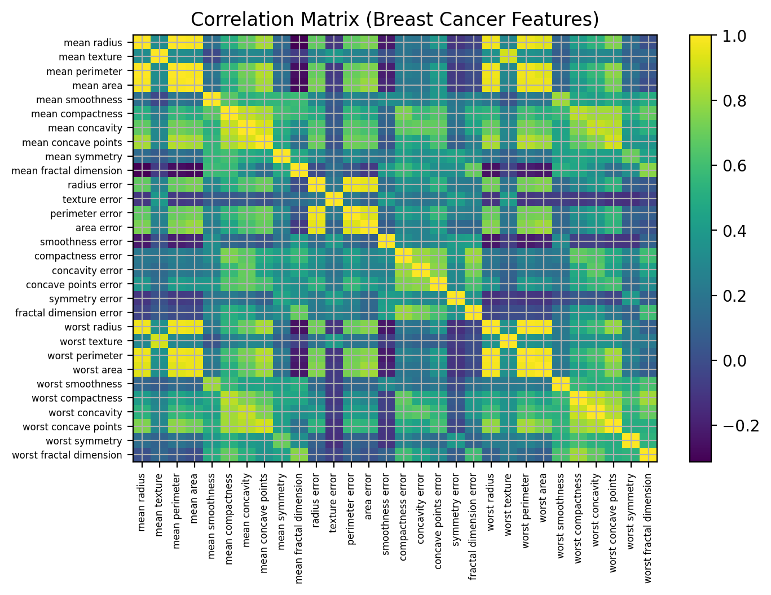
EDA & Feature Engineering
What the data told us before modeling
No missing values / duplicates detected.
Strong separation in size/texture features (e.g., mean radius, mean area).
High correlations among radius, perimeter, area → multicollinearity.
Engineered features: radius_area_ratio and compactness_by_smoothness.
Notes:
During exploratory analysis, I found that the dataset was clean, with no missing values or duplicate records.
Several size and texture-based features, such as mean radius and mean area, showed clear differences between malignant and benign cases.
However, some features were highly related to each other, especially radius, perimeter, and area, which can cause issues in modeling.
To handle this, I created two new features—radius_area_ratio and compactness_by_smoothness—to capture useful information while reducing redundancy.

Slide 4
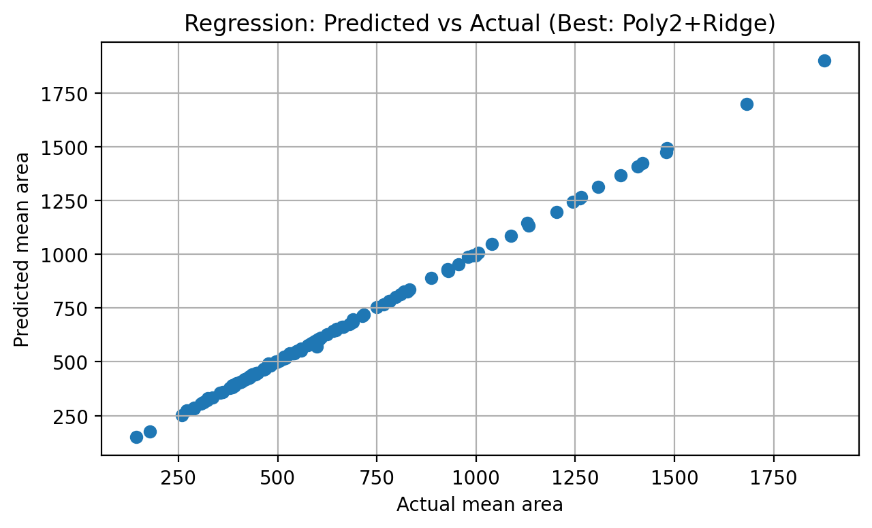
Regression (Deliverable 2)
Predicting mean area from other features
Compared Linear, Ridge, Lasso, Poly2+Ridge, Poly2+Lasso.
Best model: Poly2+Ridge (highest R², lowest error).
Regularization helps with multicollinearity; polynomial terms capture mild nonlinearity.
Notes:
In Deliverable 2, I built a regression model to predict mean area using the other features.
I tested several approaches, including Linear Regression, Ridge, Lasso, and polynomial versions of Ridge and Lasso.
The best model was Polynomial Ridge Regression, which gave the highest R-squared value and the lowest prediction error.
This shows that using regularization helps control overlapping features, while polynomial terms allow the model to capture small non-linear patterns in the data.

Slide 5
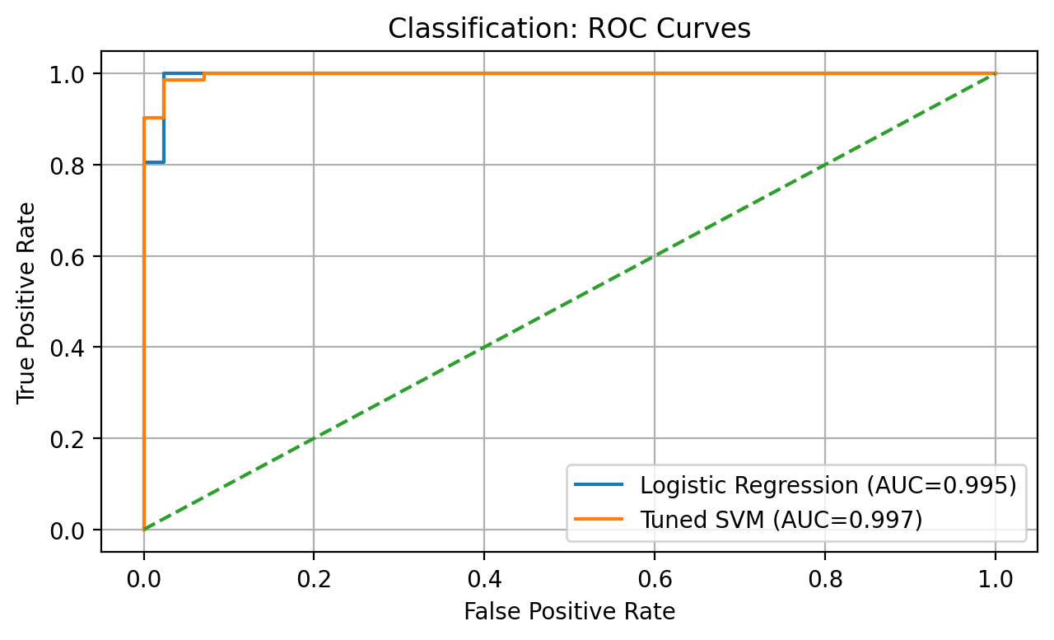
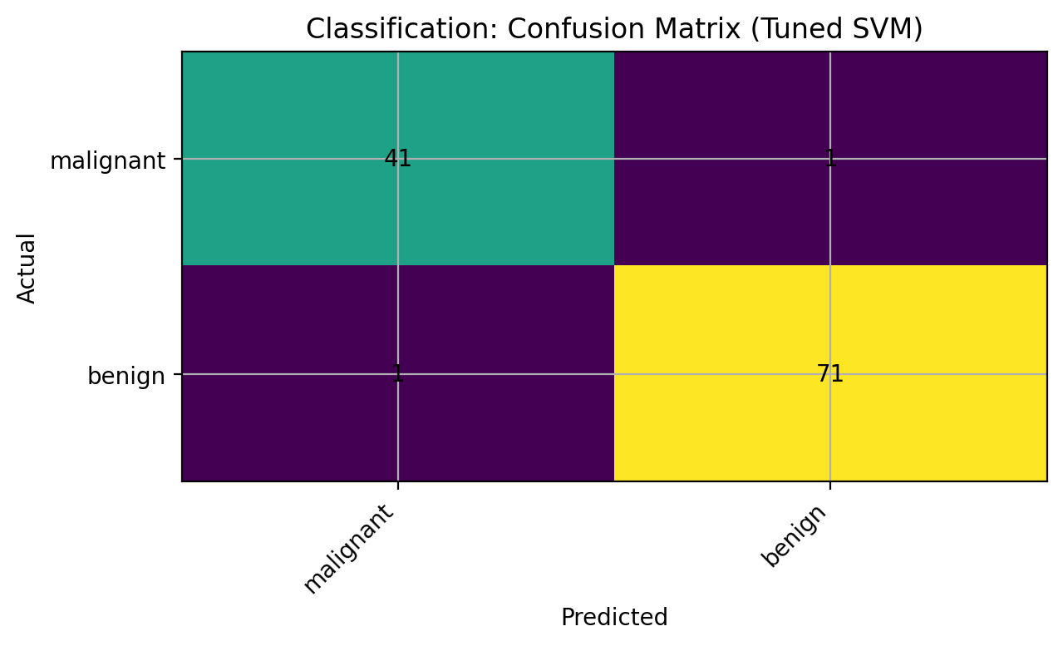
Classification (Deliverable 3)
Logistic Regression vs tuned SVM (GridSearchCV)
Tuned SVM uses RBF kernel; grid search over C and gamma.
Both models achieved high test accuracy; SVM had slightly higher AUC.
ROC curve illustrates sensitivity–specificity tradeoffs (important for medical screening).
Notes:
For classification, I compared Logistic Regression with a Support Vector Machine, or SVM.
The SVM was fine-tuned using GridSearchCV by testing different values for the C and gamma parameters.
Both models performed well, but the tuned SVM showed a slightly higher AUC, meaning it did a better job overall at separating malignant and benign cases.
The ROC curve helps show the balance between correctly identifying cancer cases and avoiding false alarms, which is very important in medical screening.

Slide 6
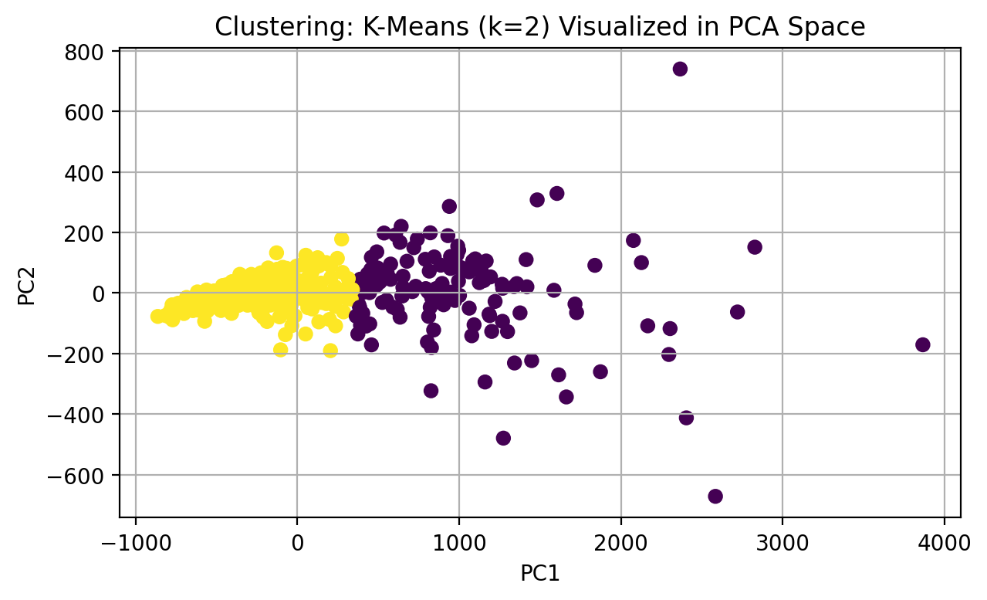
Clustering
K-Means (k=2) + PCA visualization
Unsupervised clustering finds structure without diagnosis labels.
K-Means with k=2 roughly aligns with malignant vs benign groups.
PCA projection helps visualize separation in 2D.
Notes:
I also used K-Means clustering with two clusters to explore the structure of the data without using the diagnosis labels.
Even though clustering is an unsupervised method, the groups formed by the model roughly matched the malignant and benign cases.
I used PCA to visualize the clusters in two dimensions, which helped confirm that the data has meaningful patterns and structure.

Slide 7
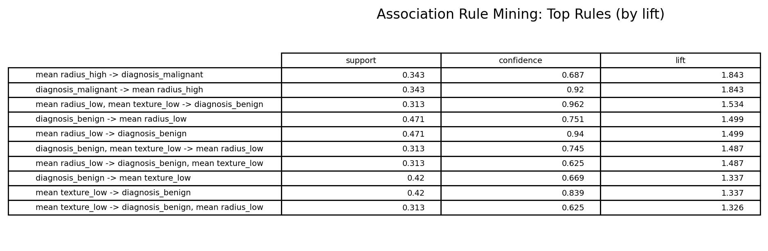
Pattern Mining (Association Rules)
Interpretable high/low feature combinations
Continuous features were discretized into high/low bins (median split).
Rules summarized using support, confidence, and lift.
Example insight: high radius → higher likelihood of malignancy; low radius/texture → benign.
Notes:
To make the results easier to understand, I used association rule mining.
I turned some numerical features into simple high and low categories using the median value, and then looked at patterns based on how often they occur and how strongly they are related.
One clear result was that higher radius values are often linked to malignant cases, while lower radius and texture values are more common in benign cases.
These patterns are easy to interpret and help explain the results from the predictive models.

Slide 8
Ethics, Recommendations, Next Steps
How to use these results responsibly
Recommendations
Use tuned SVM as decision support with calibrated thresholds.
Pair predictions with rule-based explanations for transparency.
Validate on external cohorts before deployment.
Key Takeaway
Combining predictive models (SVM) with interpretable patterns (rules) yields strong performance and better explainability for healthcare decision support.
Ethical considerations
Future work: external validation, calibration, fairness audits, and robustness checks on real-world data.
Privacy: dataset is anonymized (no PII).
Bias risk: limited representativeness may affect fairness.
Clinical use: support, not replace, clinician judgment.
Notes:
From a practical point of view, I recommend using the tuned SVM as a decision-support tool, with carefully chosen thresholds to reduce clinical risk.
Adding rule-based explanations alongside predictions helps improve transparency and trust.
From an ethical perspective, the dataset is anonymized and contains no personal information, but there is still a risk of bias because it may not represent all populations equally.
These models should support, not replace, clinical decisions, and should be tested on external datasets before real-world use.
The main takeaway from this project is that combining strong predictive models, like SVMs, with interpretable techniques, such as association rules, leads to both high accuracy and better understanding.
Future work includes external validation, model calibration, fairness checks, and testing on real-world healthcare data.

