Slide 1


Airline Reservation System
Aryan Singh B170299CS
Anoop Babu B170065CS

Slide 2
Introduction
Airline Reservation System is one of the most used data systems in the world.
Our project can be divided into two main parts:
The database part of the whole system with insertions, deletions and retrieval as the primary task of our system along with maintenance of the integrity of the system at all stages of a transaction.
Along with this we have developed a simple UI to help simulate the transactions taking place.
For the first part we used SQL and for the latter we have used NetBeans.
Our database handles the most basic functions of an airline reservation system, including reservation, cancellation and retrieval of a flight trip instance.

Slide 3
Concepts and Assumptions
An airport in an independent entity. An aeroplane must be granted permission to access an airport. An aeroplane can land on multiple airports and an airport can accommodate multiple aeroplanes.
Every airline company owns multiple planes and every plane must belong to a company.
Every seat belongs to one aeroplane and one aeroplane can have multiple seats. Without a plane a seat can not exist (seat is dependent i.e. a weak entity).
Every passenger has a seat but every seat need not have a passenger. Without a seat a passenger can not exist (passenger is dependent i.e. a weak entity). Also: without a passenger a flight-trip can not exist.
Every passenger is allotted a ticket.
A voyage can have multiple flight-trips but a flight-trip is associated with only one voyage.
If a user logs in they may or may not book single/multiple flight-trip(s).
Since the ER model was already complicated we have decided not to include a separate table for fare. We assume that after a user books/cancels his ticket, money is automatically deducted/refunded because his bank details are linked with user login.

Slide 4



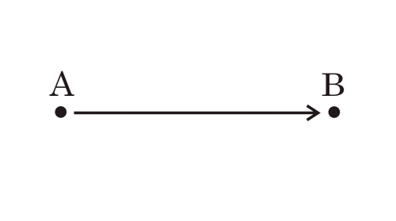
Assumptions
One flight trip can contain only one source and one destination i.e. there is no concept of connecting flights.
Consequently, one plane can not stop anywhere between its source and destination i.e. there is no concept of intermediate stops.
One flight-trip is associated with only one person i.e. a family must book tickets separately for each member.
If a user wishes to utilize any of these features they must manually book multiple flight trips.

Slide 5
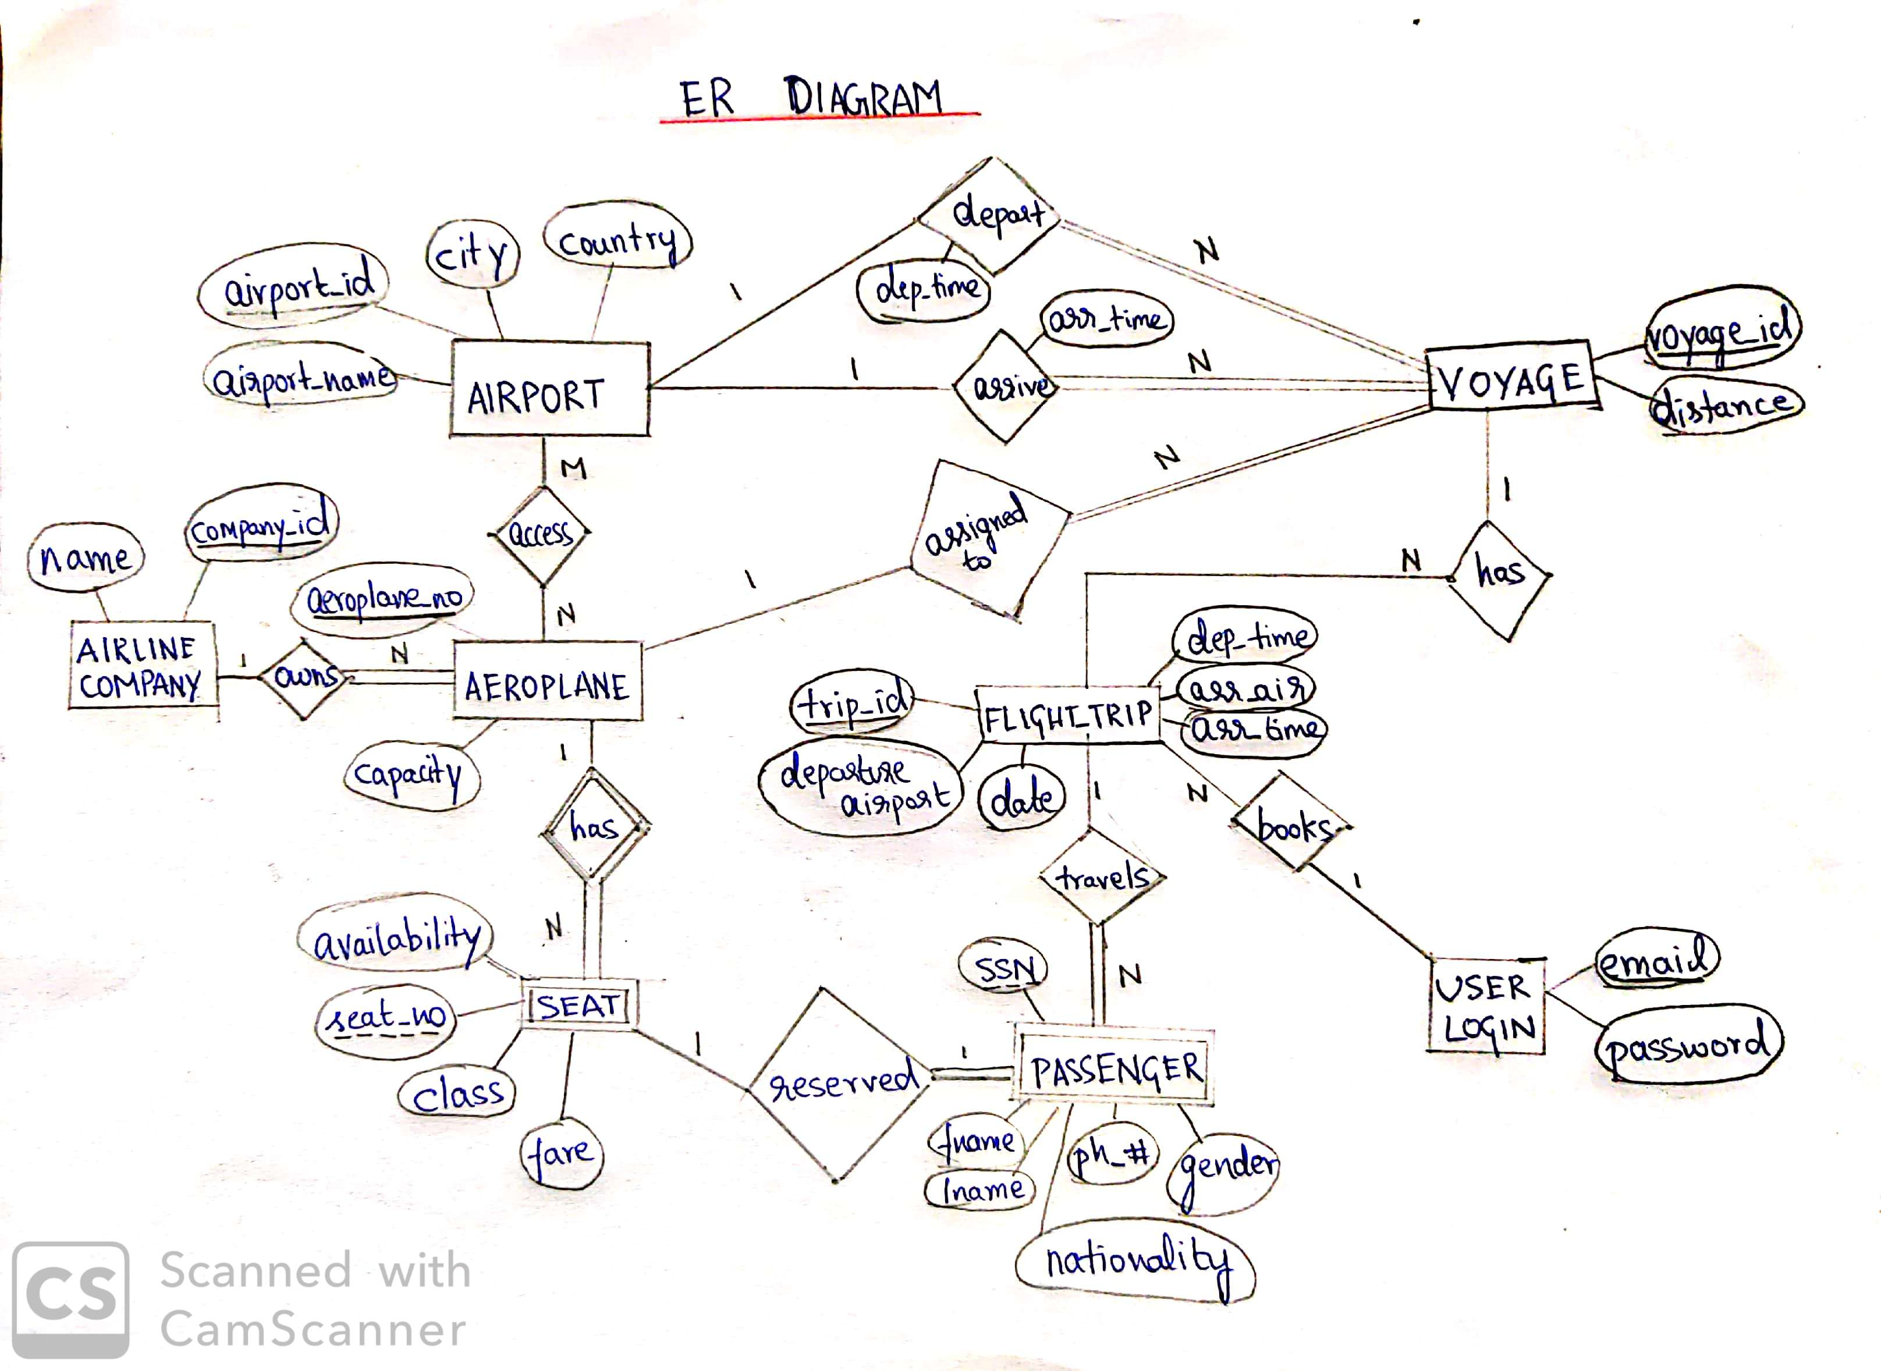
ER Diagram

Slide 6
Conversion from ER-Diagram to Relational Schema:
Step 1- Regular Entities (6):
Airport, Aeroplane, Airline_Company, Flight_Trip, User, Voyage
Step 2 – Weak Entities (2+1):
Seat, Passenger.
After constructing the Passenger table we noticed a partial dependency from SSN to passenger details such as name, phone number etc. Since this violates 2NF, we decomposed passenger table into two: Ticket and Passenger.
Step 3 to 6 – 1:1, M:N, 1:N (1):
Addition of foreign keys is implemented according to the rules.
Aeroplanes accessing airports is M:N relation and hence the addition of an extra table called access.
Step 7 – N-ary (0):
There are only binary relations so this step is irrelevant.

Slide 7
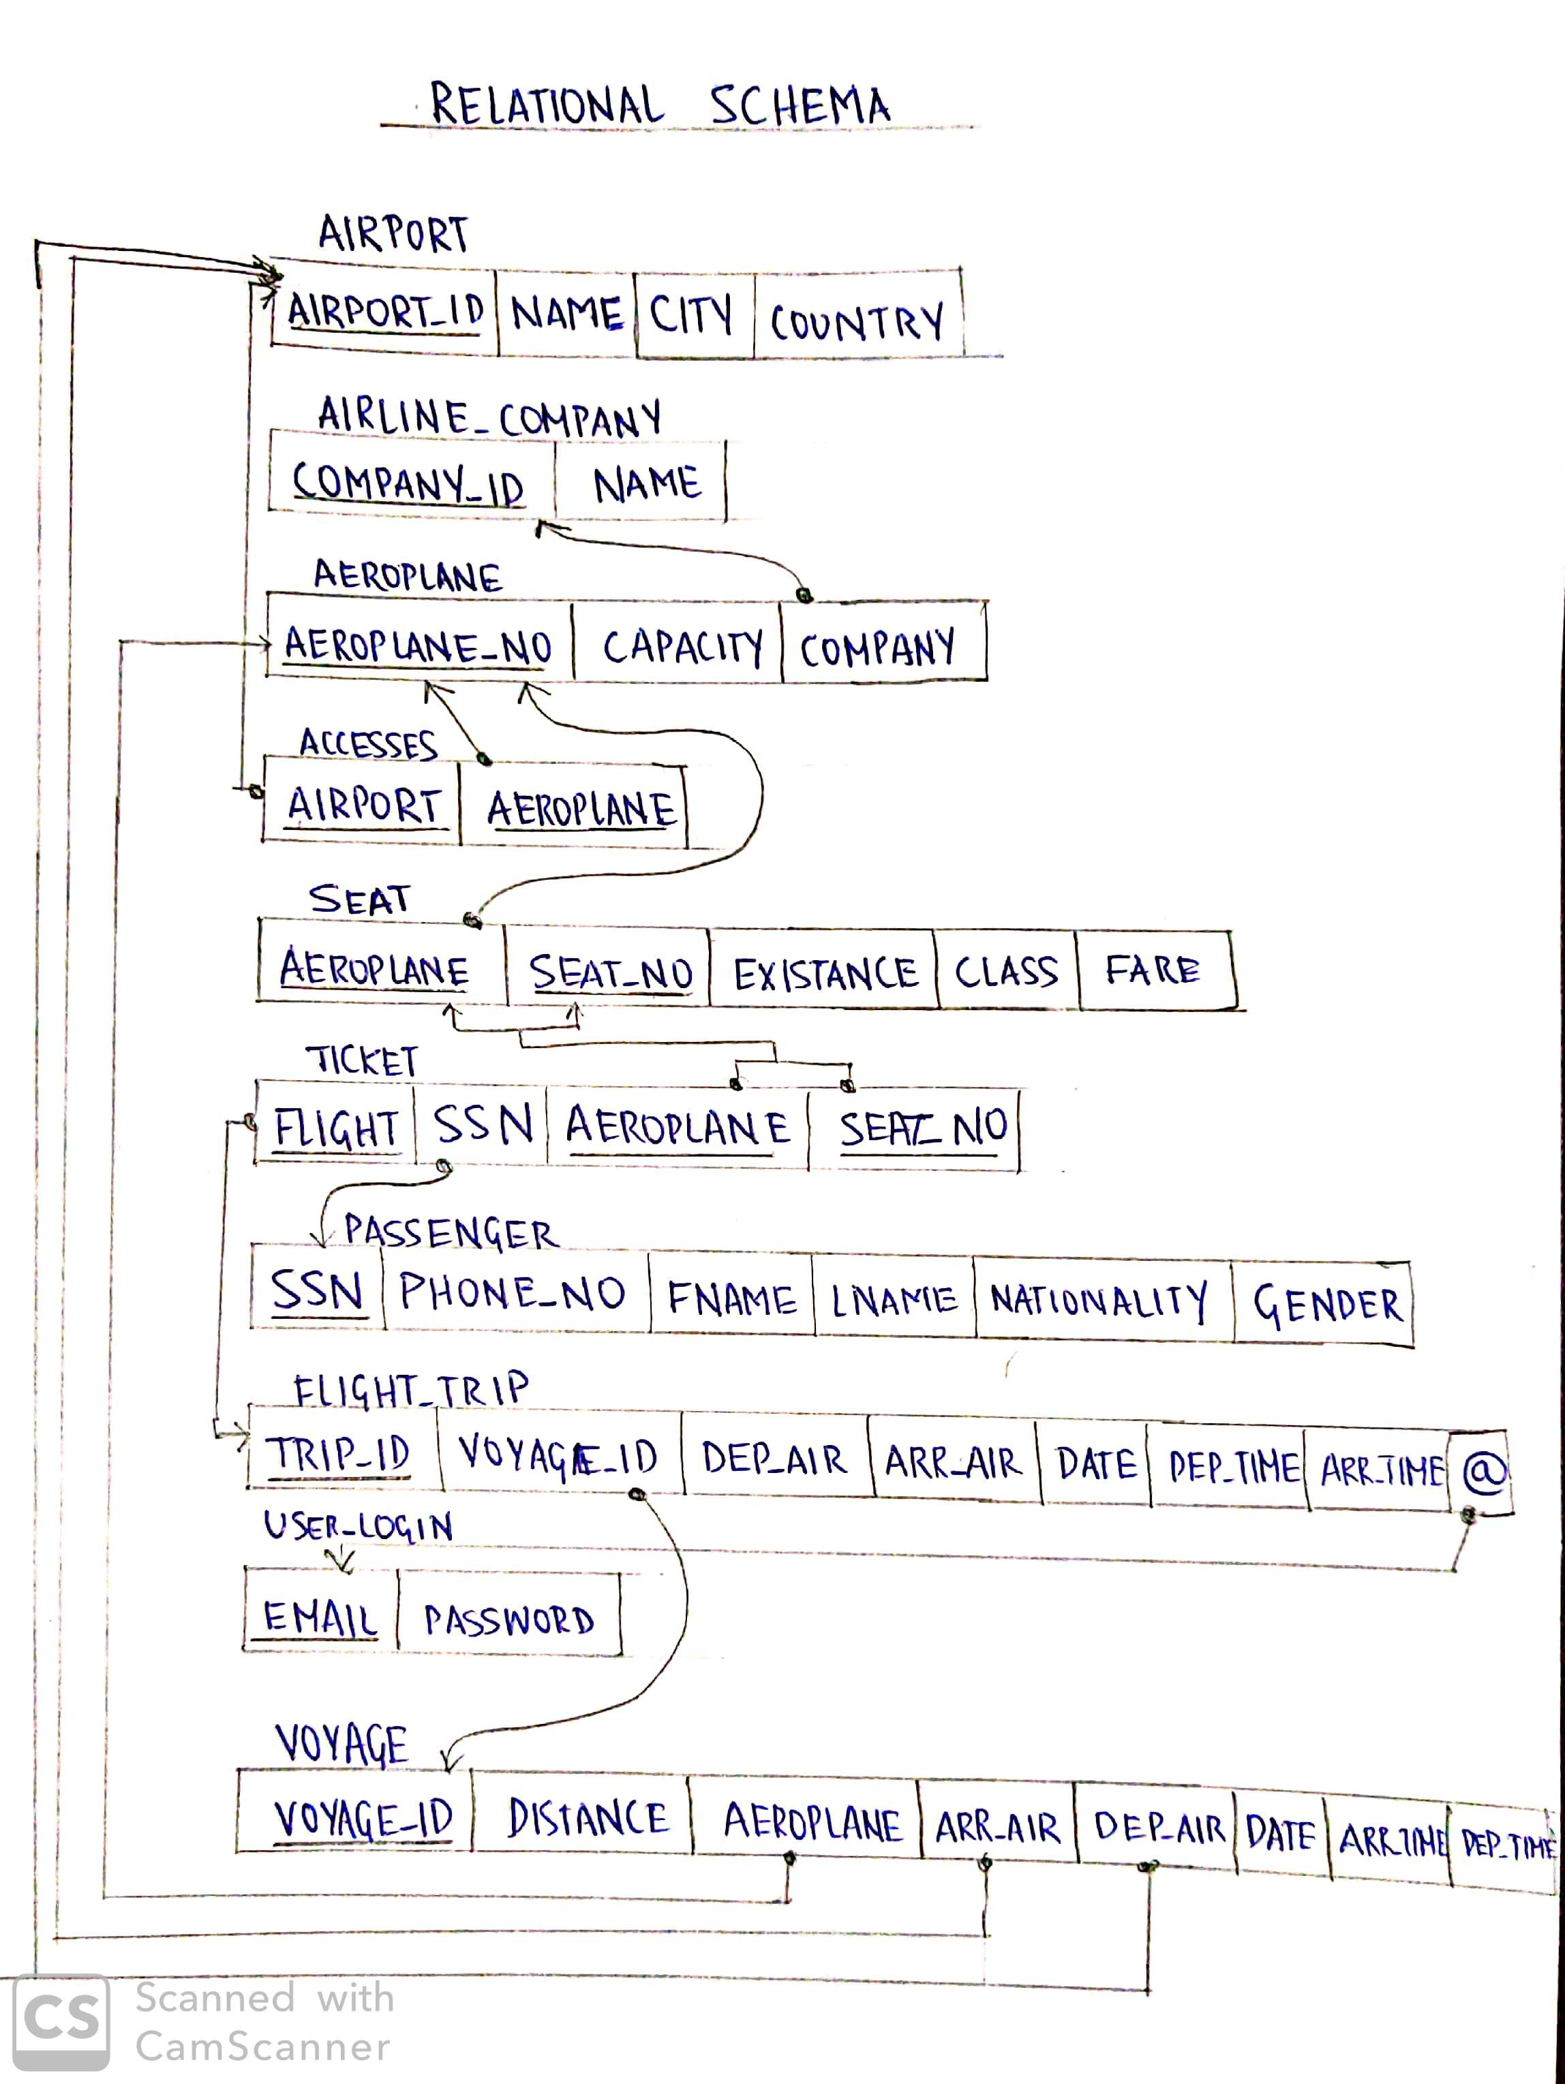
Final Conversion

Slide 8
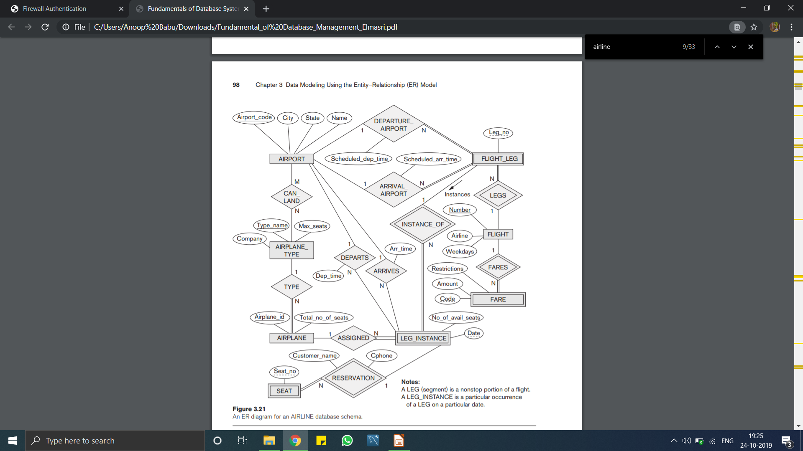
References
We have used some of the basic ideas from the ER Diagram given in the textbook. This diagram doesn’t emphasize on the actual ticket reservation process so we refined this ER model to fit our needs.

Slide 9



