Slide 1


User Guide
Airline Reservation System
Aryan Singh B170299CS
Anoop Babu B170065CS

Slide 2
Table of Contents
Six Main Screens
Login and Register Page
Welcome Page
Find Flights Page
Book Ticket Page
Help Desk Page
Cancel Ticket Page

Slide 3
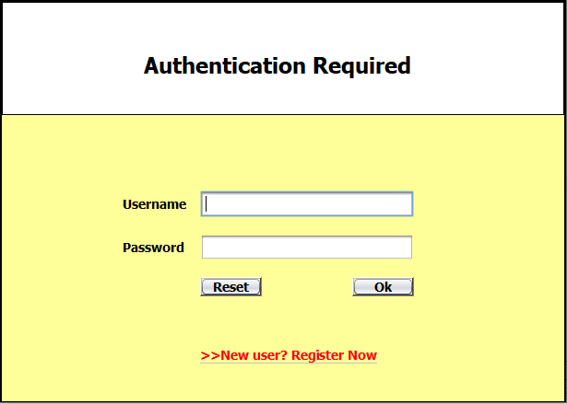
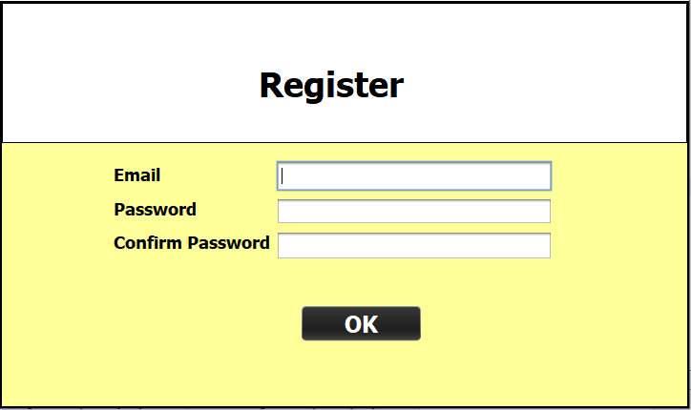
Login and Register
Once you open the project in NetBeans, the Login page will appear. If you are a new user then you can register and log in.

Slide 4
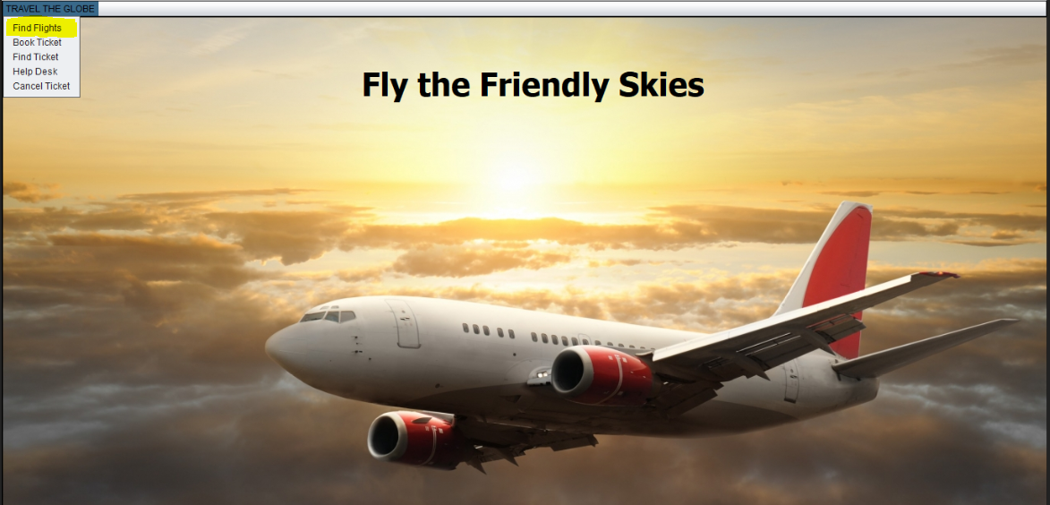
Welcome Page
Once you successfully log in, the Welcome screen will appear. From the drop down menu in the upper left corner of the screen you can choose one of five options.

Slide 5
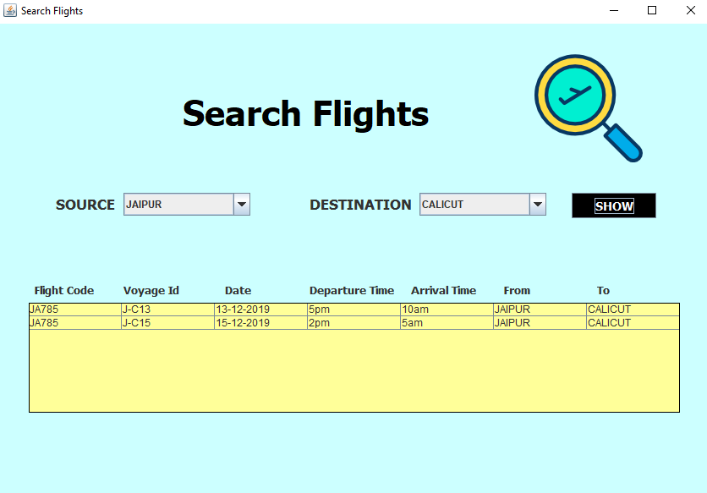
Find Flight Page
Select source and destination from the drop down box and click on SHOW
This will fetch all the available flights from source to destination and you may note down the Voyage Id of the flight from which you want to travel.

Slide 6
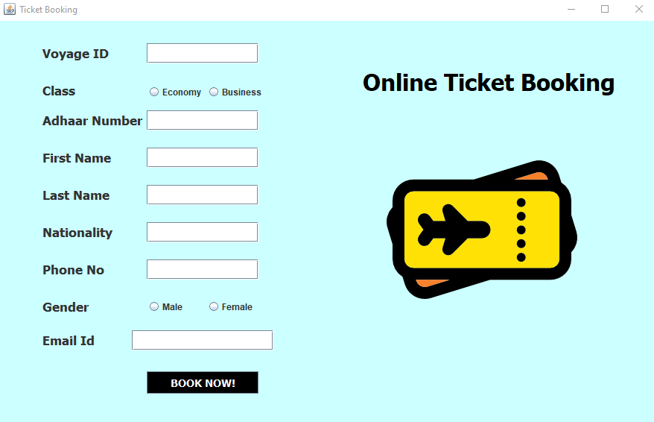
Book Ticket Page
Enter the Voyage ID and all the required details and then click on Book Now.
Make sure to write the same Email ID which you used for login.

Slide 7
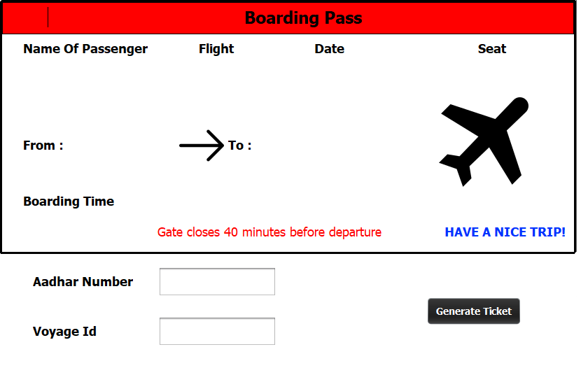
Find Ticket Page
Enter your Aadhar Number and Voyage ID and click on Generate Ticket.
Now you can print your Boarding Pass.

Slide 8
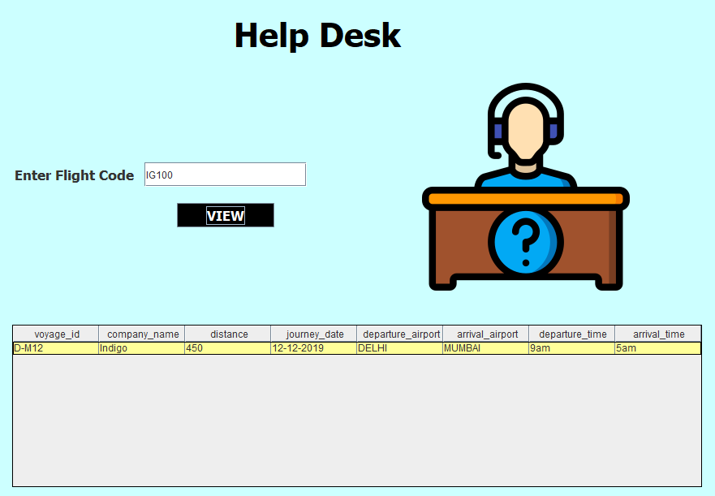
Help Desk Page
Enter the Flight Code and click on View.
This will show the all the required flight details.

Slide 9
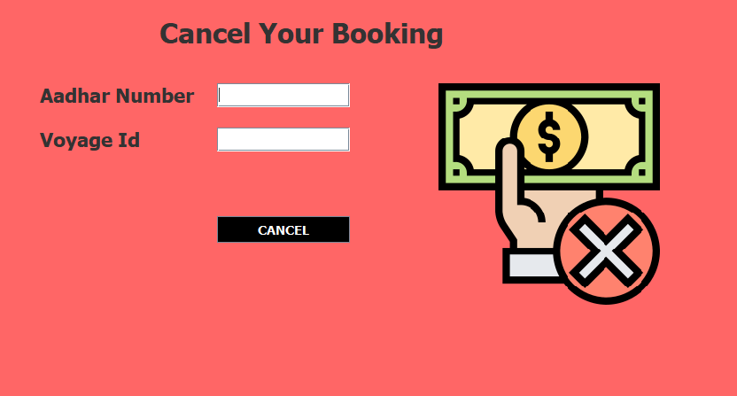
Cancel Ticket Page
Enter your Aadhar Number and Voyage ID and click on Cancel.
This will cancel your ticket and your refund will be initiated.

Slide 10


