Slide 1
Mailing Issues Details
from JIRA

Slide 2
Methods-
Automation in Jira
Using Python on PC

Slide 3
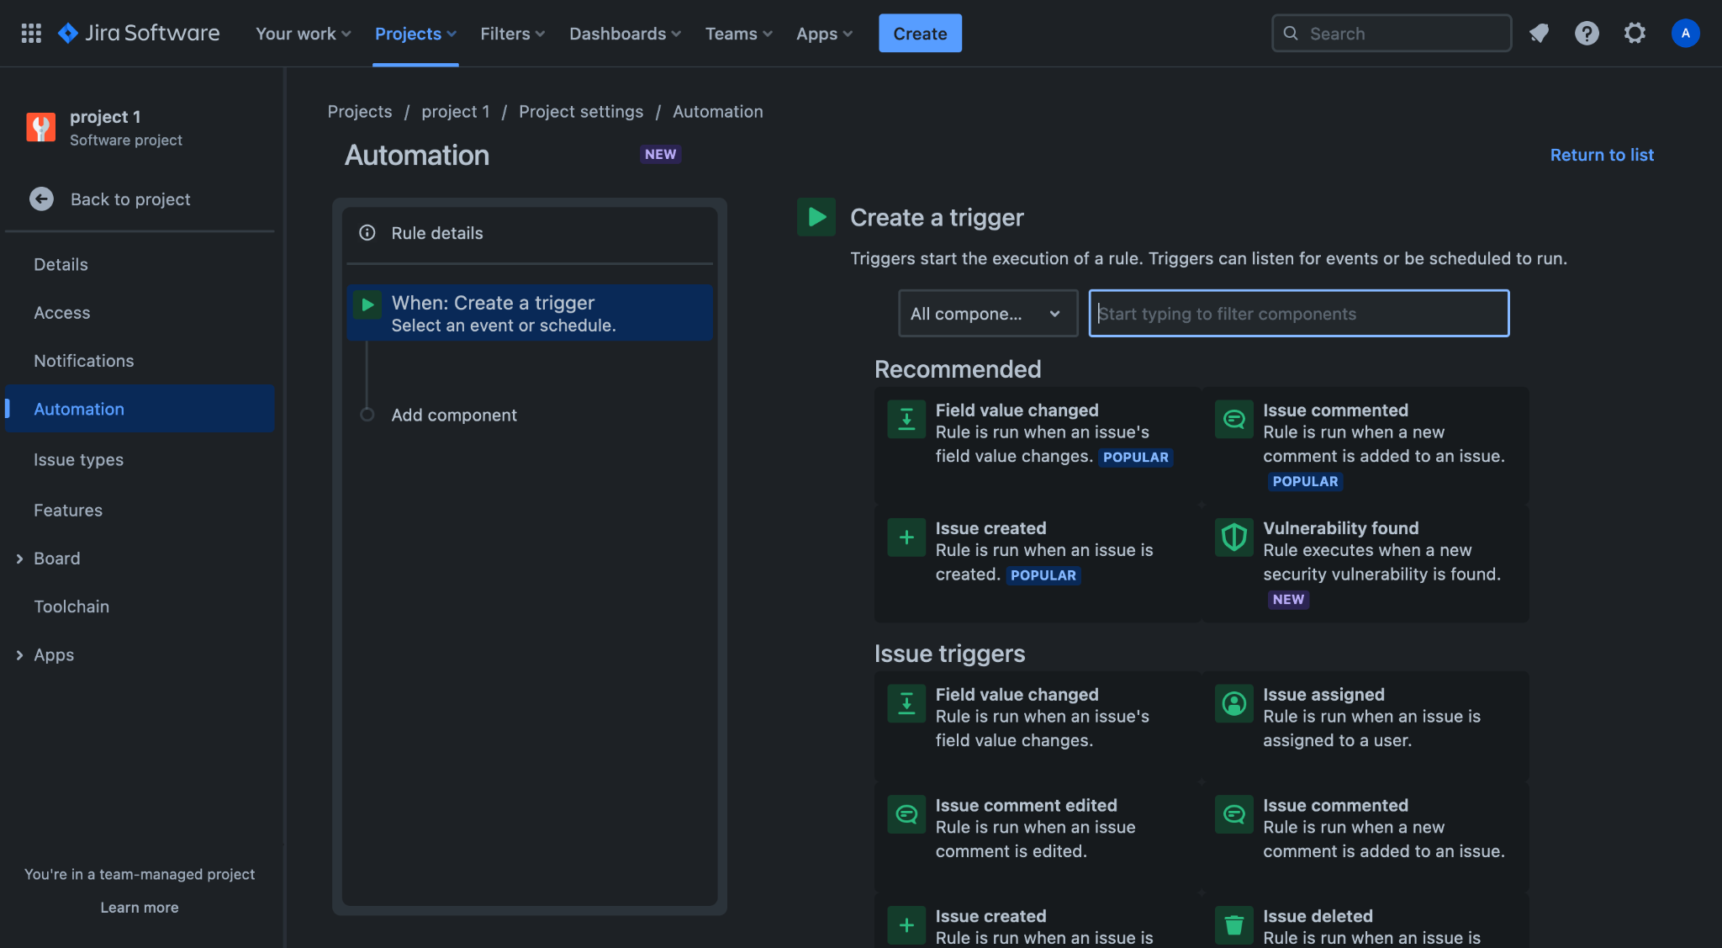
Automation in JIRA (for Assignees)
Step 1→ Open a project and go to automation in project settings.

Slide 4
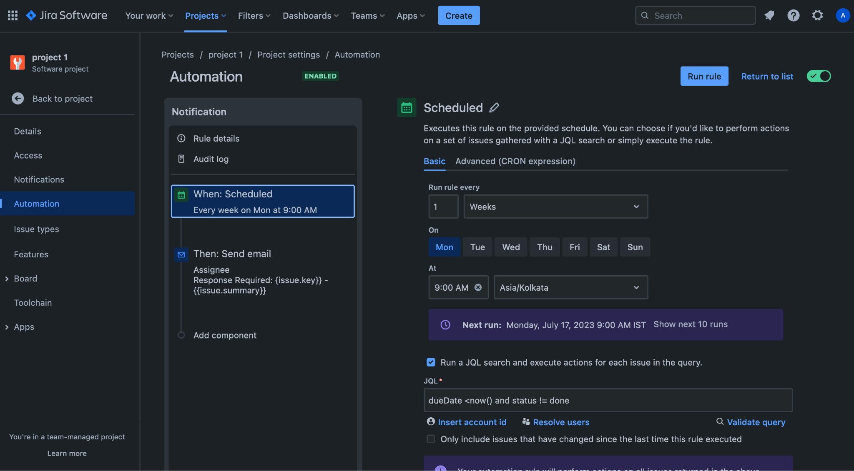
Step 2→ Add a schedule

Slide 5
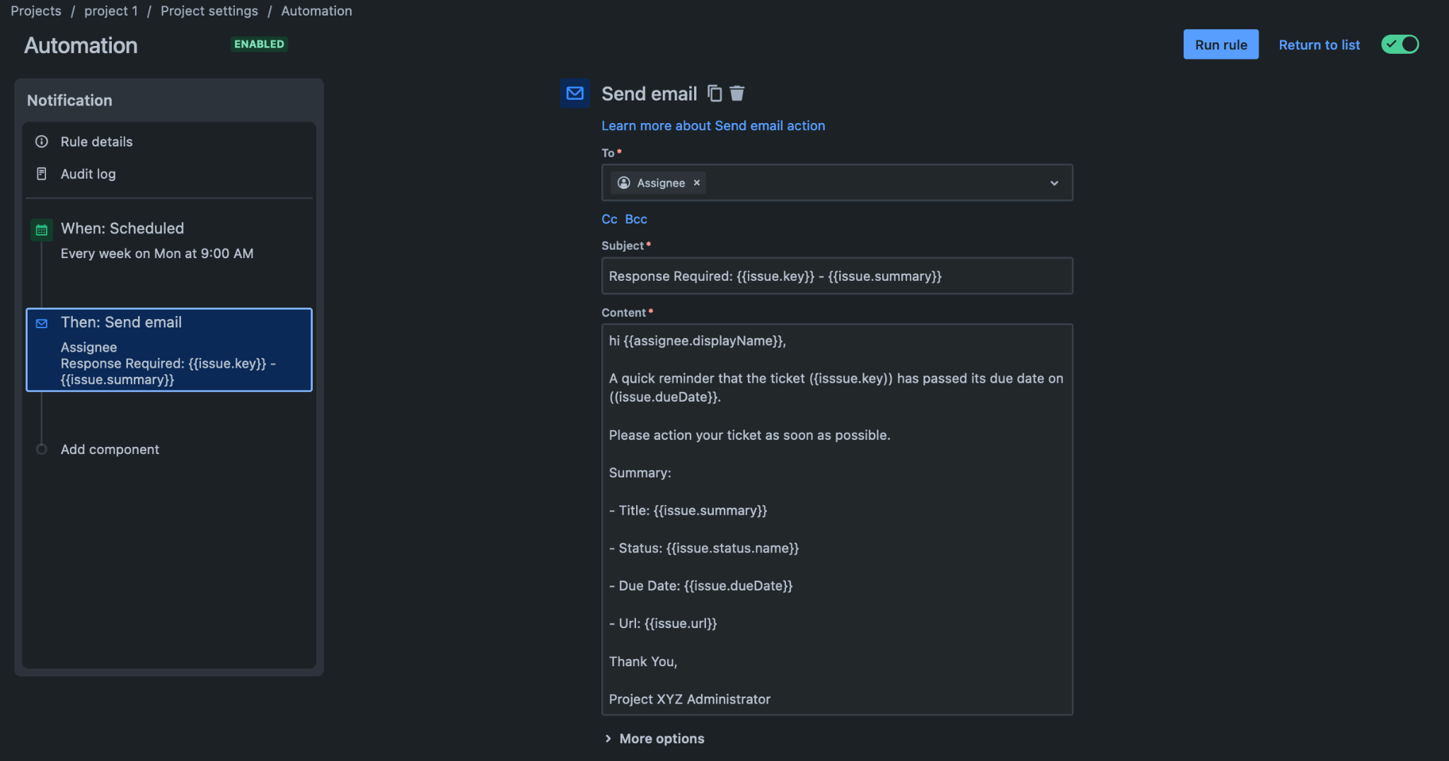
Step 3→ Add send mail action

Slide 6
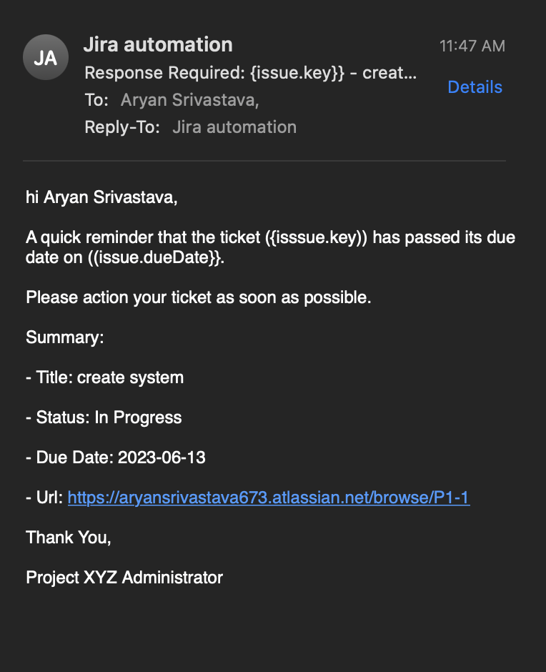
Step 4→ Save and run rule for testing
→ Mail sent successfully

Slide 7
Automation in JIRA (for Admin)
Step 1→ Open a project and go to automation in project settings.

Slide 8
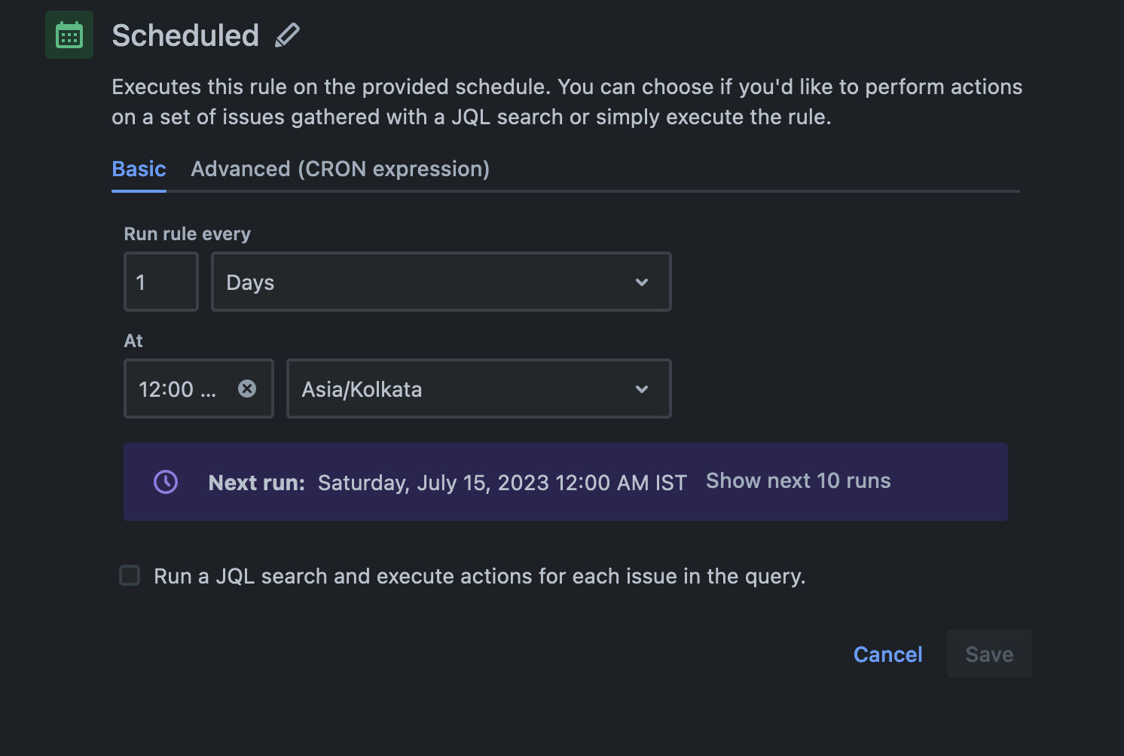
Step 2→ Add a schedule (Admin gets daily info of the incomplete issues)

Slide 9
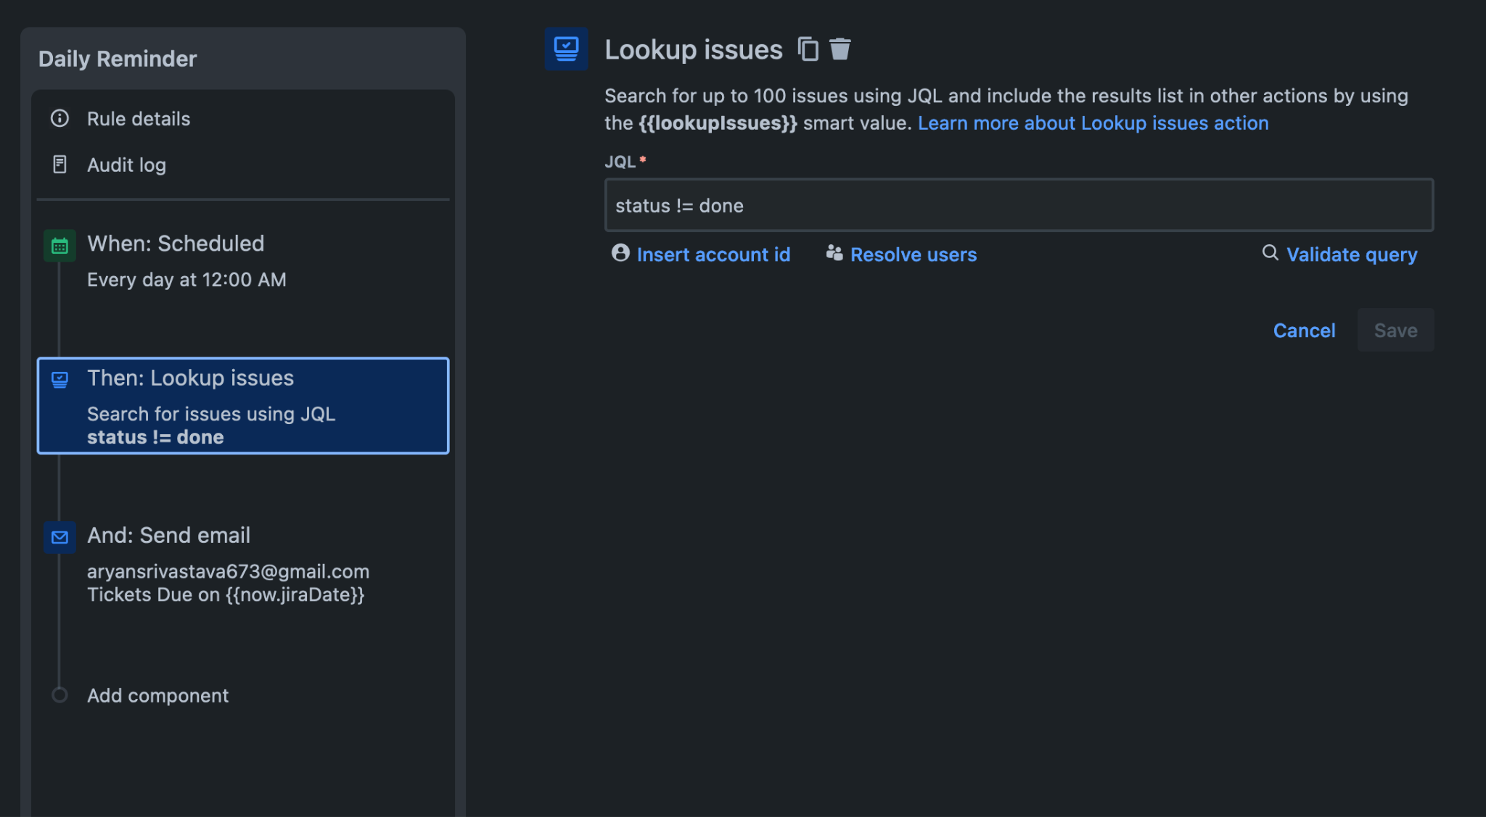
Step 3→ Add Look up issue (to find the issues that are not done)

Slide 10
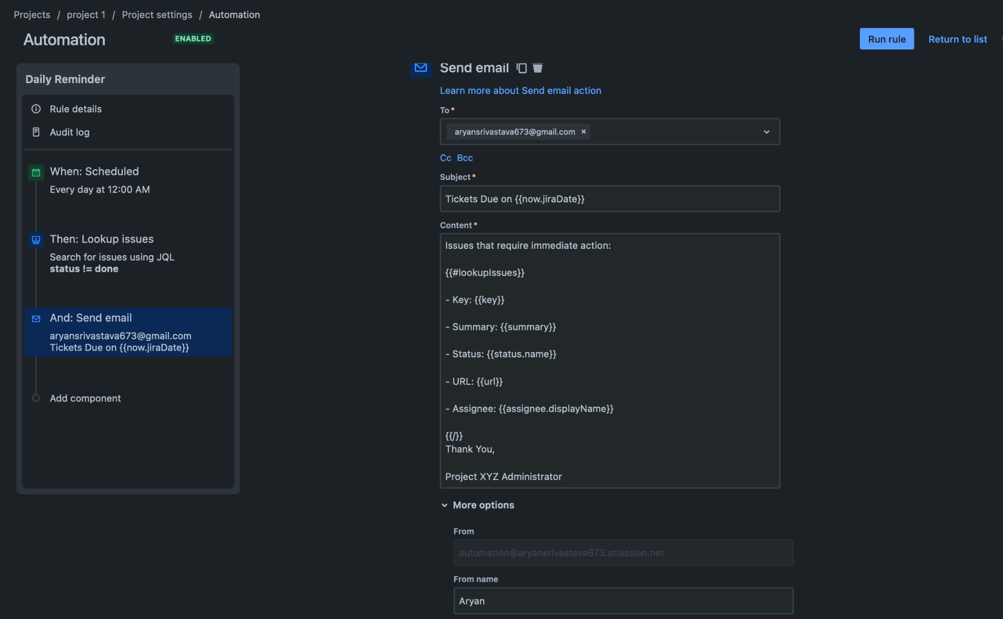
Step 4→ Add send mail action

Slide 11
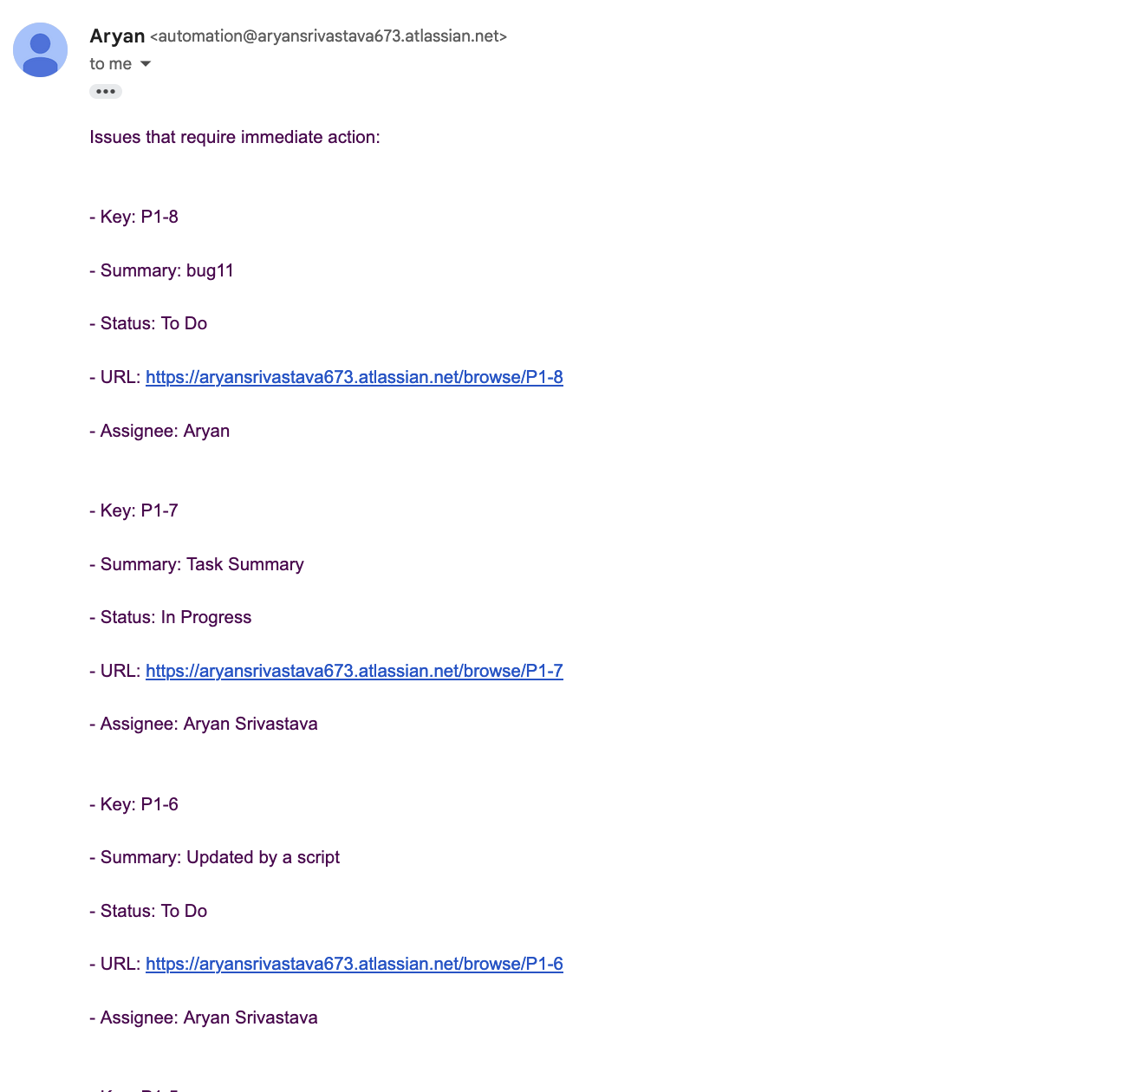
Step 5→ Save and run rule for testing
→ Mail sent successfully

Slide 12
2. Using Python on PC
Requirements libraries-
Flask
requests
smtplib
base64

Slide 13
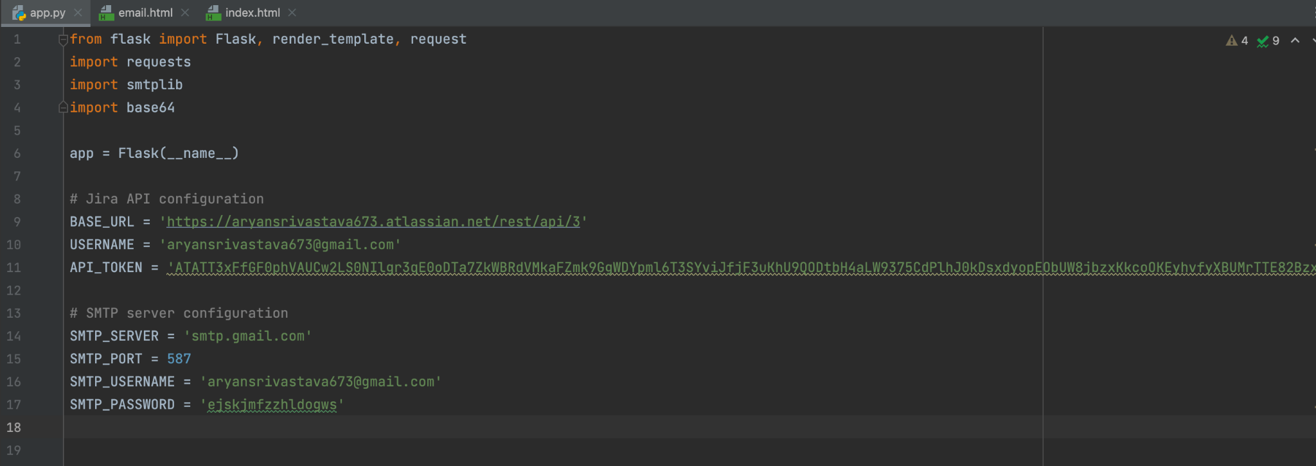
app.py

Slide 14
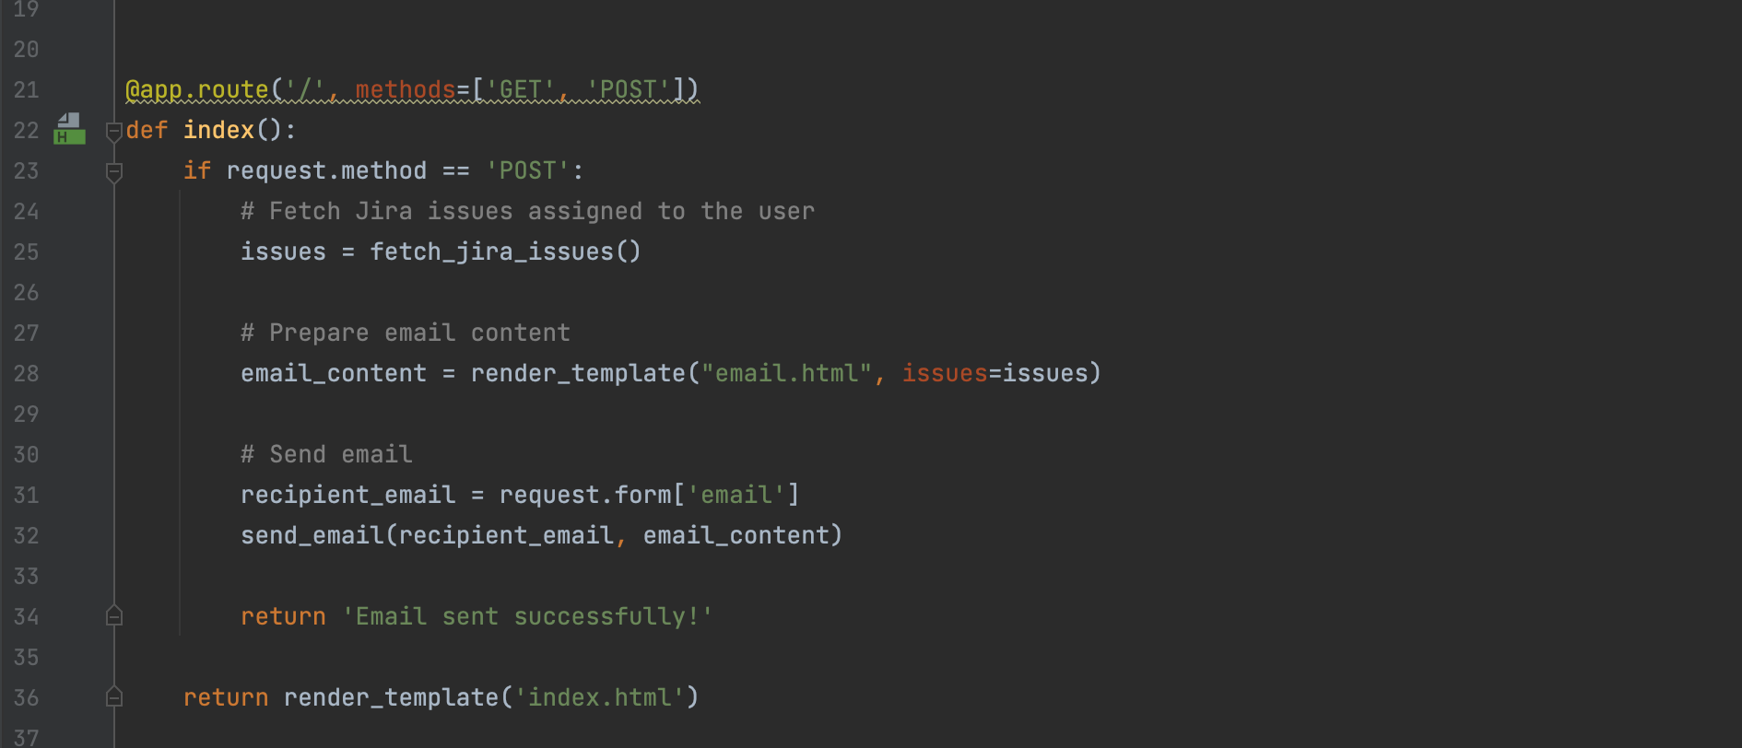

Slide 15
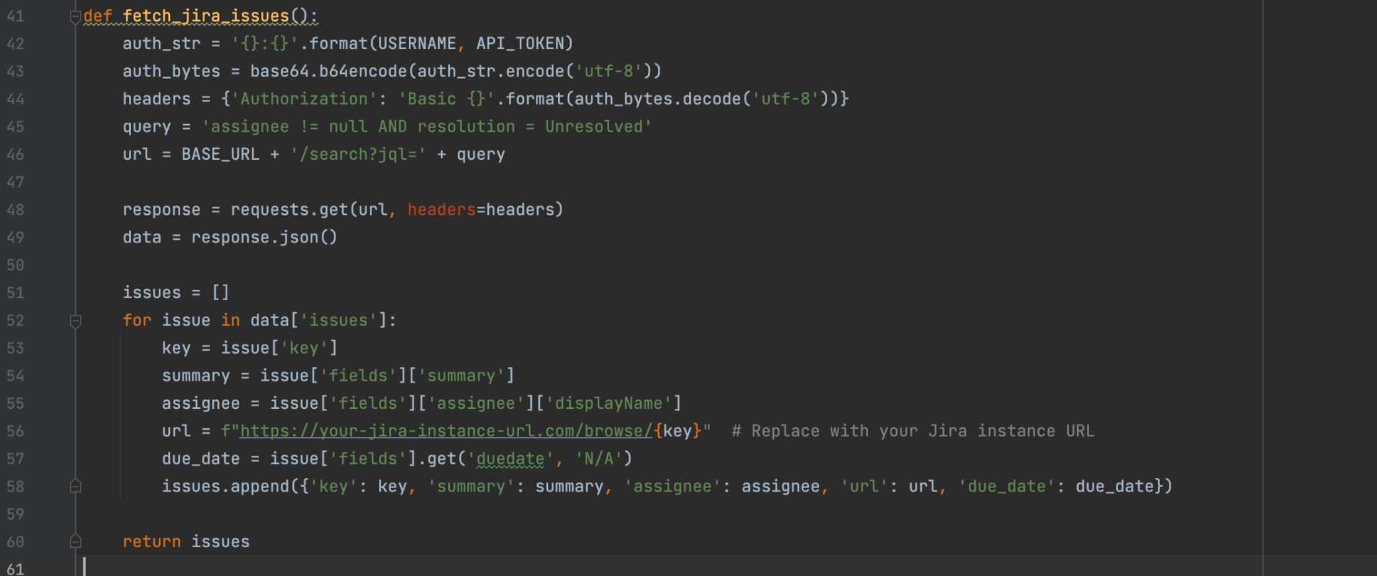

Slide 16
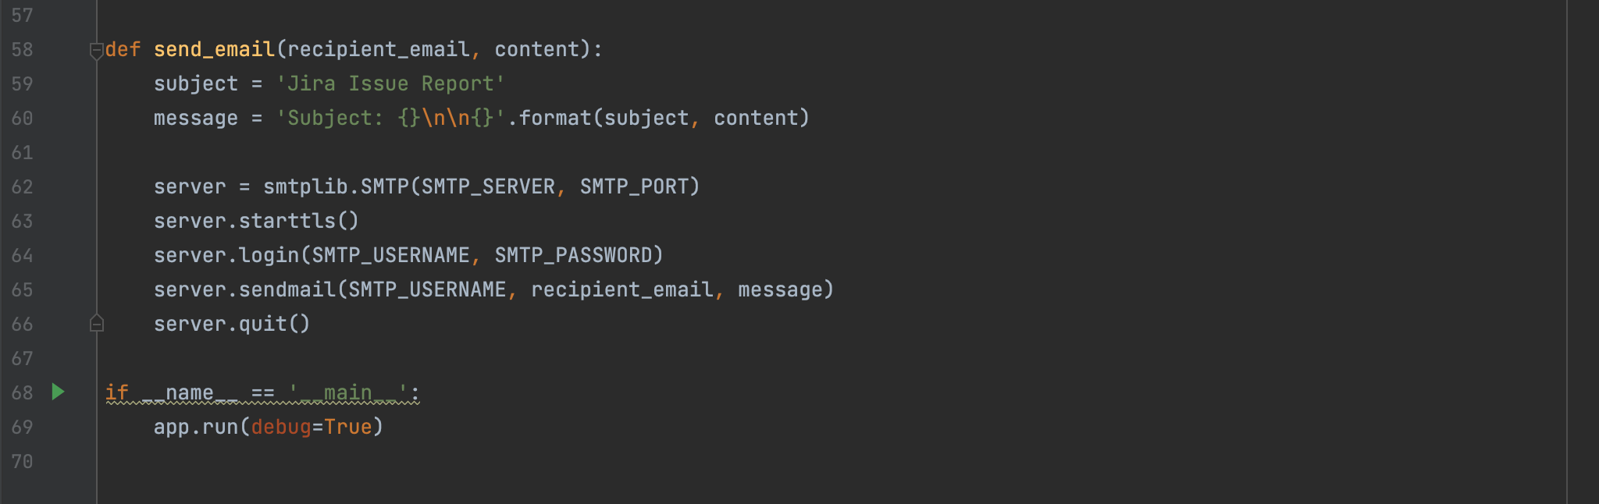

Slide 17
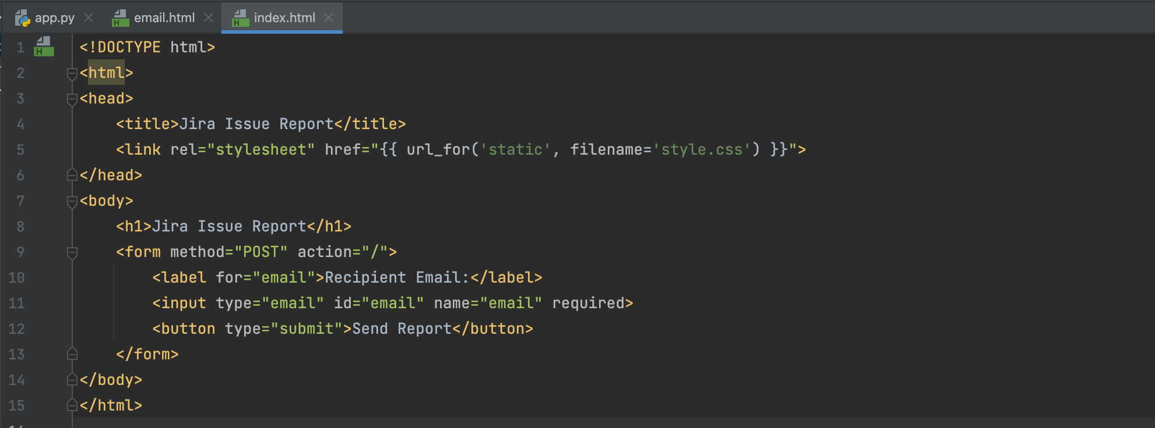
index.html

Slide 18
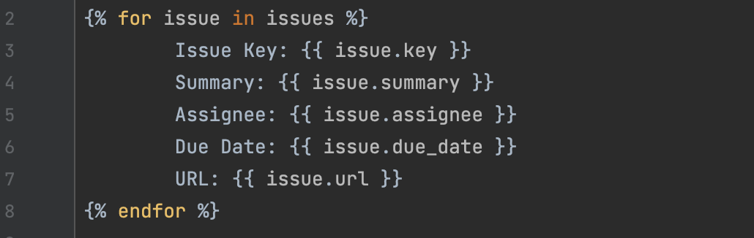
email.html

Slide 19
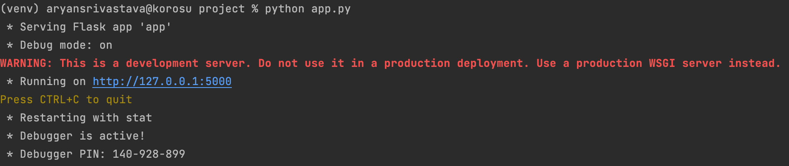
Command to run the app-
python app.py

Slide 20
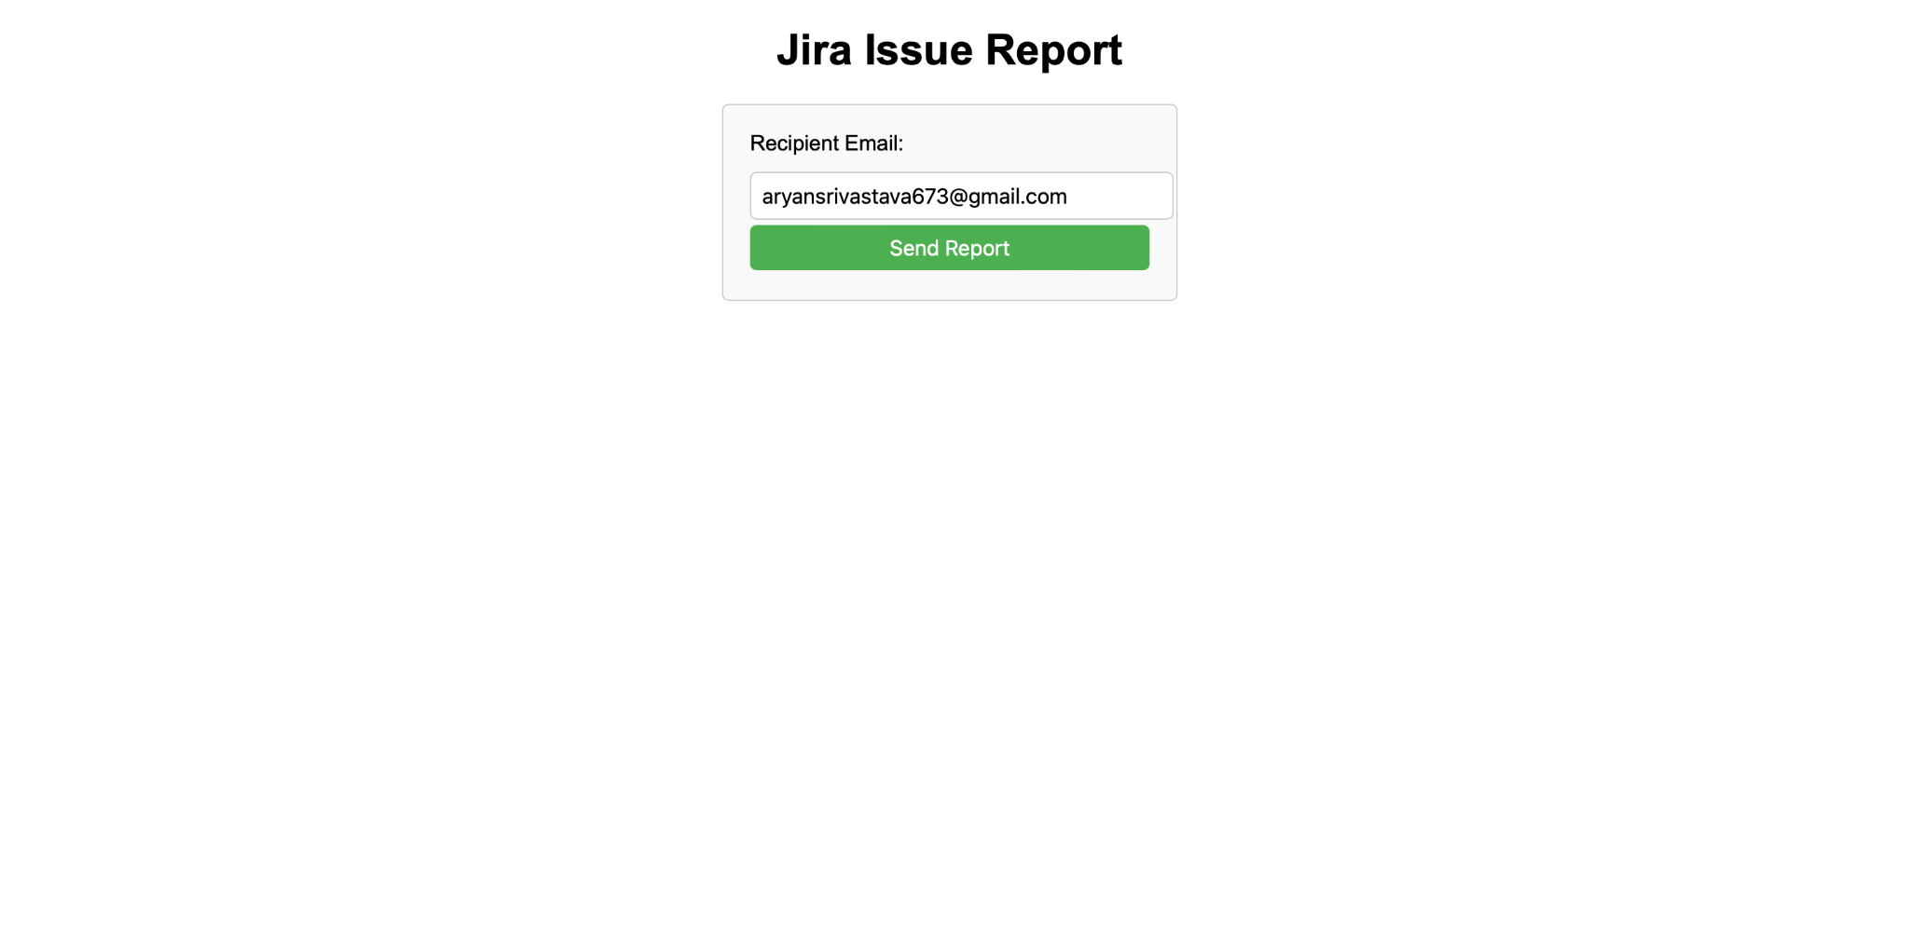
Output

Slide 21


Slide 22
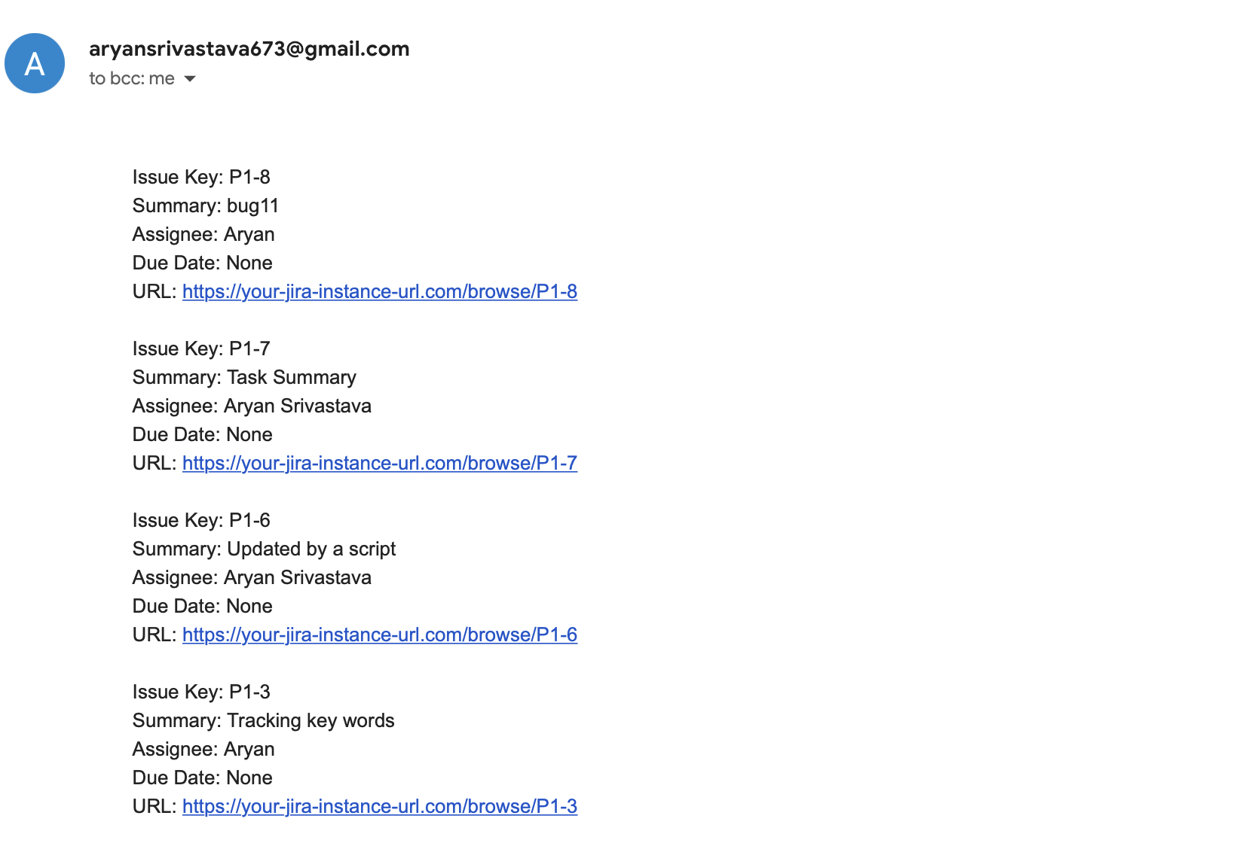

Slide 23
