Slide 1






Project Progress #2 Presentation
Page 13
TailTales
Report Date - March 12, 2025
Professor – Abidin Akkok
Team Members
Haroon Ahmed Bajwa
Aryan Tuwar
Vivian Zhonghui Liu
Mrinaal Nagpal

Slide 2
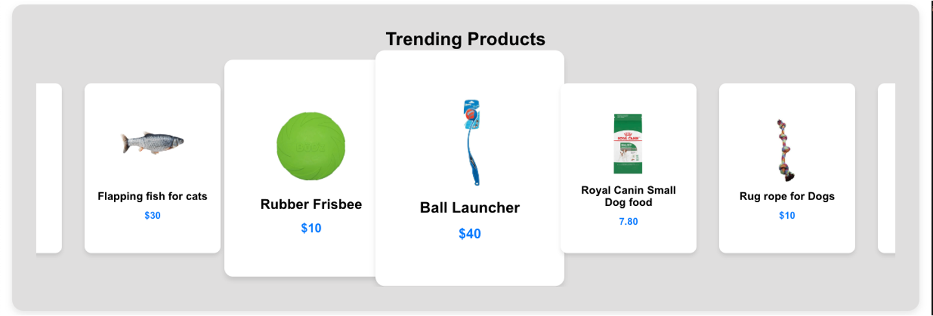

TailTalis
Page 8
Overview
TailTales has moved forward into the second phase, focusing on refining core features, improving user experience, and ensuring system stability. Key developments include backend optimizations, UI enhancements, and additional functionality for seamless user interaction.

Slide 3
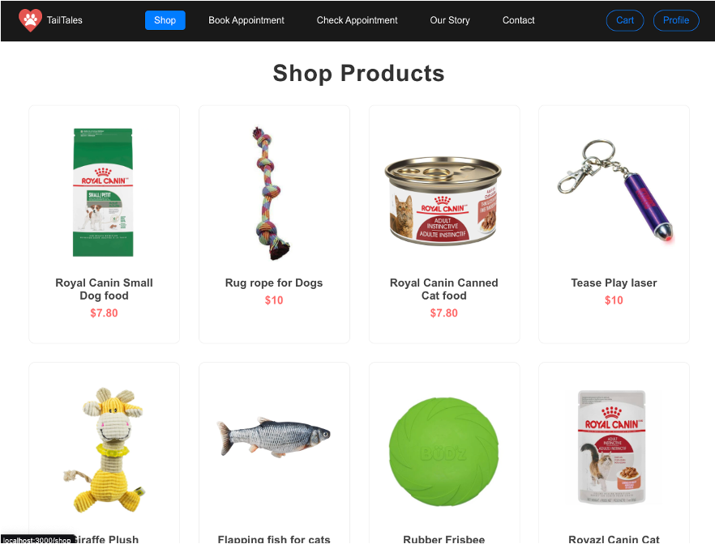

Slide 4
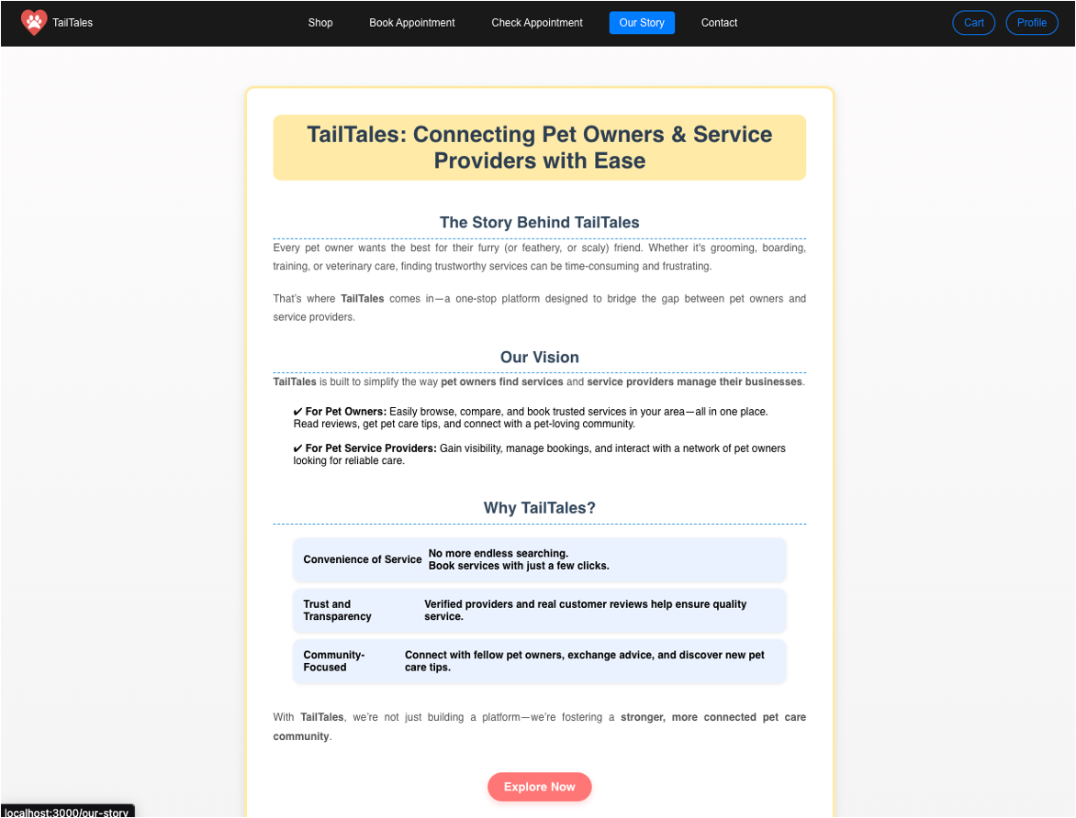

Slide 5


TailTales
Summary of Performance
Page 6
✅ Intuitive Navigation
✅ Well-structured Shop Section
✅ Dynamic Trending Products
✅ Engaging Our Story Page
✅ Progress steady, but pending tasks need completion

Slide 6
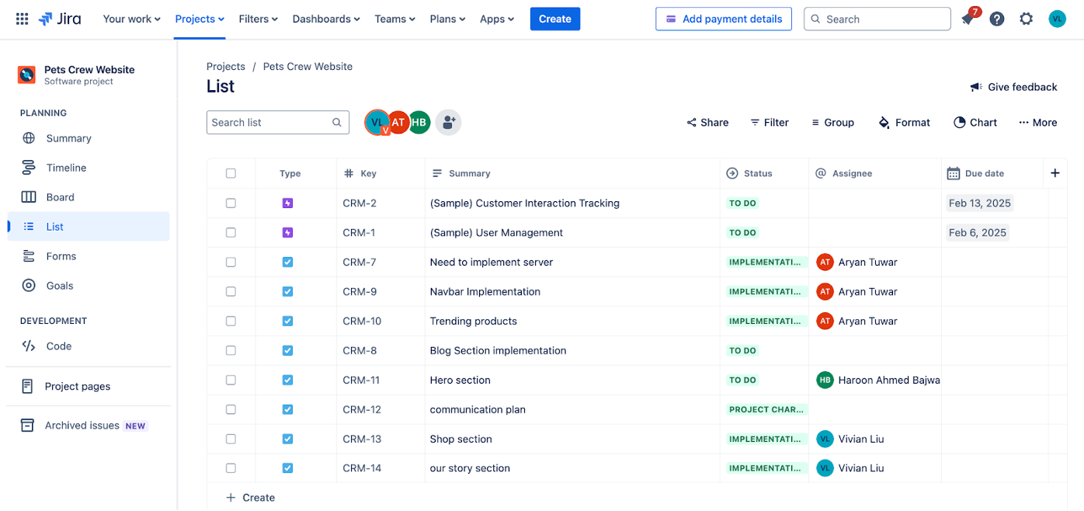

Slide 7
Key Milstones
Milestone | Planned Date | Actual Date | Status
Footer | February 12, 2025 | February 18, 2025 | ✅ Completed
HeroSection | February 12, 2025 | February 18, 2025 | ✅ Completed
Navbar | February 12, 2025 | February 18, 2025 | ✅ Completed
OurStory | February 12, 2025 | March 11, 2025 | ✅ Completed
ShopInfo | February 12, 2025 | March 11, 2025 | ✅ Completed
TrendingProucts | February 12, 2025 | February 18, 2025 | ✅ Completed
AppointmentSection | February 12, 2025 | - | ⏳ In Progress
BlogSection | February 12, 2025 | - | ⏳ In Progress
CartPage | February 12, 2025 | - | ⏳ In Progress
ProfilePage | February 12, 2025 | - | ⏳ In Progress
SignupSection | February 12, 2025 | - | ⏳ In Progress

Slide 8




TailTales
Page 11
Planned Work for Next Period
Finalizing Sections
Enhancements & Optimization
QA & Testing
•Appointment, Blog, Cart, Profile, Signup
UI improvements
Performance tuning
Backend efficiency
Internal tests
User feedback
Bug fixes

Slide 9

Issue | Description | Status | Assigned To
Navbar responsiveness | Navbar layout breaks on smaller screens | Resolved | Aryan Tuwar
Cart functionality | Users unable to update quantity in cart | In Progress | Aryan Tuwar
Slow API response | Backend APIs taking longer than expected | Pending | Haroon Ahmed Bajwa
Profile page loading | Page fails to load on certain browsers | Testing | Mrinaal Nagpal
TailTales
Page 14
High-Priority Issues
Delayed sections need completion
Backend optimizations required
Pending UI/UX bug fixes
Better Jira task management

Slide 10

TailTales
Page 10
Conclusions
✔ Progress steady, some sections incomplete
✔ High-priority issues actively addressed
✔ Focus: Completing sections & optimization
✔ On track to meet final project deadline

