Slide 1
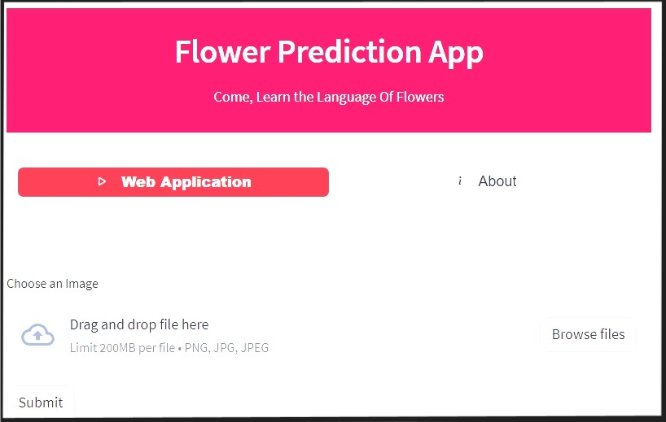

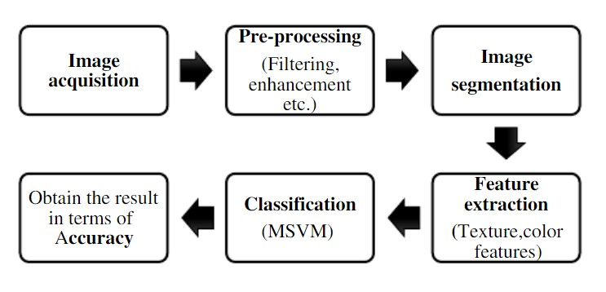
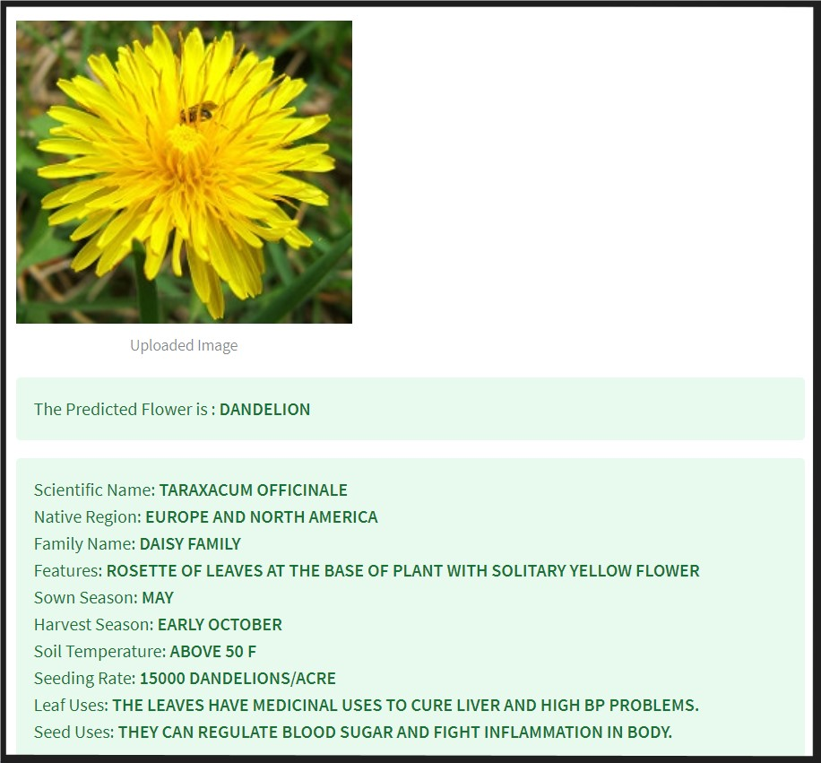
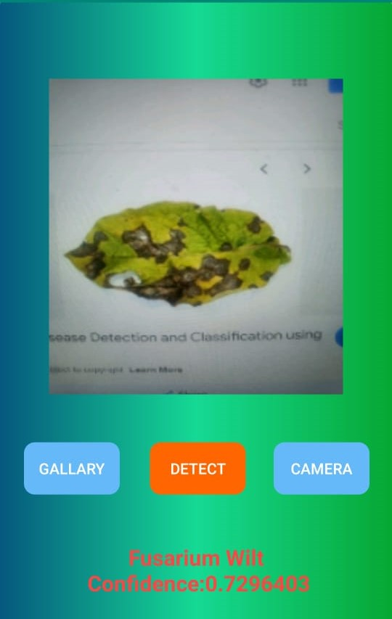
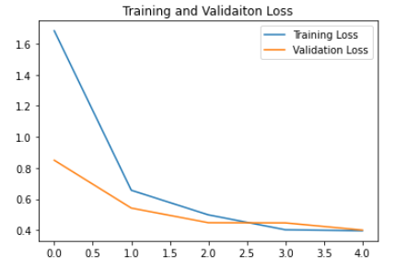
LEAF DISEASE DETECTION
TEAM EMOJIS
| ADITYA SHARMA | AMIT KUMAR YADAV | ARYAN TAPKIRE | DEVESH SHARMA |
INTRODUCTION
FEATURES
TECHNOLOGY USED
CONCLUSION
Leaf diseases can significantly reduce the crop yields by a large extent by affecting the photosynthetic capacity of the plant. Therefore, Early detection and management can help to minimize yield losses and maintain crop health.
Alongside this, Crop diseases can lead to significant economic losses for farmers and the agricultural industry. By detecting diseases early, farmers can take timely action to prevent the spread and minimize the economic impact.
Not just agricultural sector, but there are various other sectos which can get benefited through leaf disease detection. These include forest, plant research and development, urban and indoor agriculture, landscaping and turf management, nurseries and seed production, remote sensing and technology development, education and extension services, agri-tech and start-ups, etc.
It also helps us understand the leaf kingdom better, which in turn can lead to the development of new medicines, and even preservation of endangered species of leaves.
User Friendly Interface
User Enabled Image Upload
Cross – Platform web application
Easily Used on Mobile Phones
Identification + In-depth information about breeds
Kotlin - Kotlin is a modern statically typed programming language which is used by over 60% of the professional Android developers that helps tp boost the productivity, developer satisfaction, and code safety.
Python - Python is one of the most frequently utilized programming languages to build web applications, making its use crucial especially in Deep learning tasks.
TensorFlow - It’s an open source software library for high performance numerical computation. Its a flexible architecture allowing the deployment of computation.
Dataset - A dataset is a collection of data. For performing the deep learning operations and training of the model, we have used two datasets : PlantDoc dataset and Plant Diseases from the Kaggle platform.
Convolution Neural Network - A convolutional neural network (CNN or ConvNet) is a network architecture for deep learning that learns directly from data.
Through an analysis of the data set we also found that the relative number of training samples for each Leaf species are quite uneven, which seems to lead to a favouritism, from the model of leaf disease detection, and that some leaf diseases are difficult to classify than others.
The trained dataset is created using roughly 5000 steps, higher the number of steps higher its accuracy. The accuracy of the final trained dataset is 89.62%.
After the training phase the dataset was tested against a variety of testing images of Leaf diseases. The testing dataset has nearly 1000 images with an accuracy of 80%.
After analysis of these results it has been observed that the the diseases those are having the highest score has been predicted as a required disease. This result can be shown in the Training and validation graph.
Thus we were able to successfully develop and deploy the application on android platform to make it portable.
PROPOSED APPROACH
EXPERIMENTAL ANALYSIS
REFERENCES
The proposed approach is based on Deep learning and convolutional neural network fundamentals.
The set of stages and operations involved throughout the approach are diagrammatically represented below:
Upon clicking on the predict button, the user will be shown the actual breed of Flower along with some relevant Information about it.
The model generated quantitative results are listed below:
Overall Samples: 1318
Training: 70% | Validation: 20% | Testing: 10%
Loss: Categorical Cross entropy
Testing Loss: 0.32296934723854065
Testing Accuracy: 0.8962785148620605
Varshney,R.K, Graner A - Agriculture 4.0 : Broadening the horizons of crop improvement through genomics-assisted breeding. Cell, 175(2), 313-326.” (2018).
Plant leaf disease detection using computer vision and machine learning algorithms, Glob. Transitions Proc, 2022
RumpfT- Early detection and classification of plant diseases with support vector machines based on hyperspectral reflectance. comput.electron. Agric. 2010
DyrmannMads ”Plant species classification using deep convolutional neural network”. Biosyst. Eng.(2016)
LiuWeibo “A survey of neural network architectures and their applications Neurocomputing (2017)
FerentinosKonstantinos “Deep learning models for plant disease detection and diagnosis”. comput.elect. (2018)
CONTACT
Aditya Sharma (adityasharma20340@acropolis.in)
Amit Kumar Yadav (amityadav20456@acropolis.in)
Aryan Tapkire (aryantapkire20455@acropolis.in)
Devesh Sharma (deveshsharma20195@acropolis.in)

