Slide 2
Leaf Disease Detection
Submitted to:
Department of Computer Science and Engineering

Slide 3
Supervised by: Prof. Juhi Shrivastav
Team Members
1. Aditya Sharma
2. Amit Kumar Yadav
3. Aryan Tapkire
4. Devesh Sharma

Slide 4
Project Presentation Outline
Abstract
Introduction
Problem Statement
Survey of Existing Systems
Project Objectives
Requirement Analysis
Solution Proposed
The Outcome Discussion
Conclusions

Slide 5
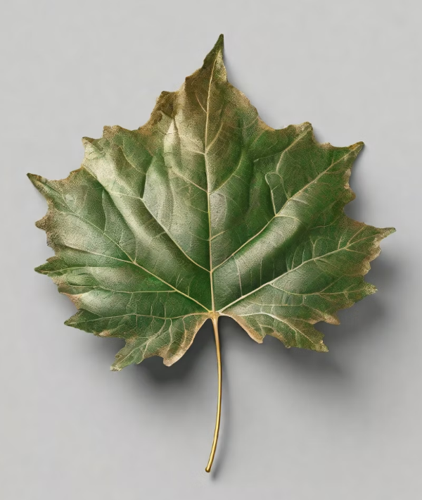
Abstract
Well, for starters, leaf disease detection plays a crucial role in various industries, from agriculture to ecology and conservation. It helps us understand the leaf kingdom better, which in turn can lead to the development of new medicines, more efficient farming practices, and even the preservation of endangered species of leaves.

Slide 6
Introduction
Leaf disease detection plays a crucial role in various industries, such as agriculture, pharmaceuticals, and ecology. Accurate identification of leaves helps in improving crop yields, developing new medicines, and understanding the ecological balance of an ecosystem.
For instance, in agriculture, identifying the right leaf specie can help farmers optimize their crop management practices, leading to higher yields and reduced costs. In the pharmaceutical industry, accurate identification of leaf disease can lead to the discovery of new medicines and treatments for various diseases.

Slide 7
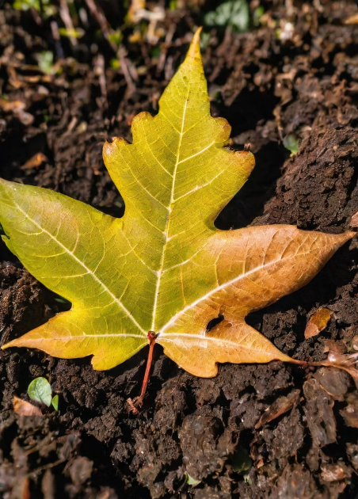
The Problem Statement
Developing a highly accurate, field-ready leaf disease detection system that overcomes the limitations of current approaches

Slide 8
Survey of Existing Systems
Leaf disease detection systems are mostly built using image processing techniques where leaf is considered the main organ in entire leaf structure.
In the past decade a lot of research has been done to develop efficient and robust Leaf disease detection systems.
Wu et al have proposed on of the earliest Flower identification system. In their scheme, they have created their own dataset named Flavia, which has been used by various other researchers as standard dataset for their work. It consists of 1907 leaf images of 32 different Flower species.

Slide 9
Survey of Existing Systems
Aakif Proposed an algorithm which used Artificial Neural Network (ANN) with back propagation. An input vector of morphological features, fourier descriptors were fed into the ANN which resulted in a classification accuracy of 96% for both the datasets.
Hossain extracted a set of unique featured called “Leaf Width Factor (LWF)” with 9 other morphological features using the Flavia dataset. These features were used as inputs for classification of leaf shape features. A total of 1200 leaf images were used.

Slide 10
Objectives
The Aim of this project is to develop a fully functioning Android application for the purpose of Identification of leaf diseases.
Creating an attractive UI for the User to use the application.
Enabling the user to upload photos of the leaf for which they want to identify in the android application.
Upon clicking on the predict button, the user will be shown the actual disease of leaf along with some relevant Information about it.

Slide 11
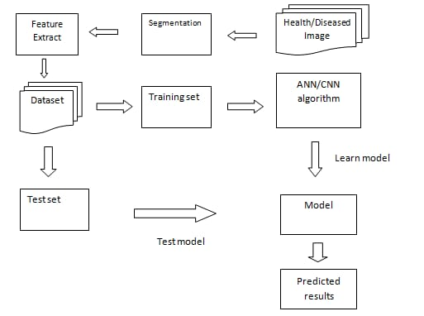
Solution Proposed
Start.
Choose and extract a dataset.
Split Images for training & testing.
Pre-processing of Images.
Train CNN Model.
Validate against testing dataset.
If Less Accuracy, modify split ratio.
Inherit the model to Android App.
End.

Slide 12
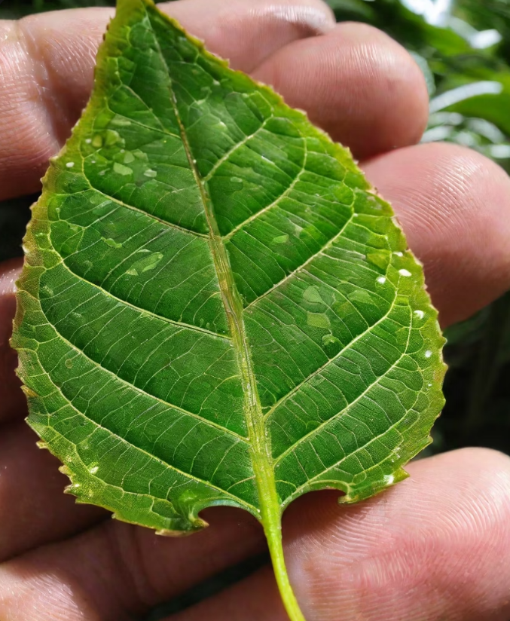
The Outcome
The Final System would ensure a fully functional and fully trained model which will be capable enough to detect various kinds of leaf diseases and provide information about them through uploading their photos to android application

Slide 13
Conclusion
Following the Proposed Solution Methodology, It would be possible to identify some of the diseases in existence on the planet through the use of deep learning fundamentals.
The User would be able to upload images of leaves through camera, local gallery or directly from the internet.
The Model is capable enough to provide abstract details about the disease.

Slide 14
THANKS

