Slide 1

CSE400
Expected stock returns and Variance risk premia
M5 Submission
Domain: - Financial Markets, Stock Return Prediction
Section 2 - Group 17
Aryan Tarachandani - AU2420177
Nishka Shah - AU2440168
Keya Shah - AU2440177
Kritee Shah - AU2440080
Lay Patel - AU240258

Slide 2


Project Context and Motivation
Core Idea
Financial markets are inherently uncertain and dynamic systems
Key variables like volatility are not directly observable, but estimated
What is VRP?
Variance Risk Premium (VRP) is defined as:
VRP = Implied Volatility − Realized Volatility
It measures the difference between:
Market expectations of future risk (IV)
Actual observed risk (RV)
03-02-2026
| 2

Slide 3
Why VRP is Important
VRP reflects how much extra return investors demand for risk
It is widely used in:
risk management
portfolio allocation
market forecasting
Key Issue
03-02-2026
| 2

Slide 4
Motivation
Traditional models treat these inputs as fixed values
This leads to:
overconfidence in predictions
ignoring variability
Project Motivation
03-02-2026
| 2

Slide 5

Base Paper Overview
Paper Objective
The paper studies whether the Variance Risk Premium (VRP) can predict future stock market returns
It focuses on understanding how risk and uncertainty are priced in financial markets
Deterministic Baseline Model
Original Base formula was:
IV = Implied volatility (from VIX)
RV = Realized volatility (from S&P 500)
03-02-2026
| 3

Slide 6
Main Idea
VRP captures uncertainty about volatility, not just volatility itself
Investors require compensation for bearing this uncertainty
Key Finding
Higher VRP is associated with higher future returns
This suggests that VRP acts as a predictor of market returns
Limitation
The paper treats VRP as a fixed quantity
It does not account for:
measurement error in IV and RV
uncertainty in VRP itself
03-02-2026
| 3

Slide 7
Problem Formulation
Title: Is VRP Reliable Under Uncertainty?
Study the effect of uncertainty in volatility
Main research question: Can VRP still be trusted when IV and RV contain errors?
Assumptions:
IV and RV are noisy measurements
Noise follows a probabilistic model
Errors may arise from market fluctuations, estimation, and data issues
Formula: IV = σ + ε₁ RV = σ + ε₂
Where:
σ = true volatility
ε₁, ε₂ = uncertainty/error terms
03-02-2026
| 3

Slide 8
Mathematical model
Title: VRP with Uncertainty Included
Base equation: VRP = IV² − RV²
Substitute noisy terms: VRP = (σ + ε₁)² − (σ + ε₂)²
Expanded form: VRP = σ² + 2σε₁ + ε₁² − (σ² + 2σε₂ + ε₂²)
Final simplified model: VRP = 2σ(ε₁ − ε₂) + (ε₁² − ε₂²)
Key Insight:
VRP is no longer deterministic
It depends on random errors
Therefore, it becomes a random variable
03-02-2026
| 3

Slide 9
Why this matters
Title: Deterministic to Probabilistic Transition
Earlier, VRP had one fixed value
After uncertainty:
It becomes a distribution of possible values
It is sensitive to volatility estimation noise
It better reflects real financial markets
Core Formula: VRP ~ Random Variable
Main Transition: Deterministic Model → Probabilistic Model
Practical Importance:
Better representation of real market behavior
Supports risk-aware decision making
Useful for simulation and bounds analysis
03-02-2026
| 3

Slide 10

Bounds Used in The Problem
Volatility (σ) ≥ 0 (cannot be negative)
VRP lies within observed empirical range
Measurement errors exist in IV and RV
Noise is modeled as:
03-02-2026
| 7

Slide 11


Deterministic Approach
Pipeline:
Collect VIX (IV) and realized volatility (RV) data
Convert percentage values to decimal form
Compute variance:
Calculate VRP:
Analyze using PDF and CDF
03-02-2026
| 8

Slide 12
Why Deterministic is Insufficient
Why Deterministic Approach is Insufficient :
No variability in output
Cannot capture real-world uncertainty
Ignores measurement noise in IV and R
Leads to biased or overconfident predictions
Fails to model stochastic market behavior
03-02-2026
| 9

Slide 13
Randomized Approach Overview
Every iteration introduces fresh stochastic noise, exploring a different region of the uncertainty space
The final output is a probabilistic map of all possible VRP outcomes under measurement noise
Gaussian noise is embedded inside every iteration, randomness is not just an input but a core computational mechanism
Randomness drives how VRP is generated, not just how data is sampled
03-02-2026
| 13

Slide 14
Randomised Algorithm Approaches
Randomized Strategy
Part 1: Bootstrap
Resample VRP values from dataset
Generates multiple samples
Limitation: no new values created
Captures Data Variability
Part 2: Monte Carlo
Sample synthetic noise from Gaussian distribution
Generates new VRP values
Recompute IV, RV, VRP each iteration
Repeat many times
03-02-2026
| 14

Slide 15
Randomized Algorithm Overview
Monte Carlo Simulation Procedure
Sample error terms εIV,εRV
Construct IV and RV using sampled errors
Compute for the formulas
Repeat for multiple iterations
Outcome
Generate multiple simulated VRP values, so VRP becomes a random variable
Captures uncertainty due to measurement error
03-02-2026
| 15

Slide 16
Work Flow of Monte Carlo Simlulation
True IV + ε_IV -> Noisy IV
True RV + ε_RV -> Noisy RV
|
VRP = Noisy IV² − Noisy RV²
|
Repeat 1000 times
|
Distribution of VRP outcomes
|
Generate PDF & CDF
03-02-2026
| 16

Slide 17
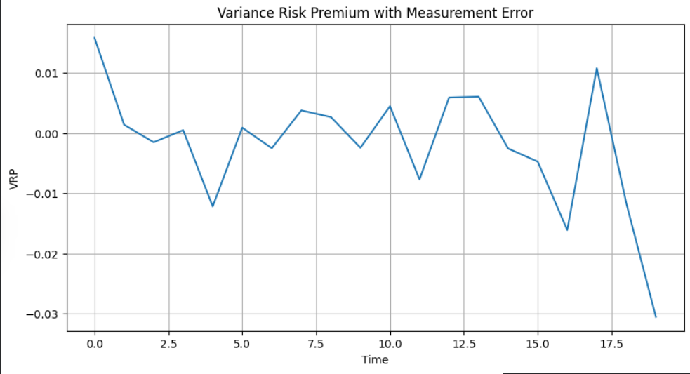
Graph
Observations
VRP shows high fluctuations over time
Presence of both positive and negative spikes
No stable level show non-stationary behavior
Occasional large negative drops and sharp positive jumps
Interpretation
Positive spikes signify market expects higher future volatility than realized (experienced)
Negative spikes show realized volatility exceeds market expectations
Frequent sign changes are a sign of unstable volatility expectations
Large spikes inficate impact of measurement error and market shocks
03-02-2026
| 10

Slide 18
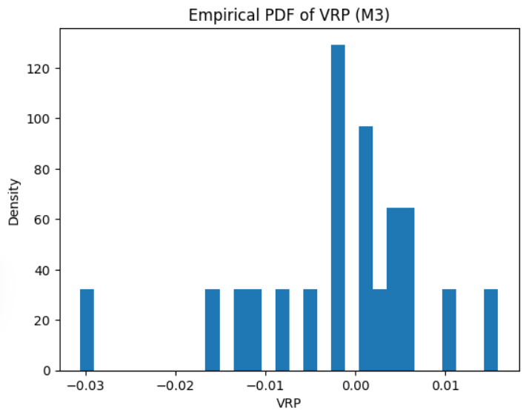
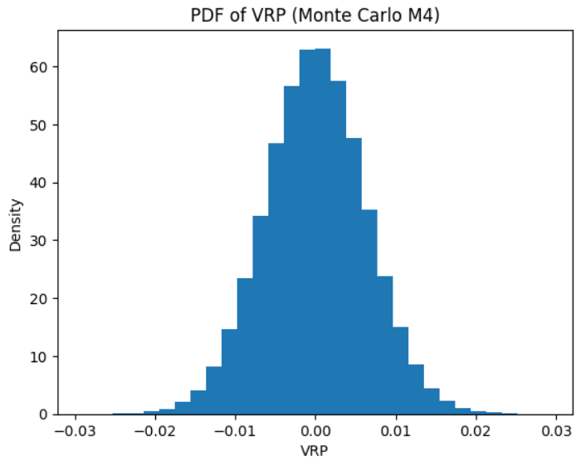
Graph Comparison
03-02-2026
| 10

Slide 19
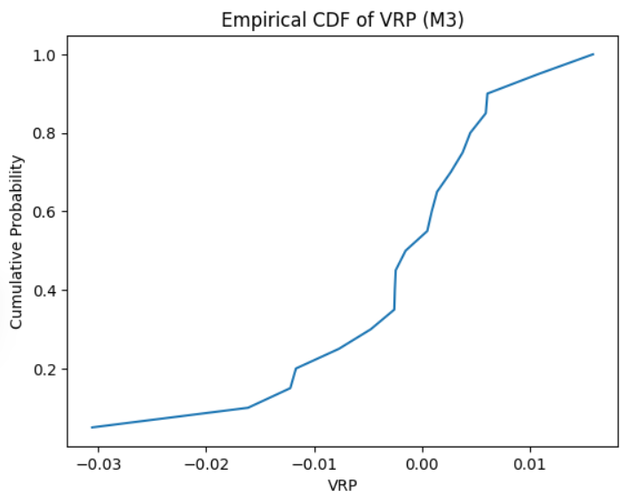
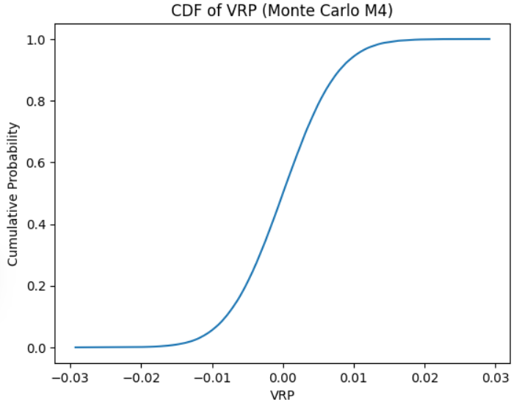
Graph Comparison
03-02-2026
| 10

Slide 20
Domain Perspective
Key Insights
VRP is not a pure risk signal
It contains actual market risk along with measurement error
Real-World Interpretation
Positive VRP - Market overestimates risk (fear, uncertainty)
Negative VRP - Market underestimates risk (unexpected shocks)
Why This Matters
Single VRP value can be misleading
Incorrect investment decisions
Poor risk estimation
Our Contribution
Instead of one value we modeled VRP as a distribution
Captures range of possible risks, not just one estimate
03-02-2026
| 10

Slide 21
Computer Science Perspective
System Insight
Real-world data is noisy and uncertain
Deterministic models generally ignores noise leading to unstable outputs
Problem in M3
Single output → loss of information
Cannot represent uncertainty
Our Solution (M4)
Introduced Monte Carlo randomization
Generated multiple VRP outcomes
Output changed from single value to a probability distribution
Impact
Better robustness
More reliability
Increased real-world applicability
03-02-2026
| 10

Slide 22
References
1. Base Research Paper
Core framework linking VRP to future stock returns
2. Academic Lecture Notes (Financial Theory)
https://pages.stern.nyu.edu/~sfiglews/documents/Figlewski Class Notes for Futures and Options UG Spring18-full set.pdf
Derivatives pricing, volatility, and risk premia concepts
https://ocw.mit.edu/courses/15-450-analytics-of-finance-fall-2010/4fa033082ff5ee58722a67fe81f0dce7_MIT15_450F10_lec03.pdf
Introduction to volatility, risk-return relationships
https://ocw.mit.edu/courses/15-450-analytics-of-finance-fall-2010/3894e9e72ac0f3d1c98d43323a104fec_MIT15_450F10_lec09.pdf
Advanced concepts in risk premia and stochastic modeling
03-02-2026
| 10

Slide 23
References
3. Financial Data Concepts
https://www.cboe.com/tradable-products/vix
CBOE Volatility Index (VIX)
https://finance.yahoo.com/
S&P 500 Index
4. Statistical & Simulation Methods
https://online.stat.psu.edu/stat200/lesson/12
Bootstrap Sampling
https://www.investopedia.com/terms/m/montecarlosimulation.asp
Monte Carlo Simulation
03-02-2026
| 10

Slide 24
THANK YOU!

