Slide 1

AES-128 HW/SW Co-Design on SoC FPGA
University of Texas at Dallas
FALL 2025
EEDG/CE 6370 Design and Analysis of Reconfigurable Systems
Supervisor:
Prof. Dr. Benjamin Carrion Schaefer
Submitted by:
Salam Kadhim Al-Khammasi, SKA240001@utdalls.edu
Aryan Verma, DAL820508@utdalls.edu

Slide 2
Project Overview
• Introduction
• System Architecture
• Perform HPS: Plaintext Input and Key Generating.
• Perform HPS–FPGA : MEMORY – MAPPED AXI.
• Demonstrate a fully working HW/SW integrated system.

Slide 3

INTRODUCTION
Field Programmable Gate Arrays (FPGAs) are widely used to accelerate computationally intensive applications such as cryptography.
This project presents a complete hardware/software (HW/SW) co-design implementation of AES-128 encryption and decryption using an SoC FPGA.
The system divides tasks between the HPS processor and FPGA fabric to achieve both flexibility and performance.

Slide 4

System Architecture
The system consists of THREE major components:
1- HPS (Processor): Handles key generation, user input, communication, software encryption/decryption, and validation.
2- FPGA Fabric: Implements AES-128 encryption accelerator.
3- AXI INTERFACE: Communication between HPS and FPGA is done using a memory-mapped AXI interface.

Slide 5
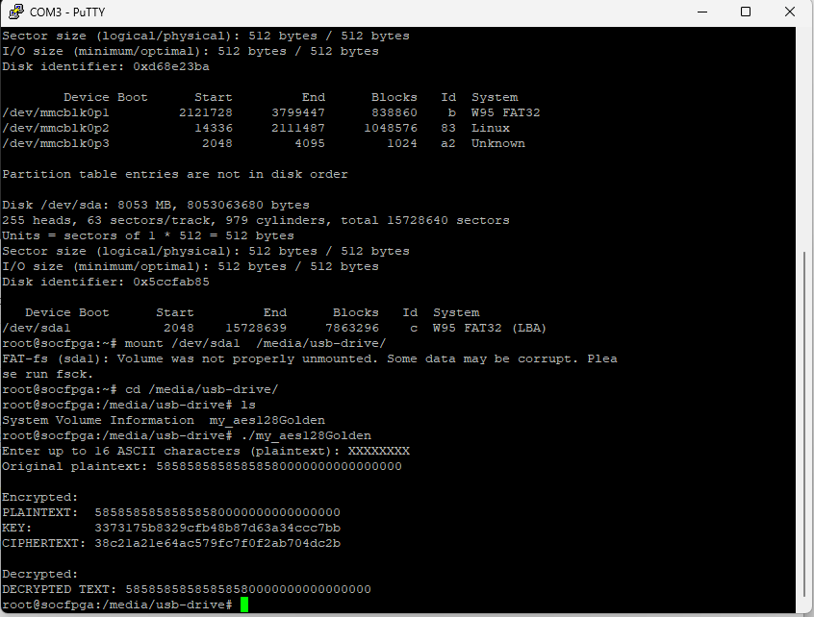
HPS: Plaintext Input and Key Generating
The user enters plaintext through the terminal using scanf().
Up to 16 ASCII characters are accepted. Key is generated inside the HPS
Decrypt the Cipher text and return the same plain text .

Slide 6
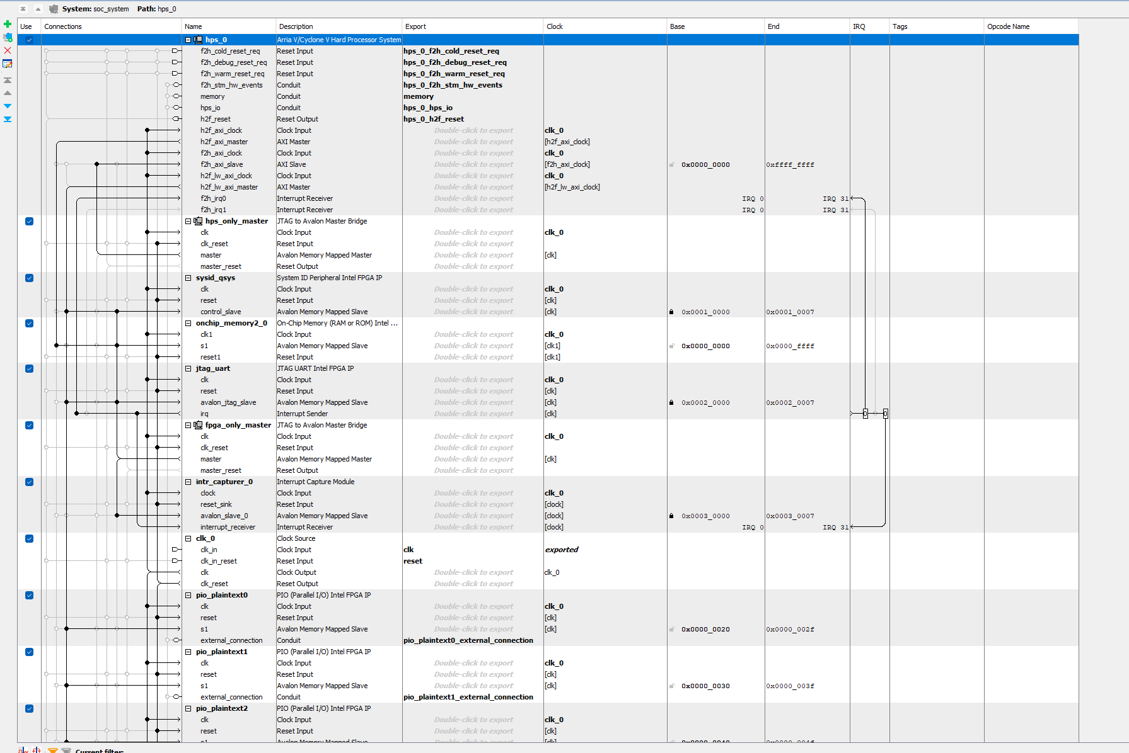
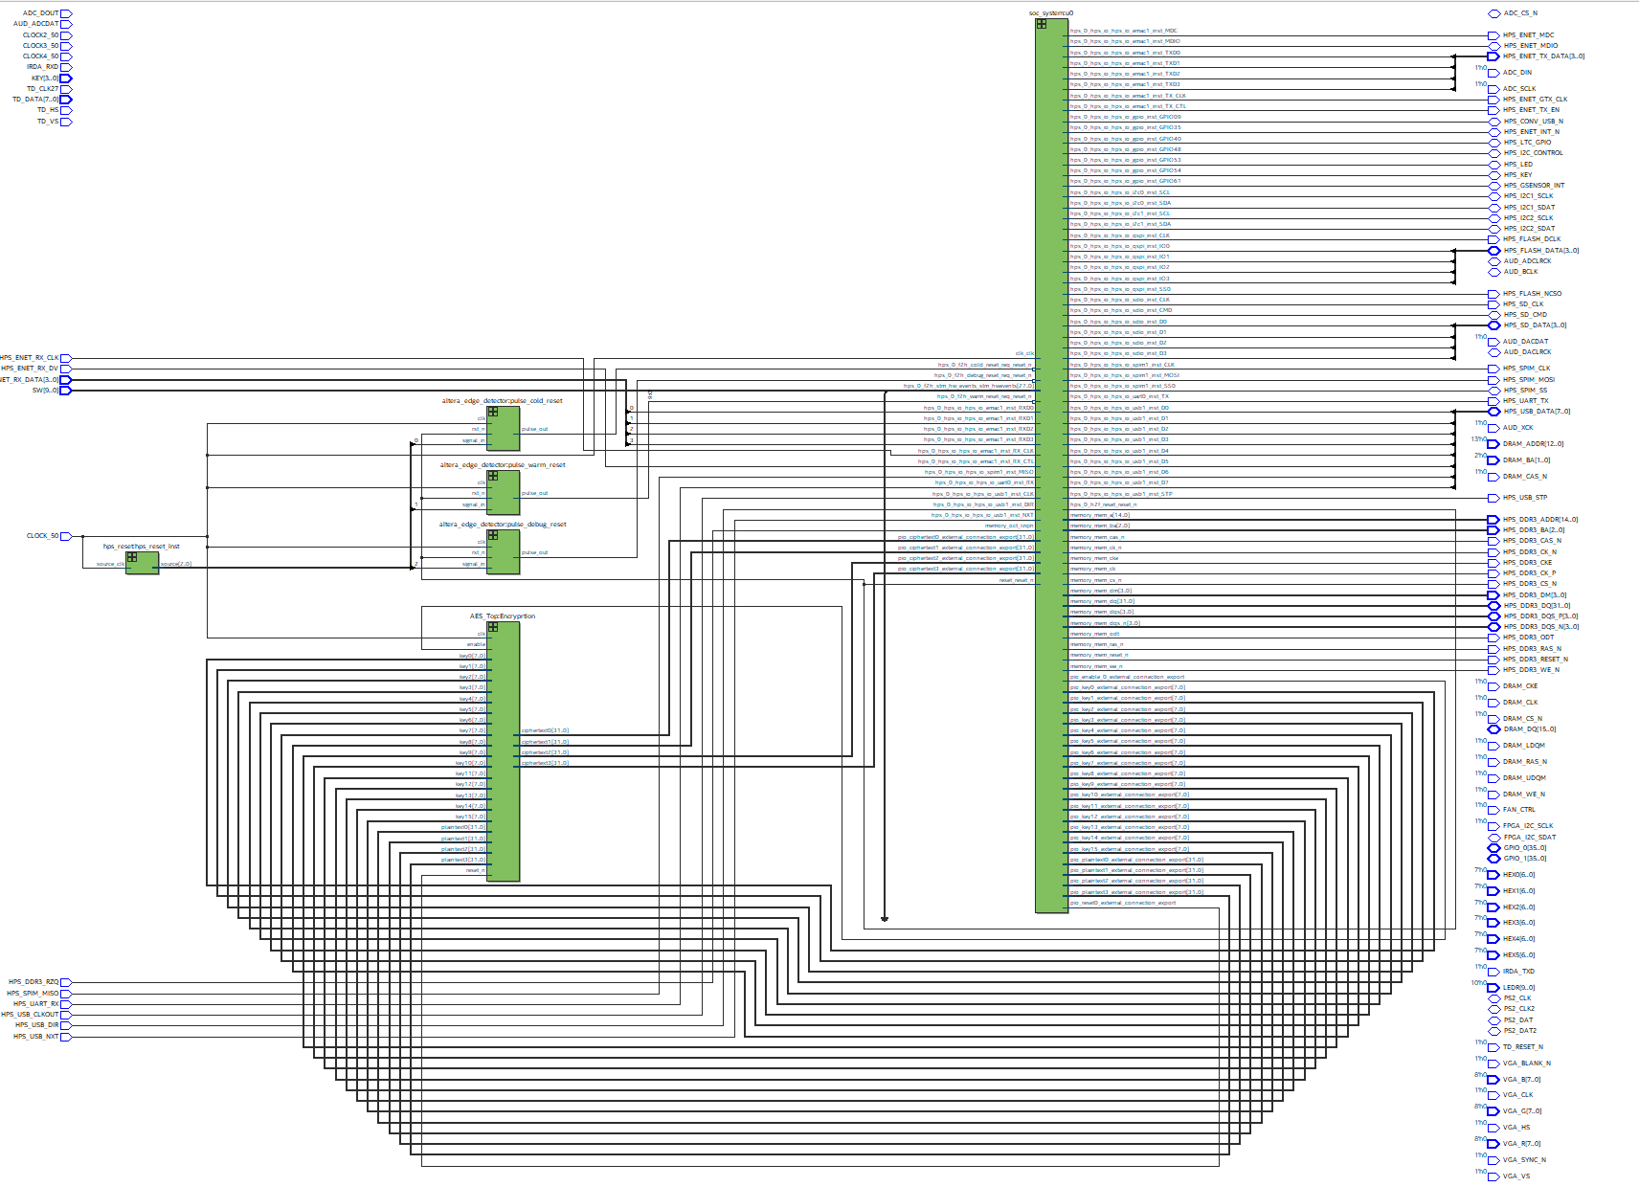
HPS–FPGA : MEMORY – MAPPED AXI
HPS sends the 128-bit encryption key and plaintext to the FPGA.
Communication is performed using memory-mapped AXI registers.
Control signals ensure proper synchronization.
Master AXI
Slave AXI
AXI
Output data from FPGA to HPS
AES - FPGA
Data from HPS to FPGA

Slide 7
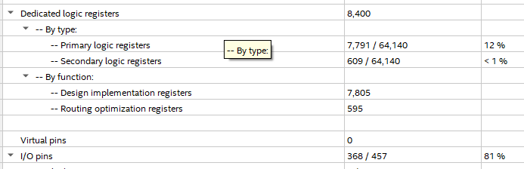
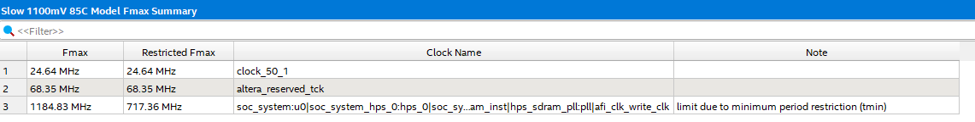
FPGA: AES-128 Encryption Module only
ALMs | 15701
Registers | 8400
I/O pins | 368
FMAX | 24.64 MHZ
FPGA receives the plaintext and encryption key from HPS.
AES-128 encryption is implemented using RTL or HLS.
FPGA performs encryption only (no decryption).
The encrypted ciphertext is sent back to the HPS.

Slide 8
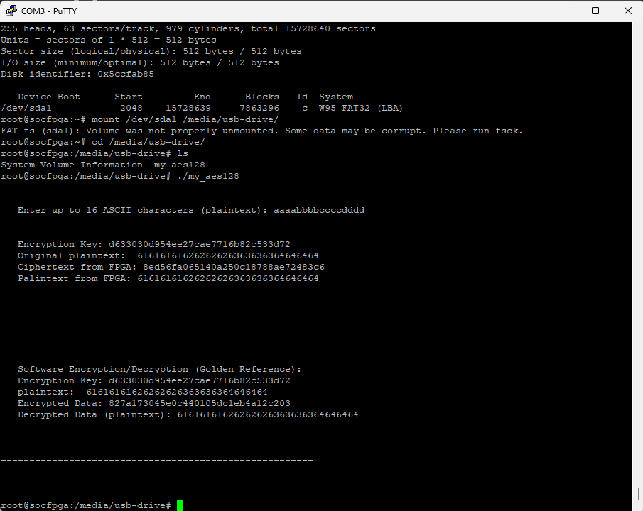
Results: HW/SW integrated system
HPS receives ciphertext generated by the FPGA.
Software AES decrypts the ciphertext using the same key.
Decrypted plaintext is compared with original input.
16 ASCII Characters
HPS – AXI - FPGA
Validation after decrypt the original plaintext

Slide 9
Demo & Implementation Evidence
End-to-end system working demonstration
Synthesis / implementation reports
YouTube demo link

