Slide 1

PART III A : Generating Insights
Sales Pipeline Conversion at a SaaS Startup
Variable
Technology Primary
B2B Sales Medium
Client Revenue Sizing Opportunity Sizing
Business from Client Last Year
Insights if any
An unusually large number of opportunities come from ERP Implementation category and they have a better than average opportunity conversion rate
Most Opportunities are from Marketing and Enterprise Sellers with the Enterprise Sellers having a better than average opportunity conversion rate.
An unusually large number of opportunities come from clients who
are less in revenue size(100K or less)
The opportunity conversion rate is significantly higher for clients with potential revenue in 0-30K range.
The conversion rate is higher for existing customers despite the number of opportunities unusually large from newer customers
Pattern of Insight
Significant Outliers
Significant Outliers
Significant Outliers Surprising Comparison
Surprising Comparison/Significant Outliers

Slide 2
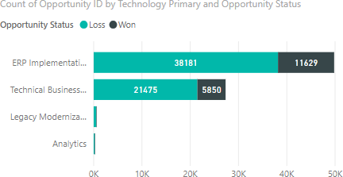
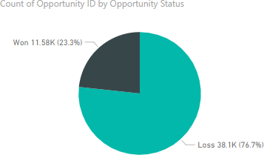
PART III A : Generating Insights
Sales Pipeline Conversion at a SaaS Startup
Variable under consideration: Technology Primary
An unusually large number of opportunities come from ERP Implementation category and they have a better than average opportunity conversion rate

Slide 3
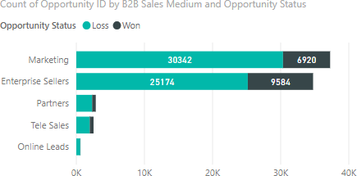
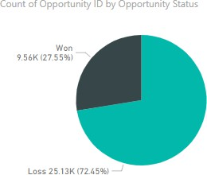
PART III A : Generating Insights
Sales Pipeline Conversion at a SaaS Startup
Variable under consideration: B2B Sales Medium
Most Opportunities are from Marketing and Enterprise Sellers with the Enterprise Sellers having a better than average opportunity conversion rate.

Slide 4
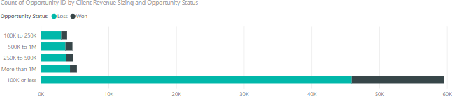
PART III A : Generating Insights
Sales Pipeline Conversion at a SaaS Startup
Variable under consideration: Client Revenue Sizing
An unusually large number of opportunities come from clients who are less in revenue size(100K or less)

Slide 5
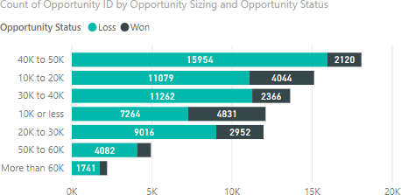
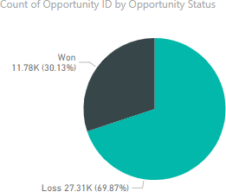
PART III A : Generating Insights
Sales Pipeline Conversion at a SaaS Startup
Variable under consideration: Opportunity Sizing
The opportunity conversion rate is significantly higher in 0-30K range.

Slide 6
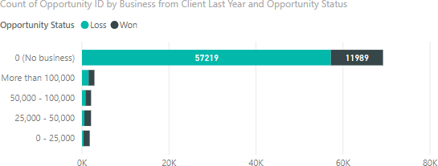
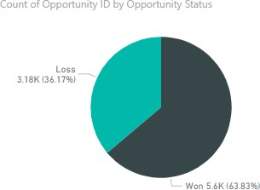
PART III A : Generating Insights
Sales Pipeline Conversion at a SaaS Startup
Variable under consideration: Business from Client last year
The conversion rate is higher for existing customers despite the number of opportunities unusually large from newer customers

Slide 7
PART III A : Generating Insights
Sales Pipeline Conversion at a SaaS Startup
Recommendations
Focus on the following categories for newer leads for ensuring high conversion rate
ERP Implementation as the type of solution
offered to the customers
Enterprise Sellers as the B2B Sales Medium
Client Revenue Sizing(100K or less)
Opportunity Sizing (0-30K)
Existing Customers
Corresponding Insights
- An unusually large number of opportunities come from ERP Implementation category and they have a better than average opportunity conversion rate
- Most Opportunities are from Marketing and Enterprise Sellers with the Enterprise Sellers having a better than average opportunity conversion rate.
- An unusually large number of opportunities come from clients who are less in revenue size(100K or less)
- The opportunity conversion rate is significantly higher for clients with potential revenue in 0-30K range.
- The conversion rate is higher for existing customers despite the number of opportunities unusually large from newer customers

Slide 8
PART III B : Presenting Findings
Sales Pipeline Conversion at a SaaS Startup
Final Recommendations
Focus on the following categories for newer leads for ensuring high conversion rate
ERP Implementation category of solution offered to the customers
Enterprise Sellers as the B2B Sales Medium
Client Revenue Sizing(100K or less)
Opportunity Sizing (0-30K)
Existing Customers

Slide 9
PART III B : Presenting Findings
Sales Pipeline Conversion at a SaaS Startup
Focus on ERP Implementation category of solutions
An unusually large number of opportunities come from ERP Implementation category and they have a better than average opportunity conversion rate

Slide 10
PART III B : Presenting Findings
Sales Pipeline Conversion at a SaaS Startup
Focus on Enterprise Sellers channel as the B2B sales medium
Most Opportunities are from Marketing and Enterprise Sellers with the Enterprise Sellers having a better than average opportunity conversion rate.

Slide 11
PART III B : Presenting Findings
Sales Pipeline Conversion at a SaaS Startup
Focus on clients who have a revenue size(100K or less)
An unusually large number of opportunities come from clients who are less in revenue size(100K or less)

Slide 12
PART III B : Presenting Findings
Sales Pipeline Conversion at a SaaS Startup
Focus on clients where the revenue generated is between 0-30K range.
The opportunity conversion rate is significantly higher in 0-30K range.

Slide 13
PART III B : Presenting Findings
Sales Pipeline Conversion at a SaaS Startup
Focus on Clients who are already existing customers
The conversion rate is higher for existing customers despite the number of opportunities unusually large from newer customers

