Slide 1

SATHYABAMA INSTITUTE OF SCIENCE AND TECHNOLOGY (DEEMED TO BE UNIVERSITY)
Accredited with Grade “A” by NAAC | 12B Status by UGC | Approved by AICTE JEPPIAAR NAGAR, RAJIV GANDHI SALAI, CHENNAI - 600119
DEPARTMENT OF COMPUTER SCIENCE AND ENGINEERING

Slide 2
ANALYSIS OF DATA FETCHING, CACHING AND MANIPULATION TECHNIQUES WITH SERVER SIDE RENDERING EXPLORING SERVER ACTIONS, SERVER COMPONENTS, AND PROGRESSIVE ENHANCEMENT
Dr. Revathy Dr. Mary Posonia
Bandepalli Surya
Aryan Amish

Slide 3
ABSTRACT
This research paper examines the optimization of data fetching, caching, and manipulation in Next.js by comparing traditional methods with the use of server actions, server components, and progressive enhancement. By analyzing the performance and scalability of both approaches, this study aims to highlight the advantages and improvements offered by the newer techniques in Next.js applications. The research will provide insights into the effectiveness of server actions, server components, and progressive enhancement in optimizing data operations, enabling developers to make informed decisions about their implementation.

Slide 4
OBJECTIVES OF THE RESEARCH
Compare performance between traditional and modern data caching and revalidation techniques in Next.js.
Evaluate the benefits and limitations of server actions and components in data fetching and manipulation compared to traditional methods.
Assess the impact of progressive enhancement on user experience in Next.js compared to traditional approaches.
Optimize data fetching, caching, and manipulation in Next.js by analyzing modern and traditional techniques.
Provide practical recommendations for developers working with data in Next.js, considering both modern and traditional approaches.

Slide 5
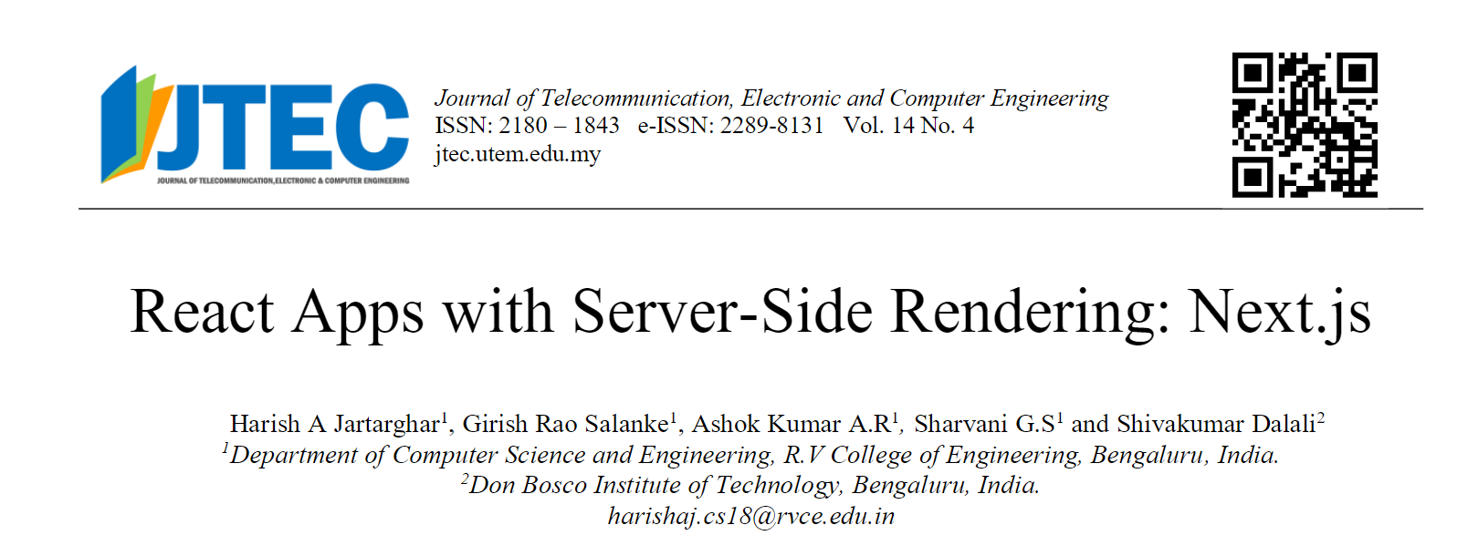
BASE PAPER
https://jtec.utem.edu.my/jtec/article/view/6192/4083

Slide 6
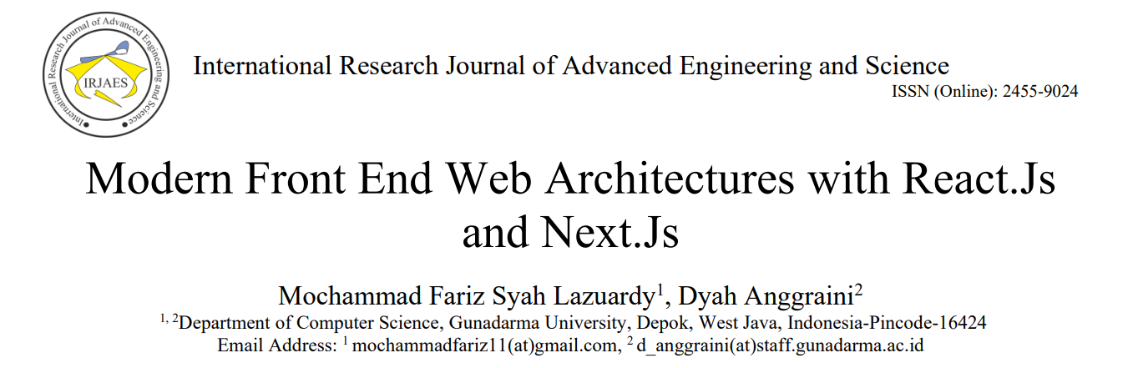
BASE PAPER
http://irjaes.com/wp-content/uploads/2022/02/IRJAES-V7N1P162Y22.pdf

Slide 7
INFERENCES (LITERATURE SURVEY)
The Next.js framework offers various data fetching mechanisms to suit application needs, including Client-Side Rendering (CSR), Server-Side Rendering (SSR), Static-Site Generation (SSG), and Incremental Static Regeneration (ISR). (Source: Research Journal of Advanced Engineering and Science, Volume 7, Issue 1, pp. 132-141, 2022)
Next.js provides built-in CSS support, easy routing mechanisms, and supports pre-rendering with SSR and SSG methods. SSR in Next.js helps improve initial loading time by rendering HTML on the server side, reducing blank screen experiences. (Source: Research Journal of Advanced Engineering and Science, Volume 7, Issue 1, pp. 132-141, 2022)
SSR is advantageous for SEO and initial load times, as pre-rendered HTML reduces white screen experiences during initial loads. (Source: Figure 3, Kishore dan BM, 2020)

Slide 8
INFERENCES (LITERATURE SURVEY)
The SIASN application utilizes local storage to store data temporarily and pass it between pages. Local storage aids in handling state and data persistence. (Source: Research Journal of Advanced Engineering and Science, Volume 7, Issue 1, pp. 132-141, 2022)
SSR and SSG methods in Next.js are advantageous for SEO, as data is pre-rendered on the server side, improving application performance and search engine indexing. (Source: Research Journal of Advanced Engineering and Science, Volume 7, Issue 1, pp. 132-141, 2022)

Slide 9
INFERENCES (LITERATURE SURVEY)
The SIASN application's front-end development involves receiving a UI prototype, slicing the design into HTML, CSS, and JavaScript code, receiving API documentation from the back-end team, connecting the API with the application, and displaying data on the web view. (Source: Research Journal of Advanced Engineering and Science, Volume 7, Issue 1, pp. 132-141, 2022)
React.js supports both class and function components, enabling reusable component development. However, it suffers from state persistence issues, initial blank screen experiences during CSR, and requires third-party libraries for routing and state management. (Source: Research Journal of Advanced Engineering and Science, Volume 7, Issue 1, pp. 132-141, 2022)

Slide 10
ALGORITHMS INVOLVED IN SSR
Combination of LRU, FIFO and LFU.
KMP and Boyer-Moore’s algorithm are used for string matching.
Deflate and Botli’s algorithms for compression.
Summation Algorithm, Binary Search for processing and transforming data before rendering or storing.
Dijkstra’s Algorithm and BFS for route optimization.
Memoisation and State While Revalidate for validating state.

Slide 11
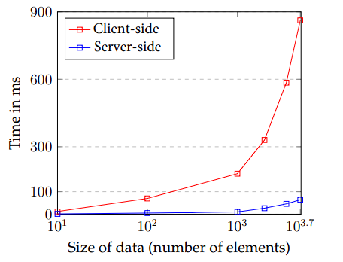
PROCESSING TIMES
The graph shows the processing times for Next.js server-side rendering (SSR) and React.js client-side rendering (CSR) as the amount of data processed increases. As you can see, the SSR times are much lower than the CSR times, especially for larger amounts of data.
This is because SSR renders the page on the server before it is sent to the client, while CSR renders the page on the client after it is loaded. This means that SSR has access to all of the data that is needed to render the page, while CSR has to wait for the data to load from the server.

Slide 12
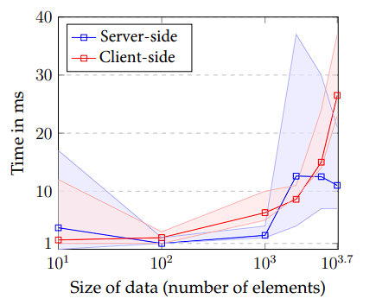
TRANSFER
The graph shows that the number of elements is a major factor in determining the rendering time. If you are trying to reduce the rendering time, you can try to reduce the number of elements that need to be rendered. You can also try to use a more efficient rendering engine.

Slide 13
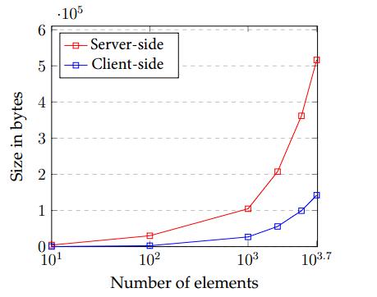
TRANSFER SIZES
The graph shows that the size of the data transferred increases as the number of elements in the DOM increases. This is because each element in the DOM requires a certain amount of data to be transferred, so the more elements there are, the more data needs to be transferred.

Slide 14
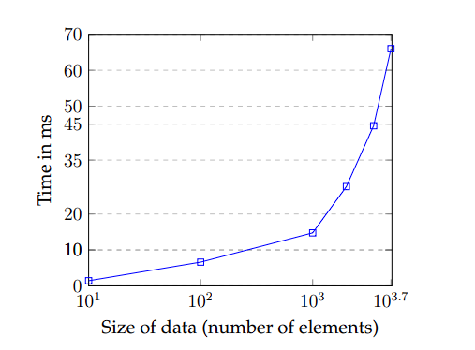
SSR DOM MANIPULATION TIMES
The graph shows the time it takes to manipulate the DOM (Document Object Model) on the server side (SSR) as the size of the data (number of elements) increases. The time increases linearly, meaning that it takes twice as long to manipulate the DOM for twice as much data. This is because the server has to do more work to process the larger amount of data.

Slide 15
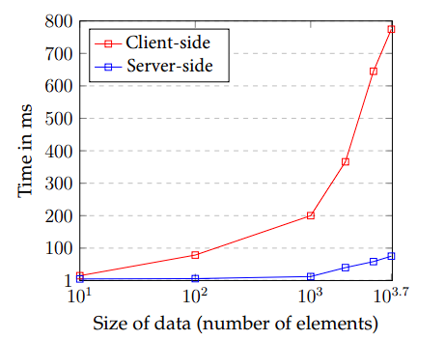
TOTAL TIME (PROCESSING + TRANSFER + DOM MANIPULATION)
The graph shows the total time it takes to process, transfer, and manipulate DOM data on the client side and server side. The x-axis shows the size of the data in terms of the number of elements, and the y-axis shows the total time in milliseconds.
The graph shows that the total time increases as the size of the data increases. However, the rate of increase is much steeper on the client side than on the server side. This is because the client side has to do more processing and manipulation of the DOM data.

Slide 16
FEATURES OF THE PROJECT
Server-Side Rendering for Improved Performance
Database Password Encryption using JSON Web Tokens (JWT)
Advanced Search Functionality
Rapid Application Submission
User-Centric Dashboard and User Interface (UI)
Intelligent Authentication
Session Management for Login State
Hierarchical Administration Structure
Multi-state Loading and Dynamic Views

Slide 17
REFERENCES
P. Kishore and M. B M, “Evolution of Client-Side Rendering over Server-Side Rendering,” vol. 3, no. 2, pp. 1–10, 2020.
Vercel, “Data Fetching Overview,” 2022. https://nextjs.org/docs/basicfeatures/data-fetching/index (accessed Jan. 24, 2022)
S. G. V and A. Sandeep, “Comprehensive Analysis of React-Redux Development Framework,” Int. J. Creat. Res. Thoughts www.ijcrt.org, vol. 8, no. 4, p. 4230, 2020.
B. McNamee, "Server-Side Rendering with React: A Comprehensive Guide," Smashing Magazine, Nov. 2020.

Slide 18
REFERENCES
A. Bhattacharya, "The Pros and Cons of Server-Side Rendering in React Apps," The Startup, May 2022. https://medium.com/swlh/the-pros-and-cons-of-server-side-rendering-in-react-apps-3505f4a2fcd5.
A. Srinivasan, "React SSR vs CSR: Benefits and Trade-offs," LogRocket Blog, May 2021. Available: https://blog.logrocket.com/react-ssr-vs-csr-benefits-and-trade-offs/.
S. Jangra, "A Comprehensive Guide to Server-Side Rendering with Next.js," Hashnode Blog, Mar. 2023. https://hashnode.com/post/a-comprehensive-guide-to-server-side-rendering-with-nextjs-ckxwoagb100x3gvs15kxdhswf.

Slide 19
THANK YOU!

