Slide 1


CREDIT CARD
ANALYSIS
Presented by ARYANANDA VP

Slide 2
INTRODUCTION
A Credit card is a type of loan that lets you borrow money from a bank or financial institution to make purchases, pay bills, or get cash. When you apply for a credit card, you receive a credit limit, which is the maximum amount you can borrow. You can use card to make purchase or get cash, and then pay back the borrowed amount, plus interest, by the due date.

Slide 3

Types of Credit Cards
Rewards Cards
Travel Cards
Earn points or miles for rewards.
Benefits for travelers, like airport lounge access.
Cash Back Cards
Business Cards
Get money back on purchases.
For business owners, with employee cards.
This Photo by Unknown Author is licensed under CC BY-ND

Slide 4
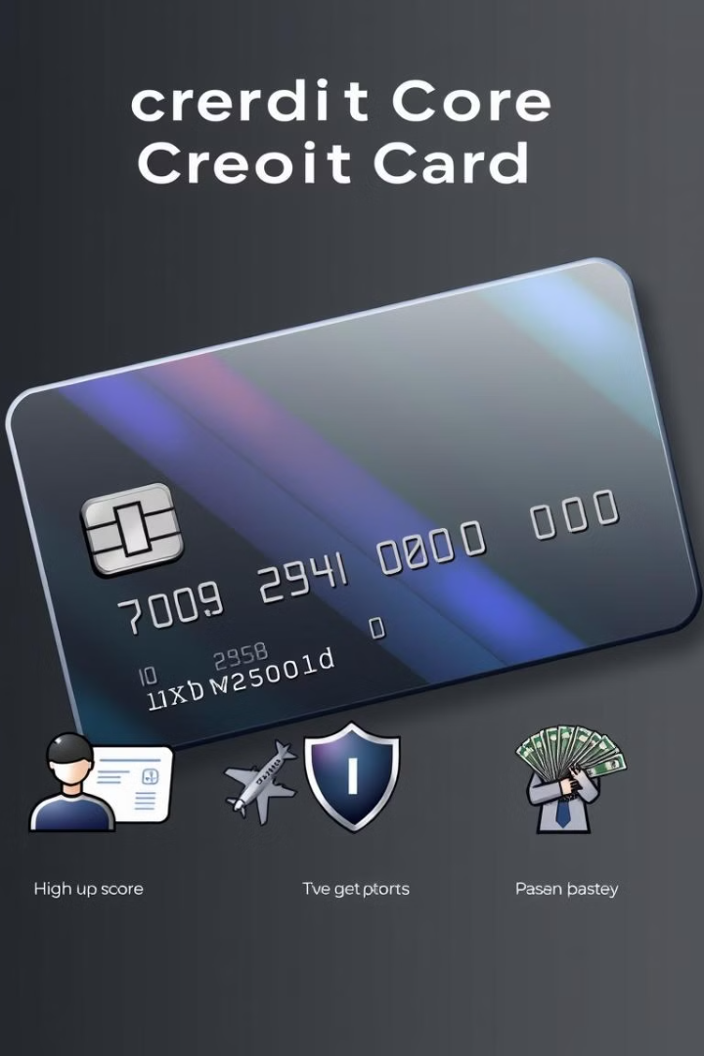
Benefits
1
Convenience
2
Purchase Protection
Easy to use for purchases and payments
You can get coverage against fraud .
3
Rewards
4
Emergency Funds
Earn points, miles, or cashback on purchases.
Provides access to cash in emergency situations.

Slide 5



Choosing the Right Card
Low Interest
Compare Offers
Reviews
If you carry a balance or want to save on interest.
Research different cards and their fees, interest rates, and rewards.
Read reviews from other cardholders to understand real-world experience.

Slide 6
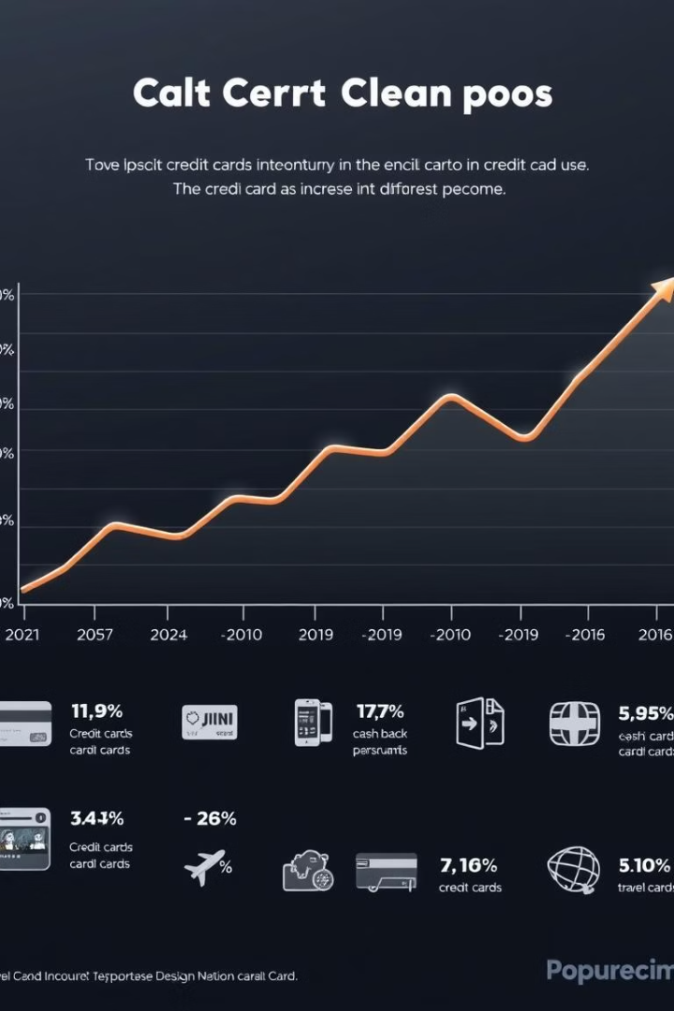
Findings from the Credit Card Landscape
270M
7,300
Credit Cards
Average Credit Score
The number of outstanding credit cards in the U.S.
The national average credit score in 2023.
7%
Credit Card Debt
Percentage of Americans carrying credit card debt.

Slide 7
Findings
Blue cards are the most popular, followed by Silver, Gold, Platinum
Women tend to have higher transaction amounts than men.
Graduate degree holders have the highest transaction amounts, while uneducated individuals have the lowest.
Married individuals hold the majority of credit cards, followed by singles.

Slide 8
Conclusion
This Credit cards analysis dashboard shows that most cardholders are married college graduates who hold silver cards. Women are more likely to have a credit card than men. This information can help credit card companies better understand their customers and develop targeted marketing campaigns.

Slide 9


Thank you

