Slide 1
Project Presented By Group-80
Arya Nath
Abhijit Maity
Mohan Kumar Jana
Arigna Adhikari
Sayak Sarkar
Suprotim Karmakar
Bratin Das
Sagor Mondal
Under The Guidance Of Respected :
Prof. Dr. Maumita Chakraborty
Project Guide
HOD, Department of Computer Science and Technology
UEM, Kolkata
And
Prof. Prasenjit Kumar Das
Project Guide and Assistant Professor
Department of Computer Science and Technology
UEM, Kolkata

Slide 2
Project Topic: Pong game developed using python

Slide 3
Project Rules:
The primary project is Pong, the design and development of which will be discussed in detail here. If you choose to submit an alternative project for this assignment, then you must submit a proposal for you version of the project and you must ensure that the following in features are included:
game loop
game graphical display with sounds
user interaction through the keyboard
at least one animated object
collision detection for fixed and moving objects
score keeping
management of game start (restart) and game completion

Slide 4
Game Design
Pong Layout
ball out of play
paddle_left
left paddle position
plx, ply
paddle_right
right paddle position
prx, pry
ball object
Keys w and s
control vertical
motion of left
paddle
ball position bx, by
ball velocity bvx, bvy
Keys up and down
control vertical
motion of right
paddle

Slide 5
game loop
init variables
quit game
?
init game
new game
?
save old positiions
init game state
ball at top or
bottom
bounce ball
exit game
ball hits paddle
return ball
ball miss paddle
score & reset
update scoreboard
players input
Pong
Game Loop
paddles at top
or bottom
stop paddle
animate
end loop

Slide 6
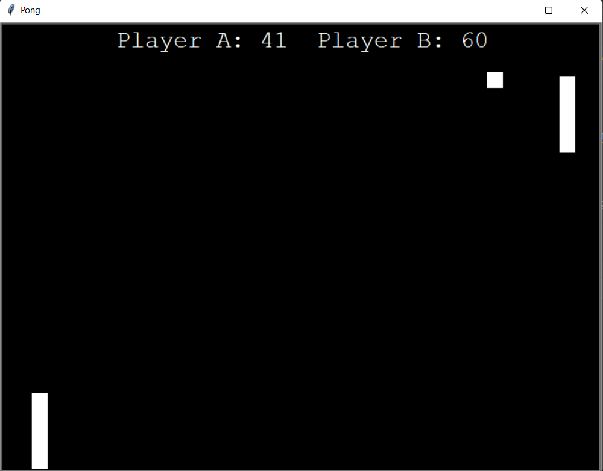
SCREENSHORT OF OUR PROJECT

