Slide 1

Driver Assistance Decision Making Over Human Current State-Of-Mind
Presented By:
Aryan Bhargav
(IEC2019026)
Project Supervisor:
Dr.Surya Prakash
Assistant Professor,
IIIT Allahabad

Slide 2
INTRODUCTION
Negative emotional states while driving can increase the risk of crashing by up to 10 times, as per recent research. Unfortunately, traffic accidents lead to 1.35 million fatalities globally each year. It is essential to reduce negative emotional states while driving to improve overall road safety. [1]
Emotional states can impact driving performance, leading to aggressive or risky behavior in response to other drivers, especially when the driver is under stress or strain.
The aim of this project is to detect the driver's emotional state and adjust the driving mode based on the analysis of the detected state.
[1]WHO newsroom.

Slide 3
LITERATURE SURVEY
Paper Title | Description
Allen Joseph(2019), Springer-Verlag GmbH Germany | Proposal of facial expression recognition with respect to the changes in the facial geometry.
Sebastian Zepf and Javier Hernandez(2020) | This review examines the existing literature on automotive emotion recognition It provides an overview of how these studies tackle the primary challenges, including the measurement of emotions, identification of relevant signal groups, detection of emotional states, and development of interaction strategies to improve the driver's experience.
Rajesh and M. Naveen kumar(2018), International Conference on Electrical, Electronics, Communication IEEE-2018 | This paper presents an analysis of two ml algorithms, the k-NN classifier and the MLP neural network, for prediction purposes. The k-NN classifier predicts by taking an average of the k nearest points to a given test point, while the MLP neural network employs backpropagation to update the network's weights during training.

Slide 4
LITERATURE SURVEY
Paper Title | Description
E. Pranav and S. Kamal(2020),International Conference on Advanced Computing and Communication Systems | In this research paper, we will demonstrate an effective way to detect emotions like neutral, happy, sad, surprise, angry, fear, and disgust from the frontal facial expression of the human in front of the live webcam.
Andrey V. Savchenko(2021),IEEE 19th International Symposium on Intelligent Systems and Informatics | In this paper, the multi-task learning of lightweight convolutional neural networks is studied for face identification And classification of facial attributes trained on cropped faces without margins.

Slide 5
Research Gap/Problem Statement
Autonomous vehicles lack a system that utilizes social media history, facial expressions, and voice recognition to detect the driver's state of mind and subsequently adjust the vehicle's mode. This absence highlights a potential avenue for future research in developing a comprehensive driver monitoring system for autonomous vehicles.
The goal is to develop a model that can significantly reduce the occurrence of accidents in vehicles.

Slide 6
Datasets
Facial Emotion Recognition
( FER2013) It consists of 35,887 grayscale images of faces, each labeled with one of seven emotions: anger, disgust, fear, happiness, sadness, surprise, and neutral.
Speech Emotion Recognition
i) RAVDESS-This dataset contains a total of 7,400 audio files and are categorized into 24 different actors (12 male and 12 female), and each actor performs a set of 60 different vocalizations.
ii) CREMA-D-The CREMA-D dataset contains a total of 7,442 audio files. Each audio file corresponds to a specific emotional expression performed by one of the actors included in the dataset.
iii) SAVEE-It contains a total of 480 audio files. These audio files are performed by four male actors and cover seven different emotions
iv) TESS-It consists of a total of 2,960 audio files. The dataset features two actresses who portray seven different emotions
Text Emotion Analysis : Sentiment140 dataset, which consists of 1.6 million tweets with sentiment labels.

Slide 7
METHODOLOGY
If the frame of mind is bad and mode is manual then it will switch to auto.
Face
3 input expressions
Two of the three majority analysis take the decision.
Voice
Microcontroller
Predict
emotions
Proposed model
Text
fig-1
If auto mode then it will remains as it is.

Slide 8
Methodology is divided into 3 sections as follows :
Section 1:Facial emotion Prediction
Section 2:Speech emotion Recognition
Section 3:Text emotion Prediction

Slide 9
1.1. Data Preprocessing
Section 1 : Facial Emotion Prediction
Emotion label are converted into text
Normalizing the pixel value in the image data
Dividing the 6 emotions and then taking out the interested label (i.e happy,neutral,sad)
Splitting the dataset in 90% training and 10%validation set .

Slide 10
1.2. Modelling
This is a deep convolutional neural network architecture with a total of 14 layers.
The input to the model is a 48x48 grayscale image.
The first convolutional layer has 64 filters of size 3x3 with a stride of 1.
The output of the first convolutional layer is normalized to reduce the internal covariate shift.
A max pooling layer with a pool size of 2x2 and a stride of 2 is applied to reduce the spatial dimension by half.
The output of the last convolutional layer is flattened to create a one-dimensional vector of length 9216.
A fully connected layer with 3 neurons and softmax activation is applied to obtain the probabilities for each of the 3 classes.
The softmax activation function takes a vector of real numbers and produces a probability distribution over multiple classes, making it suitable for multi-class classification problems.

Slide 11
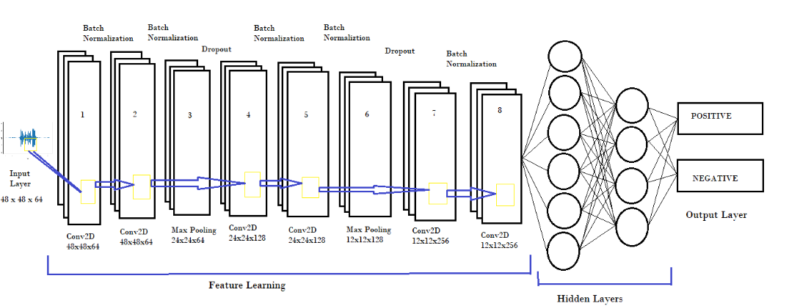
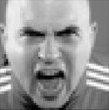
1.3. Architecture of CNN
fig-2

Slide 12
1.4. Training the Model
Two callbacks were used during training: early stopping and Reduce IROn Plateau.
Early stopping was employed to prevent overfitting by stopping training if the validation metric did not improve.
ReduceLROnPlateau adjusted the learning rate if the validation metric did not improve for a certain number of epochs.
The model was trained using the Adam optimizer.
The training used a batch size of 32, processing 32 samples at a time during training iterations.
The training process ran for 21 epochs, completing a full pass through the training dataset.
Early stopping and ReduceLROnPlateau callbacks helped optimize the training and model performance.

Slide 13
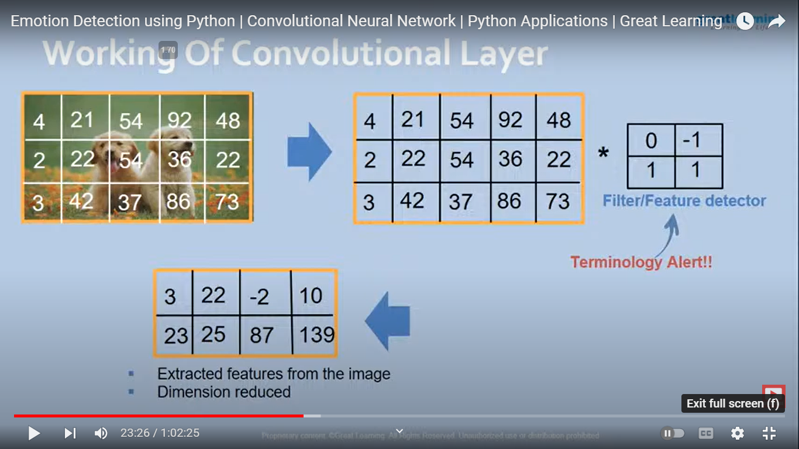
Working Convolution Layer
*
Filter/feature detector
image[1]
Extracted feature from the image
Dimension is reduced
[1] I.C.O.E braclets

Slide 14
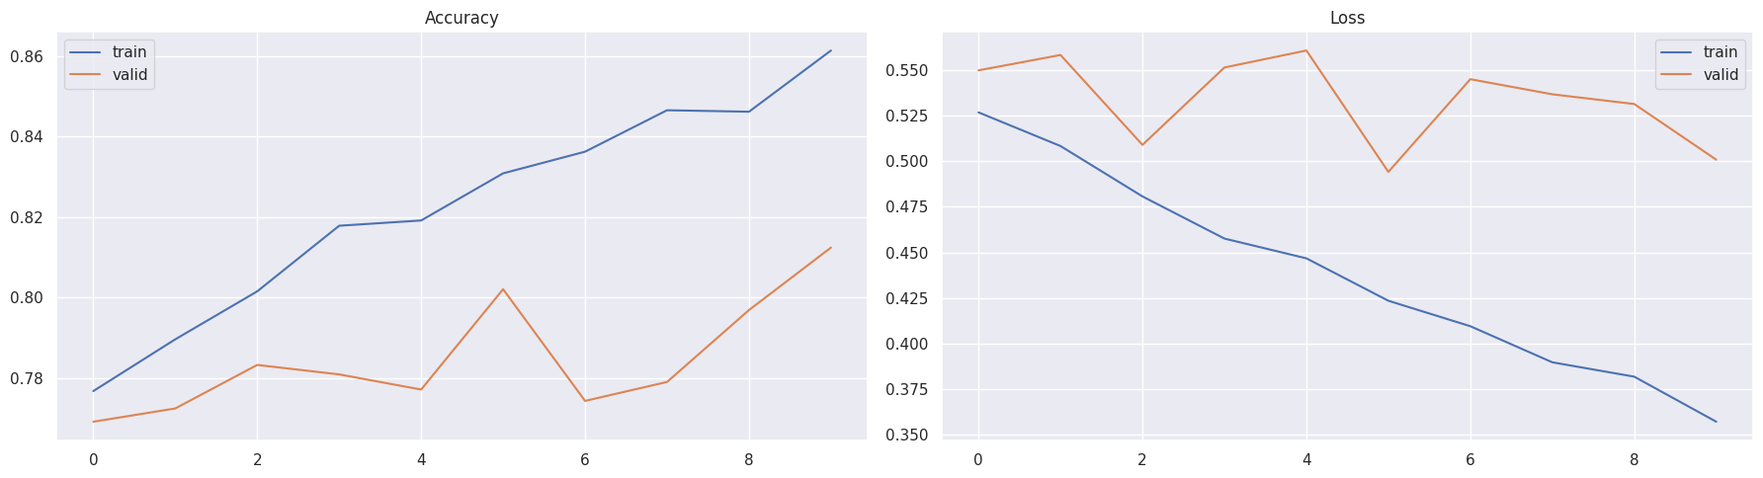
Accuracy
The image facial recognition system has an accuracy of 86.14% on training set and 81.24% on validation accuracy

Slide 15
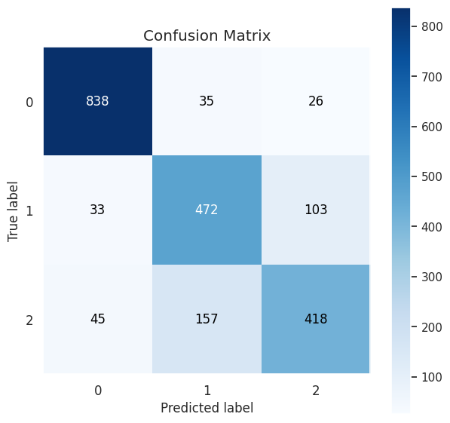
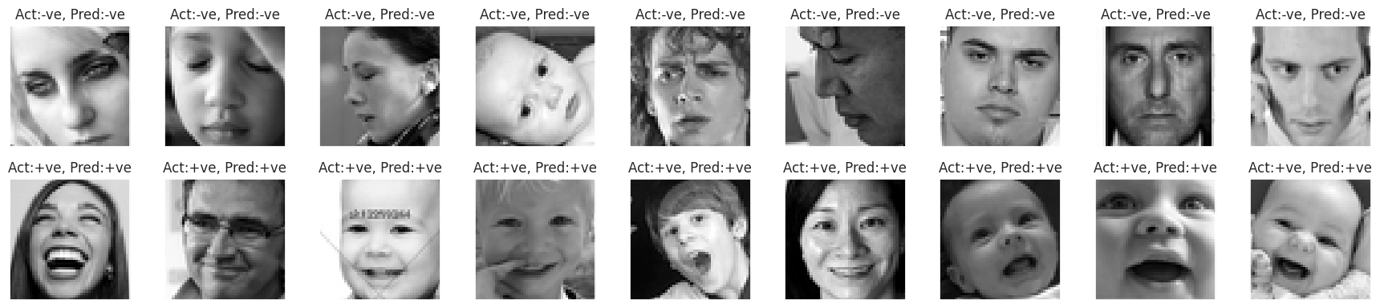
Results
Actual and Predicted labels of images fig-3
Confusion Matrix

Slide 16
Section 2 : Speech Emotion Recognition
2.1 Data Augmentation
Noise Injection : The function adds random noise to a speech signal by calculating the maximum amplitude, generating random noise within a range, and multiplying it with a standard normal distribution.
Stretching : This function stretches or compresses the time axis of the given speech signal by a random factor between 0.8 and 1.2. It uses the time_stretch() function from the librosa library to perform the time stretching.
Shifting : This function shifts the given speech signal by a random number of samples between -5000 and 5000. It uses the roll function from numpy to perform the signal shifting.
Pitching : This function changes the pitch of the given speech signal by a random number of semitones between -2 and 2 using pitch_shift function from the librosa library .

Slide 17
2.2 Feature Extraction
The following features are extracted from the speech signal:
Zero Crossing Rate (ZCR): It is the rate at which the signal changes from positive to negative or vice versa. It gives an indication of the amount of signal change or the frequency of the waveform.
Chroma STFT: It represents the 12 different pitch classes of the musical octave. It is calculated using the Short Time Fourier Transform (STFT).
MFCC: Mel-Frequency Cepstral Coefficients (MFCCs) represent the spectral envelope of the speech signal. They are commonly used in speech recognition systems.
Root Mean Square Value (RMS): It is the square root of the average of the squared values of the speech signal. It gives an indication of the amplitude of the signal.
Mel Spectrogram: It represents the spectral content of the speech signal in the Mel frequency scale. It is calculated using the Short Time Fourier Transform (STFT).

Slide 18
2.4 Modelling
The CNN model comprises of 14 layers.
There are 4 Conv1D layers followed by 4 max pooling layers to downsample the output of the previous layer. Then two Dropout layers are added to prevent overfitting.
The first layer is a Conv1D layer with 256 filters, a kernel size of 5, a stride of 1.
First 11 layers are feature learning and last 3 layers are classification layers.
The Final layer is a Dense layer with 2 units and softmax activation function, which outputs a probability distribution over the two classes.
The model is compiled using 'adam' optimizer, 'categorical_crossentropy' loss function and 'accuracy' metric.

Slide 19
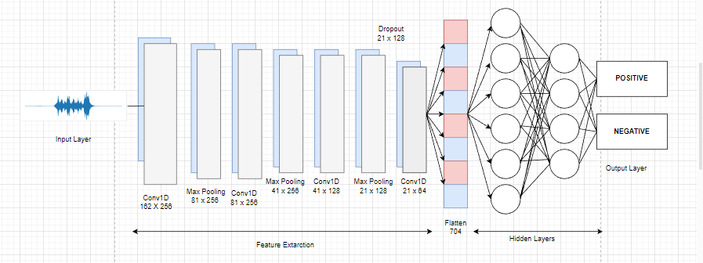
2.5 Model Architecture
fig-4

Slide 20
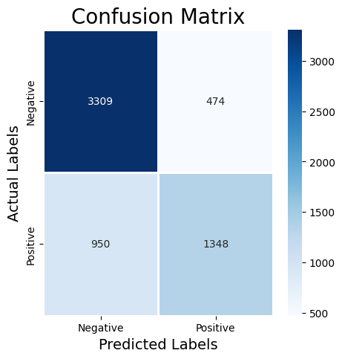
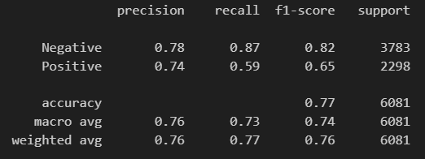
2.6. Results
Confusion Matrix
Precision,recall and f1-score

Slide 21
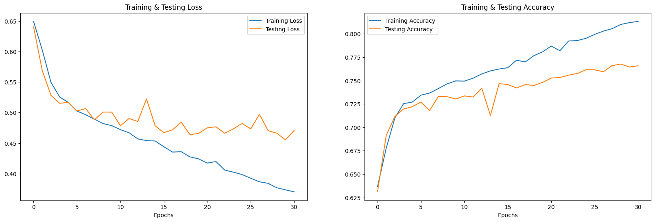
2.6.1 Accuracy
The speech recognition system has an accuracy of 81.33% .
fig-5

Slide 22
Section 3: Text Emotion Analysis from social media
3.1. Data Preprocessing
Converting the text to lowercase.
Replacing any URLs in the tweet with the string 'URL'.
Replacing any emojis in the tweet with the string 'EMOJI' concatenated with a unique identifier for the emoji (stored in a dictionary called emojis).
Replacing any usernames in the social media site with the string 'USER'.
Replacing any non-alphanumeric characters in the tweet with a space.
Replacing any sequences of 3 or more consecutive letters in the tweet with just 2 letters.
Then Lemmatizing the words using the WordNetLemmatizer.
Appending the lemmatized word to the tweetwords string.

Slide 23
3.2. Logistics Regression Model
This model performs well on binary classification problems.
Logistic regression is a statistical model used for binary classification, where the goal is to predict the probability that an instance belongs to a particular class.
Use logistic function to model the relationship between independent variables and probability of binary outcomes.
Then it uses cost function to minimize the error between predicted output and actual binary labels.
C=2 , A smaller value of C is chosen which corresponds to stronger regularization, which can help prevent overfitting by penalizing large coefficients.

Slide 24
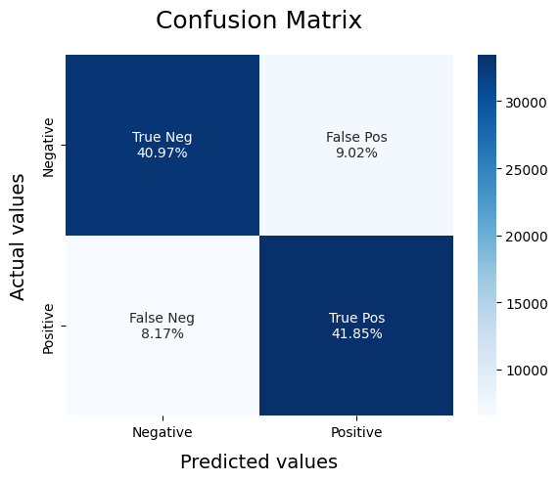
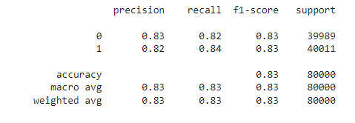
3.3. Results Of Text
The text recognition system has an accuracy of 83.00% .
Precision,recall and f1-score

Slide 25
4. OUTCOMES
After detection analysis there will be decision making:-
Manual Mode
Utilizing a combination of facial expression recognition, voice recognition, and social media history analysis, the vehicle will remain in manual mode if two of three analyses produce positive results, potentially improving the accuracy and reliability of driver state monitoring for accident prevention
Auto Mode
The proposed driver state monitoring system utilizes a combination of facial expression recognition, voice recognition, and social media history analysis to switch the vehicle from manual to auto mode if two out of three analyses produce negative results, improving the accuracy and reliability of the system for accident prevention.

Slide 26
FUTURE ASPECT
Future aspect is to implement this model on hardware (autonomous vehicle).

Slide 27
APPLICATIONS OF THE TECHNOLOGY
Autonomous Vehicles
Incorporating the proposed driver state monitoring system in vehicles can enhance driver assistance and accident prevention by providing a more comprehensive understanding of the driver's mental and emotional state through multi-source data analysis.
Robots
Facial-voice detection-based decision making can be leveraged in the fields of artificial intelligence and robotics to enhance the machines' ability to understand human emotions and behavior, enabling more effective and efficient interactions with humans..
Industry and Healthcare
Applying machine learning techniques to various data sources can aid in detecting and managing long-term conditions such as depression.

Slide 28
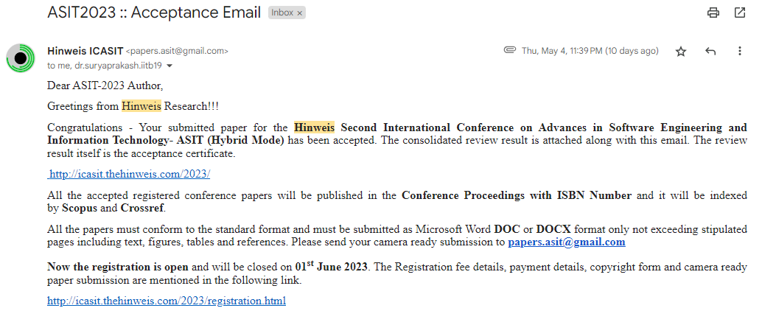
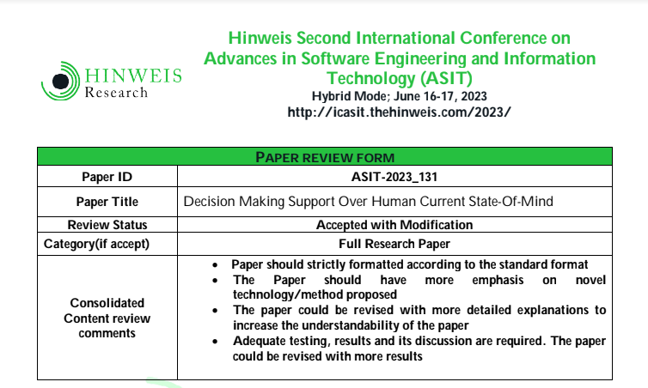
Paper Acceptance

Slide 29
REFERENCES
[1] Bakshi, Rushlene Kaur, Navneet Kaur, Ravneet Kaur, and Gurpreet Kaur. “Opinion mining and sentiment analysis.” In 2016 3rd International Conference on Computing for Sustainable Global Development (INDIACom), pp. 452-455. IEEE, 2016.
[2]Carlini, Nicholas, and David Wagner. “Audio adversarial examples: Targeted attacks on speech-to-text.” In 2018 IEEE Security and Privacy Workshops (SPW), pp. 1-7. IEEE, 2018.
[3]Sabaliauskaite, Giedre, Lin Shen Liew, and Jin Cui. “Integrating autonomous vehicle safety and security analysis using stpa method and the six-step model.” International Journal on Advances in Security 11, no. 1&2 (2018): 160-169.
[4]EEG-Based Emotion Recognition: A State-of-the-Art Review of Current Trends and Opportunities Nazmi Sofian Suhaimi, James Mountstephens, and Jason Teo 2020.
[5]Emotion Recognition from Physiological Signal Analysis: A Review Egger Maria, Ley Matthias, Hanke Sten 2019.

Slide 30
REFERENCES
[6]H. Avula, R. R and A. S Pillai, "CNN based Recognition of Emotion and Speech from Gestures and Facial Expressions," 2022 6th International Conference on Electronics, Communication and Aerospace Technology, Coimbatore, India, 2022, pp. 1360-1365.
[7]Rajesh, K. M., and M. Naveenkumar. “A robust method for face recognition and face emotion detection system using support vector machines.” In 2018 International Conference on Electrical, Electronics, Communication, Computer and Optimization Techniques (ICEECCOT), pp. 1-5. IEEE, 2018.
[8]E. Pranav, S. Kamal, C. Satheesh Chandran and M. H. Supriya, "Facial Emotion Recognition Using Deep Convolutional Neural Network," 2020 6th International Conference on Advanced Computing and Communication Systems (ICACCS), Coimbatore, India, 2020, pp. 317-320.

Slide 31
THANKS!

