Slide 1

SpaceXinvader
by Aryan Joshi

Slide 2
Space Invaders Game Implementation
Overview
This Python code implements a classic Space Invaders game using the Pygame library. The game features a player-controlled spaceship, shooting mechanics, enemies, power-ups, and progressively challenging levels.
Code Breakdown
1. Game Configuration
The GameConfig dataclass defines constants for game settings such as screen dimensions, player speed, enemy behavior, and more.
@dataclass class GameConfig: SCREEN_WIDTH = 800 SCREEN_HEIGHT = 600 FPS = 60 PLAYER_SPEED = 5 BULLET_SPEED = 7 ENEMY_SPEED = 2 ENEMY_DROP = 30 ENEMY_ROWS = 3 ENEMIES_PER_ROW = 8 BONUS_SPAWN_CHANCE = 0.002 POWER_UP_DURATION = 300

Slide 3
2. Game Objects
Base Class (GameObject):
A general object with attributes like position, size, speed, and color.
Bullet Class:
Represents player bullets, moving upward at a set speed.
Power-Up Class:
Bonus items with effects like double_shot, speed_up, or shield.
Player Class:
The player-controlled spaceship, with methods for movement, shooting, drawing, and power-up handling.
Enemy Class:
Represents enemies; they move horizontally and descend periodically.

Slide 4
3. Game Logic
Initialization:
Sets up the screen, clock, enemies, and power-ups.
Gameplay Mechanics:
Player Movement: Controlled by arrow keys.
Shooting: Spacebar fires bullets.
Enemy Behavior: Enemies move horizontally, dropping down when reaching screen edges.
Collisions: Bullets destroy enemies, and power-ups activate on player contact.
Level Progression:
Levels advance as enemies are defeated; the game ends after level 3.
Game Over:
Occurs when an unshielded player collides with an enemy.

Slide 5
4. Drawing and Display
Pygame methods render all visual elements, including:
The player spaceship (with optional shield).
Enemies with animated movement.
Bullets and power-ups.
A HUD displaying score, level, and active power-ups.

Slide 6
5. Main Game Loop
The main loop handles events, updates game state, and renders the screen:
while running: self.clock.tick(GameConfig.FPS) for event in pygame.event.get(): if event.type == pygame.QUIT: running = False if event.type == pygame.KEYDOWN: if event.key == pygame.K_ESCAPE: running = False if not self.game_over and not self.win_condition: self.handle_input() self.player.update() self.update_enemies() self.update_power_ups() self.check_collisions() self.check_win_condition() self.draw() pygame.quit()
Features
Player Mechanics:
Responsive movement and shooting.
Power-ups enhance player capabilities.
Enemies:
Realistic movement and collision detection.
Increasing difficulty across levels.
Power-Ups:
Randomly appear, providing effects like double shot, speed boost, or shield.
Game States:
Manages win/lose conditions and resets.
Graphics:
Custom shapes for elements and a clear HUD.

Slide 7
How to Run the Game
Install pygame:pip install pygame
Save the code as space_invaders.py.
Run:python space_invaders.py
Extensions and Enhancements
Future improvements could include:
More levels and enemy types.
Sound effects and background music.
Improved graphics using sprites.
Multiplayer or co-op modes.
High score tracking and saving.

Slide 8
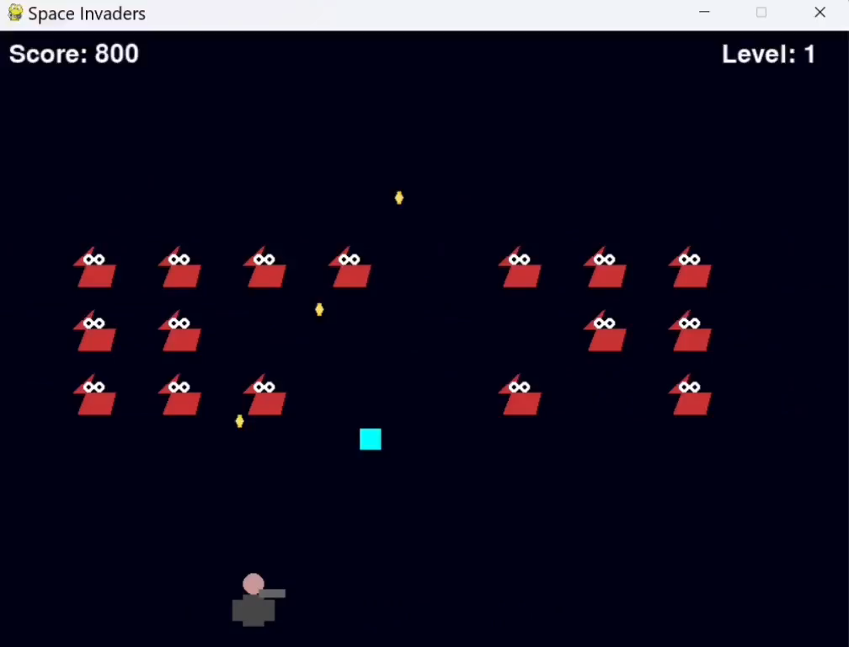
Implementation Of Game

