Slide 1

An intelligent virtual machine allocation optimization model for cloud computing environments
Virtualization and Cloud Computing Project

Slide 2
Contributors
Aryan Kumar (M23CSA510)
Ayush Mishra (M22AIE251)
Harsh Parashar (M22AIE210)
Prateek Singhal (M22AIE215)

Slide 3
Project Objective
Cloud computing enables on-demand, scalable access to computing resources.
Rapid growth of cloud services brings challenges like high energy use and inefficient resource allocation.
Fixed VM configurations and fluctuating workloads often lead to suboptimal performance and increased costs.
Our project builds on this model, aiming to improve it using predictive model for better provisioning of resources.
Results are obtained using a simulated cloud environment

Slide 4
Methodology
Random Allocation
VMs are randomly assigned to available Physical Machines (PMs).
If no PM has enough resources, a new PM is initialized.
Unallocated VMs are handled using First-Fit Decreasing (FFD).
Predictive Model (DNN-based)
Trained a Deep Neural Network using normalized Borg trace data (CPU, RAM usage).
Predicts future VM resource needs to improve allocation efficiency
Uses Differential Evolution for training optimization (multiple mutation strategies, RMSE-based fitness).
Reliable Allocation Using Prediction
Combines predictions with current PM states to ensure only suitable and reliable machines are selected.
Avoids overloading and unnecessary PM spin-ups by allocating VMs based on predicted compatibility.

Slide 5
Configuration
Simulated Environment
Used 3 types of virtual machines (S1, S2, S3) instead of real cloud infrastructure to reduce cost.
Simulated Machine Specifications
S1: 5320 MIPS, 4 GB RAM, 0.80 reliability, moderate power use.
S2: 12268 MIPS, 8 GB RAM, 0.70 reliability, energy-efficient.
S3: 36804 MIPS, 16 GB RAM, 0.90 reliability, high performance.
Why Simulation?
Enables controlled testing of energy usage, performance, and reliability without real-world cost or unpredictability.

Slide 6
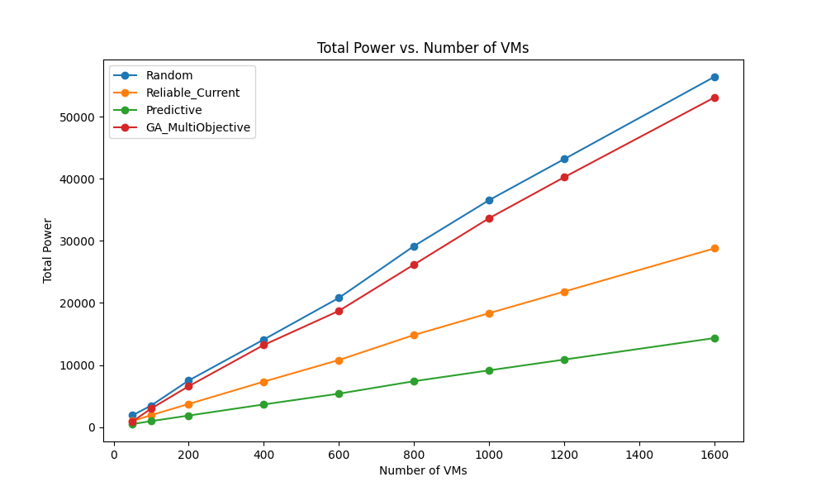
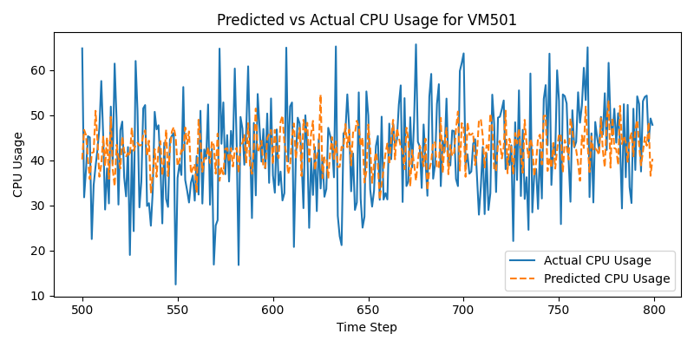
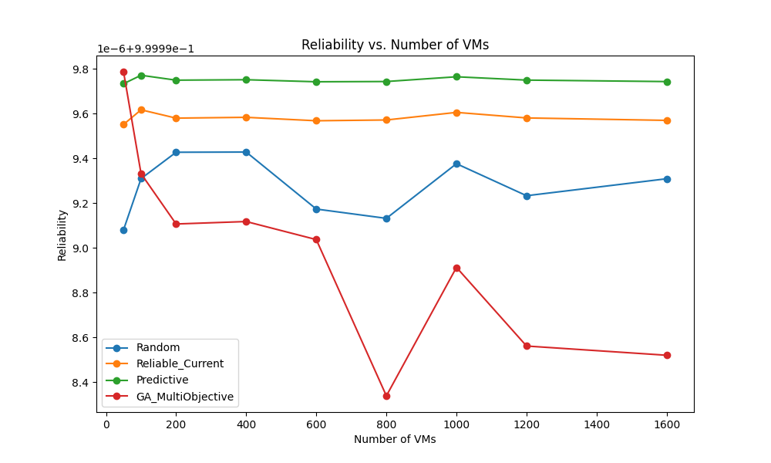
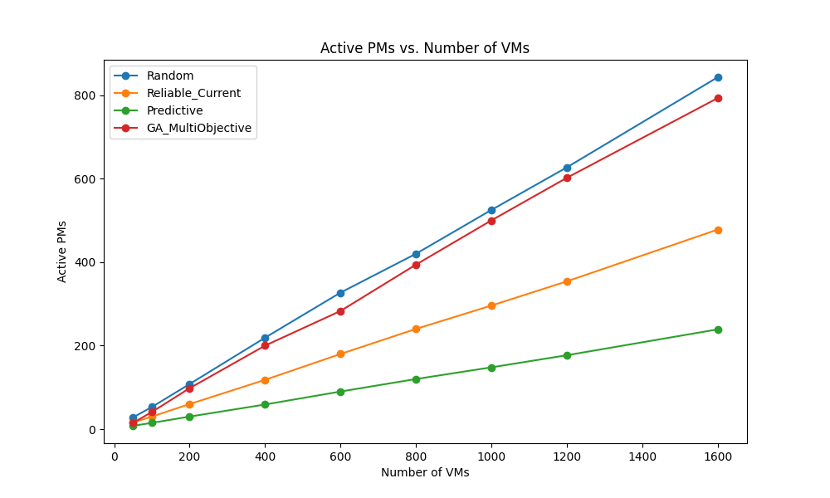
Results

Slide 7
Conclusion
Our model closely replicates the results presented in the original research paper.
Predicted vs. actual CPU usage shows high accuracy, with minor deviations during peak loads.
Reliability trends align with expected behavior slightly decreasing as resource usage increases.
Overall, the simulation validates our approach and sets the foundation for future improvements.

