Slide 1

Microservices Benchmark: REST vs gRPC
SDE – Major Project
Submitted by:
Aryan Kumar (M23CSA510)
Harsh Parashar (M22AIE210)
Prateek Singhal (M22AIE215)

Slide 2
Introduction to Microservices
Microservices architecture: A design pattern for scalable, maintainable, and resilient software.
Breaks down complex monolithic applications into independent, deployable services.
Each microservice is responsible for a specific business function.

Slide 3
Microservices Challenges
Effective communication is crucial for microservices.
Interaction occurs through well-defined communication protocols.
Protocols impact latency, throughput, and system performance.

Slide 4
Problem statement and objective
Problem Definition
Microservices architecture improves scalability but creates challenges in communication between independently deployed services.
The choice of communication protocol (e.g., REST vs. gRPC) significantly affects system performance, including latency and throughput.
Objective
To evaluate and compare the performance of REST and gRPC in microservices environments, focusing on latency, throughput, and resource utilization.
To determine the optimal protocol for various microservice scenarios based on performance metrics in real-world cloud environments.

Slide 5
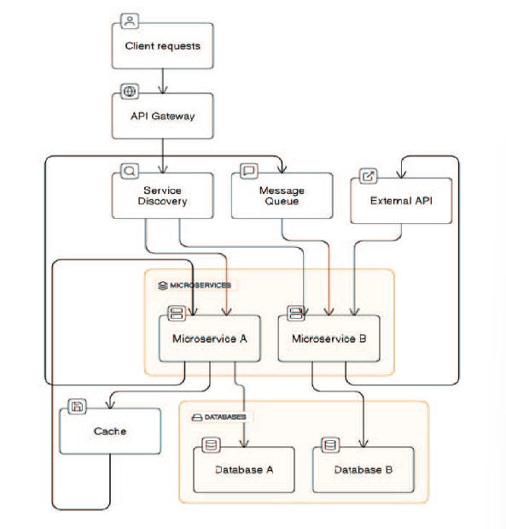
Architecture

Slide 6
Communication Protocols
REST (Representational State Transfer)
Protocol: Based on HTTP/1.1, widely adopted in web services.
Communication: Uses standard HTTP methods:
GET, POST, PUT, DELETE
Simplicity: Known for its simplicity and compatibility with web-based services.
gRPC (Google Remote Procedure Call)
Protocol: Built on HTTP/2, offering advantages in efficiency and multiplexing.
Serialization: Uses Protocol Buffers for faster and compact data serialization.
Streaming: Supports both unidirectional and bidirectional streaming.

Slide 7
Methodology for Performance Evaluation
Service Types
Simple Request-Response: Handles lightweight interactions with small data transfers.
Streaming Data: Simulates continuous data transmission under sustained connections.
Large Payload: Handles large data transfers between services.
Metrics Assessed
Latency: Evaluated the time for requests to travel between client and server, measured at various percentiles (e.g., 50th, 95th, 99th).
Throughput: Measured the number of requests processed within a time frame under varying load conditions.
Resource Utilization: Monitored CPU, memory, and network usage.
Testing Tools
Prometheus: Used for scraping performance metrics.
Grafana: Visualized the collected metrics.
Locust: Performed load testing to simulate user concurrency and varying request rates.

Slide 8
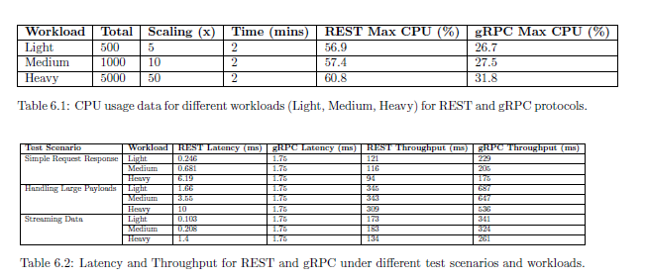
Results

Slide 9
Service Machines and IPs
gRPC Machine: 34.57.71.117
REST Machine: 34.30.3.222
REST URLs
Login URL: http://34.30.3.222:3000/login
Targets URL: http://34.30.3.222:9090/targets
gRPC URLs
Login URL: http://34.57.71.117:3000/login
Targets URL: http://34.57.71.117:9090/targets

Slide 10
Thank you!

