Slide 1
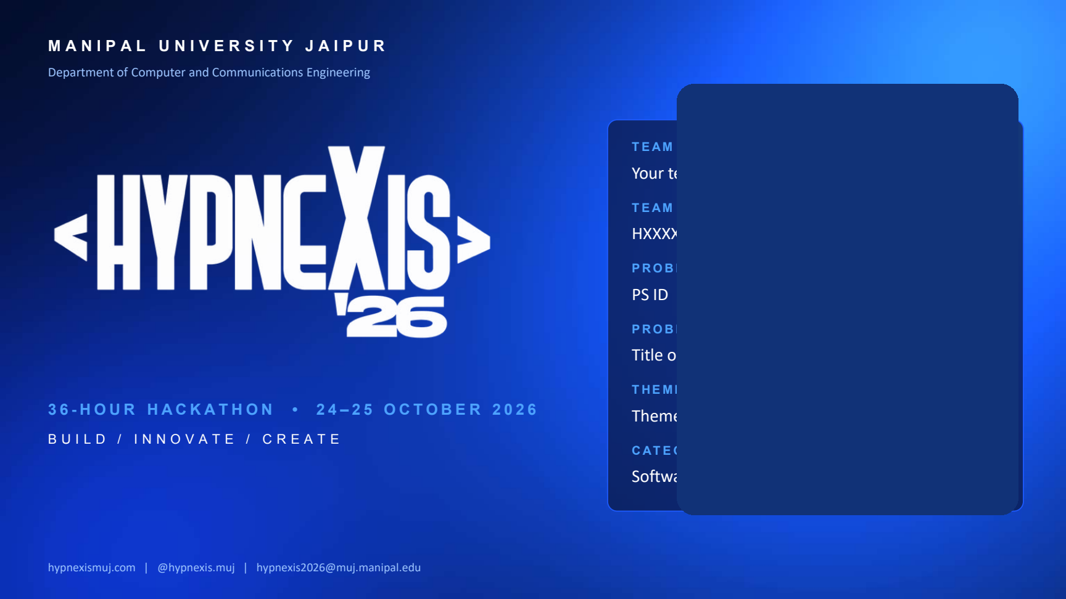
TEAM NAME
Neuro Forge
TEAM ID
[HXXXX]
PROBLEM STATEMENT ID
[PS ID]
PROBLEM STATEMENT TITLE
RxGuard India — Safer Prescriptions
THEME / DOMAIN
Healthcare · HealthTech
RxGuard India
CATEGORY
Safer prescriptions. Better decisions.
Software
An explainable prescription safety checker for Indian brand-name medicines — a deterministic rules engine, not an LLM judge.

Slide 2
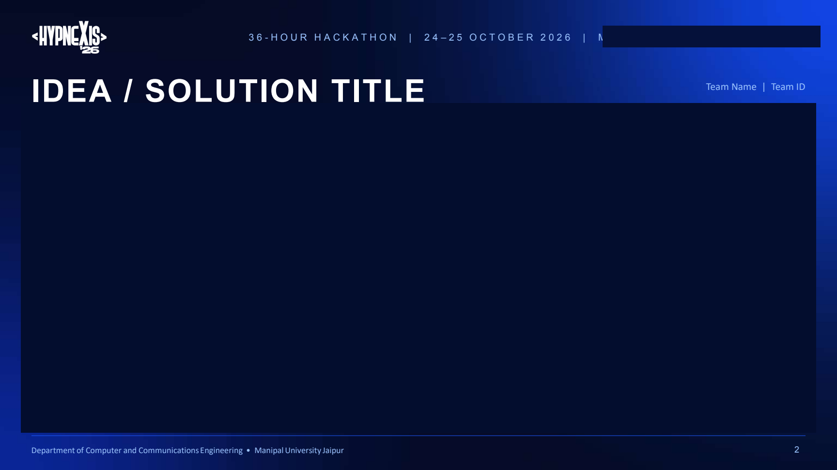
Neuro Forge | Team ID: [HXXXX]
RXGUARD INDIA — SAFER PRESCRIPTIONS
PROBLEM STATEMENT
• Indian prescriptions use brand and combination names (Dolo, Combiflam, Augmentin), so active ingredients stay hidden.
• The same ingredient across brands — e.g. paracetamol in three products — silently stacks into a duplicate daily dose.
• Shorthand (OD, BD, 1-0-1, SOS), patient-specific limits and interactions are easy to miss; naive checkers flood users with alerts.
OUR SOLUTION
• Paste, speak or scan a prescription; RxGuard resolves every brand to its ingredients and strengths.
• A deterministic rules engine — not an LLM judge — checks duplicates, daily dose totals and interactions.
• Every alert cites its rule, the numbers used and its review status — “no match” ≠ safe.
LIVE EXAMPLE · THREE PARACETAMOLS
Dolo 650 + Crocin Advance + Combiflam → 2,950 mg/day (74% of 4,000 mg adult limit)
Flagged PLEASE CHECK — duplicate paracetamol (MAX-001)
20,009 products · 3 engines (duplicate · interaction · dose) · 1 rule cited per alert

Slide 3
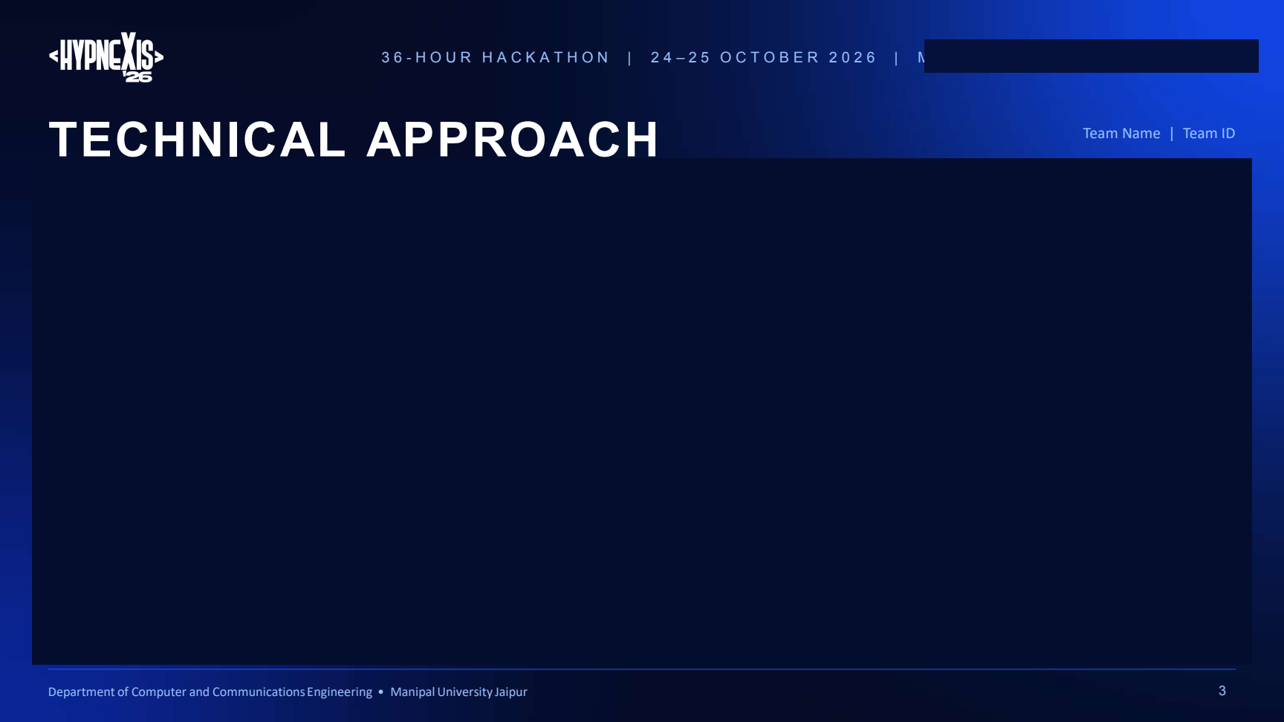
Neuro Forge | Team ID: [HXXXX]
TECHNICAL APPROACH
SYSTEM ARCHITECTURE — ANALYSIS PIPELINE
1 Parse — OD, BD, 1-0-1 → units per day
2 Resolve brand — exact → prefix → fuzzy (user confirms)
3 Expand — combinations → ingredients + strengths
4 Sum dose — Σ strength × units/day per ingredient
5 Safety engines — duplicate · interaction · dose (parallel)
6 Alert manager — merge, de-duplicate, assign tier
7 Safety report — found · why it matters · what to do
CORE TECHNOLOGIES
• Frontend: React · Vite · Tailwind · Framer Motion
• Backend: FastAPI · SQLAlchemy · SQLite
• Matching: RapidFuzz + number-aware resolver
• Data: A–Z Medicines of India · DDInter 2.0 · curated rules
• Quality: pytest · vitest · evaluate.py gold set
UNIQUE POINTS
• Deterministic and auditable: same input → same output
• Every alert cites rule ID, source, numbers and review status
• Identity confidence kept separate from severity
• “No match” never means safe; unresolved brands block dependent checks

Slide 4
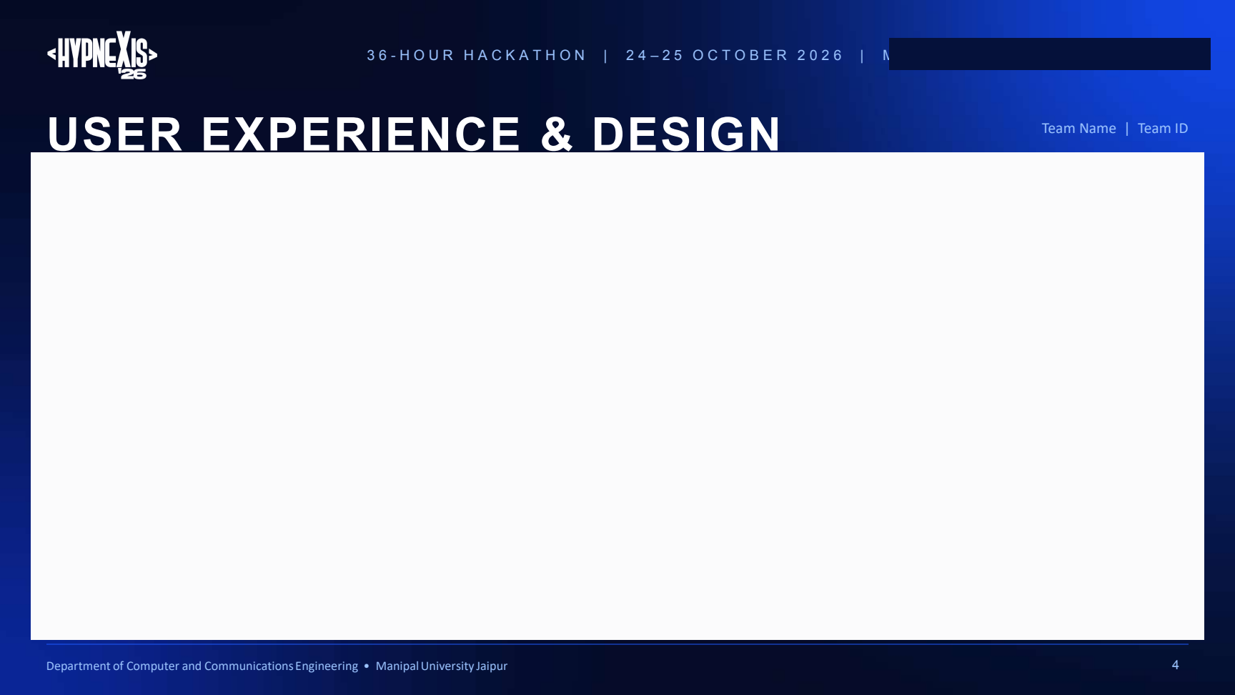
Neuro Forge | Team ID: [HXXXX]
USER EXPERIENCE & DESIGN
USER INTERFACE
• Rx editor with line numbers and live parse preview (“1-0-1 = 2/day”)
• Patient panel: age, weight, sex, kidney band, pregnancy
• One-click scenarios, voice input, in-browser OCR scan
• Verdict card, tier counts, plain-language findings, Why? drawer
• Ingredient X-ray, daily dose gauges, risk map, what-if toggles
• Accessible: Hindi/English pill card, reduced-motion safe, mobile menu
USER FLOW
1 Enter the prescription — type, speak, scan or load a sample; add patient details
2 RxGuard checks it — parse → resolve brands → expand → run rules
3 Clear, cited report — what we found, why it matters, what to do
DESIGN GOAL
Anyone reviewing a prescription should understand each alert in seconds — and see exactly which rule and which numbers produced it.
CHECKER WIREFRAME · Prescription input with live parse → cited safety report (Urgent / Please check / Info / Not run)
Example: Tab Dolo 650 1-0-1 · Tab Crocin Advance BD · Tab Combiflam 1-0-1 → Duplicate paracetamol 2,950 mg/day · MAX-001

Slide 5
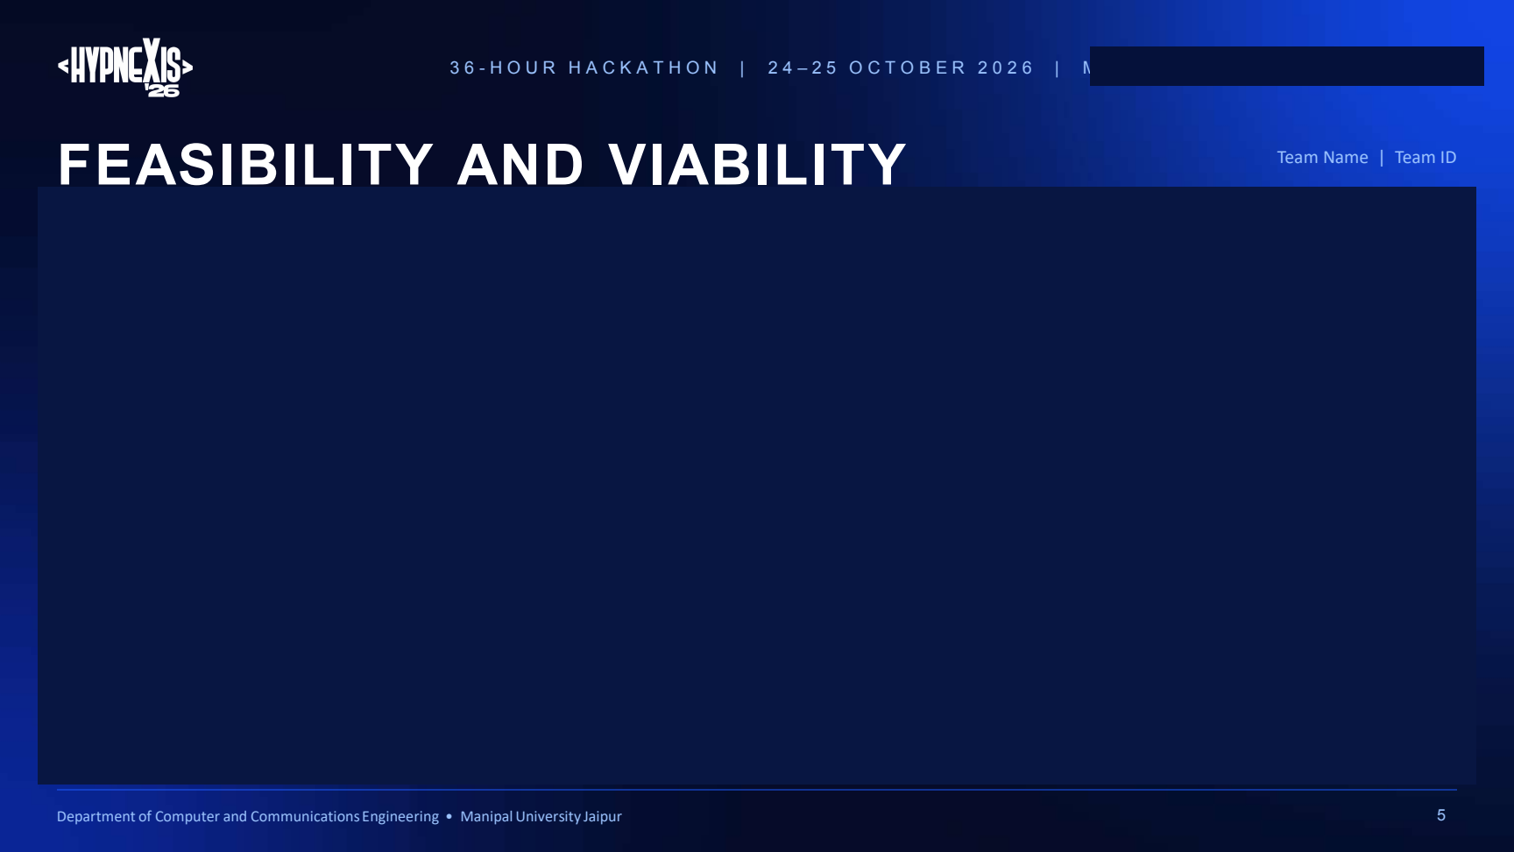
Neuro Forge | Team ID: [HXXXX]
FEASIBILITY AND VIABILITY
TECHNICAL FEASIBILITY
• Working prototype: React ↔ FastAPI ↔ SQLite catalogue + rules
• Laptop-ready, no GPU; modular engines; pytest + vitest
• Stress test: 100 synthetic Rx in 161 ms (~620/s) — speed, not accuracy
ECONOMIC FEASIBILITY
• Prototype: open-source stack + public datasets — near-zero cost
• Scaling: low-cost API hosting; main cost is pharmacist rule review
• Funding to explore: incubation grants, supervised pilots
OPERATIONAL VIABILITY
• Web app for pharmacy counter, clinic desk or mobile
• Decision support only: a professional stays in the loop
• Labelled offline demo fallback; disclaimers on every page
RISKS & MITIGATIONS
• Rules not clinically verified → Pharmacist review workflow; DRAFT / REVIEW_PENDING on every alert
• Wrong brand match → Fuzzy matches need confirmation; number-aware matching (Pantop 40 ≠ Pantop 20)
• Incomplete/dated data → Gaps flagged “unable to assess”, never passed as safe
• Over-reliance / DDInter licence → Disclaimers everywhere; licence or replace before commercial use

Slide 6
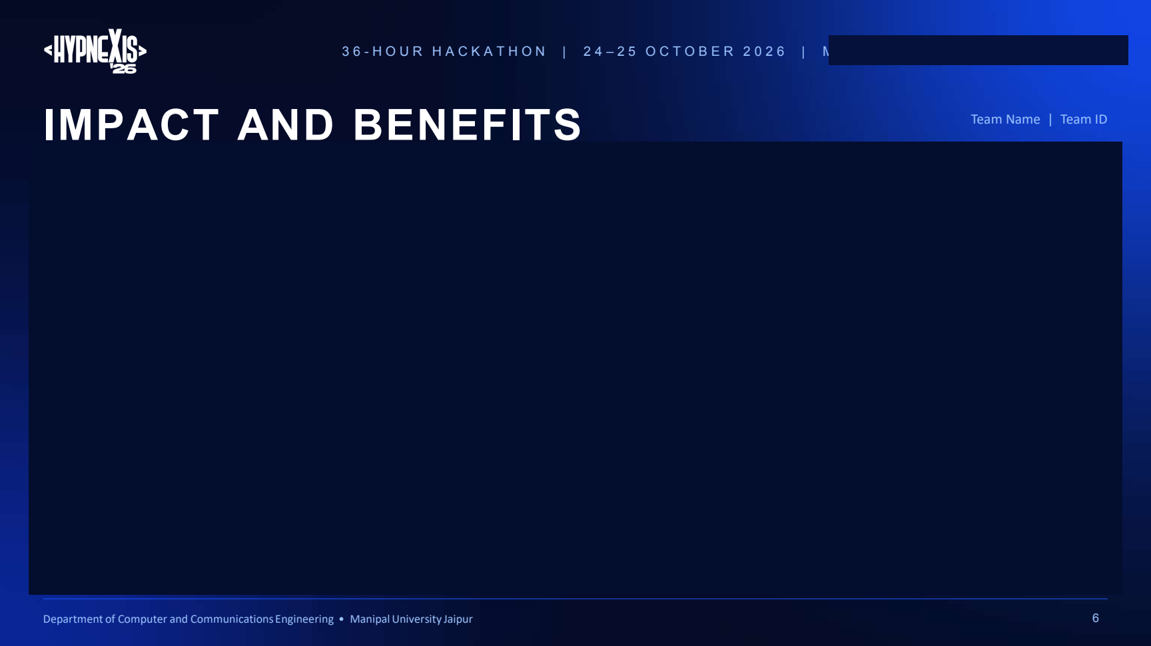
Neuro Forge | Team ID: [HXXXX]
IMPACT AND BENEFITS
1
SOCIAL IMPACT
• Patients and caregivers see what is inside their brands and ask better questions
• Pharmacists get a fast second look at brand-heavy prescriptions
• Hindi/English pill card helps non-English readers follow the schedule
2
ENVIRONMENTAL IMPACT
• Spotting duplicate products avoids buying the same ingredient twice
• Digital report and pill card reduce reprints
• Lightweight stack (SQLite, no GPU) keeps compute and energy use low
3
TECHNICAL IMPACT
• Auditable brand → ingredient pipeline for Indian combination products
• Alert merging and tiering cut repeated alerts; reproducible stress test
• Methodology page with live stats and reproduce commands
4
EDUCATIONAL IMPACT
• Ingredient X-ray and finder show how many brands share one ingredient
• Why? drawer explains the rule and numbers behind each alert
• Limitations documented openly for judges, students and reviewers

Slide 7
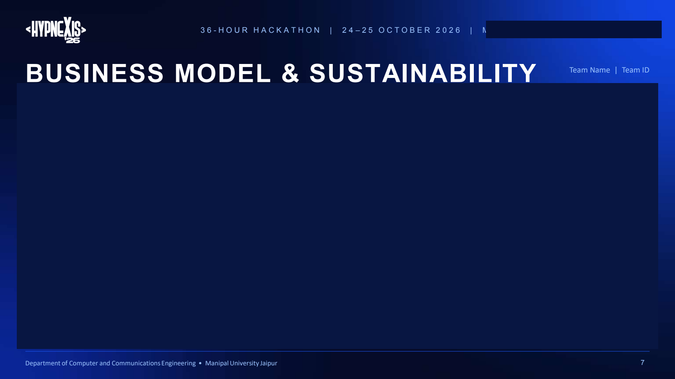
Neuro Forge | Team ID: [HXXXX]
BUSINESS MODEL & SUSTAINABILITY
TARGET USERS
• PRIMARY — Community pharmacists and pharmacy counters
• INSTITUTIONS — Small clinics; telemedicine and e-pharmacy platforms via API
• EARLY ADOPTERS — Pharmacy colleges; caregivers managing several medicines
REVENUE & COST MODEL
• PILOT — Free, supervised pilots to collect pharmacist feedback
• PRICING — Per-pharmacy SaaS; usage-based API for platforms
• LONG-TERM — Verified rule packs and catalogue refreshes as a paid service
SUSTAINABILITY
• RULE GOVERNANCE — Versioned rules: DRAFT → pharmacist-reviewed sign-off
• PARTNERS — Pharmacy colleges and pharmacologists for rule review
• OPEN SOURCE — Core on GitHub; more languages, multi-drug checks
ROADMAP (NO FIXED DATES)
NEXT — Pharmacist review of the rule set; close 3+ ingredient and syrup-strength gaps · THEN — Refresh catalogue; supervised pilot · LATER — Multi-drug checks, more Indian languages, pharmacy-software API
No revenue, pilots or partnerships exist yet — options to validate, not claims.

Slide 8
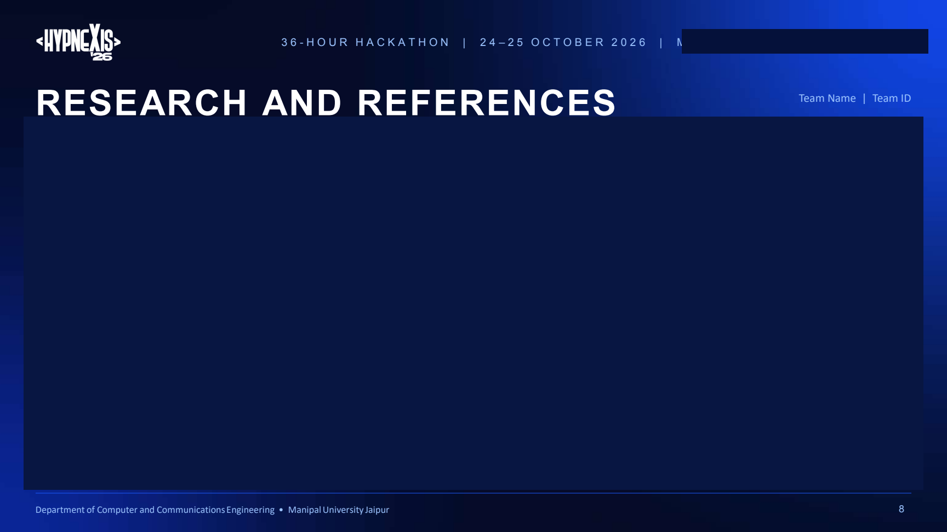
Neuro Forge | Team ID: [HXXXX]
RESEARCH AND REFERENCES
KEY TECH & RESEARCH SOURCES
• A–Z Medicine Dataset of India — Kaggle (shudhanshusingh); cleaned into the local brand catalogue
• DDInter 2.0 — drug–drug interaction database, Nucleic Acids Res. 53(D1), 2025; ddinter2.scbdd.com (academic use)
• RxNorm — U.S. National Library of Medicine; public search fallback (US terminology)
• Technology: FastAPI · SQLAlchemy · SQLite · React · Vite · Tailwind CSS · RapidFuzz · Framer Motion · Lucide
• Existing solutions studied: RxCheck, PillChecker — comparison documented in the project repository
• Project: github.com/Aryankatariya71/RxGuard-India — README, methodology, evaluation, reproduce commands
20,009
1,047
Hidden ingredient finder
products in the cleaned local catalogue
products contain amoxycillin — 843 combinations
Counts from A–Z dataset (unverified)

Slide 9

THANK YOU
RxGuard India — Safer prescriptions. Better decisions.
Team: Neuro Forge | Team ID: [HXXXX] | github.com/Aryankatariya71/RxGuard-India
OUR ASK
Pharmacist / pharmacology mentors to review our draft rules, and partners for a supervised feedback pilot.
DISCLAIMER
Decision-support prototype only — not a medical device, not clinically validated. Draft rules pending pharmacist review. No alert never means a prescription is safe.

