Slide 1

Basic Details of the Team and Problem Statement
Ministry/Organization Name/Student Innovation:
Government of Gujarat
PS Code: SIH1362
Problem Statement Title:
Student Dropout Analysis For School Education
Team Name: SDSS - School Dropout Solution Squad
Team Leader Name: PANCHAL ARYANKUMAR KAMLESHBHAI
Institute Code (AISHE): C-423
Institute Name:
GOVERNMENT ENGINEERING COLLEGE, PATAN 022
Theme Name: Smart Education

Slide 2
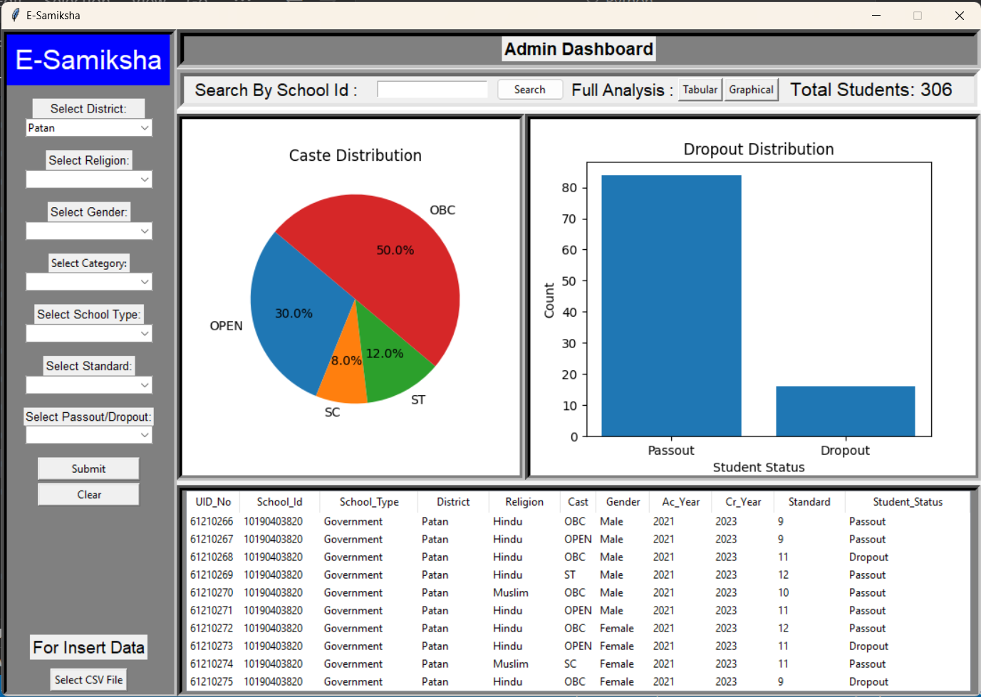
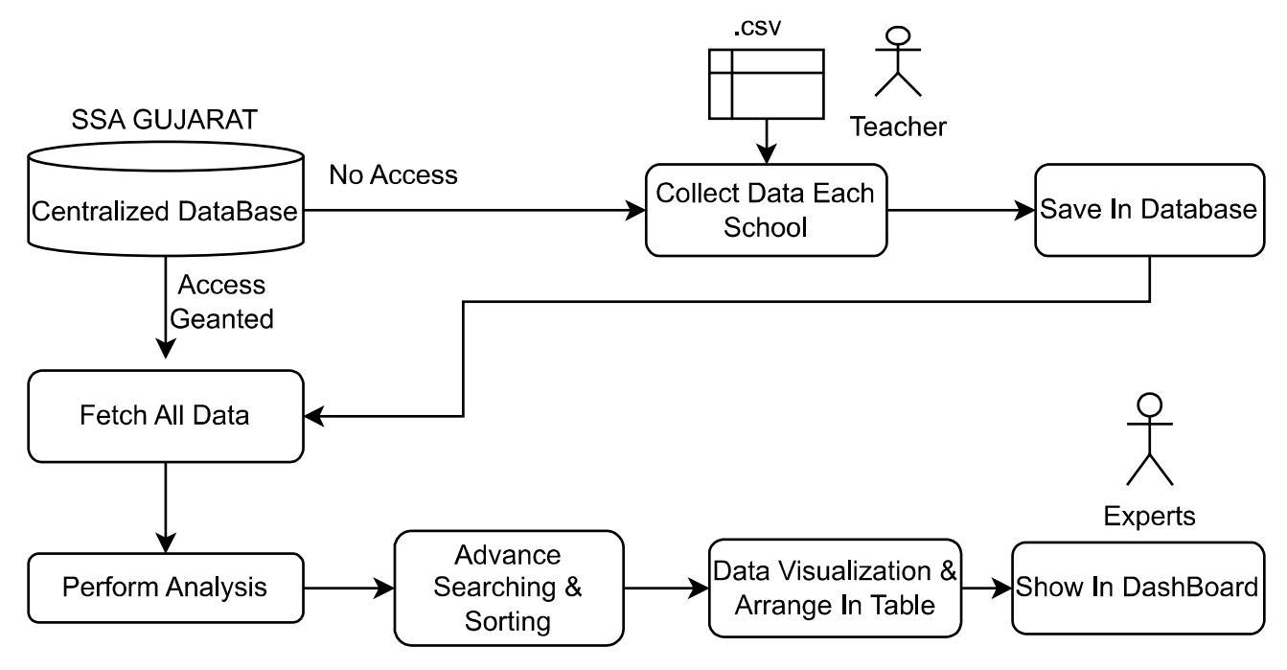
Idea/Approach Details
E-Samiksha
Describe your idea/Solution/Prototype here:
Idea is to Provide a Software Based Platform “E-Samiksha” .Where Government/User Explore Full Analysis of Gujarat Dropout Students.
First Collect All Student Releted Data.
After Collection Data We Analysis and Manipulation this data using Different Python Data Science Library and Show it on our Software.
Describe your Technology stack here:
Programming Language: Python for data analysis and machine learning.
Database : MySql
GUI : Trinket Library
Data Analysis Libraries:
NumPy for numerical operations.
Pandas for data manipulation and analysis.
Matplotlib and Seaborn for data visualization.
Scipy for advanced statistical analysis.

Slide 3
Idea/Approach Details
Describe your Use Cases here
Describe your Dependencies / Show stopper here
Government agencies can use dropout analysis to inform the development of education policies and programs aimed at reducing dropout rates and improving educational outcomes.
Dropout analysis can help governments assess and address disparities in dropout rates among different demographic groups, ensuring educational equity and equal opportunities for all students.
Dropout analysis can highlight areas where additional teacher training or support is needed to enhance student engagement and retention.
Data Availability: Access to complete and reliable student data is essential.
Resource Availability: Adequate hardware and software resources are necessary.(Student Count are in million)
Skilled Team: An expert data analysis team is required.
Machine Learning Models: Availability of suitable algorithms is needed.
Collaboration and cooperation from educational institutions, teachers, and administrators.
Data preprocessing for cleaning, handling missing values, and feature engineering.
Budget and Funding : Adequate financial support is required.

Slide 4
Team Member Details
Team Leader Name: Panchal Aryankumar Kamleshbhai
Branch : BE Stream : CSE Year : III
Team Member 1 Name: Rishiraj Dipakbhai Panchal
Branch : BE Stream : CSE Year : IV
Team Member 2 Name: Falguni Haribhai Prajapati
Branch : BE Stream : CSE Year : III
Team Member 3 Name: Dhruv Nileshkumar Patel
Branch : BE Stream : CSE Year : III
Team Member 4 Name: Gosai Yash Dharmendrabhai
Branch : BE Stream : CSE Year : III
Team Member 5 Name: Shelke Uday Dinkar
Branch : BE Stream : CSE Year : II
Team Mentor Name: Prof. Divyesh U Bavisa
Category : Academic Expertise : Android Domain Experience (in years): 5

