Slide 1



Slide 2



01CE1503 - Design and Analysis of Algorithm
Unit - 2
Divide and Conquer
Prof. Mitul N. Takodara
Department of Computer Engineering

Slide 3



OUTLINE
Introduction
Problem Solving using divide and conquer algorithm
Binary Search
Multiplying large Integers Problem,
Sorting Algorithms (Merge Sort , Quick Sort)
Max-Min problem
Matrix Multiplication
Exponential

Slide 4
INTRODUCTION
A divide and conquer is a strategy of solving a large problem by
Divide: Divide the given problem into sub-problems using recursion.
Conquer: Solve the smaller sub-problems recursively. If the sub problem is small enough, then solve it directly.
Combine: Combine the solutions of the sub-problems that are part of the
recursive process to solve the actual problem.

Slide 5
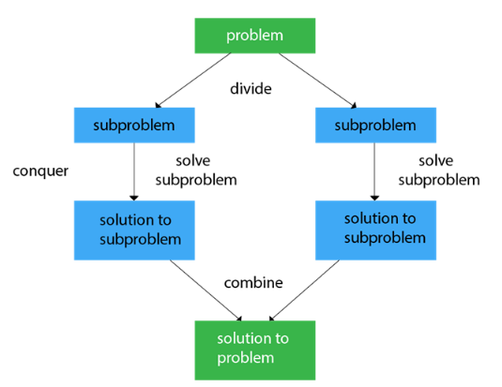
INTRODUCTION

Slide 6
BINARY SEARCH
Binary search is used to search the particular element in the list.
If the element is present in the list, then the process is called successful, and the process returns the location of that element. Otherwise, the search is called unsuccessful.
Binary search follows the divide and conquer approach in which the list is divided into two halves, and the item is compared with the middle element of the list.
If the match is found then, the location of the middle element is returned. Otherwise, we search into either of the halves depending upon the result produced through the match.
Note: Binary search can be implemented on sorted array elements. If the list elements are not arranged in a sorted manner, we have first to sort them.

Slide 7




BINARY SEARCH
int bs(int arr[ ], int l, int h, int key)
{
if (l <= h)
{
int mid = (l + h) / 2;
if (arr[mid] == key)
return mid;
if (key<arr[mid])
return bs(arr, l, mid - 1, key);
else
return bs(arr, mid + 1, h, key);
}
return -1;
}

Slide 8
MERGE SORT
Merge sort is yet another sorting algorithm that falls under the category of Divide and Conquer technique. It is one of the best sorting techniques that successfully build a recursive algorithm.
It works by recursively dividing the array into two equal halves, then sort them and combine them.

Slide 9
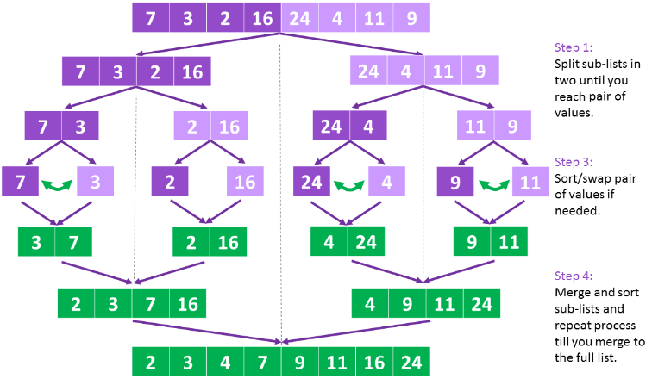
MERGE SORT

Slide 10
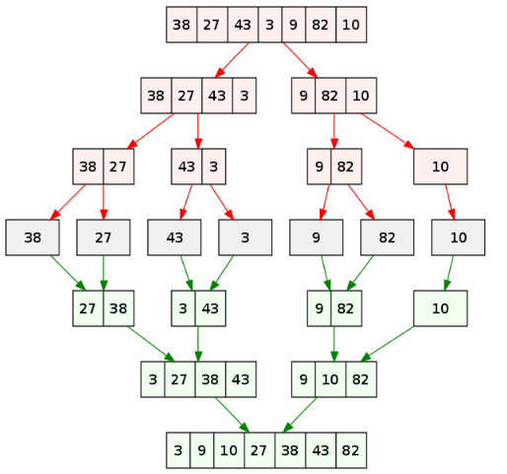
MERGE SORT

Slide 11
MERGE SORT
Algorithm MS(A[0..n-1],low, high)
{
If(low<high) then
{
mid = (low+high)/2
MS(A,low,mid)
MS(A, mid+1, high)
Combine(A,low,mid,high)
}

Slide 12
MERGE SORT
Algorithm combine(A,low,mid,high)
{
k ← low
i ← low
j ← mid+1
while ( i <= mid and j <= high) do
{
if(A[ i ] <= A[ j ] ) then
{
temp[ k ]←A[ i ]
i++
k++
}
else
{
temp[ k ]=A[ j ]
j++
k++
}
}

Slide 13
MERGE SORT
//copy left sub list
while ( i <= mid) do
{
temp[ k ]←A[ i ]
i++
k++
}
//copy right sub list
while ( j <= high) do
{
temp[ k ]←A[ j ]
j++
k++
}

Slide 14
QUICK SORT
Quick sort is a fast sorting algorithm used to sort a list of elements.
The quick sort algorithm attempts to separate the list of elements into two parts and then sort each part recursively. That means it use divide and conquer strategy.
In quick sort, the partition of the list is performed based on the element called pivot.
Here pivot element is one of the elements in the list.
The list is divided into two partitions such that "all elements to the left of pivot are smaller than the pivot and all elements to the right of pivot are greater than or equal to the pivot".

Slide 15
QUICK SORT
In Quick sort algorithm, partitioning of the list is performed using following steps...
Step 1 - Consider the first element of the list as pivot (i.e., Element at first position in the list).
Step 2 - Define two variables i and j. Set i and j to first and last elements of the list respectively.
Step 3 - Increment i until pivot >= A[i] then stop.
Step 4 - Decrement j until pivot<= A[j] then stop.
Step 5 - If i < j then exchange A[i] and A[j].
Step 6 - Repeat steps 3,4 & 5 until i > j.
Step 7 - Exchange the pivot element with A[j] element.

Slide 16


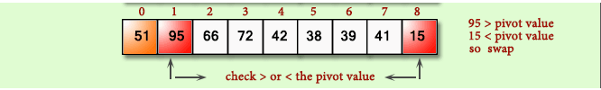

QUICK SORT

Slide 17



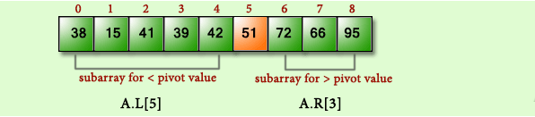
QUICK SORT

Slide 18
QUICK SORT
void quickSort(int arr[ ], int low, int high)
{
if (low < high)
{
int pivot = partition(arr, low, high);
quickSort(arr, low, pivot - 1);
quickSort(arr, pivot + 1, high);
}
}
int partition(int arr[ ], int low, int high)
{
int i = low;
int j = high;
int pivot = arr[low];
while (i < j)
{
while (pivot >= arr[i])
i++;
while (pivot < arr[j])
j--;
if (i < j)
swap(arr[i], arr[j]);
}
swap(arr[low], arr[j]);
return j;
}

Slide 19
MAX-MIN PROBLEM
Max-Min problem is to find a maximum and minimum element from the given array. We can effectively solve it using divide and conquer approach.
In the traditional approach, the maximum and minimum element can be found by comparing each element and updating Max and Min values as and when required.
This approach is simple but it does (n – 1) comparisons for finding max and the same number of comparisons for finding the min. It results in a total of 2(n – 1) comparisons.
Using a divide and conquer approach, we can reduce the number of comparisons.

Slide 20
MAX-MIN PROBLEM
Algorithm MaxMin(a, n, max, min)
{
max=min=a[0];
for i = 1 to n-1 do
{
if (a[i] > max) then
max=a[i];
if (a[i] < min) then
min=a[i];
}
return (max, min);
}

Slide 21
MAX-MIN PROBLEM
Divide and conquer approach for Max. Min problem works in three stages.
If a1 is the only element in the array, a1 is the maximum and minimum.
If the array contains only two elements a1 and a2, then the single comparison between two elements can decide the minimum and maximum of them.
If there are more than two elements, the algorithm divides the array from the middle and creates two sub problems. Both sub problems are treated as an independent problem and the same recursive process is applied to them. This division continues until sub problem size becomes one or two.
After solving two sub problems, their minimum and maximum numbers are compared to build the solution of the large problem.
This process continues in a bottom-up fashion to build the solution of a parent problem.

Slide 22
MAX-MIN PROBLEM
Algorithm DC_MAXMIN (A, low, high)
if n == 1 then
return (A[0], A[0])
else if n == 2 then
if A[0] < A[1] then
return (A[0], A[1])
else
return (A[1], A[0])
else
mid ← (low + high) / 2
[LMin, LMax] = DC_MAXMIN (A, low, mid)
[RMin, RMax] = DC_MAXMIN (A, mid + 1, high)
if LMax > RMax then
// Combine solution
max ← LMax
else
max ← RMax
end
if LMin < RMin then
// Combine solution
min ← LMin
else
min ← RMin
end
return (min, max)
end

Slide 23
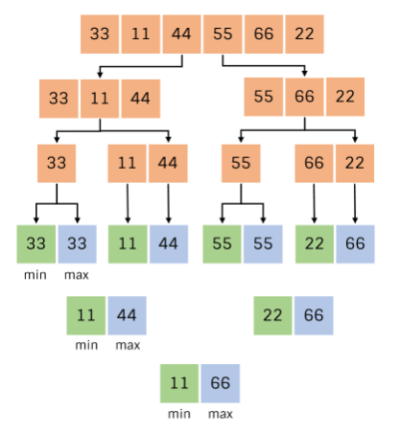
MAX-MIN PROBLEM

Slide 24
MAX-MIN PROBLEM
Complexity analysis
The conventional algorithm takes 2(n – 1) comparisons in worst, best and average case.
DC_MAXMIN does two comparisons to determine the minimum and maximum element and creates two problems of size n/2, so the recurrence can be formulated as
T(n) = 0, if n = 1
T(n) = 1, if n = 2
T(n) = 2T(n/2) + 2, if n > 2
Let us solve this equation using interactive approach.
T(n) = 2T(n/2) + 2 … (1)
By substituting n by (n / 2) in Equation (1)

Slide 25
MAX-MIN PROBLEM
T(n/2) = 2T(n/4) + 2
⇒ T(n) = 2(2T(n/4) + 2) + 2
= 4T(n/4) + 4 + 2 … (2)
By substituting n by n/4 in Equation (1),
T(n/4) = 2T(n/8) + 2
Substitute it in Equation (1),
T(n) = 4[2T(n/8) + 2] + 4 + 2
= 8T(n/8) + 8 + 4 + 2
= 2^3 T(n/2^3) + 2^3 + 2^2 + 2^1

Slide 26
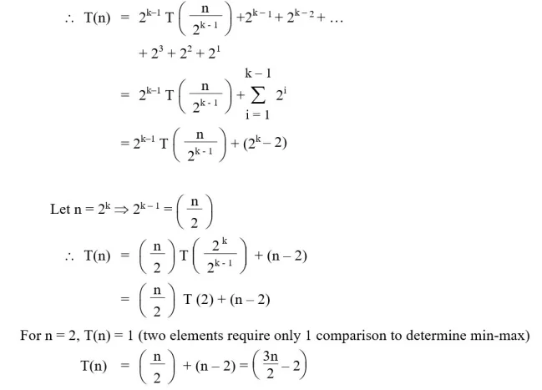
MAX-MIN PROBLEM
After k – 1 iterations

Slide 27
MAX-MIN PROBLEM
It can be observed that divide and conquer approach does only [(3n/2) – 2] comparisons compared to 2(n – 1) comparisons of the conventional approach.

