Slide 1



Slide 2



01CE1503 - Design and Analysis of Algorithm
Unit - 3
Dynamic Programming
Prof. Mitul N. Takodara
Department of Computer Engineering

Slide 3



OUTLINE
Introduction
Elements of Dynamic Programming
The Principle of Optimality
Problem Solving using Dynamic Programming –
Making Change Problem
Calculating the Binomial Coefficient
Assembly Line-Scheduling
Knapsack problem
Matrix chain multiplication
Longest Common Subsequence

Slide 4
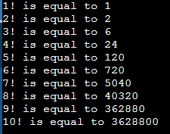
INTRODUCTION
int main()
{
int n = 10;
for(int i=1;i<=n;i++)
{
int factorial = 1;
for(int j=1;j<=i;j++)
{
factorial = factorial * j;
}
printf("\n%d! is equal to %d",i,factorial);
}
return 0;
} Time Complexity: ?
Output:

Slide 5
INTRODUCTION
int main()
{
int n = 10;
int fact[n];
fact[0]=1;
for(int i=1;i<=n;i++)
{
fact[i] = fact[i-1]*i;
printf("\n%d! is equal to %d",i,fact[i]);
}
return 0;
}
Time Complexity: ?

Slide 6
INTRODUCTION
Dynamic programming is a technique that breaks the problems into sub-problems, and saves the result for future purposes so that we do not need to compute the result again.
The subproblems are optimized to optimize the overall solution is known as optimal substructure property.
The main use of dynamic programming is to solve optimization problems.
Here, optimization problems mean that when we are trying to find out the minimum or the maximum solution of a problem.
The dynamic programming guarantees to find the optimal solution of a problem if the solution exists.

Slide 7
INTRODUCTION
How to Solve Making Change using Dynamic Programming?
Making Change problem is to find change for a given amount using a minimum number of coins from a set of denominations.
Explanation : If we are given a set of denominations D = {d₀, d₁, d₂, …, d_{n}} and if we want to change for some amount N, many combinations are possible. Suppose {d₁, d₂, d₅, d₈}, {d₀, d₂, d₄}, {d₀, d₅, d₇} all feasible solutions.
The aim of making a change is to find a solution with a minimum number of coins / denominations. Clearly, this is an optimization problem.

Slide 8
INTRODUCTION
Conventional / greedy approach selects largest denomination first which is not greater than remaining amount.
If current denomination is not possible to select then select second largest denomination and so on. Continue this process until solution is found.

Slide 9
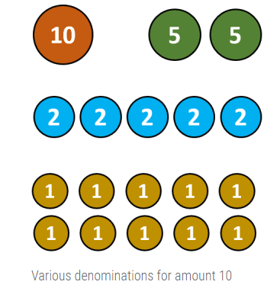
INTRODUCTION

Slide 10
INTRODUCTION
However this approach may fail to find best solution.
For example, suppose we have denominations {1, 4, 5} and if we want change for 8, then conventional or greedy approach returns four coins, <5, 1, 1, 1>, but optimal solution is <4, 4>.

Slide 11
PROPERTIES OF DYNAMIC PROGRAMMING
Properties of Dynamic programming
Overlapping Sub-problems
Optimal Substructure

Slide 12
PROPERTIES OF DYNAMIC PROGRAMMING
Overlapping Sub-problems
Similar to Divide-and-Conquer approach, Dynamic Programming also combines solutions to sub-problems.
It is mainly used where the solution of one sub-problem is needed repeatedly.
The computed solutions are stored in a table, so that these don’t have to be re-computed. Hence, this technique is needed where overlapping sub-problem exists.
For example, Binary Search does not have overlapping sub-problem. Whereas recursive program of Fibonacci numbers have many overlapping sub-problems.

Slide 13
PROPERTIES OF DYNAMIC PROGRAMMING
2. Optimal Substructure
A given problem has Optimal Substructure Property, if the optimal solution of the given problem can be obtained using optimal solutions of its sub-problems.
For example, the Shortest Path problem has the following optimal substructure property −
If a node x lies in the shortest path from a source node u to destination node v, then the shortest path from u to v is the combination of the shortest path from u to x, and the shortest path from x to v.

Slide 14
MAKING CHANGE PROBLEM
Example: Consider an instance of a problem with coins 1, 4 and 6 units. Illustrate its solutions using dynamic programming approach involving a payment of 8 units.
Mathematical Formulation
Sort all the denomination and start scanning from largest to smallest denomination. In every iteration i, if current denomination di is acceptable, then 1 coin is added in solution and total amount is reduced by amount di. Hence,
C[i, j] = 1 + (c [1, j – d1])

Slide 15
MAKING CHANGE PROBLEM
If current denomination is larger than current problem size, then we have to skip the denomination and stick with previously calculated solution. Hence,
C[i, j] = C[i – 1, j]
Our objective is to find minimum number of coins, so at each step, we have to stick with choice which returns minimum number of coin. Mathematically, we formulate the problem as,
C[i, j] = min {C[i – 1, j] , 1 + C[i, j – di]}

Slide 16
MAKING CHANGE PROBLEM
Where,
di = ith denomination ,1 ≤ i ≤ n
j = Size of sub problem
C[1…..n, 0…..N] = Size of the problem
C[n, N] = Solution of the problem
n = Number of denomination
N = Amount for which change is required By combining all three cases, we have
1. if i=1 then C[i,j] = 1 + C[1, j-d1]
2. if j<di then C[i,j] = C[i-1, j]
3. Otherwise c[i,j] = min{c[i-1,j], 1+c[i,j-di]}
Note: If no combination of coins sums to amount j, then C[i, j] = ∞

Slide 17
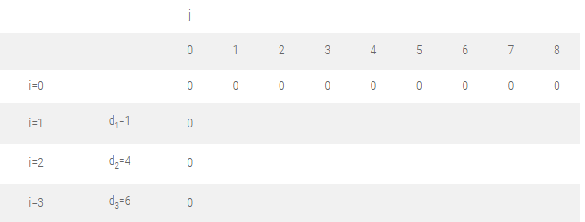
MAKING CHANGE PROBLEM
Let us find the optimal solution for D = {d₁, d₂, d₃} = {1, 4, 6} and N = 8.
Initialize the table C [i, 0] = 0 and C [0, j] = 0.
These indicate we don’t have any denomination and size of problem is zero respectively.

Slide 18
MAKING CHANGE PROBLEM
Filling first column, j = 1 :
C [1, 1] ⇒ i = 1, j = 1, d_{i} = d₁ = 1
As, i = 1, formula 1 is used
C [i, j] = C [1, 1] = 1 + C [1, j – d₁ ]
= 1 + C [1, 1 – 1]
= 1 + C [1, 0]
= 1
C [2, 1] ⇒ i = 2, j = 1, d_{i} = d₂ = 4
As, j < d₂, i.e. 1< 4
C [i, j] = C [2, 1] = C [i – 1, j] = C [1, 1] = 1
C [3, 1] ⇒ i = 3, j = 1, d_{i} = d₃ = 6
As, j < d₃,
C [3, 1] = C [i – 1, j]
= C[3-1,1]
= C [2, 1]
= 1
if i=1 then C[i,j] = 1 + C[1, j-d1]
if j<di then C[i,j] = C[i-1, j]
Otherwise c[i,j] = min{c[i-1,j], 1+c[i,j-di]}

Slide 19
MAKING CHANGE PROBLEM
Filling second column, j = 2 :
C [1, 2] ⇒ i = 1, j = 2, d_{i} = d₁ = 1
As, i = 1, formula 1 is used
C [i, j] = C [1, 2] = 1 + C [1, j – d₁]
= 1 + C [1, 2 – 1]
= 1 + C [1, 1]
= 1 + 1
= 2
C [2, 2] ⇒ i = 2, j = 2, d_{i} = d₂ = 4
As, j < d₂,
C [i, j] = C [2, 2] = C [i – 1, j]
= C [1, 2]
= 2
C [3, 2] ⇒ i = 3, j = 2, d_{i} = d₃ = 6
As, j < d₃,
C [i, j] = C [3, 2] = C [i – 1, j]
= C [2, 2]
= 2
if i=1 then C[i,j] = 1 + C[1, j-d1]
if j<di then C[i,j] = C[i-1, j]
Otherwise c[i,j] = min{c[i-1,j], 1+c[i,j-di]}

Slide 20
MAKING CHANGE PROBLEM
Filling third column, j = 3 :
C [1, 3] ⇒ i = 1, j = 3, d_{i} = d₁ = 1
As, i = 1, formula 1 is used
C [i, j] = 1 + C [1, j – d₁ ]
= 1 + C [1, 3 – 1]
= 1 + C [1, 2]
= 1 + 2
= 3
C [2, 3] ⇒ i = 2, j = 3, d_{i} = d₂ = 4
As, j < d_{i},
C [i, j] = C [2, 3] = C [i – 1, j]
= C [1, 3]
= 3
C [3, 3] ⇒ i = 3, j = 3, d_{i} = d₃ = 6
As, j < d_{i},
C [i, j] = C[3,3] = C [i – 1, j]
= C [2, 3]
= 3
if i=1 then C[i,j] = 1 + C[1, j-d1]
if j<di then C[i,j] = C[i-1, j]
Otherwise c[i,j] = min{c[i-1,j], 1+c[i,j-di]}

Slide 21
MAKING CHANGE PROBLEM
Filling fourth column, j = 4 :
C [1, 4] ⇒ i = 1, j = 4, d_{i} = d₁ = 1
As, i = 1 formula 1 is used
C [i, j] = 1 + C [1, j – d₁]
C [1, 4] = 1 + C [1, 4 – 1]
= 1 + C [1, 3]
= 1 + 3
= 4
C [2, 4] ⇒ i = 2, j = 4, d_{i} = d₂ = 4
As i ≠ 1 and j ≥ d_{i}
C [i, j] = min { C [i – 1, j], 1 + C [i, j – d_{i}] }
C [2, 4] = min { C [1, 4], 1 + C [2, 4 – 4] }
= min { C [1, 4], 1 + C [2, 0] }
= min {4, 1 + 0}
= 1
C [3, 4] ⇒ i = 3, j = 4, d_{i} = d₃ = 6
As j < d_{i},
C [i, j] = C [i – 1, j]
C [3, 4] = C [2, 4]
= 1
if i=1 then C[i,j] = 1 + C[1, j-d1]
if j<di then C[i,j] = C[i-1, j]
Otherwise c[i,j] = min{c[i-1,j], 1+c[i,j-di]}

Slide 22
MAKING CHANGE PROBLEM
Filling fifth column, j = 5 :
C [1, 5] ⇒ i = 1, j = 5, d_{i} = d₁ = 1
As, i = 1 formula 1 is used
C [i, j] = 1 + C [1, j – d₁]
= 1 + C [1, 5 – 1]
= 1 + C [1, 4]
= 1 + 4
= 5
C [2, 5] ⇒ i = 2, j = 5, d_{i} = d₂ = 4
As i ≠ 1 and j ≥ d_{i} , So,
C [i, j] = min { C [i – 1, j], 1 + C [i, j – d_{i}] }
= min { C [1, 5], 1 + C [2, 1] }
= min {5, 1 + 1}
= 2
C [3, 5] ⇒ i = 3, j = 5, d_{i} = d₃ = 6
As j < d_{i},
C [i, j] = C [i – 1, j]
C [3, 5] = C [2, 5]
= 2
if i=1 then C[i,j] = 1 + C[1, j-d1]
if j<di then C[i,j] = C[i-1, j]
Otherwise c[i,j] = min{c[i-1,j], 1+c[i,j-di]}

Slide 23
MAKING CHANGE PROBLEM
Filling sixth column, j = 6 :
C [1, 6] ⇒ i = 1, j = 6, d_{i} = d₁ = 1
As, i = 1formula 1 is used
C [i, j] = 1 + C [1, j – d₁]
= 1 + C [1, 5]
= 1 + 5
= 6
C [2, 6] ⇒ i = 2, j = 6, d_{i} = d₂ = 4
As i ≠ 1 and j ≥ d_{i}
C [i, j] = min { C [i – 1, j], 1 + C [i, j – d_{i}] }
= min { C [1, 6], 1 + C [2, 2] }
= min {6, 1 + 2}
= 3
C [3, 6] ⇒ i = 3, j = 6, d_{i} = d₃ = 6
As i ≠ 1 and j ≥ d_{i}
C [i, j] = min { C [i – 1, j], 1 + C [i, j – d_{i}] }
= min { C [2, 6], 1 + C [3, 0] }
= min {6, 1 + 0}
= 1
if i=1 then C[i,j] = 1 + C[1, j-d1]
if j<di then C[i,j] = C[i-1, j]
Otherwise c[i,j] = min{c[i-1,j], 1+c[i,j-di]}

Slide 24
MAKING CHANGE PROBLEM
Filling seventh column, j = 7 :
C [1, 7] ⇒ i = 1, j = 7, d_{i} = d₁ = 1
As, i = 1 formula 1 is used
C [i, j] = 1 + C [i, j – d_{i}]
= 1 + C [1, 6]
= 1 + 6
= 7
C [2, 7] ⇒ i = 2, j = 7, d_{i} = d₂ = 4
As i ≠ 1 and j ≥ d_{i}
C [i, j] = min { C [i – 1, j], 1 + C [i, j – d_{i}] }
= min { C [1, 7], 1 + C [2, 3] }
= min {7, 1 + 3}
= 4
C [3, 7] ⇒ i = 3, j = 7, d_{i} = d₃ = 6
As i ≠ 1 and j ≥ d_{i}
C [i, j] = min { C [i – 1, j], 1 + C [i, j – d_{i}] }
= min { C [2, 7], 1 + C [3, 17] }
= min {4, 2}
= 2
if i=1 then C[i,j] = 1 + C[1, j-d1]
if j<di then C[i,j] = C[i-1, j]
Otherwise c[i,j] = min{c[i-1,j], 1+c[i,j-di]}

Slide 25
MAKING CHANGE PROBLEM
Filling eighth column, j = 8 :
C [1, 8] ⇒ i = 1, j = 8, d_{i} = d₁ = 1
As, i = 1 formula 1 is used
C [i, j] = 1 + C [i, j – d_{i}]
= 1 + C [1, 7]
= 1 + 7
= 8
C [2, 8] ⇒ i = 2, j = 8, d_{i} = d₂ = 4
As i ≠ 1 and j ≥ d_{i}
C [i, j] = min { C [i – 1, j], 1 + C [i, j – d_{i}] }
= min { C [1, 8], 1 + C [2, 4] }
= min {8, 1 + 1}
= 2
C [3, 8] ⇒ i = 3, j = 8, d_{i} = d₃ = 6
As i ≠ 1 and j ≥ d_{i}
C [i, j] = min { C [i – 1, j], 1 + C [i, j – d_{i}]
= min { C [2, 8], 1 + C [3, 2] }
= min {2, 1 + 2}
= 2
if i=1 then C[i,j] = 1 + C[1, j-d1]
if j<di then C[i,j] = C[i-1, j]
Otherwise c[i,j] = min{c[i-1,j], 1+c[i,j-di]}

Slide 26
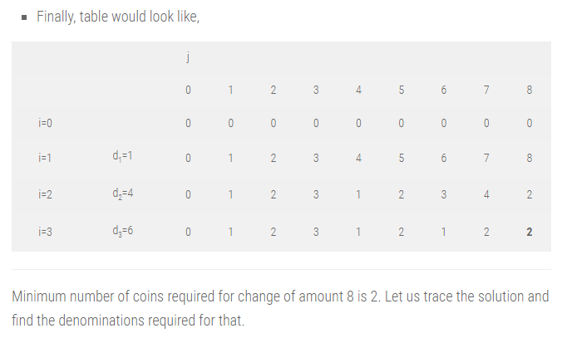
MAKING CHANGE PROBLEM

Slide 27
MAKING CHANGE PROBLEM
TRACING SOLUTION:
For last cell in table, i and j would be 3 and 8 respectively.
C[n, N] = C[i, j] = C[3, 8] = 2
Step 1 : (i = 3, j = 8) : C[3, 8] = 2 and C[2, 8] = 2
Here, C[i, j] = C[i – 1, j], implies nothing was added in previous solution.
Algorithm has propagated the solution of previous iteration in current iteration.
So go to previous step by reducing i. So, i = i – 1 = 3 – 1 = 2

Slide 28
MAKING CHANGE PROBLEM
Step 2 : (i = 2, j = 8) : C[2, 8] = 2 and C[1, 8] = 8
Here, C[i, j] ≠ C[i – 1, j], implies denomination d_{i} = d₂ = 4 was added in previous solution.
So add d_{i} in solution set and reduce problem size j by d_{i}.
Solution set S = {4}, j = j – d_{i} = 8 – 4 = 4.
Now we have, i = 2 and j = 4.

Slide 29
MAKING CHANGE PROBLEM
Step 3 : (i = 2, j = 4) : C[2, 4] = 1 and C[1, 4] = 4
Here, C[i, j] ≠ C[i – 1, j], implies denomination d_{i} = d₂ = 4 was added in previous solution.
So add d_{i} in solution set and reduce problem size j by d_{i}.
Solution set S = {4, 4}, j = j – d_{i} = 4 – 4 = 0.
Problem size j is zero. So stop.
We need two coins of amount 4 for optimal change of amount 8.

Slide 30
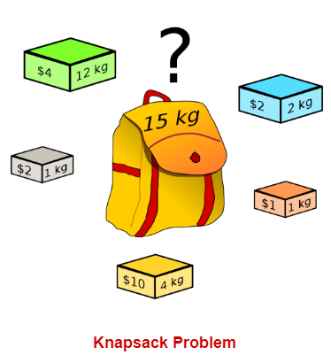
KNAPSACK PROBLEM

Slide 31
KNAPSACK PROBLEM
Problem : Given a set of items, each having different weight and value or profit associated with it. Find the set of items such that the total weight is less than or equal to a capacity of the knapsack and the total value earned is as large as possible.
The knapsack problem is useful in solving resource allocation problem.
Let X = < x₁, x₂, x₃, . . . . . , x_{n}> be the set of n items. Sets W = <w₁, w₂, w₃, . . . , w_{n}> and V = < v₁, v₂, v₃, . . . , v_{n}> are weight and value (profit) associated with each item in X. Knapsack capacity is M unit.
The knapsack problem is to find the set of items which maximizes the profit such that collective weight of selected items does not cross the knapsack capacity.
Knapsack problem has two variations. 0/1 knapsack, that does not allow breaking of items. Either add an entire item or reject it. It is also known as a binary knapsack. Fractional knapsack allows breaking of items.

Slide 32
KNAPSACK PROBLEM
Mathematical formulation :
We can select any item only ones.
We can put items x_{i} in knapsack if knapsack can accommodate it.
If the item is added to a knapsack, the associated profit is accumulated.
If the weight of the item is larger than the remaining knapsack capacity, we skip the item, and the solution of the previous step remains as it is.
Otherwise, we should add the item to the solution set and the problem size will be reduced by the weight of that item.
Corresponding profit will be added for the selected item.

Slide 33
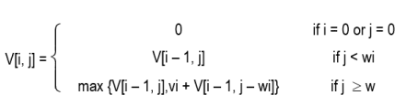
KNAPSACK PROBLEM
Mathematical formulation :
Dynamic programming divides the problem into small sub-problems.
Let V is an array of the solution of sub-problems.
V[i, j] represents the solution for problem size j with first i items.
The mathematical notion of the knapsack problem is given as :
V [1 …. n, 0 … M] : Size of the table
V (n, M) = Solution
n = Number of items

Slide 34
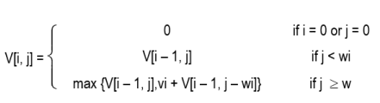
KNAPSACK PROBLEM
Example: Find an optimal solution for following 0/1 Knapsack problem using dynamic programming: Number of objects n = 4, Knapsack Capacity M = 5, Weights (W1, W2, W3, W4) = (2, 3, 4, 5) and profits (P1, P2, P3, P4) = (3, 4, 5, 6).
Solution: Solution of the knapsack problem is defined as,

Slide 35
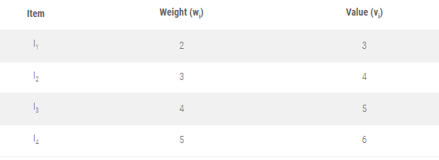
KNAPSACK PROBLEM

Slide 36
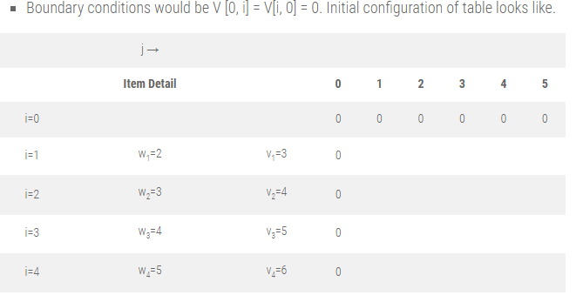
KNAPSACK PROBLEM

Slide 37
MAKING CHANGE PROBLEM
Filling first column, j = 1
V [1, 1] ⇒ i = 1, j = 1, w_{i} = w₁ = 2
As, j < w_{i},
V [i, j] = V [i – 1, j]
V [1, 1] = V [0, 1]
= 0
V [2, 1] ⇒ i = 2, j = 1, w_{i} = w₂ = 3
As, j < w_{i},
V [i, j] = V [i – 1, j]
V [2, 1] = V [1, 1]
= 0
V [3, 1] ⇒ i = 3, j = 1, w_{i} = w₃ = 4
As, j < w_{i},
V [i, j] = V [i – 1, j]
V [3, 1] = V [2, 1] = 0
V [4, 1] ⇒ i = 4, j = 1, w_{i} = w₄ = 5
As, j < w_{i},
V[i, j] = V[i – 1, j]
V [4, 1] = V [3, 1] = 0

Slide 38
MAKING CHANGE PROBLEM
Filling first column, j = 2
V[1, 2] ⇒ i = 1, j = 2, w_{i} = w₁ = 2, v_{i} = 3
As, j ≥ w_{i},
V [i, j] =max {V [i – 1, j], v_{i} + V[i – 1, j – w_{i}] }
= max {V [0, 2], 3 + V [0, 0]}
V[1, 2] = max (0, 3)
= 3
V[2, 2] ⇒ i = 2, j = 2, w_{i} = w₂ = 3, v_{i} = 4
As, j < w_{i},
V [i, j] = V[i – 1, j]
V[2, 2] = V[1, 2]
= 3
V[3, 2] ⇒ i = 3, j = 2, w_{i} = w₃ = 4, v_{i} = 5
As, j < w_{i},
V[i, j] = V[i – 1, j]
V[3, 2] = V [2, 2] = 3
V[4, 2] ⇒ i = 4, j = 2, w_{i} = w₄ = 5, v_{i} = 6
As, j < w_{i}, V[i, j] = V[i – 1, j]
V[4, 2] = V[3, 2] = 3

Slide 39
MAKING CHANGE PROBLEM
Filling first column, j = 3
V[1, 3] ⇒ i = 1, j = 3, w_{i} = w₁ = 2, v_{i} = 3
As, j ≥ w_{i},
V [i, j] =max {V [i – 1, j], v_{i} + V [i – 1, j – w_{i}] }
= max {V [0, 3], 3 + V [0, 1]}
V[1, 3] = max (0, 3) = 3
V[2, 3] ⇒ i = 2, j = 3, w_{i} = w₂ = 3, v_{i} = 4
As, j ≥ w_{i},
V [i, j] = max {V [i – 1, j], v_{i} + V [i – 1, j – w_{i}] }
= max {V [1, 3], 4 + V [1, 0]}
V[2, 3] = max (3, 4) = 4
V[3, 3] ⇒ i = 3, j = 3, w_{i} = w₃ = 4, v_{i} = 5
As, j < w_{i},
V [i, j] = V [i – 1, j]
V[3, 3] = V [2, 3] = 4
V[4, 3] ⇒ i = 4, j = 3, w_{i} = w₄ = 5, v_{i} = 6
As, j < w_{i},
V[i, j] = V[i – 1, j]
V[4, 3] = V [3, 3] = 4

Slide 40
MAKING CHANGE PROBLEM
Filling first column, j = 4
V[1, 4] ⇒ i = 1, j = 4, w_{i} = w₁ = 2, v_{i} = 3
As, j ≥ w_{i},
V [i, j] = max {V [i – 1, j], v_{i} + V [i – 1, j – w_{i}] }
= max {V [0, 4], 3 + V [0, 2]}
V[1, 4] = max (0, 3) = 3
V[2, 4] ⇒ i = 2, j = 4, w_{i} = w₂ = 3 , v_{i} = 4
As, j ≥ w_{i},
V [i, j] = max {V [i – 1, j], v_{i} + V [i – 1, j – w_{i}] }
= max {V [1, 4], 4 + V [1, 1]}
V[2, 4] = max (3, 4 + 0) = 4
V[3, 4] ⇒ i = 3, j = 4, w_{i} = w₃ = 4, v_{i} = 5
As, j ≥ w_{i},
V [i, j] =max {V [i – 1, j], v_{i} + V [i – 1, j – w_{i}] }
=max {V [2, 4], 5 + V [2, 0]}
V[3, 4] =max (4, 5 + 0) = 5
V[4, 4] ⇒ i = 4, j = 4, w_{i} = w₄ = 5, v_{i} = 6
As, j < w_{i},
V [i, j] = V [i – 1, j]
V[4, 4] = V [3, 4] = 5

Slide 41
MAKING CHANGE PROBLEM
Filling first column, j = 5
V [1, 5] ⇒ i = 1, j = 5, w_{i} = w₁ = 2, v_{i} = 3
As, j ≥ w_{i},
V [i, j] = max {V [i – 1, j], v_{i} + V [i – 1, j – w_{i}] }
= max {V [0, 5], 3 + V [0, 3]}
V[1, 5] = max (0, 3) = 3
V[2, 5] ⇒ i = 2, j = 5, w_{i} = w₂ = 3, v_{i} = 4
As, j ≥ w_{i},
V [i, j] = max {V [i – 1, j], v_{i} + V [i – 1, j – w_{i}] }
= max {V [1, 5], 4 + V [1, 2]}
V[2, 5]= max (3, 4 + 3) = 7
V[3, 5] ⇒ i = 3, j = 5, w_{i} = w₃ = 4, v_{i} = 5
As, j ≥ w_{i},
V [i, j] = max {V [i – 1, j], v_{i} + V [i – 1, j – w_{i}] }
= max {V [2, 5], 5 + V [2, 1]}
V[3, 5] = max (7, 5 + 0) = 7
V [4, 5] ⇒ i = 4, j = 5, w_{i} = w₄ =5, v_{i} = 6
As, j ≥ w_{i},
V [i, j] = max {V [i – 1, j], v_{i} + V [i – 1, j – w_{i}] }
= max {V [3, 5], 6 + V [3, 0]}
V[4, 5] = max (7, 6 + 0) = 7

Slide 42
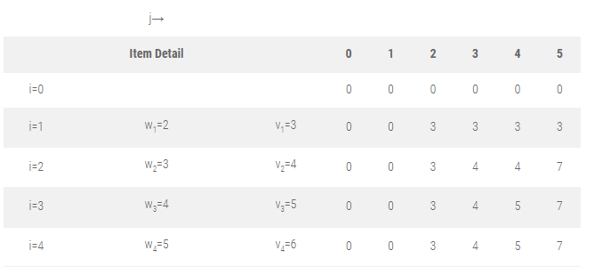
KNAPSACK PROBLEM

Slide 43
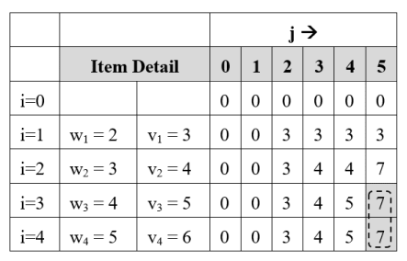
KNAPSACK PROBLEM
Find selected items for M = 5
Step 1 : Initially, i = n = 4, j = M = 5

Slide 44
KNAPSACK PROBLEM
Find selected items for M = 5
Step 1 : Initially, i = n = 4, j = M = 5
V[i, j] = V[4, 5] = 7
V[i – 1, j] = V[3, 5] = 7
V[i, j] = V[i – 1, j],
so don’t select i^{th} item and check for the previous item.
so i = i – 1 = 4 – 1 = 3
Solution Set S = { }

Slide 45
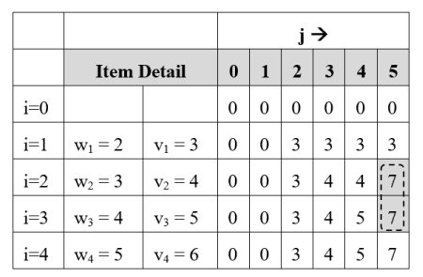
KNAPSACK PROBLEM
Step 2 : i = 3, j = 5
V[i, j] = V[3, 5] = 7
V[i – 1, j] = V[2, 5] = 7
V[i, j] = V[i – 1, j],
so don’t select i^{th} item and check for the previous item.
so i = i – 1 = 3 – 1 = 2
Solution Set S = { }

Slide 46
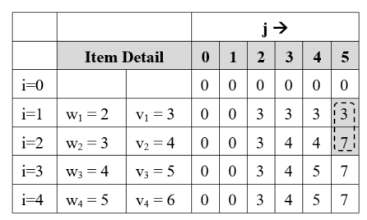
KNAPSACK PROBLEM
Step 3 : i = 2, j = 5
V[i, j] = V[2, 5] = 7
V[i – 1, j] = V[1, 5] = 3
V[i, j] ≠ V[i – 1, j],
so add item Ii = I₂ in solution set.
Reduce problem size j by w_{i}
j = j – w_{i} = j – w₂ = 5 – 3 = 2
i = i – 1 = 2 – 1 = 1
Solution Set S = {I₂}

Slide 47
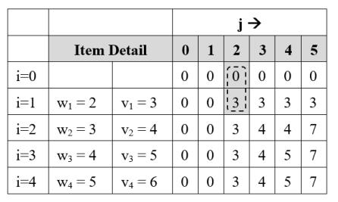
KNAPSACK PROBLEM
Step 4 : i = 1, j = 2
V[1, j] = V[1, 2] = 3
V[i – 1, j] = V[0, 2] = 0
V[i, j] ≠ V[i – 1, j],
so add item Ii = I₁ in solution set.
Reduce problem size j by w_{i}
j = j – w_{i} = j – w₁ = 2 – 2 = 0
Solution Set S = {I₁, I₂}
Problem size has reached to 0,
so final solution is
S = {I₁, I₂} Earned profit = P₁ + P₂ = 7

Slide 48

BINOMIAL CO-EFFICIENT
Computing binomial coefficient is very fundamental problem of mathematics and computer science.
Binomial coefficient C(n, k) defines coefficient of the term x^{k} in the expansion of (1 + x)^{n}.
C(n, k) also defines the number of ways to select any k items out of n items.
Many sub problems are called again and again, since they have an overlapping sub problems property.
Re-computations of the same sub problems is avoided by storing their results in the temporary array C[i, j.
The optimal substructure for using dynamic programming is stated as,

Slide 49
BINOMIAL CO-EFFICIENT
Formula of Binomial Co-efficient:
C (n, k) = C (n-1, k-1 ) + C (n-1, k) ;
C(n, 0) = 1
C(n, n) = 1
Where n > k > 0

Slide 50
BINOMIAL CO-EFFICIENT
Example : Calculate : C(4, 2)
C(4,2) = C (3, 1) + C(3, 2) ----------------------------(1)
Let’s calculate first C(3, 1)
C(3, 1) = C(2, 0) + C(2, 1)
= 1 + C(1, 0) + C(1, 1)
= 1 + 1 + 1
= 3 ---------------------------------------------- (2)
Now let’s calculate C(3, 2)
C(3, 2) = C(2, 1) + C(2, 2)
= C(1, 0) + C(1, 1) + 1
= 1+ 1+ 1
= 3 ----- (3)
Put value of (2) and (3) into (1)
C(4,2) = C (3, 1) + C(3, 2) ----(1)
= 3 + 3
= 6

Slide 51
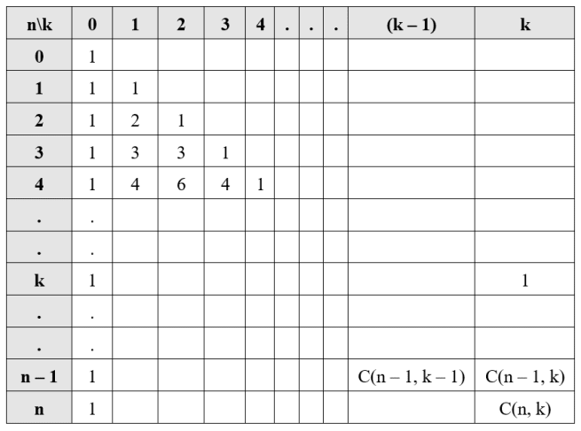
BINOMIAL CO-EFFICIENT
This tabular representation of binomial coefficients is also known as Pascal’s triangle.

Slide 52
BINOMIAL CO-EFFICIENT
Example 2. Calculate : C(5, 2)
Example 3. Calculate : C(6, 3)

Slide 53
MATRIX CHAIN MULTIPLICATION
Problem: In what order, n matrices A1, A2, A3, …. An should be multiplied so that it would take a minimum number of computations to derive the result.
Cost of matrix multiplication: Two matrices are called compatible only if the number of columns in the first matrix and the number of rows in the second matrix are the same. Matrix multiplication is possible only if they are compatible. Let A and B be two compatible matrices of dimensions p x q and q x r.
Each element of each row of the first matrix is multiplied with corresponding elements of the appropriate column in the second matrix.
The total numbers of multiplications required to multiply matrix A and B are p x q x r.

Slide 54
MATRIX CHAIN MULTIPLICATION
Suppose dimension of three matrices are :
A1 = 5 x 4
A2 = 4 x 6
A3 = 6 x 2
Matrix multiplication is associative. So
(A1 A2 ) A3 = {(5 x 4 ) x (4 x 6) } x (6 x 2)
= (5 x 4 x 6) + (5 x 6 x 2)
= 180
A1 (A2 A3) = (5 x 4) x {(4 x 6) x (6 x 2) }
= (5 x 4 x 2) + (4 x 6 x 2)
= 88
The answer of both multiplication sequences would be the same, but the numbers of multiplications are different. This leads to the question, what order should be selected for a chain of matrices to minimize the number of multiplications?

Slide 55
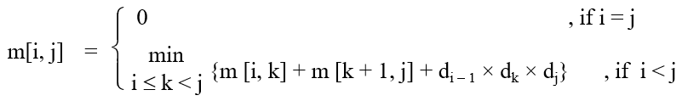
MATRIX CHAIN MULTIPLICATION
The optimal substructure is defined as,
Where d = {d0, d1, d2, …, dn} is the vector of matrix dimensions.
m[i, j] = Least number of multiplications required to multiply matrix sequence Ai….Aj .

Slide 56
MATRIX CHAIN MULTIPLICATION
Example: Find a minimum number of multiplications required to multiply: A [1 × 5],
B [5 × 4], C [4 × 3], D [3 × 2], and E [2 × 1]. Also, give optimal parenthesization.
Solution:
Here d = {d0, d1, d2, d3, d4, d5} = {1, 5, 4, 3, 2, 1}
Optimal substructure of matrix chain multiplication is,
m[i, j] = 0, for i = 1 to 5
m[1, 1] = m[2 , 2] = m[3, 3] = m[4, 4] = m[5, 5] = 0

Slide 57
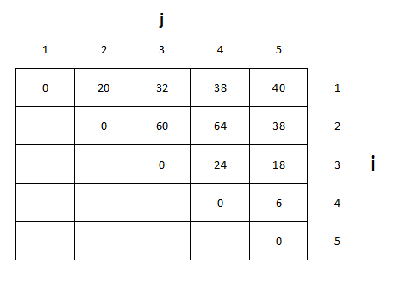
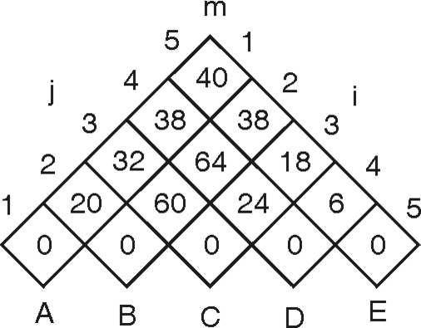
MATRIX CHAIN MULTIPLICATION

Slide 58
MATRIX CHAIN MULTIPLICATION
Here d = {d0, d1, d2, d3, d4, d5} = {1, 5, 4, 3, 2, 1}
Optimal substructure of matrix chain multiplication is,
m[1, 2] = {m[1, 1] + m[2, 2] + d0 x d1 x d2}
= {0 + 0 + 1 × 5 × 4}
= 20
m[2, 3] = {m[2, 2] + m[3, 3] + d1 x d2 x d3}
= {0 + 0 + 5 × 4 × 3}
= 60
m[3, 4] = {m[3, 3] + m[4, 4] + d2 x d3 x d4}
= {0 + 0 + 4 × 3 × 2}
= 24
m[4, 5] = {m[4, 4] + m[5, 5] + d3 x d4 x d5}
= {0 + 0 + 3 × 2 × 1}
= 6

Slide 59
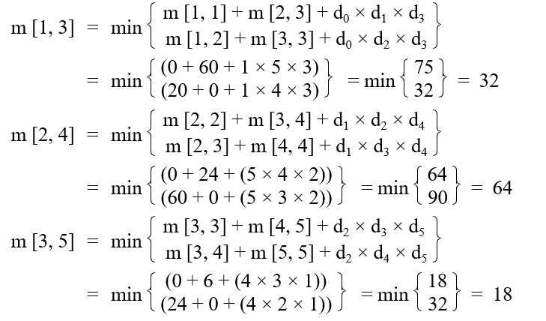
MATRIX CHAIN MULTIPLICATION

Slide 60
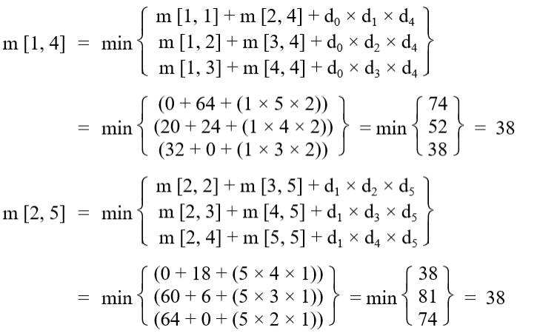
MATRIX CHAIN MULTIPLICATION

Slide 61
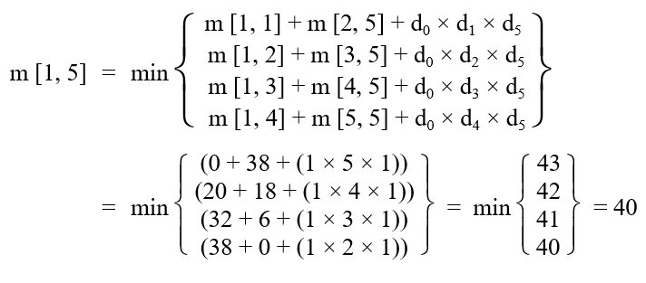
MATRIX CHAIN MULTIPLICATION

Slide 62
MATRIX CHAIN MULTIPLICATION

Slide 63
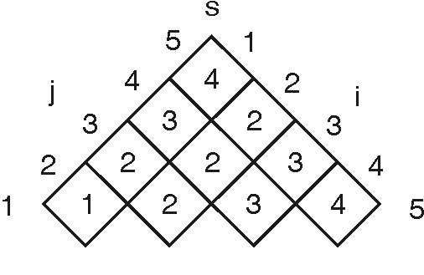
MATRIX CHAIN MULTIPLICATION

Slide 64
LONGEST COMMON SUBSEQUENCE
Longest Common Subsequence Problem:
Let A = < a1, a2, a3 …an> and B = < b1, b2, b3 …bm> be two strings over an alphabets. Then B is subsequence of A, if B can be generated by striking out some elements from A.
By subsequence, we mean that the values must occur in the order of the sequence, but they need not be consecutive.
If A = < X, Y, X, X, Z, Y, X > and B = < X, X, Y, X > then by deleting A[2], A[4] and A[5] from A, we can derive B. So B is the subsequence of A.

Slide 65
LONGEST COMMON SUBSEQUENCE
The common subsequence of A and B is the subsequence that can be generated by striking some characters from A and B both.
If A = {a, b, a, c, b, c, b} and B = {a, b, c, b, b, a, c}, then the sequence {a, c}, {a, b, c}, {a, c, c}, {a, b, c, b} etc. are common subsequences of A and B, but {a, b, c, b, a} is not.
{a, b, c, b, a} is a subsequence of B but it is not a subsequence of A.
String of length m has 2^{m} subsequences. So finding the longest common subsequences using the brute force approach takes exponential time.
Such algorithms are practically not useful for long sequences.

Slide 66
LONGEST COMMON SUBSEQUENCE
The common subsequence of A and B is the subsequence that can be generated by striking some characters from A and B both.
If A = {a, b, a, c, b, c, b} and B = {a, b, c, b, b, a, c}, then the sequence {a, c}, {a, b, c}, {a, c, c}, {a, b, c, b} etc. are common subsequences of A and B, but {a, b, c, b, a} is not.
{a, b, c, b, a} is a subsequence of B but it is not a subsequence of A.
String of length m has 2^{m} subsequences. So finding the longest common subsequences using the brute force approach takes exponential time.
Such algorithms are practically not useful for long sequences.

Slide 67
ASSEMBLY LINE SCHEDULING
Assembly line scheduling is a manufacturing problem. In automobile industries, assembly lines are used to transfer parts from one station to another.
The main goal of solving the Assembly Line Scheduling problem is to determine which stations to choose from line 1 and which to choose from line 2 in order to minimize assembly time.
A car factory has two assembly lines, each with n stations. A station is denoted by Si,j where i is either 1 or 2 and indicates the assembly line the station is on, and j indicates the number of the station.
The time taken per station is denoted by a_{i,j}
Each station is dedicated to some sort of work like engine fitting, body fitting, light fitting, seats, painting, and so on.

Slide 68
ASSEMBLY LINE SCHEDULING
So, a car chassis must pass through each of the n stations in order before exiting the factory.
The parallel stations of the two assembly lines perform the same task.
After it passes through station Si,j, it will continue to station Si,j+1 unless it decides to transfer to the other line.
Continuing on the same line incurs no extra cost, but transferring from line i at station j – 1 to station j on the other line takes time ti,j
Each assembly line takes an entry time ei and exit time xi which may be different for the two lines. Give an algorithm for computing the minimum time it will take to build a car chassis.
Determine which station should be selected from assembly line 1 and which to choose from assembly line 2 in order to minimize the total time to build the entire product.

Slide 69
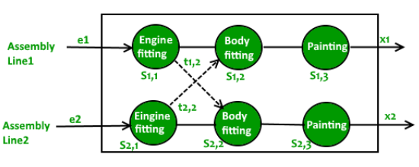
ASSEMBLY LINE SCHEDULING

Slide 70
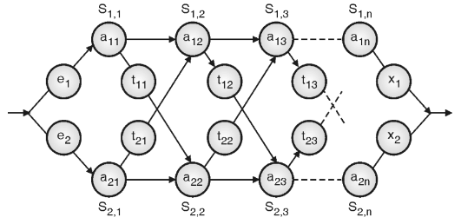
ASSEMBLY LINE SCHEDULING

Slide 71
ASSEMBLY LINE SCHEDULING
Terminologies are explained here :
Sij = Station j on assembly line i.
aij = Time needed to assemble the partial component at station j on assembly line i.
tij = Time required to transfer component from one assembly to other from station j to (j + 1).
ei = Entry time on assembly line i.
xi = Exit time from assembly line i.

Slide 72

ASSEMBLY LINE SCHEDULING
Mathematical formulation
Time required to build component on first station of both line is summation of entry time for particular assembly line and assembly time on first station of particular line.
Minimum time required to put the partially assembled product out of any station j on line 1 is minimum of :
(Minimum time taken up to station j – 1 on same assembly line 1) + (assembly time on station j of same assembly line)
(Minimum time taken up to station j – 1 on assembly line 2) + (assembly line transfer time) + (assembly time on station j of assembly line 2)

Slide 73
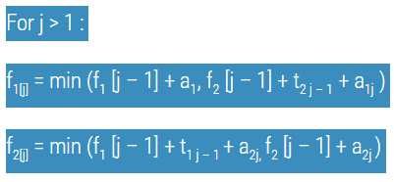
ASSEMBLY LINE SCHEDULING
Mathematical formulation
We can derive the conclusion for assembly line 2 in similar way. So mathematically we can formulate the problem as :

Slide 74

ASSEMBLY LINE SCHEDULING
Mathematical formulation
Exit time from assembly line 1 and 2 are x1 and x2 respectively. Thus, minimum time to take away the product from assembly line is :

Slide 75
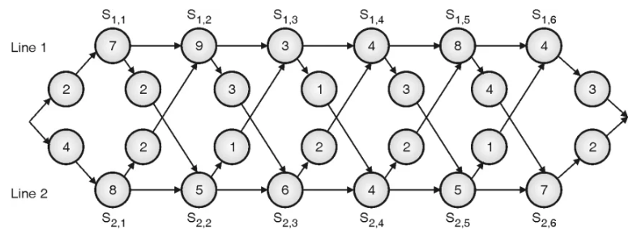
ASSEMBLY LINE SCHEDULING
Example : Find optimal assembly line schedule for given data.

Slide 76
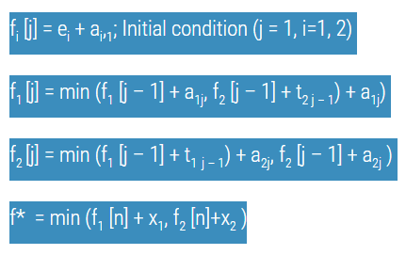
ASSEMBLY LINE SCHEDULING
Solution:

Slide 77
ASSEMBLY LINE SCHEDULING
Solution:
f_{i}[1] = e_{i} + a_{i1} , for i = 1, 2
Here, i indicates assembly line, i.e. 1 or 2,
f₁ [1] = e₁ + a₁₁
= 2 + 7
= 9
f₂ [1] = e₂ + a₂₁
= 4 + 8
= 12

Slide 78
ASSEMBLY LINE SCHEDULING
For j = 2 :
f₁ [2] = min (f₁ [1] + a₁₂, f₂ [1] + t₂₁ + a₁₂)
= min (9 + 9, 12 + 2 + 9)
= 18
f₂ [2] = min (f₁ [1] + t₁₁ + a₂₂ , f₂ [1] + a₂₂)
= min (9 + 2 + 5, 12 + 5)
= 16
For j = 3 :
f₁ [3] = min (f₁ [2] + a₁₃ , f₂ [2] + t₂₂ + a₁₃)
= min (18 + 3, 16 + 1 + 3)
= 20
f₂ [3] = min (f₁ [2] + t₁₂ + a₂₃ , f₂ [2] + a₂₃)
= min (18 + 3 + 6, 16 + 6)
= 22

Slide 79
ASSEMBLY LINE SCHEDULING
For j = 4 :
f₁ (4) = min (f₁ [3] + a₁₄, f₂ [3] + t₂₃ + a₁₄)
= min (20 + 4, 22 + 2 + 4)
= 24
f₂ (4) = min (f₁ [3] + t₁₃ + a₂₄, f₂ [3] + a₂₄)
= min (20 + 1 + 4, 22 + 4)
= 25
For j = 5 :
f₁ (5) = min (f₁ [4] + a₁₅, f₂ [4] + t₂₄ + a₁₅)
= min (24 + 8, 25 + 2 + 8)
= 32
f₂ (5) = min (f₁ [4] + t₁₄ + a₂₅, f₂ [4] + a₂₅)
= min (24 + 3 + 5, 25 + 5)
= 30

Slide 80
ASSEMBLY LINE SCHEDULING
For j = 6 :
f₁ (6) = min (f₁ [5] + a₁₆, f₂ [5] + t₂₅ + a₁₆)
= min (32 + 4, 30 + 1 + 4)
= 35
f₂ (6) = min (f₁ [5] + t₁₅ + a₂₆, f₂ [5] + a₂₆)
= min (32 + 4 + 7, 30 + 7)
= 37

Slide 81
ASSEMBLY LINE SCHEDULING
f* = min (f₁ (n) + x₁, f₂ (n) + x₂)
where n = number of stations = 6
x₁ and x₂ are exit time from line 1 and line 2 respectively.
x₁ = 3 and x₂ = 2
f* = min (f₁ [6] + x₁, f₂ [6] + x₂)
= min (35 + 3, 37 + 2)
= 38

Slide 82
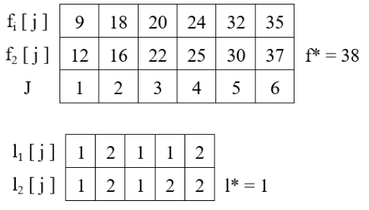
ASSEMBLY LINE SCHEDULING

Slide 83
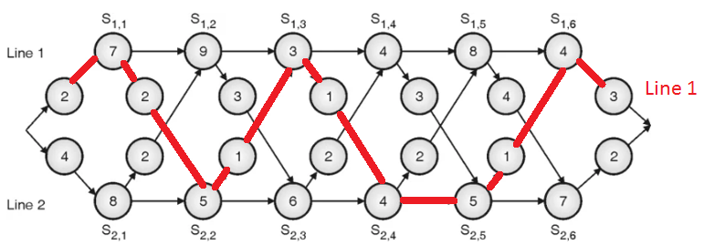
ASSEMBLY LINE SCHEDULING

