Slide 1



Slide 2



Slide 3



B TECH. 2ND Year (Sem III)
UNIT 1:
Logic and Predicates

Slide 4
Content:
Logical expressions and Operators,
Predicates
Rules of quantifiers,
Rules of Inference for predicates and propositions.

Slide 5
Statement :
A sentence is called a statement if it can be true or false not both
Examples:
P: 2 is an odd no.
q: 3 is less than 5
r: today weather is sunny
s: x +10 = 0
Ans: Here sentence p , q and r are statement but s in not a statement
All possible values of statements are called truth values, and are denoted by T AND F

Slide 6

Negation
Let P be the statement then negation of P is denoted by ~ p or $¬ p$
It is defined as
p: 2 is an even number
~ p : 2 is not even number
Table :
p
T
F
~ p
F
T

Slide 7
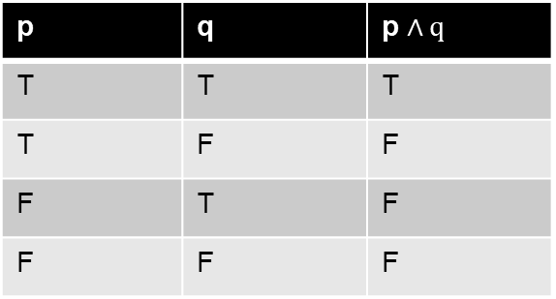

Conjunction
The conjunction of the two statement p and q is denoted by p $∧q$( read as p and q )
It is defined as
p: 4 is an even number
q: 3 is an odd number
Then p $∧q$: 2 is an even number and 3 is an odd number
Table :
p | q | p $∧q$
T | T | T
T | F | F
F | T | F
F | F | F

Slide 8
Example 2
p: 2 divides 45
q: 3 is greater than 5
p Ʌ q: 2 divides 45 and 3 is greater than 5
Notice that p Ʌ q is F because both p and q are not T.

Slide 9
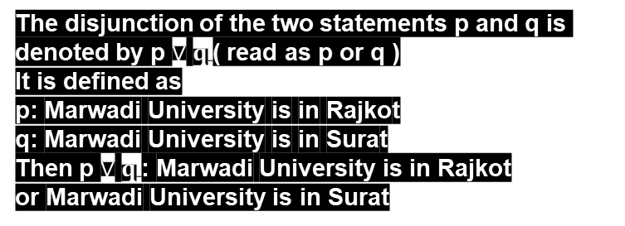
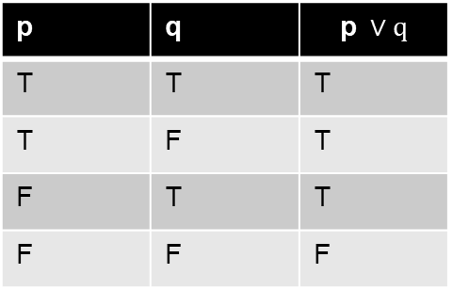
Disjunction
The disjunction of the two statements p and q is denoted by p $∨$ $q$( read as p or q )
It is defined as
p: Marwadi University is in Rajkot
q: Marwadi University is in Surat
Then p $∨$ $q$: Marwadi University is in Rajkot
or Marwadi University is in Surat
p | q | $$\text{p} ∨q$$
T | T | T
T | F | T
F | T | T
F | F | F

Slide 10
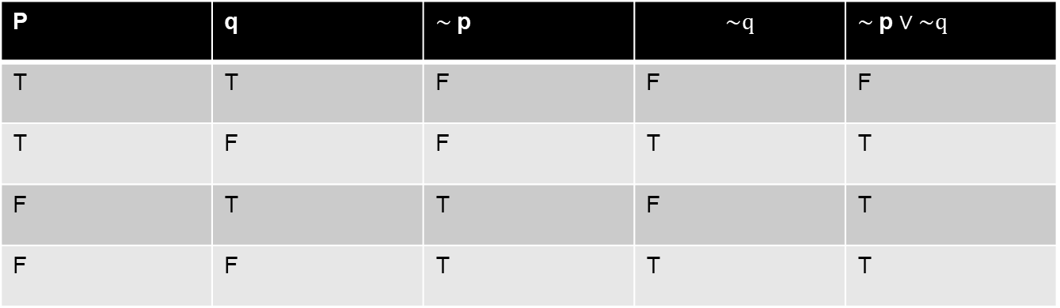
Example
Derive the truth table:
1] $\sim$p $∨\sim q$
P | q | $\sim$p | $$\sim q$$ | $\sim$p $∨\sim q$
T | T | F | F | F
T | F | F | T | T
F | T | T | F | T
F | F | T | T | T

Slide 11
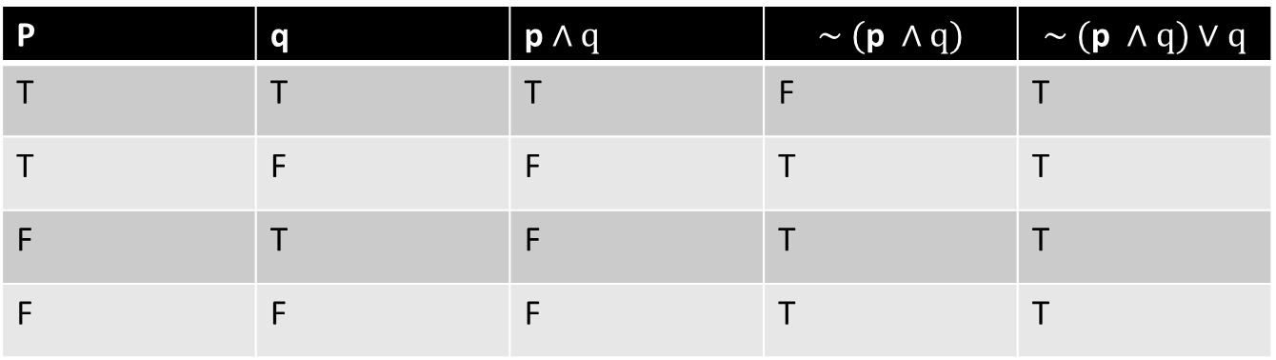
Example
Derive truth table: (~(p Ʌ q) )˅ q
P | q
T | T | T | F | T
T | F | F | T | T
F | T | F | T | T
F | F | F | T | T

Slide 12
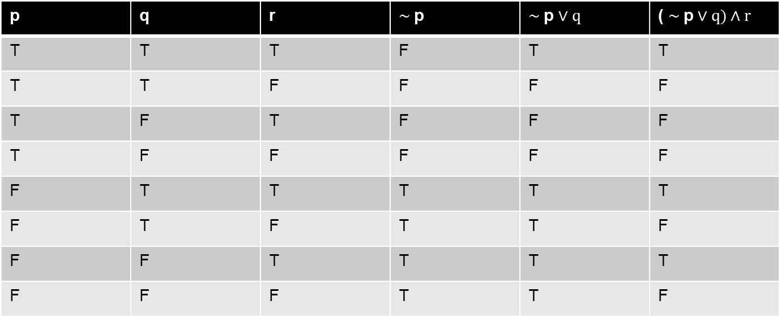


Example
Derive truth table: ( $\sim$p $∨q)∧r$
p | q | r | $\sim$p | $\sim$p $∨q$ | ( $\sim$p $∨q)∧r$
T | T | T | F | T | T
T | T | F | F | F | F
T | F | T | F | F | F
T | F | F | F | F | F
F | T | T | T | T | T
F | T | F | T | T | F
F | F | T | T | T | T
F | F | F | T | T | F

Slide 13
Example
Derive truth table: (~(p Ʌ q) )˅ q
P | q
T | T | T | F | T
T | F | F | T | T
F | T | F | T | T
F | F | F | T | T

Slide 14
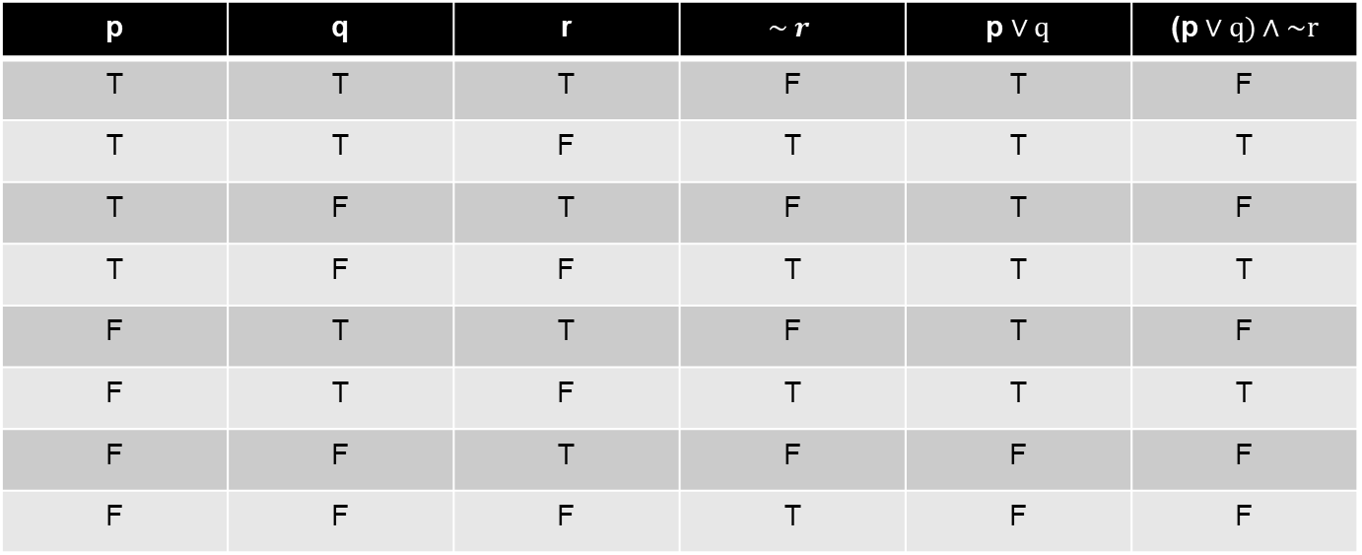

Example
Derive truth table: (p $∨q)∧\sim r$
p | q | r | $$\sim r$$ | p $∨q$ | (p $∨q)∧\sim r$
T | T | T | F | T | F
T | T | F | T | T | T
T | F | T | F | T | F
T | F | F | T | T | T
F | T | T | F | T | F
F | T | F | T | T | T
F | F | T | F | F | F
F | F | F | T | F | F

Slide 15
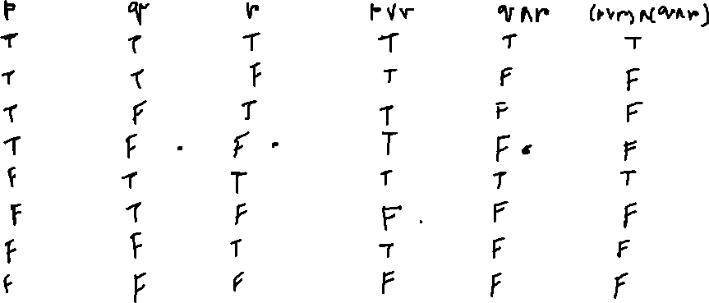

Example
Derive truth table: (p $∨r)∧(q∧r$)

Slide 16

Example
Derive truth table: (q$∨r)∧\sim p$

Slide 17

Example
Derive truth table: (p $∨q)∧(\sim r∧q)$

Slide 18
Conditional statement
Let p & q be given two statements. Then “if p, then q” is a statement called an implication, or a condition, written as p → q
The statement p→q is also to be read as p implies q.
The implication p→ q is considered false when p is true and q is false; otherwise it is considered true.
P | q | p → q
T | T | T
T | F | F
F | T | T
F | F | T
In the Implication p→ q, p is called the hypothesis and q is called the conclusion. The truth table of the implication p→ q is given as below.

Slide 19

Converse, Inverse, Contrapositive
The statement q → p is called the converse of the implication p → q.
The statement ~p → ~q is called the inverse of the implication p → q.
The statement ~q → ~p is called the contrapositive of the implication p → q.

Slide 20
Example:
Consider the statement “ If today is Sunday, then I will go for a walk.” Let p and q be the following statements.
p: Today is Sunday
q: I will go for a walk
Then the given statement can be written as p→ q.
The converse of this implication is q → p, which is
q →p : If I will go for a walk, then today is Sunday.
The inverse of the above implication is ~p → ~q, which is ~p →~q : If today is not Sunday, then I will not go for a walk.
The contrapositive of the above implication is ~q → ~p, which is ~q → ~p: If I will not go for a walk then today is not Sunday.

Slide 21
Biconditional statement
Let p and q be two statements, then “ p if and only if q”, written p↔q, is called the biimplication, or biconditional of statements p and q.
The statement p↔q may also be read as “ p is necessary and sufficient for q”. We define that the biimplication p↔q is considered to be true when both p and q have the same truth values and false otherwise.
Truth table of p↔q
P | q | p↔q
T | T | T
T | F | F
F | T | F
F | F | T

Slide 22
Statement Formulas
A statement formula, or formula, is defined as below.
A statement variable is a statement formula.
If p and q are statements, then the expressions (~p), (p Ʌq), (p˅q), (p→q) and (p↔q) are statement formulas.

Slide 23


Tautology
A statement formula A is said to be a tautology if the truth value of A is T for any assignment of the truth values T and F to the statement variables occurring in A. If A is Tautology then it is denoted by ╞ A .
For Example,
p | $\sim$p | p $∨\sim$p
T | F | T
F | T | T

Slide 24


Contradiction
A Statement formula A is said to be a contradiction if the truth value of A is F for any assignment of the truth values T and F to the statement variables occurring in A.
For Example,
p | $\sim$p | p$∧\sim$p
T | F | F
F | T | F

Slide 25
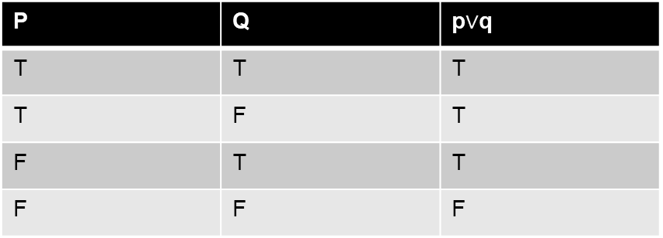

Contingency
A compound statement which is neither tautology nor contradiction is called contingency
The compound statement
p$∨$q is contingency
P | Q | p$∨$q
T | T | T
T | F | T
F | T | T
F | F | F

Slide 26
Example.
Let A be the statement formula (~pɅq) → (~(q→p)). We Construct the truth table for A. Let us check whether A is Tautology or Contradiction or Contingency.

Slide 27
Truth Table for A= (~pɅq) → (~(q→p))
p | q | ~p | ~pɅq | q→p | ~(q→p) | A
T | T | F | F | T | F | T
T | F | F | F | T | F | T
F | T | T | T | F | T | T
F | F | T | F | T | F | T
Hence, A is a Tautology.

Slide 28
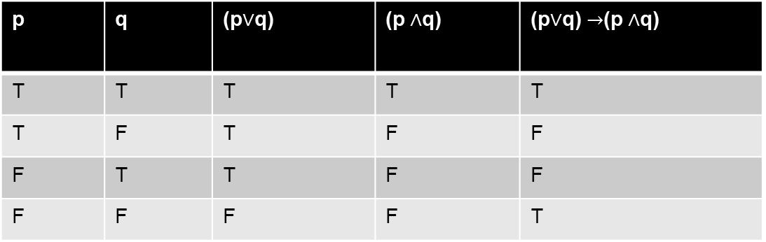

Check the following compound statement are tautology or not
(p$∨$q) $→$(p $∧$q)
p | q | (p$∨$q) | (p $∧$q) | (p$∨$q) $→$(p $∧$q)
T | T | T | T | T
T | F | T | F | F
F | T | T | F | F
F | F | F | F | T
Hence, A is not Tautology.

Slide 29

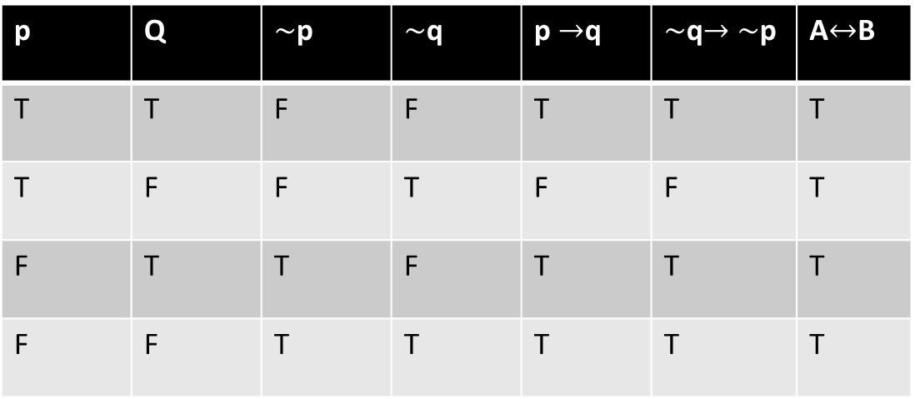
Let (p $→$q)$↔$ ($\sim$q$→\sim$p) be the statement formula construct the truth table for it
and check whether it is Tautology or contradiction.
(p $→$q)$↔$ ($\sim$q$→\sim$p)
p | q
T | T | F | F | T | T | T
T | F | F | T | F | F | T
F | T | T | F | T | T | T
F | F | T | T | T | T | T
Hence, (p $→$q)$↔$ ($\sim$q$→\sim$p)
is a Tautology.

Slide 30

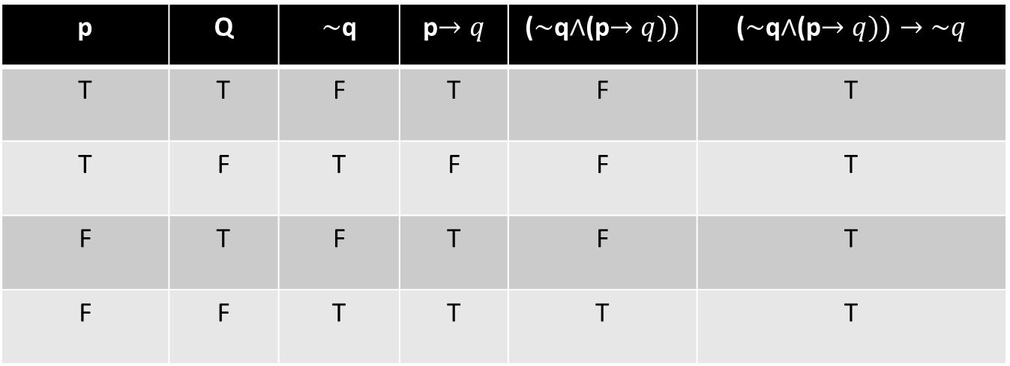
Let ($\sim$q$∧$(p$→q))→\sim q$ be the statement formula.
construct the truth table and check whether it is Tautology or contradiction.
($\sim$q$∧$(p$→q))→\sim q$
p | q
T | T | F | T | F | T
T | F | T | F | F | T
F | T | F | T | F | T
F | F | T | T | T | T
Hence, ($\sim$q$∧$(p$→q))→\sim q$ is a Tautology.

Slide 31

Logical equivalent .
Let p and q be the two statements then both are logical equivalent
if p$↔$q is tautology
It is denoted by p$≡q$ (p logical equivalent to q )

Slide 32
Example
We show that the statement formula (p→q) is logically equivalent to (~p˅q) .For this we construct the truth table of (p→q) ↔(~p˅q)
p | q | ~p | (p→q) | (~p˅q) | (p→q) ↔(~p˅q)
T | T | F | T | T | T
T | F | F | F | F | T
F | T | T | T | T | T
F | F | T | T | T | T
From this table , it follows that (p→q) ↔(~p˅q) is a tautology and hence p→q is logically equivalent to ~p˅q.
Hence (p→q) ≡ (~p˅q)

Slide 33
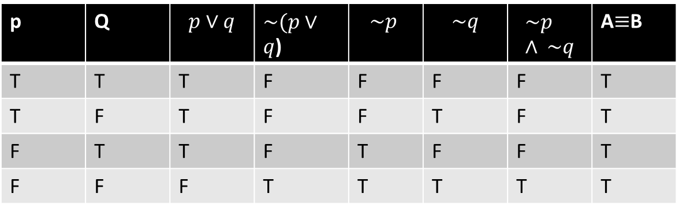


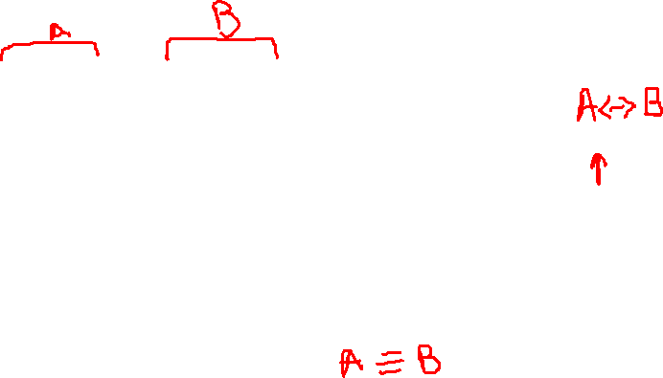
De'Morgan's law
Let p and q be two statements then
(1) $\sim (p∨q$) $≡\sim p ∧ \sim q$
(2)$\sim (p∧q$) $≡\sim p ∨\sim q$
Proof:
(1) $\sim (p∨q$) $≡\sim p ∧ \sim q$
p | q
T | T | T | F | F | F | F | T
T | F | T | F | F | T | F | T
F | T | T | F | T | F | F | T
F | F | F | T | T | T | T | T

Slide 34
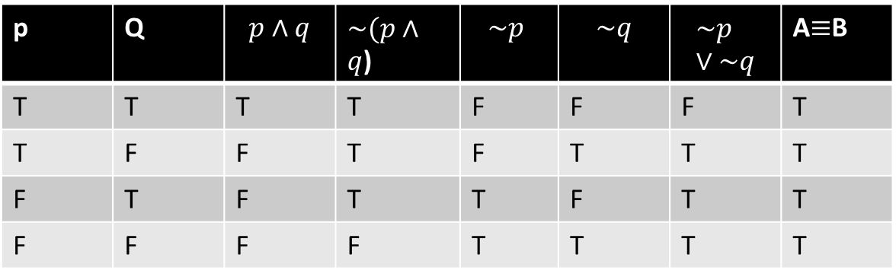

Proof cont.
(2) $\sim (p∧q$) $≡\sim p∨\sim q$
p | q
T | T | T | F | F | F | F | T
T | F | F | T | F | T | T | T
F | T | F | T | T | F | T | T
F | F | F | T | T | T | T | T
Hence, it is proved

Slide 35
Theorem:
Let p,q and r be statements. Then the following logical equivalences hold.
Commutative Law : pɅq ≡ qɅp and p˅q ≡ q˅p
Associative Law: (pɅq) Ʌr ≡ pɅ(qɅr)
(p˅q) ˅r ≡p˅(q ˅r)
Distributive Law: p˅(qɅr) ≡(p˅q)Ʌ(p˅r)
pɅ (q˅r) ≡(pɅq) ˅ (pɅr)
Absorption Law: pɅ(p˅q) ≡p
p˅ (pɅq) ≡p
Idempotent Law: pɅp ≡p and p˅p ≡p
Double negation Law: ~~p ≡p

Slide 36
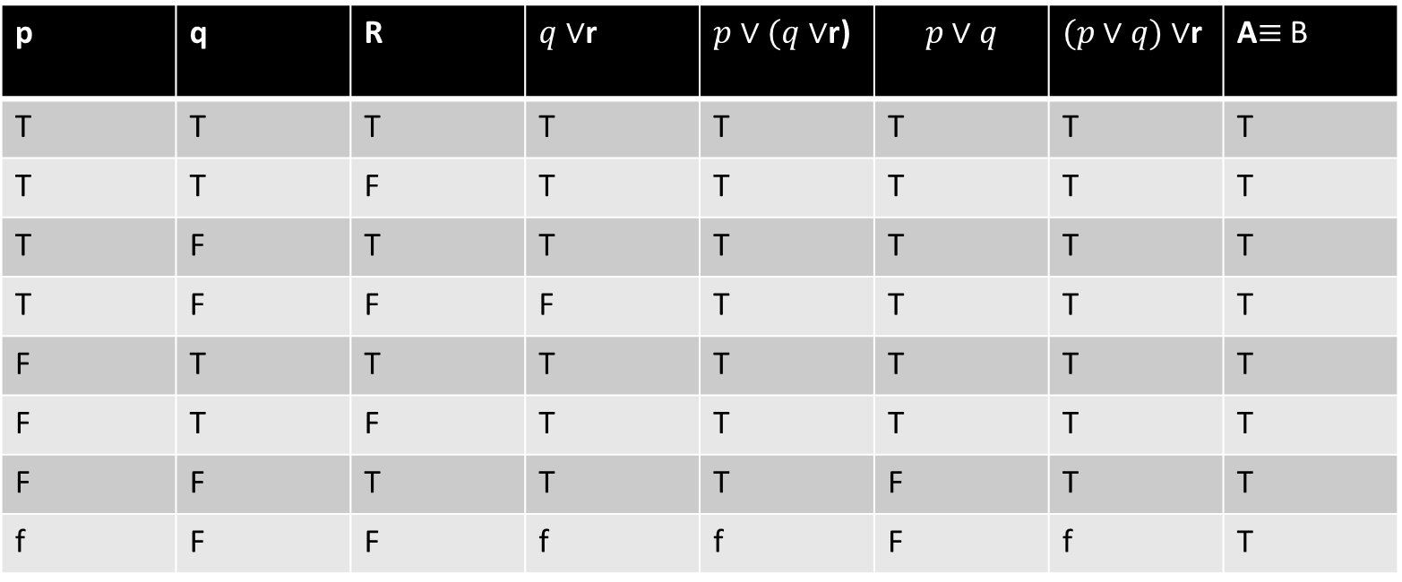



Associative law
Let p , q and r be three statements then
(1) $p∨(q∨$r) $≡(p∨q)∨$r
(2)$p∧(q∧$ r) $≡(p∧q)∧r$
proof
p | q | r
T | T | T | T | T | T | T | T
T | T | F | T | T | T | T | T
T | F | T | T | T | T | T | T
T | F | F | F | T | T | T | T
F | T | T | T | T | T | T | T
F | T | F | T | T | T | T | T
F | F | T | T | T | F | T | T
F | F | F | F | F | F | F | T
(1) $p∨(q∨$r) $≡(p∨q)∨$r

Slide 37



Associative law
p | q | r
T | T | T | T | T | T | T | T
T | T | F | F | F | T | F | T
T | F | T | F | F | F | F | T
T | F | F | F | F | F | F | T
F | T | T | T | F | F | F | T
F | T | F | F | F | F | F | T
F | F | T | F | F | F | F | T
F | F | F | F | F | F | F | T
Proof cont.
(2)$p∧(q∧$ r) $≡(p∧q)∧r$

Slide 38
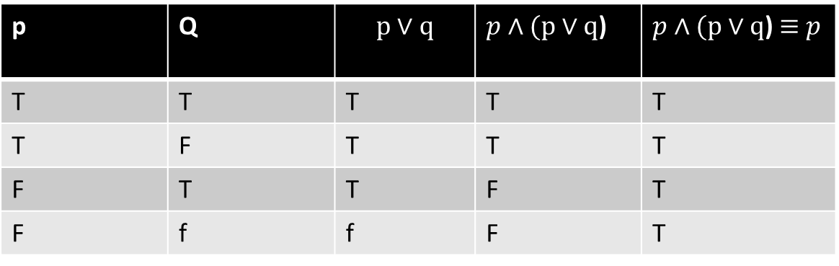


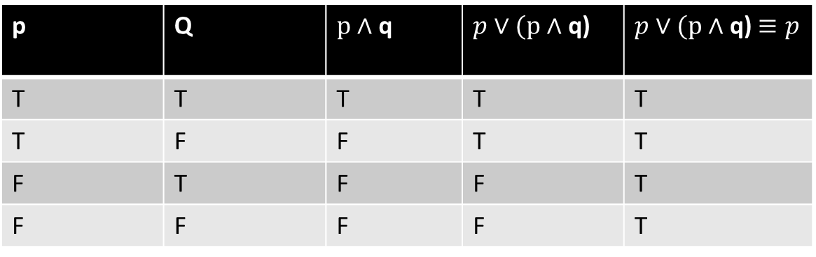
Absorption law
Let p and be two statements then
(1) $p∧(p∨q$) $≡p$
(2)$p∨(p∧$ q) $≡p$
Proof .
p | q
T | T | T | T | T
T | F | T | T | T
F | T | T | F | T
F | F | F | F | T
(1) $p∧(p∨q$) $≡p$
(2)$p∨(p∧$ q) $≡p$
p | q
T | T | T | T | T
T | F | F | T | T
F | T | F | F | T
F | F | F | F | T

Slide 39



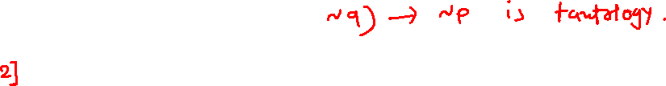


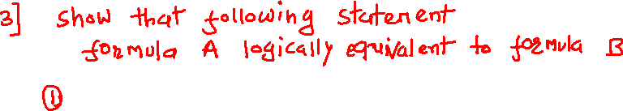
Exercise

Slide 40
Validity of Argument
A finite sequence A₁, A₂, A₃, ….., A_{n-1} , A_{n} of statements is called an argument. The final statement A_{n} is the conclusion and the statements A₁, A₂, A₃, ….., A_{n-1} are called the premises of the argument.
An argument A₁, A₂, A₃, ….., A_{n-1} , A_{n} is called logically valid if the statement formula
(A₁ Ʌ A₂ Ʌ A₃ Ʌ …..Ʌ A_{n-1}) →A_{n}
is a tautology.
Sometimes we write an argument in the following form
A₁
A₂
A₃
.
.
.
.
A_{n-1}
⸫ A_{n}

Slide 41
Example:
Consider the following argument.
If Neha solved seven problems correctly then Neha obtained grade A. Neha solved seven problems correctly. Therefore, Neha obtained the grade A.
We first write the arguments by statement letters and logical connectives. Let,
p: Neha solved seven problems correctly.
q: Neha obtained grade A.
so the argument takes the form,
p→q
p
⸫q
Now consider the truth table for the statement formula ((p→q) Ʌp) →q
P | Q | p→q | (p→q) Ʌp | ((p→q) Ʌp) →q
T | T | T | T | T
T | F | F | F | T
F | T | T | F | T
F | F | T | F | T
As((p→q) Ʌp) →q is a tautology, it follows that the given argument is valid.

Slide 42
Example:
If Prof. Vaidya does not accept the invitation as an Expert for the Technical Talk, then Prof. Roy can be invited for the Technical Talk. Prof. Roy can be invited for the Technical Talk. Therefore, Prof. Vaidya does not accept the invitation as an Expert for the Technical Talk.
We first write the arguments by statement letters and logical connectives. Let,
p: Prof. Vaidya does not accept the invitation as an Expert for the Technical Talk.
q: Prof. Roy can be invited for the Technical Talk
so, the argument takes the form,
p→q
q
⸫p
Now consider the truth table for the statement formula
((p→q) Ʌq) →p
p | q | p→q | ((p→q) Ʌq) | ((p→q) Ʌq) →p
T | T | T | T | T
T | F | F | F | T
F | T | T | T | F
F | F | T | F | T
As ((p→q) Ʌq) →p is not a tautology, it follows that the given argument is not valid.

Slide 43
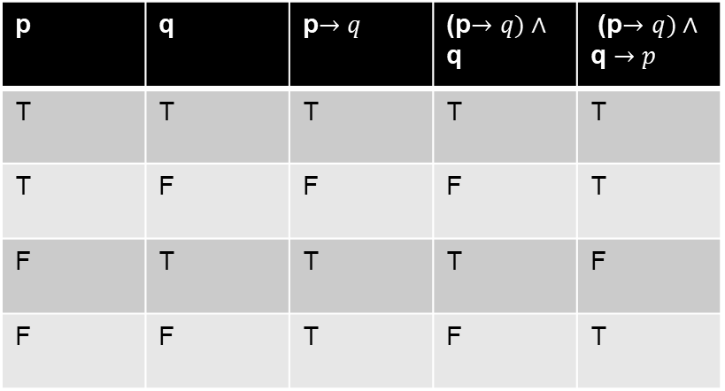

Prove that the following argument is invalid
p | q | p$→q$ | (p$→q)∧$ q | (p$→q)∧$ q $→p$
T | T | T | T | T
T | F | F | F | T
F | T | T | T | F
F | F | T | F | T
p$→q$
q
$$∴p$$
Ans we will check Truth table for
(p$→q)∧$ q $→p$
since, (p$→q)∧$ q $→p is not Tautology, the argument is not valid.$

Slide 44


Determine following argument is valid or not
$\sim$p $∨$ q
r $→ \left(\sim \text{q}\right)$
$∴$p $→ \left(\sim \text{r}\right)$
Ans : we will check
$(\sim$p $∨$ q ) $∧$ ( r $→\left(\sim \text{q}\right)$ )$→$ (p $→ \left(\sim \text{r}\right))$ is tautology

Slide 45
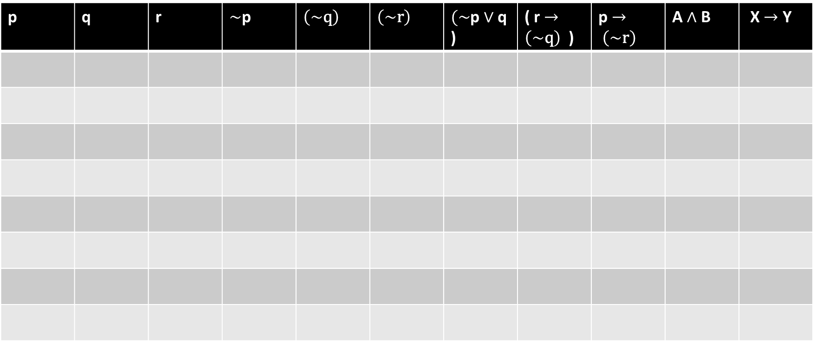
p | q | r

Slide 46
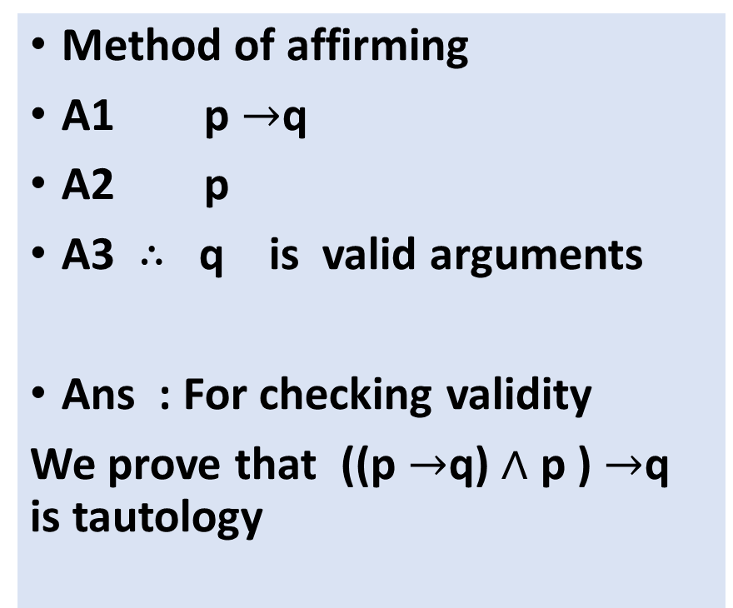
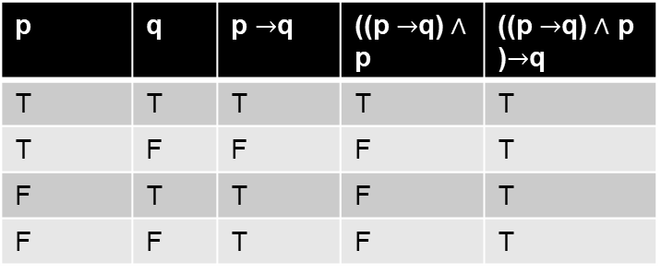
Some well known arguments
p | q | p $→$q | ((p $→$q) $∧$ p | ((p $→$q) $∧$ p )$→$q
T | T | T | T | T
T | F | F | F | T
F | T | T | F | T
F | F | T | F | T
1111111111111111111111111111

Slide 47

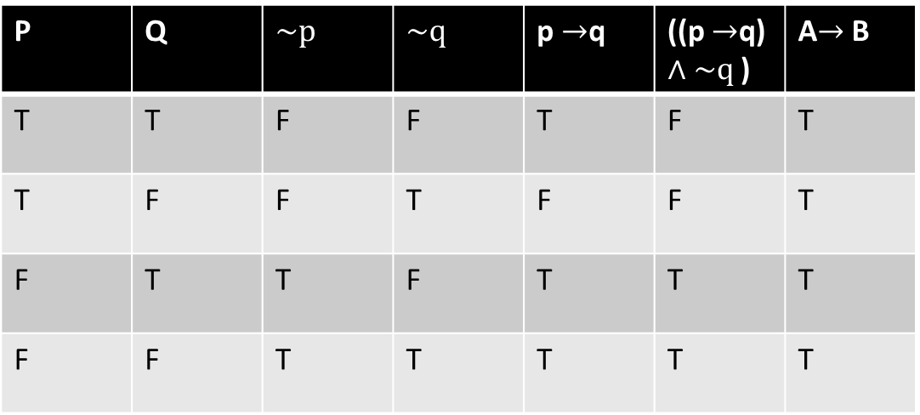
Method of denying
A1 p $→$q
A2 $\sim q$
A3 $∴\sim p$
is valid argument.
Ans : For checking validity
We prove that
((p $→$q) $∧\sim q$ )$→\sim p$ is tautology
P | q
T | T | F | F | T | F | T
T | F | F | T | F | F | T
F | T | T | F | T | F | T
F | F | T | T | T | T | T

Slide 48



3] Dilemma
A1 p$∨$q
A2 p$→r$
A3 q$→r$
A4 $∴$ r
is valid argument
p | q | r | p$∨$q | p$→r$ | q$→r$ | x$∧$y$∧$z | A$→$B
T | T | T | T | T | T | T | T
T | T | F | T | F | F | F | T
T | F | T | T | T | T | T | T
T | F | F | T | F | T | F | T
F | T | T | T | T | T | T | T
F | T | F | T | T | F | F | T
F | F | T | F | T | T | F | T
F | F | F | F | T | T | F | T
Ans : For checking validity
We prove that
(p$∨$q) $∧$ (p$→r$ ) $∧$ (q$→r)→r$ is tautology

Slide 49
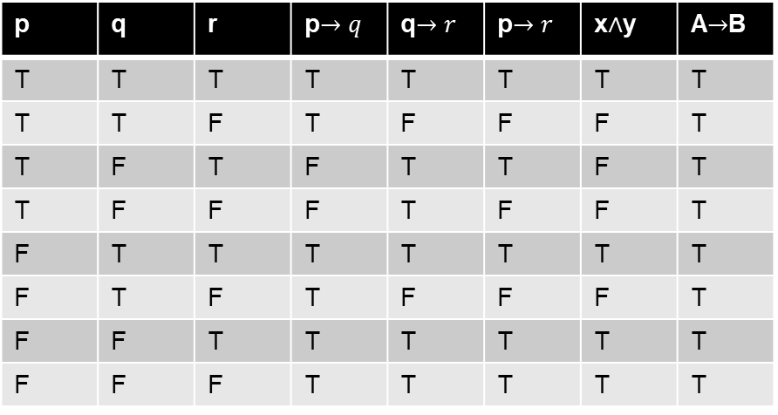


p | q | r | p$→q$ | q$→r$ | p$→r$ | x$∧$y | A$→$B
T | T | T | T | T | T | T | T
T | T | F | T | F | F | F | T
T | F | T | F | T | T | F | T
T | F | F | F | T | F | F | T
F | T | T | T | T | T | T | T
F | T | F | T | F | F | F | T
F | F | T | T | T | T | T | T
F | F | F | T | T | T | T | T
4] Hypothetical syllogism
A1 p$→q$
A2 q$→r$
A3 $∴$ p$→r$
is valid argument
Ans : For checking validity
We prove that
(p$→q$) $∧$ (q$→r)→$ (p$→r)$is tautology

Slide 50
5. Disjunctive syllogisms
(a) p˅q (b) p˅q
~p ~q
⸫q ⸫p

Slide 51
6. Conjunctive simplifications
a. pɅ q b. pɅq
⸫p ⸫q
7. Disjunctive additions
a. p b. q
⸫ p˅q ⸫ p˅q
8. conjunctive addition
p
q
⸫pɅq

Slide 52
Predicates
Def:
A predicate is a declarative sentence whose true false value depends on one or more variables
A predicate with one variable is denoted p(x)
A predicate with two variables is denoted by p(x ,y)
And so on …..

Slide 53
Examples
1) p(x) : x is divisible by 7
Here x is a variable
x is divisible by 7, is known as predicate.
Predicate p(x) is also known as propositional function of x
Answer :
Lets assign the value
P(14) : 14 is divisible by 7
thus p(14) is true .
p(5) : 5 is divisible by 7
thus p(5) is not true ..

Slide 54

Example 2 Example 3
P(x) : x is a prime number
Answer :
P(3) : 3 is a prime number
so, p(3) is true
P(14) : 14 is not a prime number
so, p(14) is false
P(x,y ) : 2x+ y is divisible by $y^{2}$
Answer :
P(1,-1 ) : 1 is divisible by 1
its true thus p(1,-1) is true
P(2,3) :7 is divisible by 9
It is false : p(2,3) is false

Slide 55


Quantifiers
1] Universal Quantifiers
The universal quantification of p(x) is the statement
“p(x) for all x $ε$ D “
where D is called the domain
It is denoted by $∀ x p\left(x\right)$
$∀ x p\left(x\right)$ is true if p(x) is true for every x in domain
$∀ x p\left(x\right)$ is false if p(x) is false for at least one value of x in domain

Slide 56

Notes:
The ‘x’ for which $∀ x p\left(x\right)$ is false is called counter example of $∀ x p\left(x\right)$
If domain D = $∅ then ∀ x p\left(x\right)$ is by default true as there are no counter example.

Slide 57
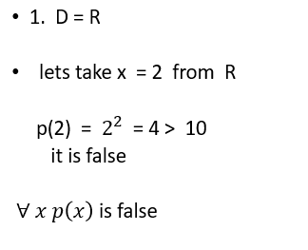
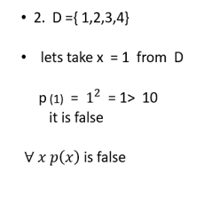
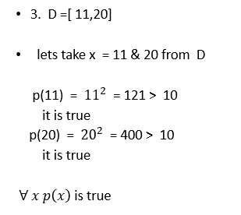

Example:
If p(x) : $x^{2}$> 10 then what is true /false value of $∀ x p\left(x\right)$ if
D = R
D ={ 1,2,3,4}
D = [11,20]

Slide 58


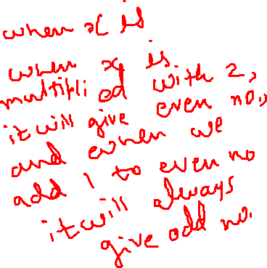
Example
Let ,P(x) : x is an even no then 2x+1 is always an odd no ,
D = N, then find the truth value of $∀ x p\left(x\right)$
Ans : lets take x = 2 even no
Then
P(2) : 2 is an even no then 5 is an odd no .
Thus for every x from N
P(x) is true
Thus $∀ x p\left(x\right)$ is true ..

Slide 59
Universal Specification & Generalization
The statement P(x) is true then P(a) is true for any arbitrary element a є D.
All humans are good. Karan is a human then Karan is good.
D: All humans
P(x): x is good.
All humans are good is true.
So, for specific a= Karan P(a): karan is good is true as aєD

Slide 60


Quantifiers
2] Existential Quantifiers
The existential quantification of p(x) is the statement
“there exist x $ε$ D such that p(x) “
where D is called the domain
( domain of discourse )
It is denoted by $∃ x p\left(x\right)$
$∃ x p\left(x\right)$is true if p(x) is true for one or more x $ε$ D
$∃ x p\left(x\right)$is false if p(x) is false for every x $ε$ D .

Slide 61

Notes :
The ‘x’ for which $∃ x p\left(x\right)$ is true is called ‘witness’ of $∃ x p\left(x\right)$
If domain D = $∅ then ∃ x p\left(x\right)$ is by default false as there are no witnesses.

Slide 62
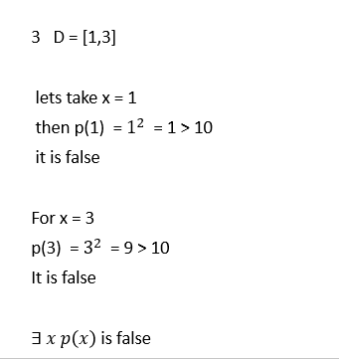
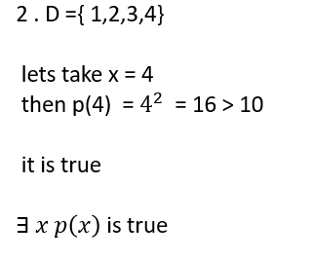
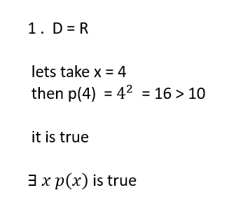

Examples
If p(x) : $x^{2}$> 10 then what is true /false value of $∃ x p\left(x\right)$ if
D = R
D ={ 1,2,3,4}
D = [1,3]

Slide 63


Example
P(x) : $x≥x^{2}$ D = {5,6,9,-9,0}
what is true /false value of $∃ x p\left(x\right)$
Ans : here D = {5,6,9,-9,0}
Take x =0
Then
P(0) = 0 $≥$ 0
It is true , thus $∃ x p\left(x\right)$ is true

Slide 64
Existential Specification & Generalization
The statement x P(x) is true then P(a) is true for at least one aєD.
If P(x) is true when we replace x by at least one aєD then x P(x) is true.
Example: ICT student Harsh got A grade in DMGT. So, someone got A grade in DMGT.
D= students of ICT.
P(x) : x got A grade in DMGT.
X = Harsh, got A grade in DMGT.
P(Harsh) is true. So, x P(x) is true.

Slide 65
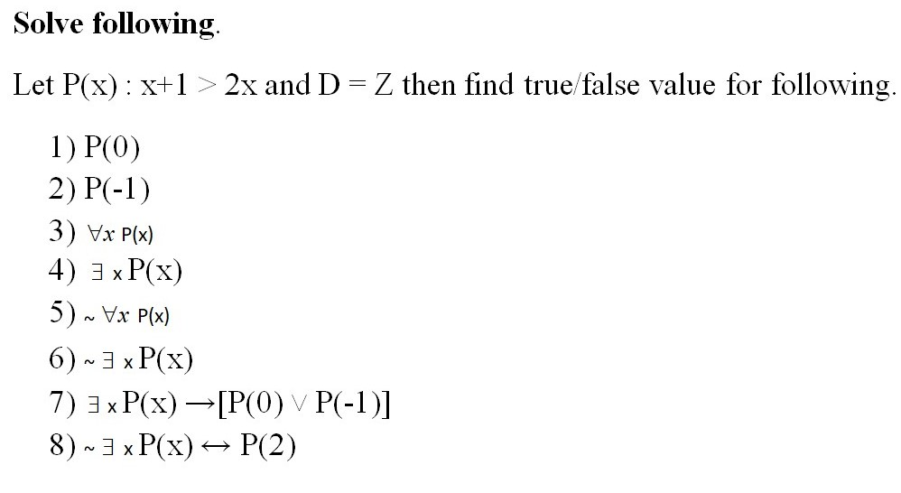
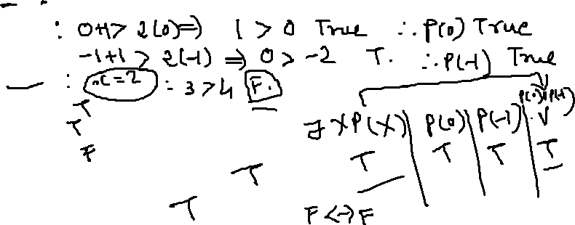

Slide 66
De’ Morgan’s Law for Quantifiers
Let P(x) be the Predicate and D be the given domain then,
~ Ɐx P(x) ≡ ⁆ x ~P(x)
~ ⁆ x P(x) ≡ Ɐx ~P(x)

Slide 67
1)
Let ~ Ɐx P(x) be true.
Ɐx P(x) is false.
There exists at least one xєD for which P(x) is false.
There exists at least one xєD for which ~P(x) is true.
⁆ x ~P(x) is true.
Now let ⁆ x ~P(x) is true.
There exists at least one xєD for which ~P(x) is true.
There exists at least one xєD for which P(x) is false.
P(x) is false for one x so, Ɐx P(x) is false.
~ Ɐx P(x) be true.

Slide 68
2)
Let ~ ⁆ x P(x) be true.
⁆ x P(x) is false.
for every xєD, P(x) is false.
for every xєD, ~P(x) is true.
Ɐx ~P(x) is true.
Now let Ɐx ~P(x) be true.
for every xєD, ~P(x) is true.
for every xєD, P(x) is false.
There exists no x for which P(x) is true.
⁆ x P(x) is false.
~ ⁆ x P(x) is true.

