Slide 1

Unit 2
Lattice
Department of ICT
Unit no 2
“Lattice”
Discrete Mathematics and Graph theory
Prof. Foram

Slide 2
Topics
Different types of Relations
Partially ordered set
Totally ordered set
Hasse diagram
Lattice as Partially ordered set
Properties of lattices
Lattice as an algebraic system

Slide 3
Different types of Relations
Power Set :
Power set of set A is the collection of all subset of A. It is denoted by P( A ).
Example : A = { 1, 2, 3 } Then P(A) = { Φ, {1}, {2}, {3}, {1, 2}, {2, 3}, {1, 3}, A}
Note: If A has n elements then P(A) has 2^{n} elements.
Product set:
For any set A, the collection of all possible order pair ( x, y ) where x and y are elements of A is called product set of A. It is denoted by AxA.
i.e. AxA = { (x, y) / x,y є A}
Example : A = { 1, 2 } Then AxA = { (1, 1), (1, 2), (2, 1), (2, 2) }

Slide 4
Different types of Relations
Relation :
For given set A, subset R of AxA is called relation on A.
Example : If A = {a, b, c} then R = { (a, a), (a, b), (b, c) } is a relation on A.
Here (a, b) є R it means a is related to b. It is denoted by aRb
R1 = { (a, a), (b, b), (b, c) }, R2 = { (a, a), (c, b), (b, c) }, R3 = { (a, -a), (b, b), (b, -c) } here R1 and R2 are relation on A but R3 is not subset of AxA so R3 is not relation on A.
Reflexive Relation :
A relation R is called reflexive relation on set A if (a, a) є R for all a є A i.e. aRa for all a є A
Example : If A = {a, b, c} then R = { (a, a), (b, b), (c, c) } is a reflexive relation on A.
R1 = { (a, a), (b, b), (b, c) } is not a reflexive relation on A because (c, c) is not in R1

Slide 5
Different types of Relations
Example: Check whether the following relations on Z are reflexive or not.
1) xRy if | x – y | = even number
For integer a, | a – a | = 0 = even number
Therefore R is reflexive relation on Z.
2) xRy if xy ≥ 0
For integer a, aa = a² ≥ 0
Therefore R is reflexive relation on Z.
3) xRy if xy < 0
For 2, 2*2 = 4 so 2 is not related to 2
Therefore R is not reflexive relation on Z.

Slide 6
Different types of Relations
Symmetric relation:
A relation R is called symmetric relation on set A if (a, b) є R for a, b є A then (b, a) є R
i.e. if aRb then bRa for all a, b є A
Example : If A = {a, b, c} then R = { (a, b), (b, a), (c, c) } is a symmetric relation on A.
R1 = { (a, b), (b, a), (b, c) } is not a symmetric relation on A because (c, b) is not in R1
Anti - Symmetric relation:
A relation R is called Anti - symmetric relation on set A for a, b є A a≠b if (a, b) є R then (b, a) is not in R
i.e. for a, b є A a≠b if aRb then b is not related to a.
Example : If A = {a, b, c} then R = { (a, b), (a, c), (b, b) } is Anti - symmetric relation on A.
R1 = { (a, b), (b, a), (b, c) } is not anti symmetric relation on A because (a, b), (b, a) є R

Slide 7
Different types of Relations
Example: Check whether the following relations on Z are symmetric or not.
1) xRy if | x – y | = even number
For integers x, y, if xRy then | x – y | = even number
⸫ | y – x | = even number
⸫ yRx
Therefore R is symmetric relation on Z.
2) xRy if x ≥ y
For integers x, y, if xRy then x ≥ y
⸫ y can't be getter than x
⸫ y is not related to x
Therefore R is not symmetric relation on Z.
Example: Check whether the following relations on Z are anti symmetric or not.
1) xRy if | x – y | = even number
For integers x, y, if xRy then | x – y | = even number
⸫ | y – x | = even number
⸫ yRx
Therefore R is not anti symmetric relation on Z.
2) xRy if x ≥ y
For integers x, y, if xRy then x ≥ y
⸫ y can't be getter than x
⸫ y is not related to x
Therefore R is anti symmetric relation on Z.

Slide 8
Different types of Relations
Example: A = Set of all males
R = { (x, y) / x is brother of y } relation on A
If x is brother of y then y is also brother of x
⸫ If xRy then yRx
⸫ R is symmetric
Example: A = Set of all males
R = { (x, y) / x is father of y } relation on A
If x is father of y then y can’t be father of x
⸫ If xRy then y is not related to x
⸫ R is anti symmetric
Example: On the set A = { 1, 2, 3, 4 } define
Relation R which is symmetric but not anti symmetric
Relation R which is anti symmetric but not symmetric
Relation R which is both symmetric and anti symmetric.
Relation R which is neither symmetric nor anti symmetric.
Answer :
R = { (1, 2), (2, 1), (3, 3) }
R = { (1, 2), (2, 4), (3, 3) }
R = { (1, 1), (2, 2), (3, 3) }
R = { (1, 2), (2, 1), (3, 4) }

Slide 9
Different types of Relations
Transitive relation:
A relation R is called transitive relation on set A if (a, b), (b, c) є R for a, b, c є A then (a, c) є R
i.e. if aRb and bRc then aRc for a, b, c є A
Example :
If A = {a, b, c} then R = { (a, b), (b, a), (a, a), (a, c), (b, c) } is a transitive relation on A.
R1 = { (a, b), (b, c), (b, b) } is not a transitive relation on A because (a, c) is not in R1
Example: Check whether the following relations on Z are transitive or not.
1) xRy if | x – y | = even number
For integers a, b, c if aRb and bRc then
| a – b | = even number and | b – c | = even number
⸫ |a – c| = |a - b| + | b – c | = even number + even number = even number
Therefore R is transitive relation on Z.

Slide 10
Different types of Relations
2) xRy if x ≥ y
For integers a, b, c
If aRb and bRc then a ≥ b and b ≥ c
⸫ a ≥ c
⸫ aRb
Therefore R is transitive relation on Z.
3) xRy if xy < 0
(-3)*2 = - 6 < 0 and 2*(-4) = -8 < 0
⸫ -3R2 and 2R(-4)
but (-3)*(-4) = 12 > 0
⸫ -3 is not related to (-4)
Therefore R is not transitive relation on Z.

Slide 11
Different types of Relations
Equivalence relation:
A relation R is called Equivalence relation on set A if R is Reflexive, Symmetric and Transitive relation on A
Example :
A = {a, b, c} and R = { (a, b), (b, a), (a, a), (a, c), (b, c), (b, b), (c, c), (c, b), (c, a) } is a relation on A
Here
R is reflexive
R is symmetric
R is transitive
⸫ R is an equivalence relation on A.

Slide 12
Different types of Relations
Example: Check whether the following relations on Z are Equivalence relation or not.
1) xRy if | x – y | = even number
For integer a, | a – a | = 0 = even number
Therefore R is reflexive relation on Z.
For integers a, b, if aRb then | a – b | = even number
⸫ | b – a | = even number
⸫ bRa
Therefore R is symmetric relation on Z.
For integers a, b, c if aRb and bRc then
| a – b | = even number and | b – c | = even number
⸫ |a – c| = |a - b| + | b – c | = even number + even number = even number
Therefore R is transitive relation on Z.
Therefore R is equivalence relation on Z.

Slide 13
Different types of Relations
2) xRy if xy ≥ 0
For integer x, x*x = x² ≥ 0
Therefore R is reflexive relation on Z.
For integers x, y, if xRy then x y ≥ 0
⸫ yx ≥ 0
⸫ yRx
Therefore R is symmetric relation on Z.
For integers x, y, z if xRy and yRz then x y ≥ 0 and yz ≥ 0
but, x z ≥ 0 always, for example -2 ≥ 0 , 0 ≥ 3 but -2 ≥ 3
Therefore R is not transitive relation on Z.
Therefore R is not Equivalence relation on Z.

Slide 14
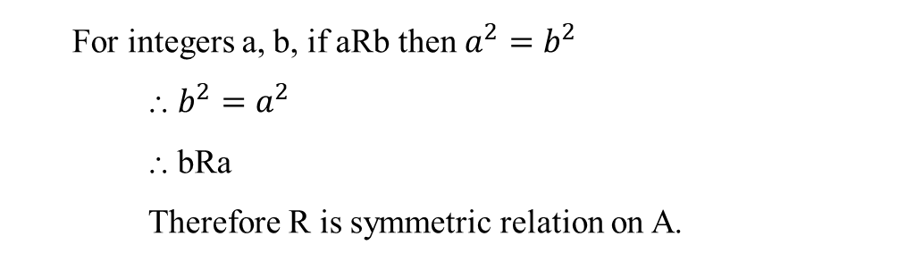
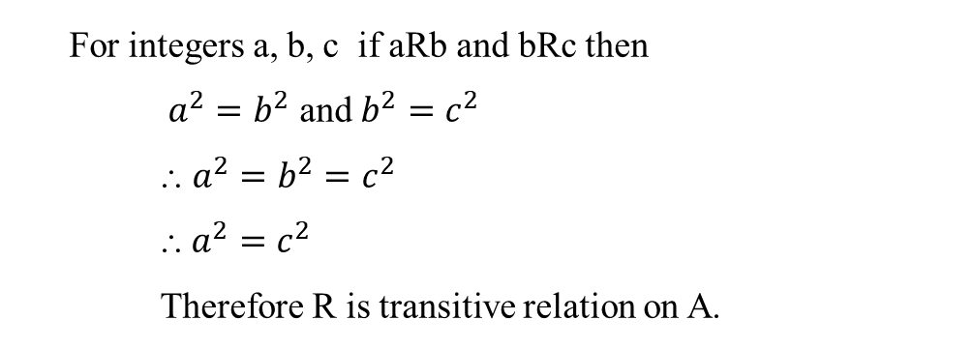

Different types of Relations
Example: A = Set of all integers, R = { (x, y) / x² = y² } relation on A
Solution:
For any integer $a$, we can say that: $a^{2}=a^{2}$
Therefore R is reflexive relation on A.
For integers a, b, c if aRb and bRc then
$a^{2}=b^{2}$ and $b^{2}=c^{2}$
⸫ $a^{2}=b^{2}$ $=c^{2}$
⸫ $a^{2}=c^{2}$
Therefore R is transitive relation on A.
For integers a, b, if aRb then $a^{2}=b^{2}$
⸫ $b^{2}=a^{2}$
⸫ bRa
Therefore R is symmetric relation on A.
Therefore R is equivalence relation on A.

Slide 15
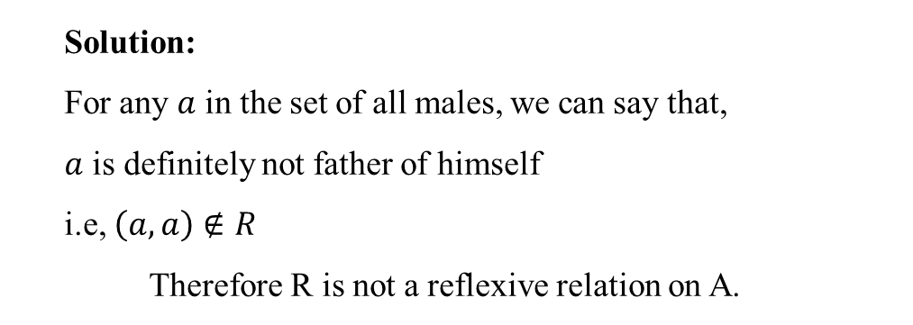
Different types of Relations
Example: A = Set of all males , R = { (x, y) / x is father of y } relation on A
Solution:
For any $a$ in the set of all males, we can say that,
$a$ is definitely not father of himself
i.e, $\left(a,a\right)∉R$
Therefore R is not a reflexive relation on A.
Therefore R is not an equivalence relation on A.

Slide 16
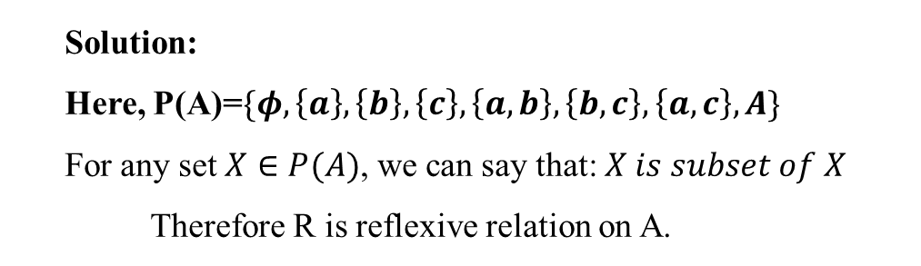
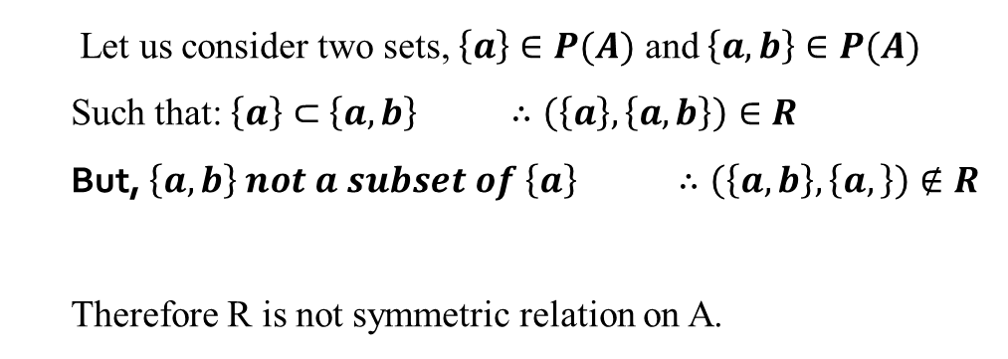
Different types of Relations
Example: A = {a, b, c}, xRy if x is subset of y for x, y є P(A)
Solution:
Here, P(A)=$\{φ,\left\{a\right\},\left\{b\right\},\left\{c\right\},\left\{a,b\right\},\left\{b,c\right\},\left\{a,c\right\},A\}$
For any set $X∈P(A)$, we can say that: $X is subset of X$
Therefore R is reflexive relation on A.
Let us consider two sets, $\left\{a\right\}∈P(A)$ and $\left\{a,b\right\}∈P(A)$
Such that: $\left\{a\right\}⊂$ $\left\{a,b\right\} ∴\left(\left\{a\right\},\left\{a,b\right\}\right)∈R$
But, $\left\{a,b\right\}$ $not a subset of \left\{a\right\} ∴\left(\left\{a,b\right\},\left\{a,\right\}\right)∉R$
Therefore R is not symmetric relation on A.
Therefore R is not an equivalence relation on A.

Slide 17
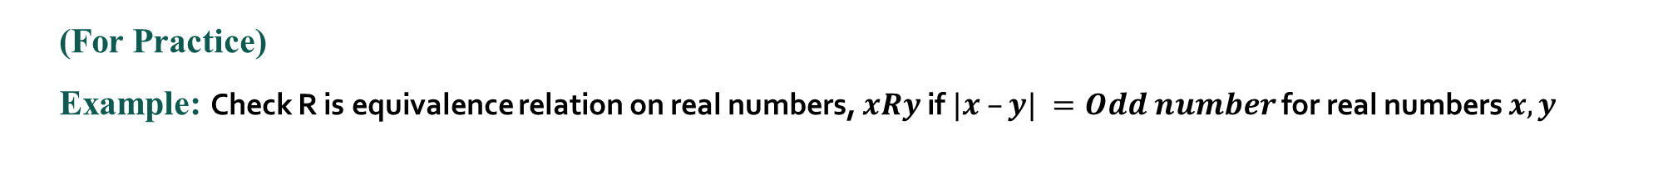
Different types of Relations
(For Practice)
Example: Check R is equivalence relation on real numbers, $xRy$if $|x –y| =Odd number$ for real numbers $x, y$

Slide 18
Partially ordered set
Partially ordered set (POSET):
If R is a relation on set A and R is reflexive, anti symmetric and transitive relation on A then (A, R) is called Poset.
It is also denoted by < A, R >
Example :
If A = {a, b, c} then R = { (a, b), (b, b), (a, a), (a, c), (b, c), (c, c) } is a relation on A.
Here
R is reflexive on A
R is anti symmetric on A
R is transitive on A
Therefore (A, R) is a Poset.

Slide 19
Partially ordered set
Example: Check whether the (Z, ≤) is Poset or not
For integer x, x ≤ x so that xRx
⸫ ≤ is reflexive relation on Z.
For integers x ≠ y, if x ≤ y then y can’t less then x
⸫ ≤ is anti symmetric relation on Z.
For integers x, y, z, if x ≤ y and y ≤ z then x ≤ z
⸫ ≤ is transitive relation on Z.
⸫ (Z, ≤) is Poset. .
Note:
S_{n} is the set of positive divisor of n Like S₁₂ = {1,2,3,4,6,12}
D is a divides relation i.e. if a divides b then aDb Like 2D6, 5D30

Slide 20
Partially ordered set
Example: Check whether the ( N, D ) is Poset or not where D is divides relation.
For any x є N, x = 1*x , 1 є N
⸫ xDx
⸫ D is reflexive relation on N.
For any x, y є N, x ≠ y, if xDy then y = x*z where z є N
⸫ y can’t divide x
⸫ D is anti symmetric relation on N.
For x, y, z є N if xDy and yDz then y = m*x and z = n*y where m,n є N
⸫ z = n*y = n*(m*x) = (m*n)*x where m*n є N
⸫ xDz
⸫ D is transitive relation on N.
⸫ ( N, D) is Poset.

Slide 21
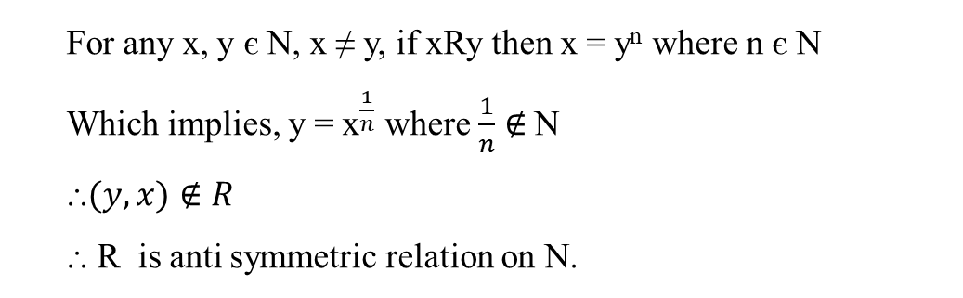
Partially ordered set
Example: Check whether the ( Z, R ) is Poset or not where aRb if and only if a = b^{n} for positive integer n.
For any x є Z, x = x¹ for positive integer 1.
⸫ xDx
⸫ R is reflexive relation on Z.
For x, y, z є N if xRy and yRz then x = y^{m} and y = z^{n} where m,n є N
⸫ x = y^{m} = (z^{n})^{m} = z^{mn} where mn є N
⸫ xRz
⸫ R is transitive relation on N.
For any x, y є N, x ≠ y, if xRy then x = y^{n} where n є N
Which implies, y = ${\text{x}}^{\frac{1}{n}}$ where $\frac{1}{n}$ $∉$N
⸫$(y,x)∉R$
⸫ R is anti symmetric relation on N.
⸫ ( Z, R) is Poset.

Slide 22
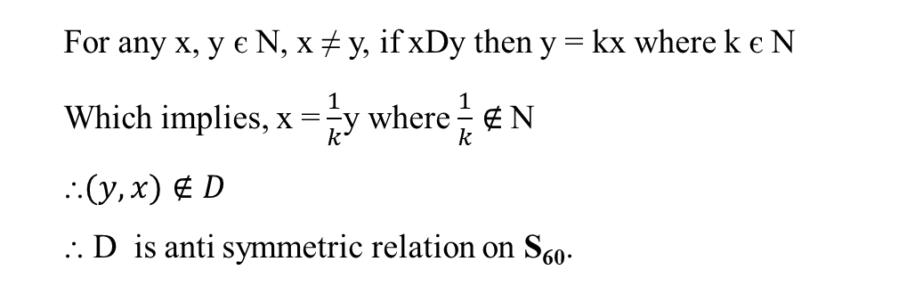
Partially ordered set
Example: Prove that ( S₆₀, D ) is Poset or not where D is divides relation
Here, S₆₀= {1,2,3,4,5,6,10,12,15,20,30,60}
For any x є S₆₀, xDx
⸫ D is reflexive relation on S₆₀.
For x, y, z є N if xDy and yDz then y = mx and z = ny where m,n є N
⸫ z = ny = n(mx) = nm(x) where nm є N
⸫ xDz
⸫ D is transitive relation on S₆₀.
For any x, y є N, x ≠ y, if xDy then y = kx where k є N
Which implies, x =$\frac{1}{k}$y where $\frac{1}{k}$ $∉$N
⸫$(y,x)∉D$
⸫ D is anti symmetric relation on S₆₀.
⸫ (S₆₀, D) is Poset.

Slide 23
Partially ordered set
HW: Prove that is Poset where A = { a, b, c }

Slide 24
Totally ordered set
Comparable elements :
Let ( A, R) be a Poset. Two elements a, b є A, a ≠ b are called comparable if aRb or bRa
Example :
( S₁₈ , D) is a Poset. S₁₈ ={ 1,2,3,6,9,18 }
Here 2D6 so 2 and 6 are called comparable elements.
But 2 does not divides 3 and 3 does not divides 2
So 2 and 3 are non comparable elements.
Totally ordered set (TOSET) or Chain :
A Poset ( A, R) is called Toset ( or Chain) if any two elements of A are comparable elements.

Slide 25
Totally ordered set
Example : Check whether the ( N, ≤ ) is Toset or not
For positive integer x, x ≤ x so that xRx
⸫ ≤ is reflexive relation on N.
For positive integers x ≠ y, if x ≤ y then y can’t less then x
⸫ ≤ is anti symmetric relation on N.
For positive integers x, y, z, if x ≤ y and y ≤ z then x ≤ z
⸫ ≤ is transitive relation on N.
⸫ (N, ≤) is Poset.
For any two positive integers x ≠ y, either x ≤ y or y ≤ x
⸫ Either xRy or yRx
⸫ x and y are comparable elements.
⸫ ( N, ≤ ) is Toset ( or Chain)

Slide 26
Totally ordered set
Example : Check whether the ( S₆₄, D ) is Chain or not
Here S₆₄ ={ 1,2,4,8,16,32,64}
For any x є S₆₄ , x = 1*x , 1 є N
⸫ xDx ⸫ D is reflexive relation on S₆₄ .
For any x, y є S₆₄ , x ≠ y, if xDy then x = y*z where z є N
⸫ y can’t divides x ⸫ D is anti symmetric relation on S64 .
For x, y, z є S₆₄ if xDy and yDz then y = m*x and z = n*y where m,n є N
⸫ z = n*y = n*(m*x) = (m*n)*x where m*n є N
⸫ xDz ⸫ D is transitive relation on S₆₄ .
⸫ (S₆₄ , D) is Poset.
Now 1D2, 2D4, 4D8, 8D16, 16D32 and 32D64
⸫ For any two elements of S₆₄ x ≠ y, either xDy or yDx
⸫ (S_{64,} D) is Chain

Slide 27
Totally ordered set
Example: Check whether the ( Z, ≤ ) is Toset or not
Example: Check if ( S₁₆, D ) is Toset or not where D is divides relation
Example: Check whether the is Chain or not where A = { a, b, c }

Slide 28
Hasse diagram
Cover of an elements :
Let ( A, R) be a Poset. For elements a, b є A, a ≠ b, b is called cover of a if aRb and there is no c є A such that aRc and cRb
Example :
( S₁₈ , D) is a Poset. S₁₈ ={ 1,2,3,6,9,18 }
Elements Cover of elements
1 2,3
2 6
3 6,9
6 18
9 18
18 ------
Example :
is a Poset. A ={ 1,2,3 }
Elements Cover of elements
Φ {1}, {2}, {3}
{1} {1,2}, {1,3}
{2} {1,2}, {2,3}
{3} {1,3}, {2,3}
{1,2} A
{1,3} A
{2,3} A
A --------

Slide 29
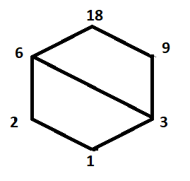
Hasse diagram
Hasse diagram:
Hasse diagram is a graphical representation of Poset elements. Each elements of Poset is represented by a dot and join by lines according to following rules
If b is cover of a then dot corresponding a appears below in the diagram than the dot corresponding to b.
The two elements a and b are connected by line segment if either a is cover of b or b is cover of a.
Example :
( S₁₈ , D) is a Poset. S₁₈ ={ 1,2,3,6,9,18 }
Elements Cover of elements
1 2,3
2 6
3 6,9
6 18
9 18
18 ------
( S₁₈ , D)

Slide 30
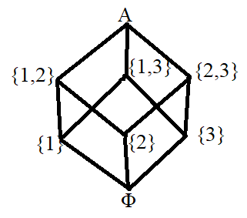
Hasse diagram
Example :
is a Poset. A ={ 1,2,3 }
Elements Cover of elements
Φ {1}, {2}, {3}
{1} {1,2}, {1,3}
{2} {1,2}, {2,3}
{3} {1,3}, {2,3}
{1,2} A
{1,3} A
{2,3} A
A --------

Slide 31
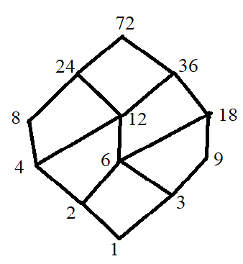
Hasse diagram
Example :
( S₇₂ , D) is a Poset. S₇₂ ={ 1,2,3,4,6,8,9,12,18,24,36,72 }
Elements Cover of elements
1 2,3
2 4,6
3 6,9
4 8,12
6 12,18
8 24
9 18
12 24,36
18 36
24 72
36 72
72 -----
( S₇₂ , D)

Slide 32
Hasse diagram
HW : Draw the Hasse diagram of (1) (S36, D )
(2) ( S64, D )
(3) (S42, D )
(4)

Slide 33
Lattice as Partially ordered set
Lower bound :
Let (A, R) be a Poset and B is a subset of A then x є A is called lower bound of B if xRy for all y in B.
Greatest Lower bound :
Let (A, R) be a Poset and B is a subset of A then x є A is called greatest lower bound of B if (1) x is a lower bound of B (2) if a is any other lower bound of B then aRx
Example :
Let (N, ≤) be a Poset and B = {4,6,8,10}
Lower bounds = 1, 2, 3, 4
Greatest lower bound = 4

Slide 34
Lattice as Partially ordered set
Upper bound :
Let (A, R) be a Poset and B is a subset of A then x є A is called upper bound of B if yRx for all y in B.
Least upper bound :
Let (A, R) be a Poset and B is a subset of A then x є A is called Least upper bound of B if (1) x is a upper bound of B (2) if a is any other upper bound of B then xRa
Example :
Let (N, ≤) be a Poset and B = {4,6,8,10}
Upper bounds = 10, 11, 12, ……
Least upper bound = 10

Slide 35
Lattice as Partially ordered set
Lattice as Poset:
Poset (A, R) is called lattice as Poset if glb(a, b) and lub(a, b) are in A for all elements a, b of A.
i.e. (A, R) is a Poset and for all a, b є A , glb(a, b) є A and lub(a, b) є A
Note :
Let Poset (A, R) , for elements a, b є A , we denotes glb(a, b) = and lub(a, b) =
Some standard relation and their glb(a, b) and lub(a, b)
D glb(a, b) = gcd(a, b)
lub(a, b) = lcm(a, b)
2) ≤ glb(a, b) = min(a, b)
lub(a, b) = max(a, b)
3)

Slide 36
Lattice as Partially ordered set
Example : Prove that ( S₃₀, D ) is a lattice as Poset.
Here first we prove that ( S₃₀, D ) is Poset
[prove that D is reflexive, anti symmetric and transitive relation on S₃₀ ]
Now we prove that for all a, b є S_{30 ,} glb(a, b) = gcd(a, b) and lub(a, b) = lcm(a, b) є S₃₀
S₃₀ = {1,2,3,5,6,10,15,30}
gcd(a, b) | 1 | 2 | 3 | 5 | 6 | 10 | 15 | 30
1 | 1 | 1 | 1 | 1 | 1 | 1 | 1 | 1
2 | 1 | 2 | 1 | 1 | 2 | 2 | 1 | 2
3 | 1 | 1 | 3 | 1 | 3 | 1 | 3 | 3
5 | 1 | 1 | 1 | 5 | 1 | 5 | 5 | 5
6 | 1 | 2 | 3 | 1 | 6 | 2 | 3 | 6
10 | 1 | 2 | 1 | 5 | 2 | 10 | 5 | 10
15 | 1 | 1 | 3 | 5 | 3 | 5 | 15 | 15
30 | 1 | 2 | 3 | 5 | 6 | 10 | 15 | 30
lcm(a, b) | 1 | 2 | 3 | 5 | 6 | 10 | 15 | 30
1 | 1 | 2 | 3 | 5 | 6 | 10 | 15 | 30
2 | 2 | 2 | 6 | 10 | 6 | 10 | 30 | 30
3 | 3 | 6 | 3 | 15 | 6 | 30 | 15 | 30
5 | 5 | 10 | 15 | 5 | 30 | 10 | 15 | 30
6 | 6 | 6 | 6 | 30 | 6 | 30 | 30 | 30
10 | 10 | 10 | 30 | 10 | 30 | 10 | 30 | 30
15 | 15 | 30 | 15 | 15 | 30 | 30 | 15 | 30
30 | 30 | 30 | 30 | 30 | 30 | 30 | 30 | 30

Slide 37
Lattice as Partially ordered set
In the above two tables all elements are from S_{30 .}
So that for all a, b є S_{30 ,} glb(a, b) = gcd(a, b) and lub(a, b) = lcm(a, b) є S₃₀
( S₃₀, D ) is a lattice as Poset
Example : Prove that ( N, ≤ ) is a lattice as Poset.
Here first we prove that ( N, ≤ ) is Poset
[prove that ≤ is reflexive, anti symmetric and transitive relation on N. ]
Now we prove that for all a, b є N , glb(a, b) = min(a, b) and lub(a, b) = max(a, b) є N
For any a, b є N, either a ≤ b or b ≤ a
So that either min(a, b) = a, max(a, b) = b or min(a, b) = b, max(a, b) = a
So in both case glb(a, b) = min(a, b) and lub(a, b) = max(a, b) є N
⸫ ( N, ≤ ) is a lattice as Poset.

Slide 38
Lattice as Partially ordered set
Example :
Example : Prove that ( N, D ) is a lattice as Poset.
Example : Prove that ( S₂₄, D ) is a lattice as Poset.

Slide 39
Properties of Lattice
Properties of Lattice :
Let (A, R) be a Lattice.
1) Idempotent law 2) Commutative law
3) Associative law 4) Absorption law

Slide 40
Lattice as an algebraic system
Lattice :
Let L be a non empty set and are two binary operations define on L. Is called Lattice as an algebraic if L satisfied following properties
For all a, b, c є L
1) Commutative
Associative
Absorption

Slide 41
Lattice as an algebraic system
Example :Check whether the ( N, Min, Max ) is a lattice.
For any a, b, c є N,
1) Commutative property
Associative property

Slide 42
Lattice as an algebraic system
3) Absorption property
For any a, b є N, either a ≤ b or b ≤ a
⸫ ( N, Min, Max ) is a lattice.

Slide 43
Lattice as an algebraic system
Example : Prove that ( S₃₀, GCD, LCM ) is a lattice
Here S₃₀ = {1,2,3,5,6,10,15,30}, for all a, b, c є S₃₀
1) Commutative property
2) Associative property

Slide 44
Lattice as an algebraic system
3) Absorption property
For any a, b є S₃₀ , there are four cases
1) a divides b i.e. b = ma
2) b divides a i.e. a = mb

Slide 45
Lattice as an algebraic system
3) a and b are co prime
a and b has common factor m other than 1
a = mx and b = my where m,x,y are positive integers and m ≠ 1
⸫ (S₃₀, Min, Max ) is a lattice.

Slide 46
Lattice as an algebraic system
Example : Prove that ( N, GCD, LCM ) is a lattice.
Example : Prove that ( R, Min, Max ) is a lattice.
Example :

Slide 47
Lattice as an algebraic system
Sub Lattice :
Let be a Lattice and S is subset of L then is a sub lattice of if glb and lub of elements of S are in S. i.e. for all
Example : Check whether the following subsets are sub lattice of lattice ( S₂₄, GCD, LCM )
1) A = {1,2,3,6}
To prove that A is Sub lattice we draw tables of lub and glb
Here all elements of this tables are from A
⸫ A is sub lattice of S₂₄.
gcd | 1 | 2 | 3 | 6
1 | 1 | 1 | 1 | 1
2 | 1 | 2 | 1 | 2
3 | 1 | 1 | 3 | 3
6 | 1 | 2 | 3 | 6
lcm | 1 | 2 | 3 | 6
1 | 1 | 2 | 3 | 6
2 | 2 | 2 | 6 | 6
3 | 3 | 6 | 3 | 6
6 | 6 | 6 | 6 | 6

Slide 48
Lattice as an algebraic system
2) B = {1,2,3,8}
Here
⸫ B is not sub lattice of S₂₄.
Example : Check whether the following subsets are sub lattice of lattice ( N, GCD, LCM )
(1) A = { 1, 2, 5, 10 } (2) A = { 1, 2, 5, 7, 10, 14, 70 }
Example : Check whether the following subsets are sub lattice of lattice
(1) S = {Φ,{a},{b},{a,b}} (2) T = {Φ,{a},{b},{c},{a,b},{a,c},A}

Slide 49
Lattice as an algebraic system
Distributive lattice :
A lattice is called distributive lattice if satisfies distributive law
i.e.
Note :

Slide 50
Lattice as an algebraic system
Example : Prove that ( R, Min, Max ) is a distributive lattice.
(R, min, max) is a lattice (to be proved)
4) Distributive property
⸫ ( R, Min, Max ) is a distributive lattice.

Slide 51
Lattice as an algebraic system
Example : Prove that ( N, GCD, LCM) is distributive lattice.
Example :

Slide 52
Lattice as an algebraic system
Bounded lattice :
Lattice is called bounded lattice if glb(L) and lub(L) are exist in L.
glb(L) is denoted by 0 element and lub(L) is denoted by I element
Bounded lattice is denoted by
Example:
( S₂₄, GCD, LCM ) is lattice
S₂₄ = { 1,2,3,4,6,8,12,24}
For all x є S₂₄ 1Dx and xD24
⸫ glb(S₂₄ ) = 0 element = 1 and lcm(S₂₄ ) = I element = 24
⸫ ( S₂₄, GCD, LCM ) is bounded lattice

Slide 53
Lattice as an algebraic system
Complement elements :
Let be a bounded lattice then two elements a,b of L are called complement of each other if
Complement of a is denoted by a’
Complemented lattice :
A bounded lattice is called complemented lattice if each element of L has complement in L.
Complemented lattice is denoted by
Example: Check whether the ( S₂₄, GCD, LCM ) is Complemented lattice or not.
S₂₄ = { 1,2,3,4,6,8,12,24}, glb(S₂₄ ) = 0 element = 1 and lcm(S₂₄ ) = I element = 24
For 2 there is no element in S₂₄ such that
So 2 does not have complement therefore ( S₂₄, GCD, LCM ) is not Complemented lattice

Slide 54
Lattice as an algebraic system
Example : Check whether the is Complemented lattice or not, where
A= {a,b,c,d}
First prove that is lattice.
Now Φ is subset of all elements of P(A) and all elements of P(A) are subset of A
⸫ 0 element = Φ and I element = A
All complements are in P(A)
⸫ is complemented lattice.

Slide 55
Lattice as an algebraic system
Example : Prove that ( S₃₀, GCD, LCM ) is a Complemented lattice.
Example : Check whether the ( S₉₀, GCD, LCM ) is Complemented lattice or not
Example : Check whether the ( S₉₀, min, max ) is Complemented lattice or not

Slide 56
End
of
Unit 2
Lattice
Unit no 2
“Lattice”
Discrete Mathematics and Graph theory

