Slide 1



Slide 2



Unit 3
Boolean Algebra

Slide 3
Topics
Boolean Algebra
Atom
Anti Atom
Sub Boolean Algebra
Boolean Variable & Expression

Slide 4
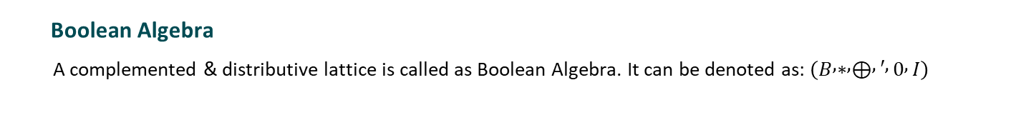
Boolean Algebra
A complemented & distributive lattice is called as Boolean Algebra. It can be denoted as: $\left(B , ∗ , ⊕ , ′ , 0 , I\right)$
Boolean Algebra is used to analyse and simplify the digital (logic) circuits. It uses only the binary numbers i.e. 0 and 1. It is also called as Binary Algebra or logical Algebra. Boolean algebra was invented by George Boole in 1854.

Slide 5
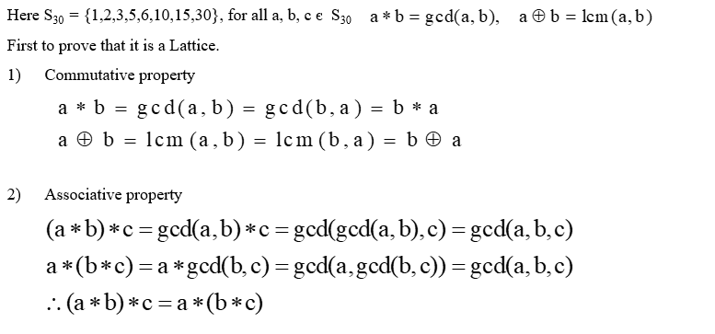
Example :

Slide 6
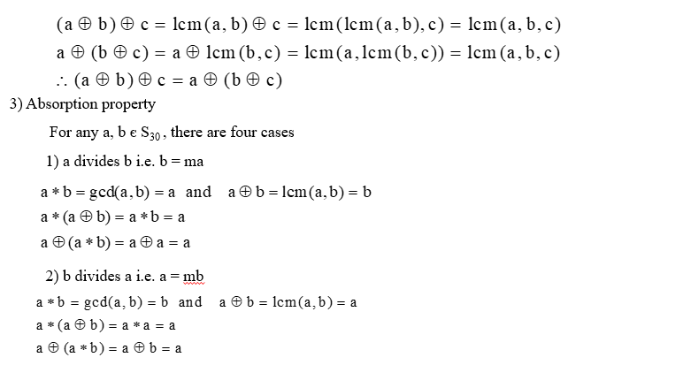

Slide 7
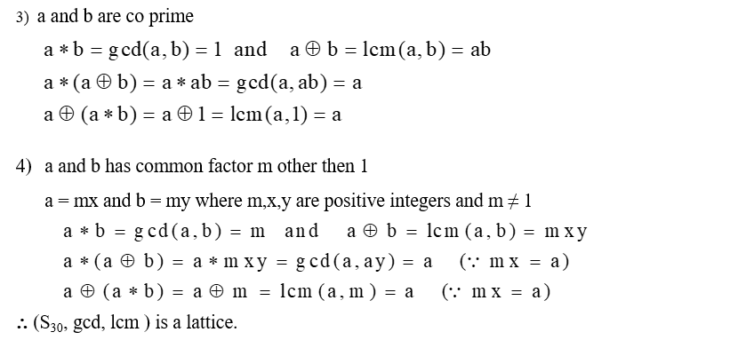

Slide 8
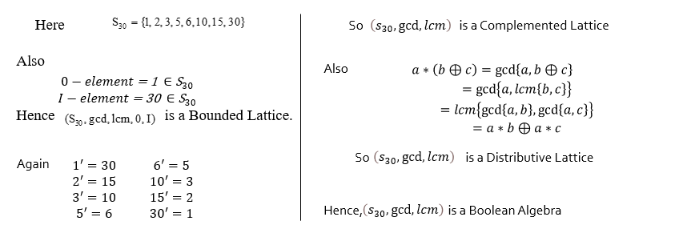

Slide 9
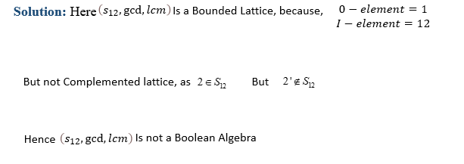

Slide 11


Slide 12
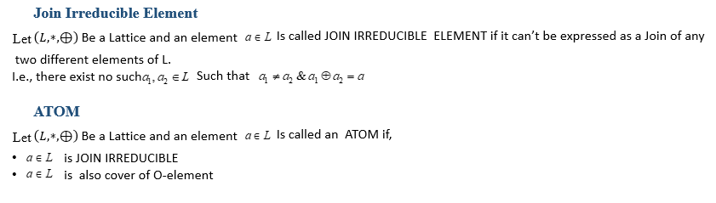
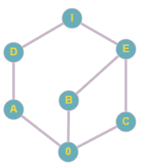
Example: From the given figure of Hasse Diagram, find Join Irreducible Elements & Atoms
Join Irreducible: A ,B, C, D
Atoms: A, B, C

Slide 13
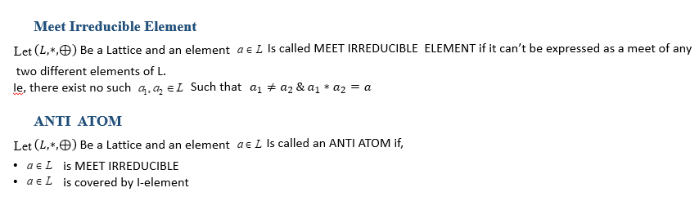
Example: From the given figure of Hasse Diagram, find Meet Irreducible Elements & antiatoms
Meet Irreducible: A,B,C,D,E
Anti Atoms: D,E

Slide 14
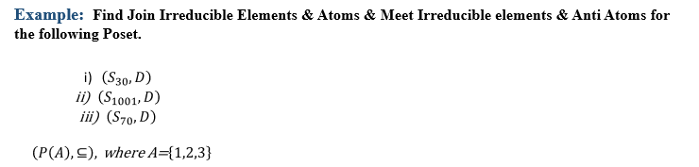

Slide 15
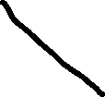
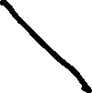




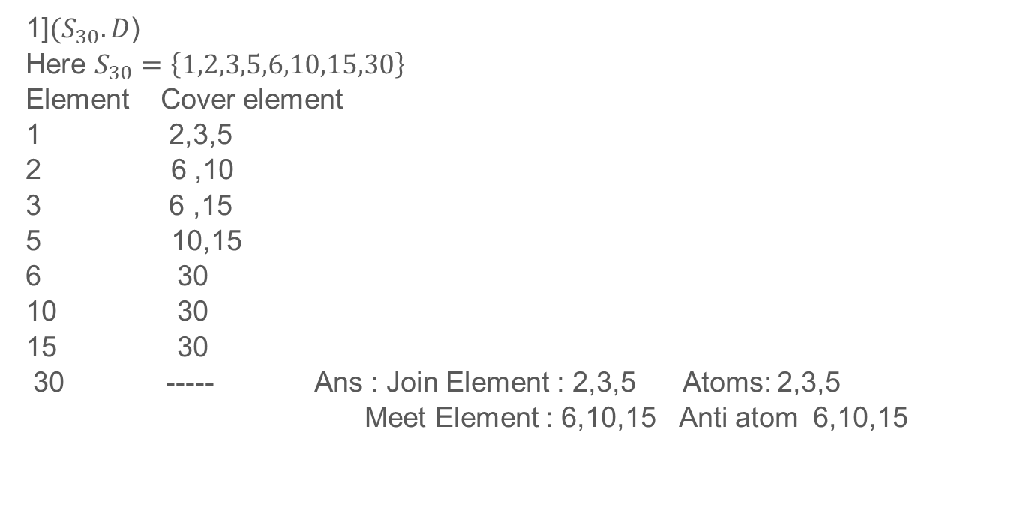

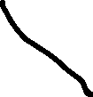
Solution :
1]${(S}_{30}.D$)
Here $S_{30}=\left\{1,2,3,5,6,10,15,30\right\}$
Element Cover element
2,3,5
6 ,10
6 ,15
5 10,15
30
30
30
30 ----- Ans : Join Element : 2,3,5 Atoms: 2,3,5
Meet Element : 6,10,15 Anti atom 6,10,15

Slide 16

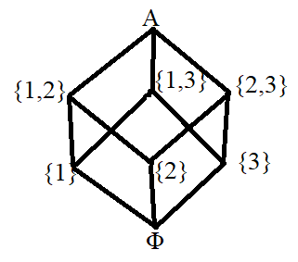
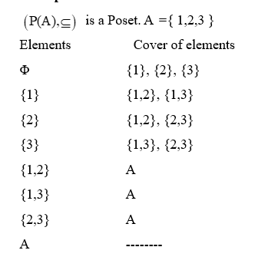
Join Element : {1},{2},{3}
Atoms : {1},{2},{3}
Meet Element : {1,2},{1,3},{2,3}
Anti atoms: {1,2},{1,3},{2,3}

Slide 17
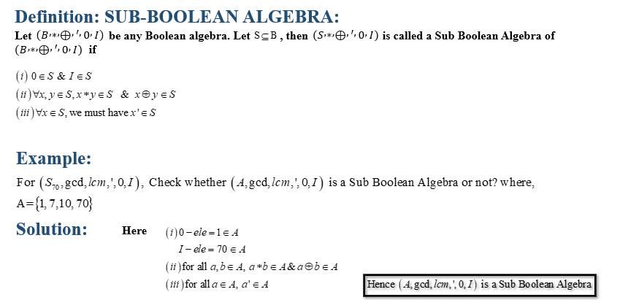

Slide 18
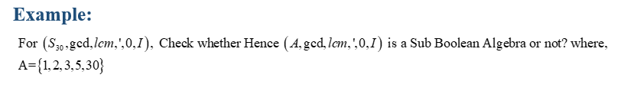

Slide 19

Boolean expression
Let B = {0,1} then $B^{n}=\{(x_{1},x_{2}$,,,,, $x_{n}),x_{i}∈B\} the variable x_{1},x_{2}$,,,,, $x_{n} are called boolean variable which takes value from set B$
Examples ${ x}_{1}∗x_{2}{ x}_{1}∗x_{2}∗x_{3}$
${ x}_{1}⊕x_{2}⊕$ ${ x}_{3}$

Slide 20

Note:
0 and I are also Boolean expression
0 = ${ x}_{1}∗x_{1}^{′}$ I = ${ x}_{1}⊕x_{1}^{′}$
$if α(x_{1},x_{2}$,,,,, $x_{n}) and β(x_{1},x_{2}$,,,,, $x_{n})$are Boolean expression then
$α∗β and α⊕β$are also Boolean expression.

Slide 21
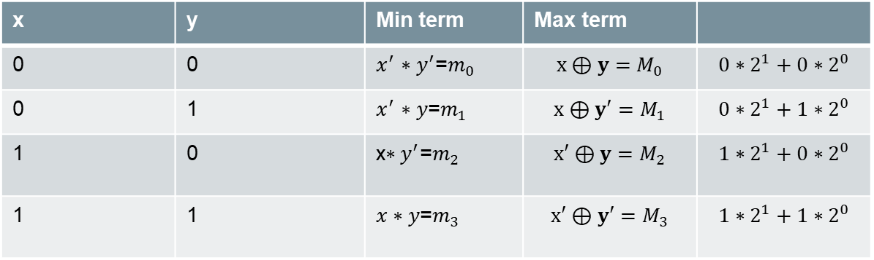

Min term and Max term
Min term $m_{n}$ $x^{′}→0 x→1$
Max term $M_{n}$ $x^{′}→1 x→0$
For two variables
x | y | Min term | Max term
0 | 0 | $x^{′}$ $∗y^{′}$=$m_{0}$ | $$x⊕y=M_{0}$$ | $$0∗2^{1}+0∗2^{0}$$
0 | 1 | $x^{′}$ $∗y$=$m_{1}$ | $$x⊕y′=M_{1}$$ | $$0∗2^{1}+1∗2^{0}$$
1 | 0 | x$∗y^{′}$=$m_{2}$ | $$x′⊕y=M_{2}$$ | $$1∗2^{1}+0∗2^{0}$$
1 | 1 | $x∗y$=$m_{3}$ | $$x′⊕y′=M_{3}$$ | $$1∗2^{1}+1∗2^{0}$$

Slide 22
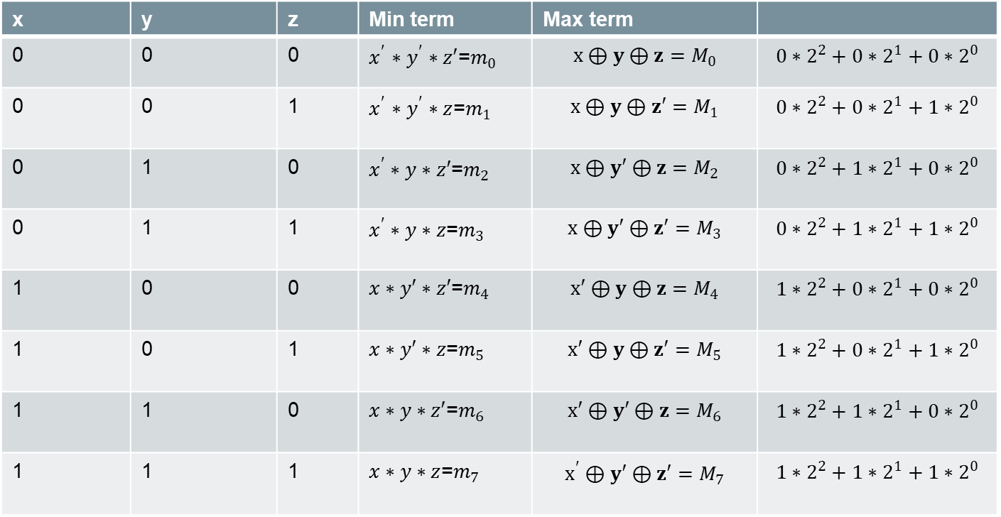
x | y | z | Min term | Max term
0 | 0 | 0 | $x^{′}$ $∗y^{′}∗z′$=$m_{0}$ | $$x⊕y⊕z=M_{0}$$ | $$0∗2^{2}+0∗2^{1}+0∗2^{0}$$
0 | 0 | 1 | $x^{′}$ $∗y^{′}∗z$=$m_{1}$ | $$x⊕y⊕z′=M_{1}$$ | $$0∗2^{2}+0∗2^{1}+1∗2^{0}$$
0 | 1 | 0 | $x^{′}∗y∗z′$=$m_{2}$ | $$x⊕y′⊕z=M_{2}$$ | $$0∗2^{2}+1∗2^{1}+0∗2^{0}$$
0 | 1 | 1 | $x^{′}∗y∗z$=$m_{3}$ | $$x⊕y′⊕z′=M_{3}$$ | $$0∗2^{2}+1∗2^{1}+1∗2^{0}$$
1 | 0 | 0 | $x∗y′∗z′$=$m_{4}$ | $$x′⊕y⊕z=M_{4}$$ | $$1∗2^{2}+0∗2^{1}+0∗2^{0}$$
1 | 0 | 1 | $x∗y′∗z$=$m_{5}$ | $$x′⊕y⊕z′=M_{5}$$ | $$1∗2^{2}+0∗2^{1}+1∗2^{0}$$
1 | 1 | 0 | $x∗y∗z′$=$m_{6}$ | $$x′⊕y′⊕z=M_{6}$$ | $$1∗2^{2}+1∗2^{1}+0∗2^{0}$$
1 | 1 | 1 | $x∗y∗z$=$m_{7}$ | $$x^{′}⊕y′⊕z′=M_{7}$$ | $$1∗2^{2}+1∗2^{1}+1∗2^{0}$$

Slide 23

Ex. Find the min term and max term of following
1) (1,0,1,1)
Min term : $x∗y^{′}∗z∗w$
=$1∗2^{3}+0∗2^{2}+1∗2^{1}+1∗2^{0}$ = 11
=$m_{11}$
Max term : $x′⊕y⊕z′⊕w$’
=$1∗2^{3}+0∗2^{2}+1∗2^{1}+1∗2^{0}$ = 11
$=M_{11}$

Slide 24

2 ) (1,1,1,1)
Min term : $x∗y∗z∗w$
=$1∗2^{3}+1∗2^{2}+1∗2^{1}+1∗2^{0}$ = 15
=$m_{15}$
Max term : $x^{′}⊕y′⊕z′⊕w′$
=$1∗2^{3}+0∗2^{2}+1∗2^{1}+1∗2^{0}$ = 15
$=M_{15}$

Slide 25

Sum of min term [ sum of product ]
Every Boolean expression can be expressed as sum of min term
Example : Find sum of product of following for two variables
1] ${ x}_{2}$
= ${ x}_{2}∗I$
=${ x}_{2}∗(x_{1}$ $⊕x_{1}′)$
= ${ (x}_{2}∗x_{1})$ $⊕{{ (x}_{2}∗x}_{1}′)$
= ${ (x}_{1}∗x_{2})$ $⊕{{ (x}_{1}∗x}_{2}′)$
= $m_{3}{⊕m}_{1}$

Slide 26
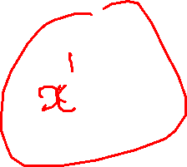

2] ${ x}_{1}$
= ${ x}_{1}∗I$
=${ x}_{1}∗(x_{2}$ $⊕x_{2}′)$
= ${ (x}_{1}∗x_{2})$ $⊕{{ (x}_{1}∗x}_{2}′)$
= ${ (x}_{1}∗x_{2})$ $⊕{{ (x}_{1}∗x}_{2}′)$
= $m_{3}{⊕m}_{2}$

Slide 27

3] $x′$
=$x′∗I$
=$x′∗(y⊕y′$)
=$(x^{′}∗y)⊕(x^{′}∗y′$)
= = $m_{1}{⊕m}_{0}$

Slide 28

4] ${ x}_{2}$’
= ${ x}_{2}′∗I$
=${ x}_{2}′∗(x_{1}$ $⊕x_{1}′)$
= ${ (x}_{2}′∗x_{1})$ $⊕{{ (x}_{2}′∗x}_{1}′)$
= ${ (x}_{1}∗x_{2}′)$ $⊕{{ (x}_{1}′∗x}_{2}′)$
= $m_{2}{⊕m}_{0}$

Slide 29

2] ${ x}_{2}$
= ${ x}_{2}⊕0$
=${ x}_{2}⊕(x_{1}∗x_{1}′)$
= ${ (x}_{2}⊕x_{1})$ $∗{{ (x}_{2}⊕x}_{1}′)$
= ${ (x}_{1}⊕x_{2})$ $∗{{ (x}_{1}′⊕x}_{2})$
$\left[0∗2^{1}+0∗2^{0}=0\right] [1∗2^{1}+0∗2^{0}$ =2]
= $M_{0}∗M_{2}$

Slide 30
End of Unit 3

